Slide 1
State Track: Reporting
Melissa Torgerson

Slide 2
Objectives
LIHEAP Reports
Using the OLDC
Resources
Questions and Answers
Notes:
LIHEAP Reports
Which reports LIHEAP grantees are required to submit to OCS
How each report contributes to effective program management
Who reviews the reports and what they check
Using the OLDC
How OLDC helps you to get each report right the first time
How OLDC checks for year-over-year and form-to-form consistency
Resources
Questions and Answers

Slide 3
LIHEAP Reports

Slide 4
FFY 2016 Reports – The Basics
FFY 2015 Carryover and Reallotment Report
  Indicates the amount of unobligated FFY 2015 funds carried over to FFY 2016
FFY 2016 LIHEAP Plan
  Provides information to OCS and the public about how the grantee will operate the program
FFY 2016 Carryover and Reallotment Report
  Indicates the amount of unobligated FFY 2016 funds carried over to FFY 2017

Slide 5
FFY 2016 Reports – The Basics (continued)
FFY 2016 Household Report
  Documents the number and characteristics of recipient and applicant households
FFY 2016 Performance Data Form – Section I
  Shows the sources and uses of LIHEAP funds
FFY 2016 Performance Data Forms – Sections II & III
  Demonstrates performance on Energy Burden targeting and service restoration and service loss prevention

Slide 6
FFY 2016 Reports – Planned Due Dates
FFY 2015 Carryover and Reallotment Report – 8/1/2015
FFY 2016 LIHEAP Plan – 9/1/2015
FFY 2016 Carryover and Reallotment Report - 8/1/2016
FFY 2016 Household Report – 9/1/2016 (Preliminary)
FFY 2016 Household Report – 12/15/2016 (Final)
FFY 2016 Performance Data Form – Section I - 1/31/2017
FFY 2016 Performance Data Form – Sections II & III – 1/31/2017

Slide 7
LIHEAP Reports – Planned Due Dates
8/1/2015 – FFY 2015 Carryover and Reallotment Report
9/1/2015 – FFY 2016 LIHEAP Plan
9/1/2015 - FFY 2015 Household Report (Preliminary)
- - - - - FFY 2016 Program Begins - - - - -
12/15/2015 – FFY 2015 Household Report (Final)
1/31/2016 – FFY 2015 Performance Data Form
8/1/2016 – FFY 2016 Carryover and Reallotment Report
9/1/2016 – FFY 2017 LIHEAP Plan
9/1/2016 – FFY 2016 Household Report (Preliminary)
- - - - - FFY 2016 Program Ends - - - - -
12/15/2016 – FFY 2016 Household Report (Final)
1/31/2017 – FFY 2016 Performance Data Form

Slide 8
FFY 2015 Carryover and Reallotment Report
When is this report due?
  August 1, 2015… prior to the end of FFY 2015
What is the purpose of this report?
  The grantee reports…
    Carryover – Funds carried over to FFY 2016
    Reallotment – Funds to be returned to government
How does this report contribute to program management?
  Reminds the grantee they must obligate 90% of funds
  Alerts OCS if there will be funds available for reallotment
  Gives the OCS the opportunity to advise the grantee

Slide 9
FFY 2015 Carryover and Reallotment Report
Who reviews the report?
  Report is reviewed by your OCS liaison or her designee
What does she check?
  Accuracy of the reported information
  Compliance of reported information with LIHEAP rules
How does she use the information?
  She will contact you if calculations appear to be incorrect.
  She will contact you with alternatives to returning funds.
  There are rules related to obligation of funds and carryover.
  Be sure to contact your liaison if you have any questions.

Slide 10
FFY 2016 Detailed Model Plan
When is this report due?
  September 1, 2015… prior to the beginning of FFY 2016
What is the purpose of this report?
  Serves as the grantee’s application for funds
  Provides information to the Federal Government and the public on how the grantee plans to use funds
How does this report contribute to program management?
  Grantee should use a reference when preparing their program policy manual
  Allows OCS to ensure that the grantee plans are consistent with the statute and other OCS guidance

Slide 11
FFY 2016 Detailed Model Plan
Who reviews the report?
  Report is reviewed by your OCS liaison or her designee
What does she check?
  Details… for example, in Section 1 – Program Components: Checks that Crisis Program end date is no earlier than 3/15/16
  Concepts… for example, in Section 17 – Program Integrity: Checks for a comprehensive approach to program integrity
  Program Issues… for example, in Item 1.7 - SNAP Benefits: Looks whether you addressed important issues in a way that is consistent with OCS guidance
  Performance Issues… for example in Section 13 - Assurance 16: Checks that proposed program is consistent with guidelines and that you are documenting program accomplishments

Slide 12
FFY 2016 Detailed Model Plan
How is the information used?
  OCS Liaison… Will alert you if there are any problems with your planned approach to the program
  OCS Management… Uses plans to better understand the different ways that grantees approach LIHEAP program design and implementation
  LIHEAP Clearinghouse… Posts all state plans and extracts key information to help grantees look at other ways that they can run their LIHEAP programs.

Slide 13
FFY 2016 Carryover and Reallotment Report
When is this report due?
  August 1, 2016… prior to the end of FFY 2016
Other notes…
  Same as FFY 2015 Report

Slide 14
FFY 2016 Household Report
When is this report due?
  Preliminary - 9/1/2016… prior to the end of FFY 2016
  Final - 12/15/2016… after the end of FFY 2016
What is the purpose of this report?
  Collects information on the number of households served with EACH type of program and by ANY program type
  Obtains information on the number of recipient households with vulnerable members and the number of recipient households by poverty level
  Gathers information on applicant households

Slide 15
FFY 2016 Household Report
How does this report contribute to program management?
  The Household Report data is the foundation on which OCS starts the LIHEAP Performance Management process.
Really… They really use the numbers I report?
  OCS has developed information on the home energy needs of the low income population and how that varies by household type.
  The Household Report allows OCS and the Grantee to understand what share of the households in need were served by the program AND what types of households were served.

Slide 16
FFY 2016 Household Report
Who reviews the report?
  Grantee / OLDC: The first set of Household Report checks are completed by the Grantee with the “support” of OLDC.
  Technical Support Contractor: The second set of Household Report checks are completed by the Technical Support Contractor in collaboration with the grantee.

Slide 17
FFY 2016 Household Report
What do they check?
  Internal Consistency: Are the reported numbers logically and mathematically consistent?
  Form-to-Form Consistency: Is the Household Report consistent with the Model Plan?
  Year-over-Year Consistency: Are there major differences between the FFY 2015 and FFY 2016 numbers?

Slide 18
Using the OLDC

Slide 19
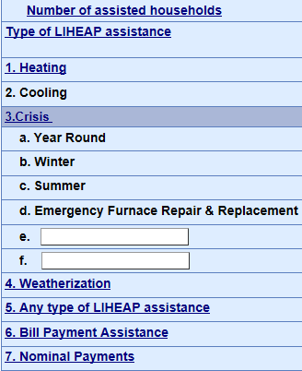
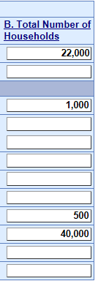
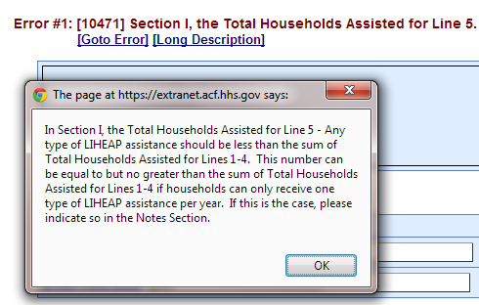
FFY 2016 Household Report – Internal Consistency Check – Example #1
OLDC checks that the number of households that received “any type of LIHEAP assistance” is less than or equal to the sum of the number of households that received each type of assistance:

Slide 20
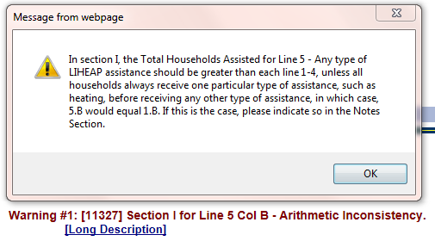
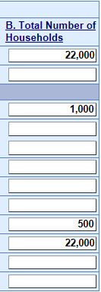
FFY 2016 Household Report – Internal Consistency Check – Example #2
OLDC checks to see if the number of households that received heating assistance is equal to the number of households that received “any type of LIHEAP assistance”:

Slide 21
FFY 2016 Household Report – Internal Consistency Check – Warnings
How do I deal with warning messages in OLDC?
  If you receive a warning message in OLDC, but you confirm that the LIHEAP program data reported in your Household Report is accurate, please include an explanation in the “Notes” field of your form.

Slide 22
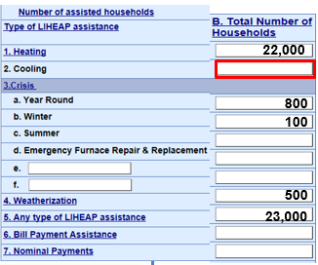
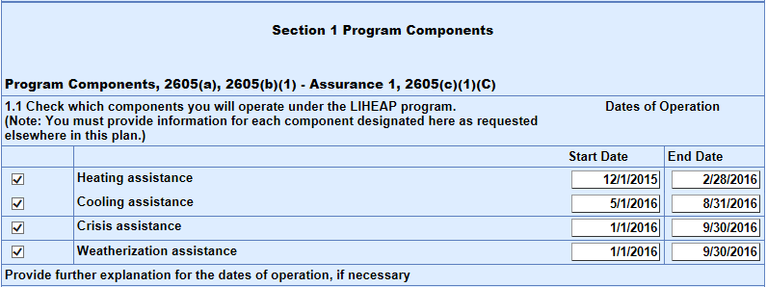
FFY 2016 Household Report – Form-to-Form Consistency Check – Example
OLDC checks to see if a Grantee reported providing a particular type of LIHEAP assistance during the fiscal year in their Model Plan, but did not report any households receiving that type of assistance in their Household Report:
FFY 2016 Model Plan
FFY 2016 HHR

Slide 23
FFY 2016 Household Report – Form-to-Form Consistency Check – Update Procedure
How do I address differences between my Model Plan and Household Report?
  If you implemented your LIHEAP program differently during the fiscal year than what is stated in your Model Plan, you should go back and update your plan.
  Grantees do not need to request permission from OCS to update your Model Plan. But, you do need to alert your OCS liaison of any changes you make and also document these changes in your Model Plan in OLDC.

Slide 24
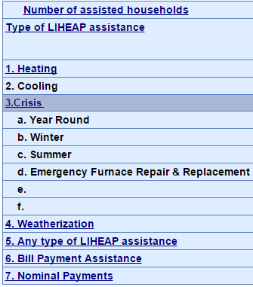
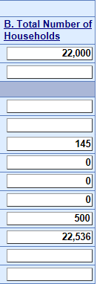
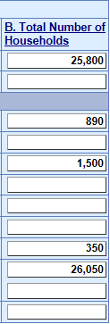
FFY 2016 Household Report – Year Over Year Consistency Check – Example
OLDC checks if the number of households that received a particular type of LIHEAP assistance during the current fiscal year is less than 1/10th the number of households that received that type of assistance in the previous fiscal year:
FFY 2015 HHR
FFY 2016 HHR

Slide 25
FFY 2016 Household Report – Year over Year Consistency Check – Adding a Note
How do I address differences between my current year Household Report and my previous year Household Report?
  If you had a warning that was flagged by OLDC, but you have verified the number is correct, please add a note that explains the reason for the change in your current year Household Report.

Slide 26
FFY 2016 Household Report – Summary
FFY 2016 Household Report…
  Checked for logical and mathematical consistency
  Compared to the grantee’s FFY 2016 Model Plan
  Compared to the grantee’s FFY 2015 Household Report

Slide 27
FFY 2016 Performance Data Form –
Section I – Grantee Survey
When is this report due?
  1/31/2017… after the end of FFY 2016
What is the purpose of this report?
  Collects information on the sources of funds available for FFY 2016
  Reports information on how funds were used for LIHEAP program purposes for FFY 2016
  Furnishes information on eligibility thresholds and average benefits

Slide 28
FFY 2016 Performance Data Form –
Section I – Grantee Survey
How does this report contribute to program management?
  The Grantee Survey data is important for both program Fiscal Integrity and for LIHEAP Performance Management.
    Fiscal Integrity: Showing that the grantee has accurate accounting for where the funds come from and how they are used highlights that the grantee has a good foundation for fiscal integrity.
    Performance Management: Reviewing the allocation of funds among the different program components is an important step in working how to achieve the maximum benefit from funds spent.

Slide 29
FFY 2016 Performance Data Form –
Section I – Grantee Survey
Who reviews the report?
  Grantee / OLDC: The first set of Grantee Survey checks are completed by the Grantee with the “support” of OLDC.
  Technical Support Contractor: The second set of Grantee Survey checks are completed by the Technical Support Contractor in collaboration with the grantee.

Slide 30
FFY 2016 Performance Data Form –
Section I – Grantee Survey
What do they check?
  Internal Consistency: Are the reported numbers logically and mathematically consistent?
  Form-to-Form Consistency: Is the Grantee Survey consistent with all other submitted reports?
  Year-over-Year Consistency: Are there major differences between the FFY 2015 and FFY 2016 numbers?

Slide 31
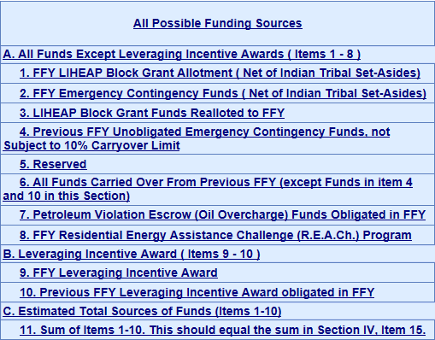
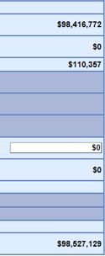
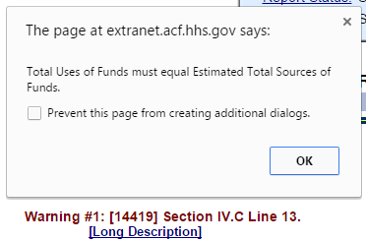
FFY 2016 Grantee Survey – Internal Consistency Check – Example #1
OLDC checks that the reported total ‘Sources of Funds’ in Section III matches the total ‘Uses of Funds’ in Section IV:
FFY 2016 GS Section –
Sources of Funds
FFY 2016 GS Section –
Uses of Funds
$98,300,000

Slide 32
FFY 2016 Grantee Survey – Form-to-Form Consistency Check – Example #1
Grantee Survey vs. Carryover & Reallotment Reports:
  OLDC checks that the carryover amounts reported in the Grantee Survey matches the carryover amounts reported in the Grantee’s FFY 2015 and FFY 2016 Carryover and Reallotment Reports.

Slide 33
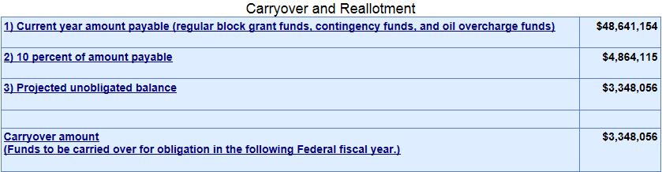
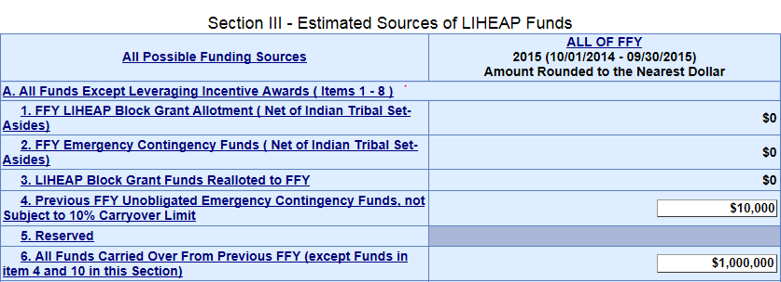
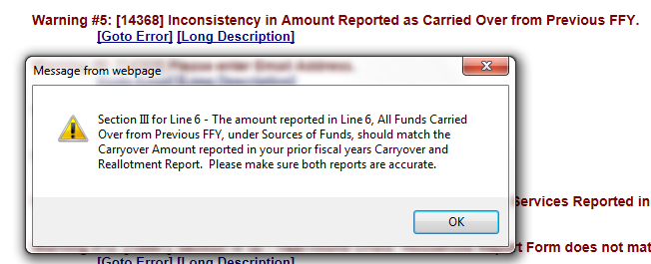
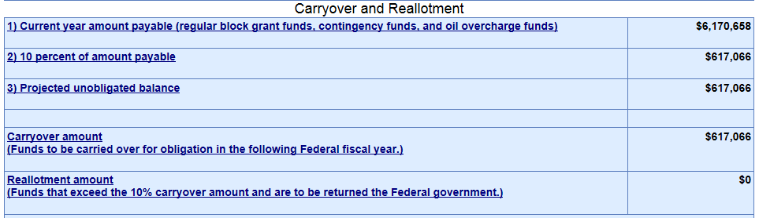
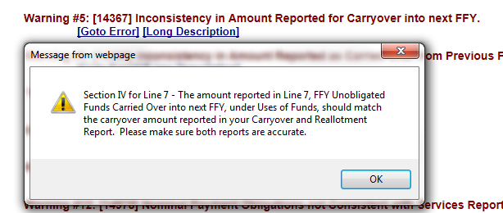

FFY 2016 Grantee Survey – Form-to-Form Consistency Check – Example #1
FFY 2015 C&R Report
FFY 2016 GS Section –
Sources of Funds
FFY 2016 C&R Report
FFY 2016 GS Section –
Uses of Funds

Slide 34
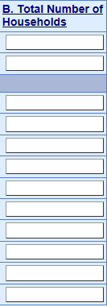
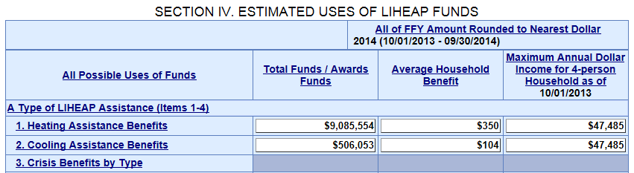

FFY 2016 Grantee Survey – Form-to-Form Consistency Check – Example #2
Grantee Survey vs. Household Report:
  OLDC checks to see if a Grantee reported obligating funds for a particular type of LIHEAP assistance in their Grantee Survey, but did not report assisting households with that type of assistance in their Household Report.
FFY 2016 Household Report
FFY 2016 Grantee Survey
22,000

Slide 35
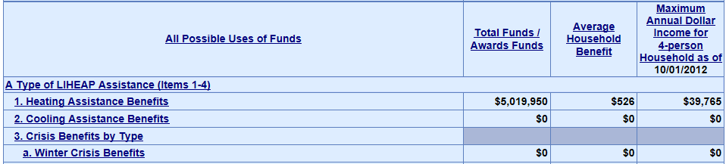

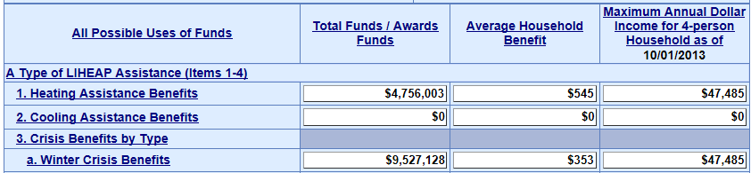
FFY 2016 Grantee Survey – Form-to-Form Consistency Check – Example #3
FFY 2016 Grantee Survey vs. FFY 2015 Grantee Survey:
  OLDC checks to see if a Grantee reported obligating funds for a particular type of LIHEAP assistance in their current year Grantee Survey, but did not report obligating funds for that particular type of LIHEAP assistance in their prior year Grantee Survey:
FFY 2015 Grantee Survey
FFY 2016 Grantee Survey

Slide 36
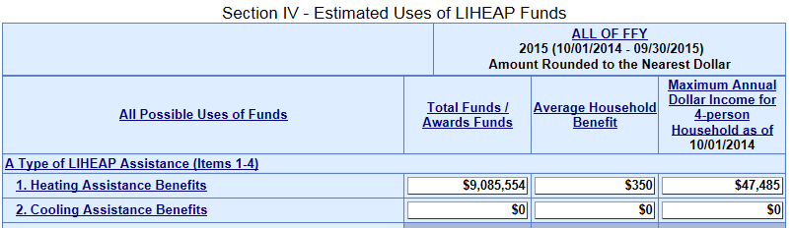
FFY 2016 Grantee Survey – Form-to-Form Consistency Check – Example #4
Grantee Survey vs. Model Plan:
  OLDC checks to see if a Grantee reported providing a particular type of LIHEAP assistance during the fiscal year in their Model Plan, but did not report obligating funds for that type of assistance in their Grantee Survey:
FFY 2016 Model Plan
FFY 2016 Grantee Survey

Slide 37
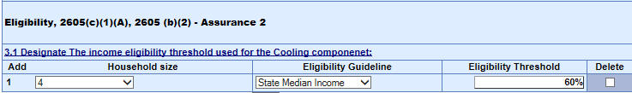
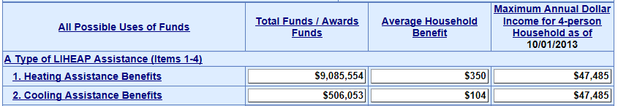
FFY 2016 Grantee Survey – Form-to-Form Consistency Check – Example #5
Grantee Survey vs. Model Plan:
  The LIHEAP Technical Support contractor conducts a manual check of the Grantee Survey to confirm that the reported income thresholds in the Grantee Survey are consistent with the income thresholds reported in the Grantees’ Model Plan:
FFY 2016 Model Plan
FFY 2016 Grantee Survey

Slide 38
FFY 2016 Grantee Survey – Summary
FFY 2016 Grantee Survey…
  Checked for logical and mathematical consistency
  Compared to the grantee’s FFY 2015 and FFY 2016 Carryover & Reallotment Reports
  Compared to the grantee’s FFY 2016 Household Report
  Compared to the grantee’s FFY 2015 Grantee Survey Report
  Compared to the grantee’s FFY 2016 Model Plan

Slide 39
Summary
Each Grantee Report plays an important role in allowing the Grantee and OCS to effectively manage the program.
All Grantee Reports are connected and are checked for consistency.
OLDC helps to alert you to any inconsistencies in your individual reports and the set of reports.
Your liaison and the LIHEAP Technical Support contractor are there to help you complete the reports correctly and… sometimes… better understand LIHEAP program guidelines in the process.

Slide 40
Key Take Away
Every piece of information that you supply in your grantee reports is reviewed and used by OCS. It is critical that the program have these data so that OCS can report to the Administration, Congress, and the public on the important work that you are doing!!!

Slide 41
Questions and Answers

Slide 42
Resources
Users with questions about Grantee Reports:
  Review the training supplied for each individual report.
    Completing the LIHEAP Model Plan
    Completing the LIHEAP Household Report Long Form
    Completing the LIHEAP Performance Data Form
  These resources can be found on the ACF Website: http://www.acf.hhs.gov/programs/ocs/resource/liheap-trainings
  LIHEAP State Plans, Manuals and Delegation Letters:
  http://www.liheap.ncat.org/stateplans.htm

Slide 43
Resources
Users with questions about Grantee Reports:
  Contact the APPRISE Team directly:
    Trayvon Braxton Melissa Torgerson
    Trayvon-Braxton@appriseinc.org melissa@verveassociates.net
    609-252-9053 503-706-2647

Slide 44
ACF Capabilities to support states, tribes, and territories in disaster preparedness, response & Recovery
The next session is...

