Slide 1
LIHEAP Virtual Library
Melissa Torgerson, APPRISE
Heather Jones, Missouri

Slide 2
Objectives
After this session, attendees will have a better understanding of:
  The Purpose of the LIHEAP Virtual Library
  Key Features of the LIHEAP Virtual Library
  How the LIHEAP Virtual Library Fits with Other Grantee Resources
  Ways the LIHEAP Virtual Library Can Be Used to Improve LIHEAP Programs
  Grantee Role in Developing the LIHEAP Virtual Library
Resources
Questions and Answers

Slide 3
purpose

Slide 4
Background
The LIHEAP Virtual Library was designed by the Performance Management Implementation Work Group (PMIWG) to help grantees:
  Learn about key elements of an effective LIHEAP program
  Better use information to plan, design, manage, evaluate, and improve their programs (Performance Management)
The Beta Version of the LIHEAP Virtual Library is currently available at https://liheappm.acf.hhs.gov/assessment/#nbb

Slide 5
Key features

Slide 6
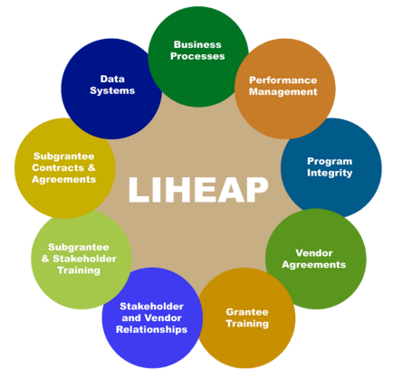
Key Features—The Landing Page
The main page graphic outlines nine focus areas for grantees as they plan, design, and evaluate their programs.
Within each focus area, there are two primary methods for exploring resources.

Slide 7
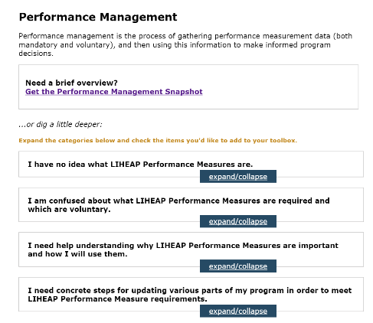
Key Features—Exploring Resources
The Snapshot provides an overview of the specific focus area. This includes relevant legal citations as well as highlighted resources and guidance. The snapshot also outlines steps grantees can take to use resources in program planning and evaluation.
The Guided Search is intended to serve as a “road map” for grantees. Category headings help users systematically think about each focus area. Resources are sorted within each category to help grantees learn more based on their needs.

Slide 8
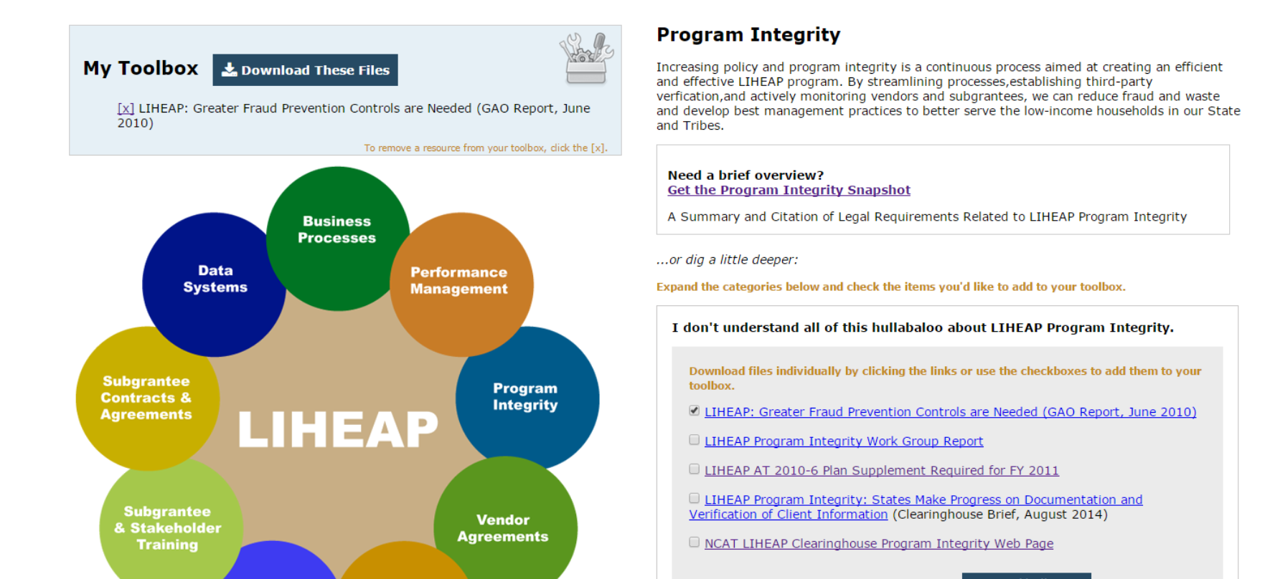
Key Features—Exploring Resources
Resources listed anywhere in the Virtual Library can be opened and previewed in a new tab, or added to a “toolbox.”

Slide 9
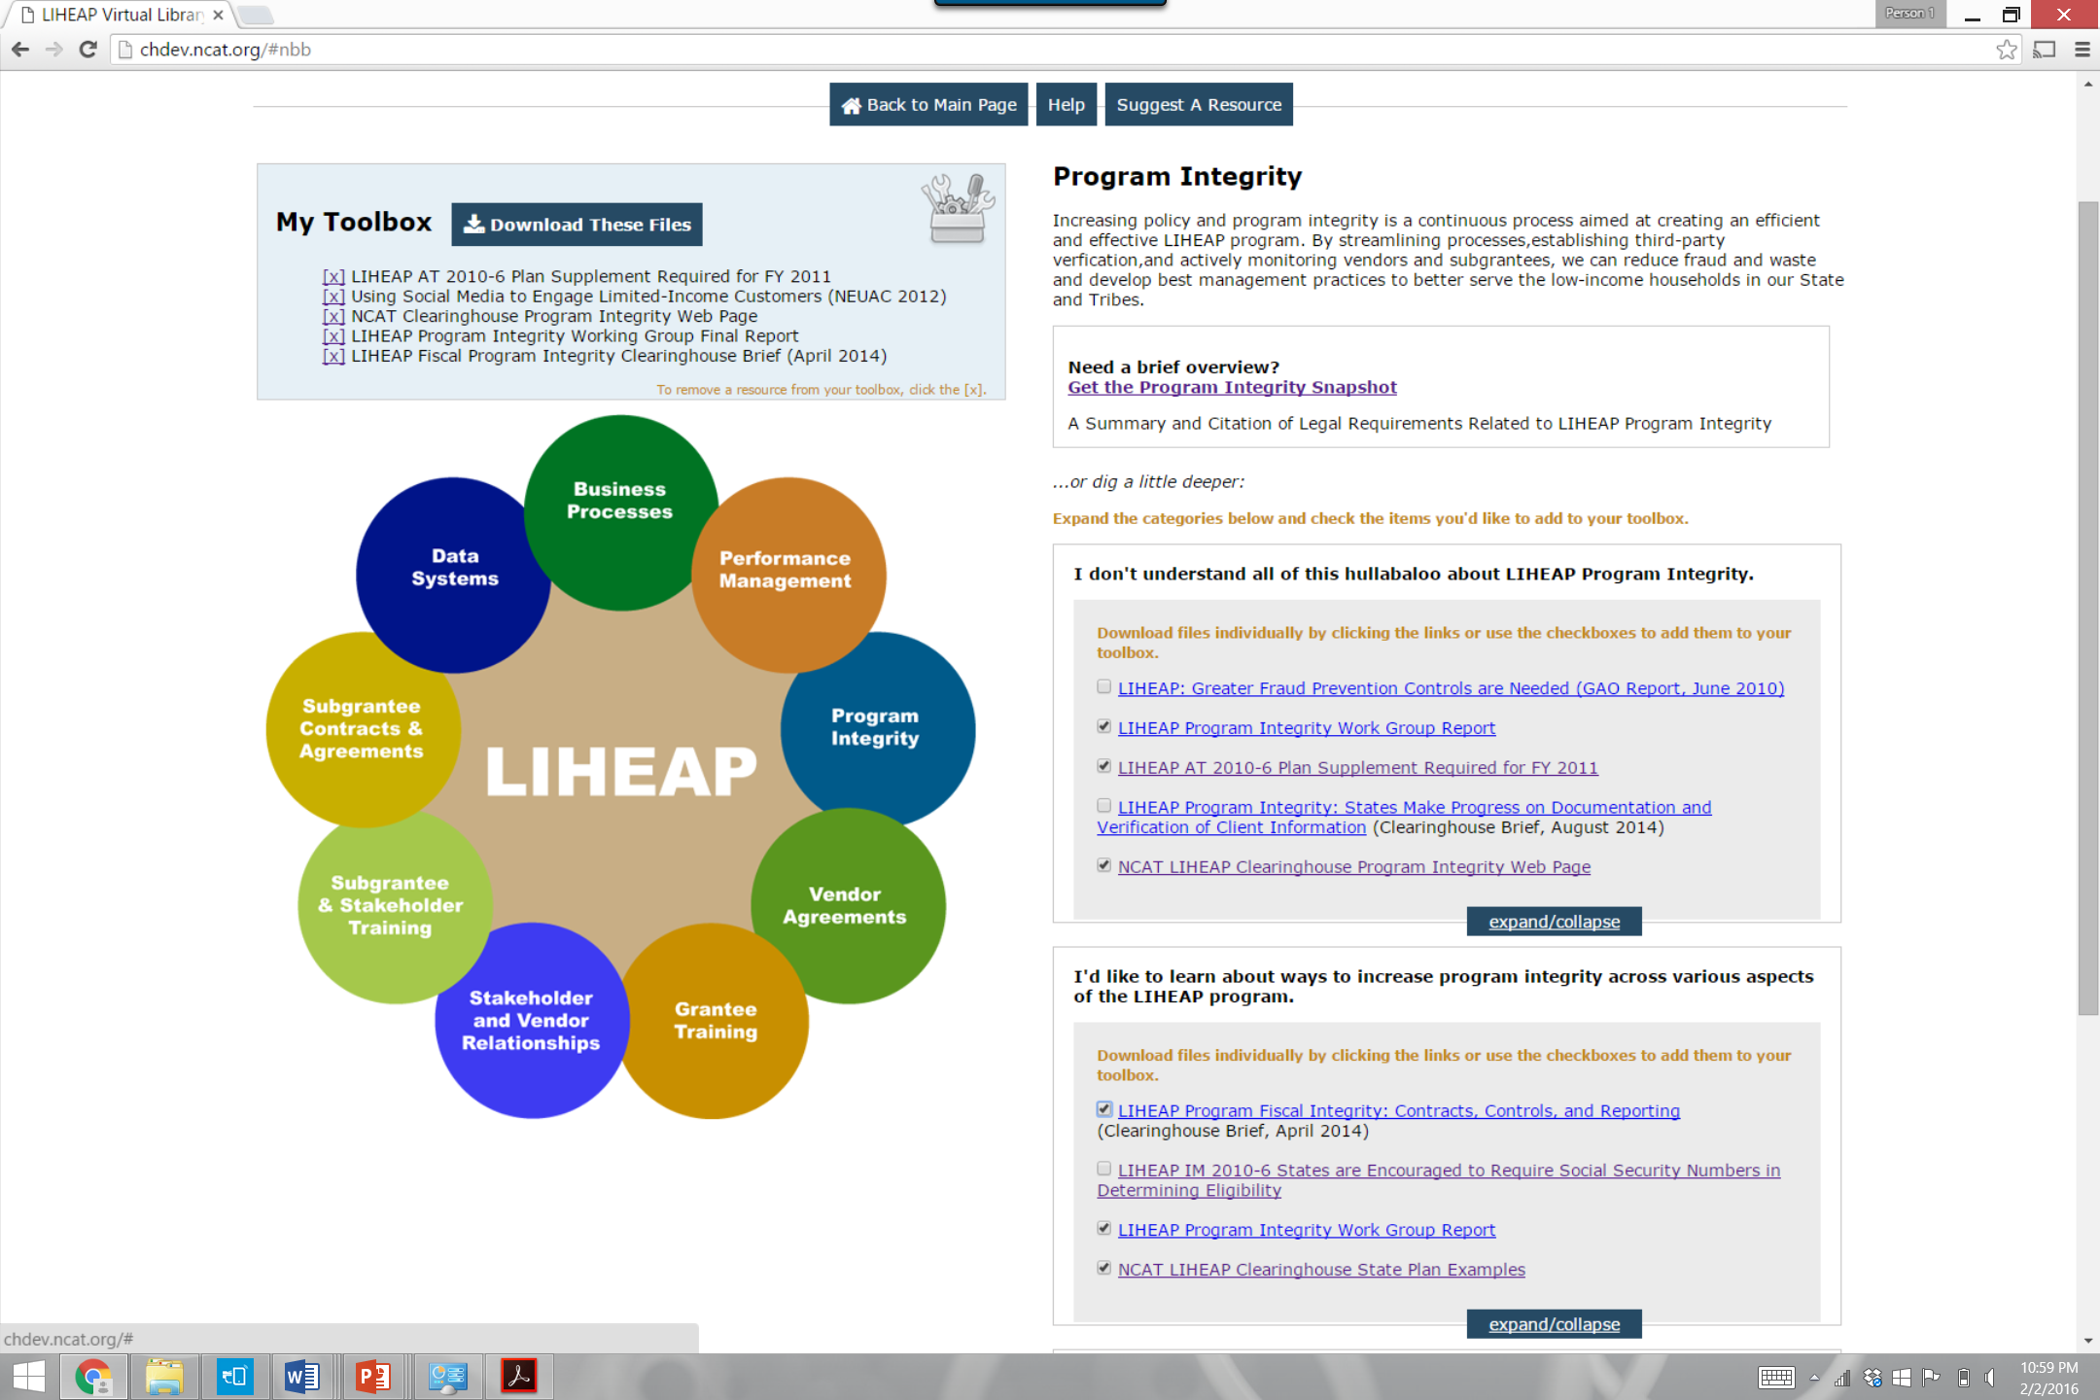
Key Features—Downloading Resources
Once a customized toolbox is created, the user can download all resources into one folder for printing or later viewing.
Note: The toolbox is saved locally. This means that if you exit the site, your resources will no longer be in your toolbox when you come back.

Slide 10
Using the LIHEAP Virtual Library

Slide 11
The Role of the Virtual Library
NCAT LIHEAP Clearinghouse: Houses all LIHEAP grantee resources in one location. Includes examples, summaries, and issue briefs.
ACF Website: “Official” guidance, training resources, contact information.
LIHEAP Performance Management Website: Performance Management training and technical assistance resources--including a grantee forum, data warehouse, and report building capabilities.
NEADA Website: Forum for NEADA members and national LIHEAP information.
LIHEAP Virtual Library: Provides a framework that helps grantees find and use information to manage their programs.

Slide 12
The Role of the Virtual Library
What makes the Virtual Library distinct?
Although the LIHEAP Virtual Library references and categorizes resources found across multiple websites, the primary purpose of the Virtual Library is to help grantees think about how they use information to design, manage, evaluate, and ultimately improve their programs.

Slide 13
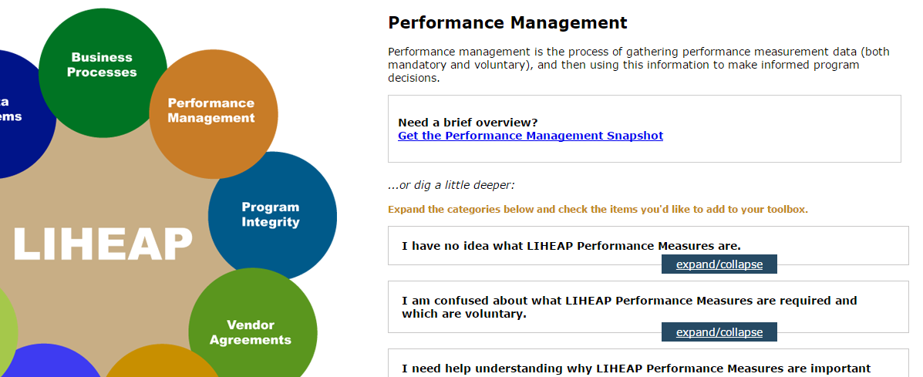
Example #1: Performance Management
As a new coordinator, you’ve been tasked with making sure your state is prepared to comply with new LIHEAP Performance Measurement requirements.

Slide 14
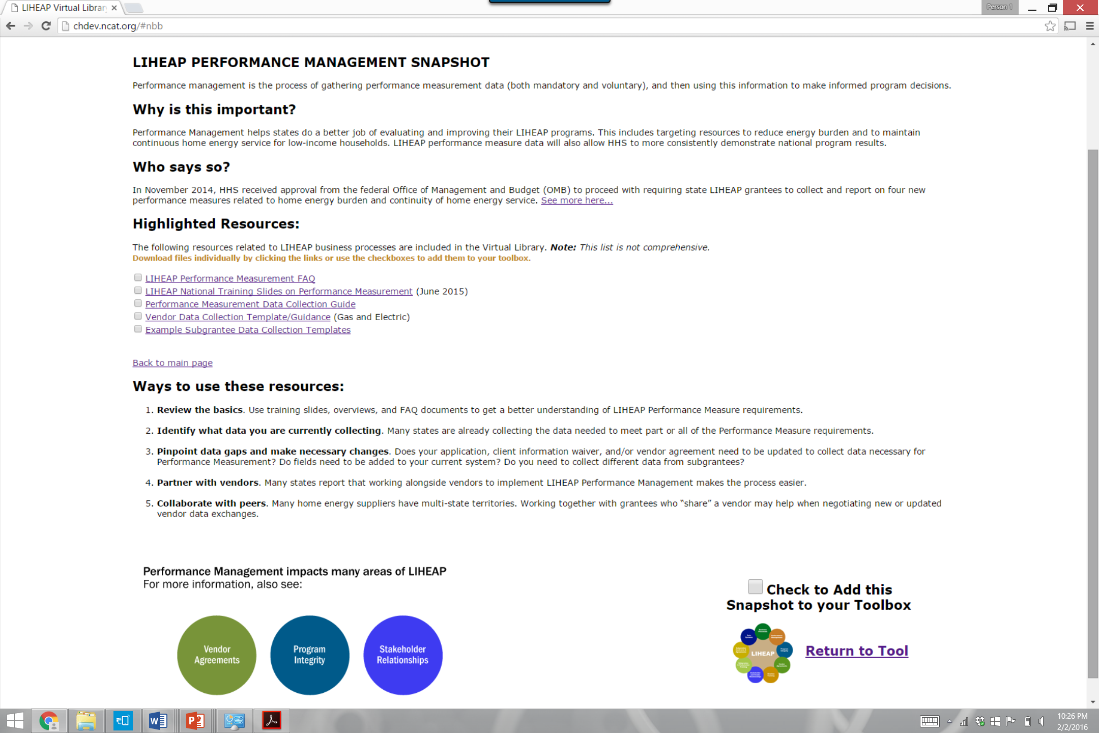
Example #1: Performance Management
The LIHEAP Virtual Library allows grantees to get a quick (10,000 foot) overview of LIHEAP Performance Management via the Snapshot.

Slide 15
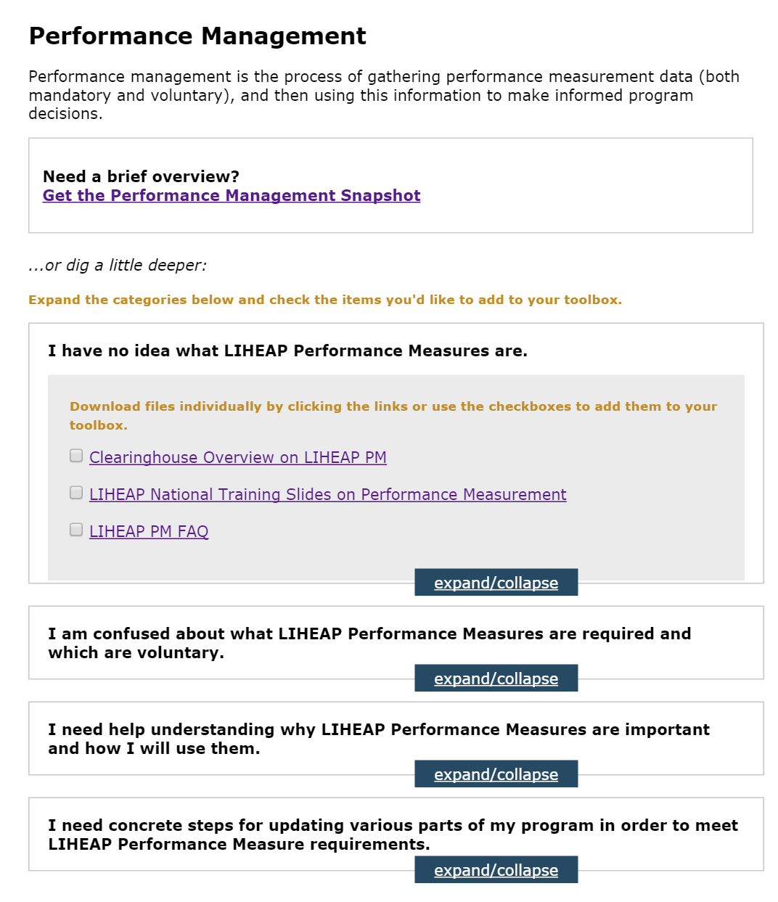
Example #1: Performance Management
Category headings in the Guided Search illustrate how to think about Performance Management in an increasingly progressive manner.
For example, the Guided Search starts with the basics.
Then moves into steps for implementation.

Slide 16
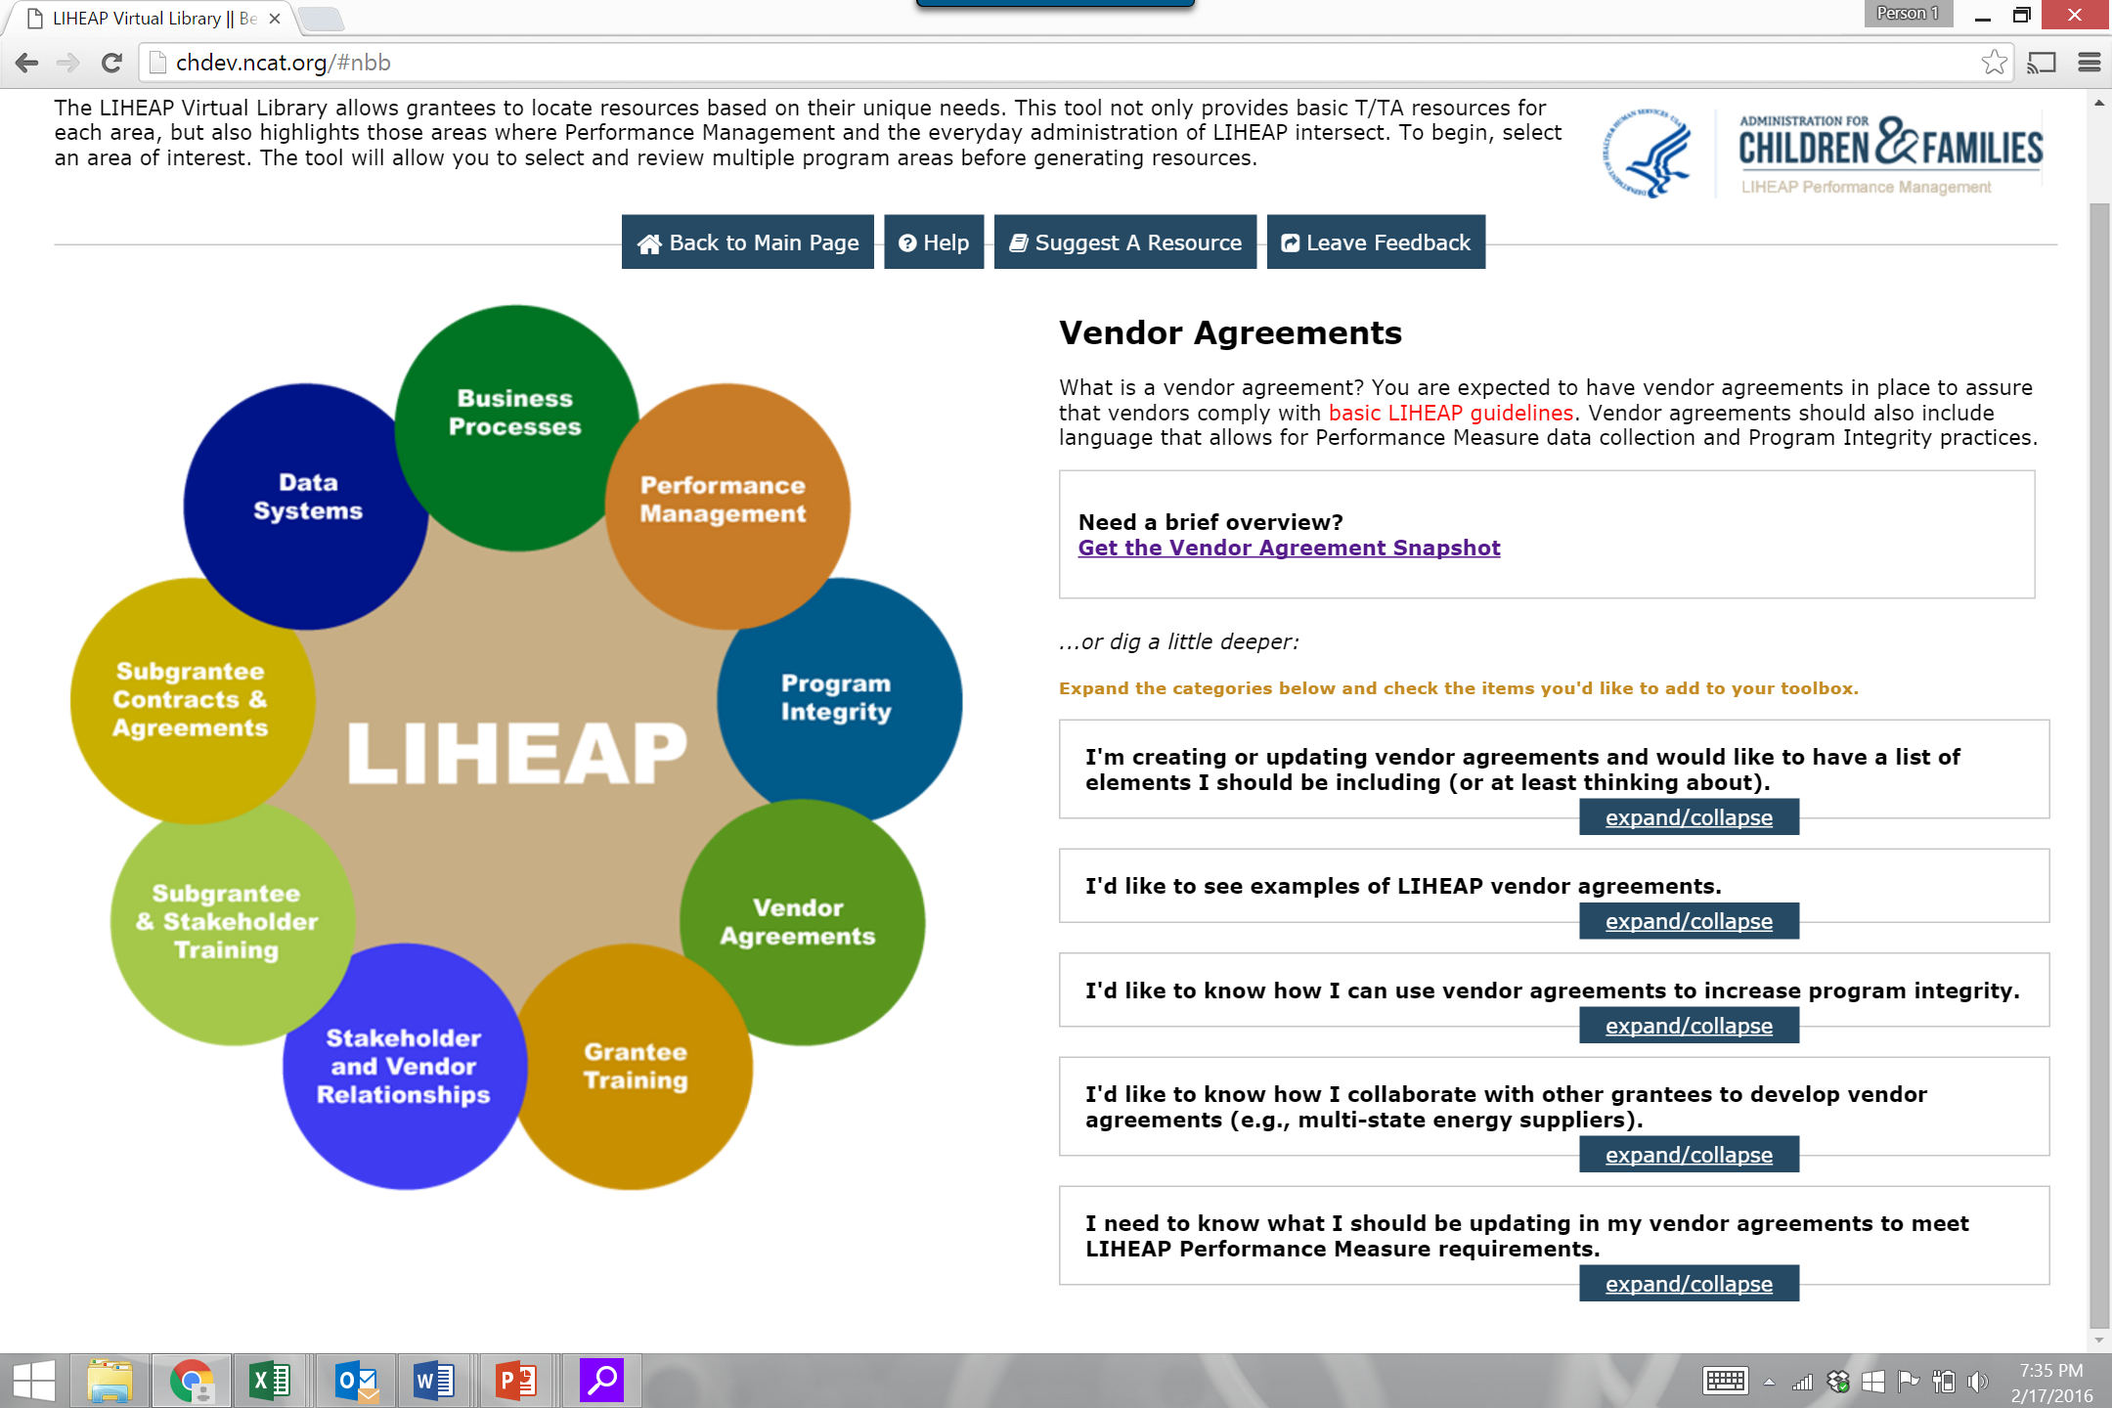
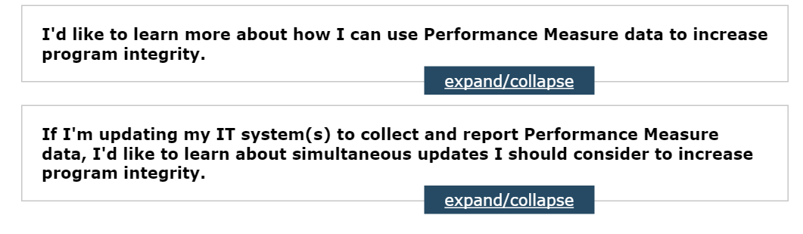
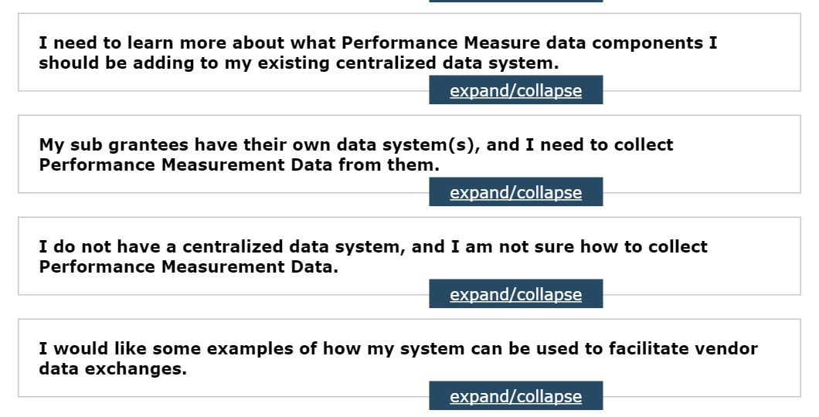
Example #1: Performance Management
DATA
SYSTEMS
Many experienced LIHEAP coordinators say that “if I had understood how everything works together, I could have saved a lot of time.”
The LIHEAP Virtual Library also helps grantees to identify intersections between key program elements. For example:
How should I be updating my vendor agreements to meet Performance Measure requirements?
How can Performance Measurement Data be used to increase Program Integrity?
When updating data systems for Performance Measurement, what other updates should I be considering?
PROGRAM
INTEGRITY
DATA
SYSTEMS

Slide 17
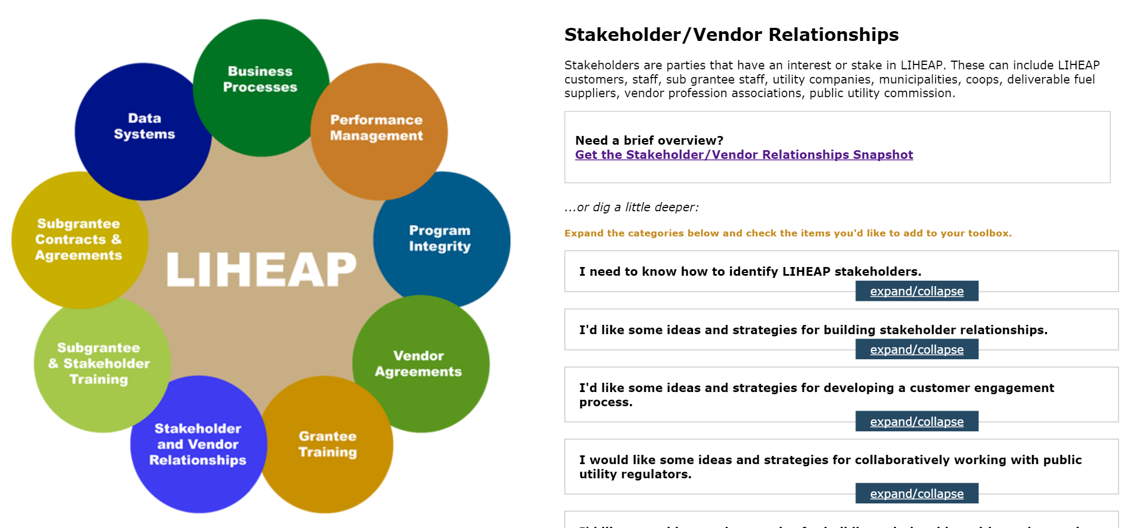
Example #2: Stakeholder Relationships
The director of your agency has just returned from a week-long leadership conference. He is now concerned that you are too focused on program basics, and not spending enough time building relationships. He wants you to develop a plan to address this.

Slide 18
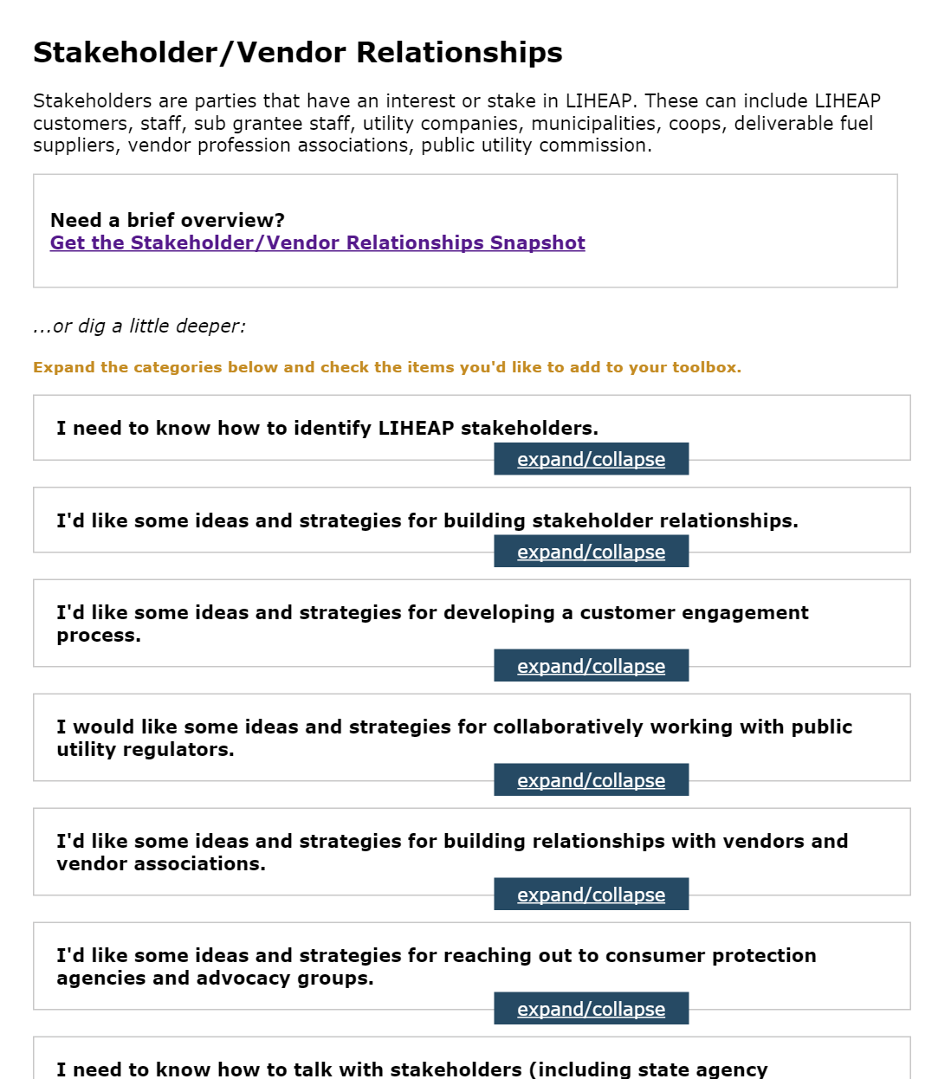
Example #2: Stakeholder Relationships
Category headings in the Guided Search help grantees identify ways to think about stakeholder relationships in an increasingly progressive manner. For example:
Newer coordinators may want to begin by figuring out who their stakeholders are.
The library also walks through stakeholders that should be considered when developing an engagement plan.

Slide 19
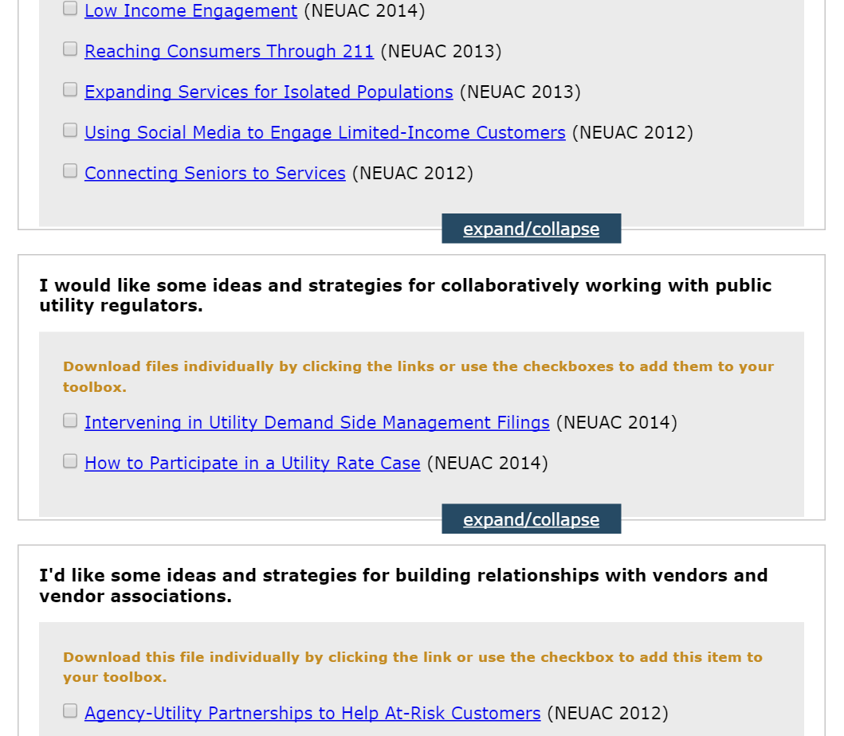
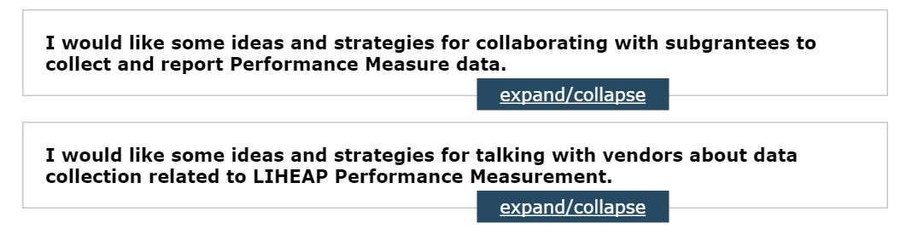
Example #2: Stakeholder Relationships
Your director’s newfound enthusiasm for relationship building does not come with additional FTE.
The LIHEAP Virtual Library helps grantees think about ways to engage stakeholders in the work they are already doing.
For example:
Selected resources provide specific information about engaging stakeholders to conduct outreach, advocate for households, and inform program design.
“Intersections” across the library highlight areas where subgrantees and vendors have a direct role in Performance Management.

Slide 20
Developing the LIHEAP Virtual Library

Slide 21
Grantee Role in Developing the Virtual Library
The LIHEAP Virtual Library was designed to be both responsive and dynamic.
This means that:
  The library will be regularly updated to reflect new guidance, issues, or requirements.
  The library is open to resources generated by Grantees.
  The library is adaptive to Grantee feedback.

Slide 22
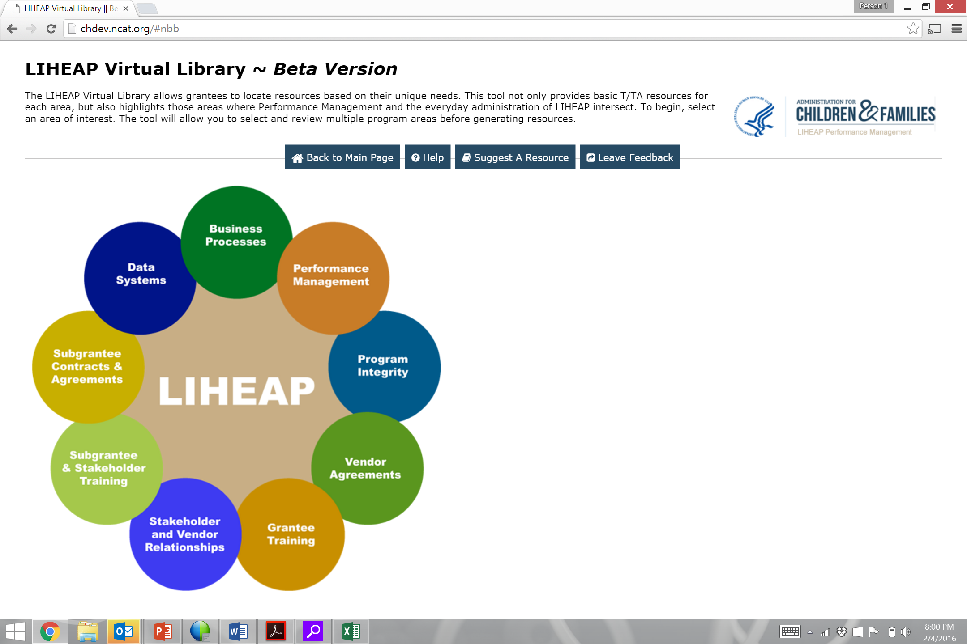
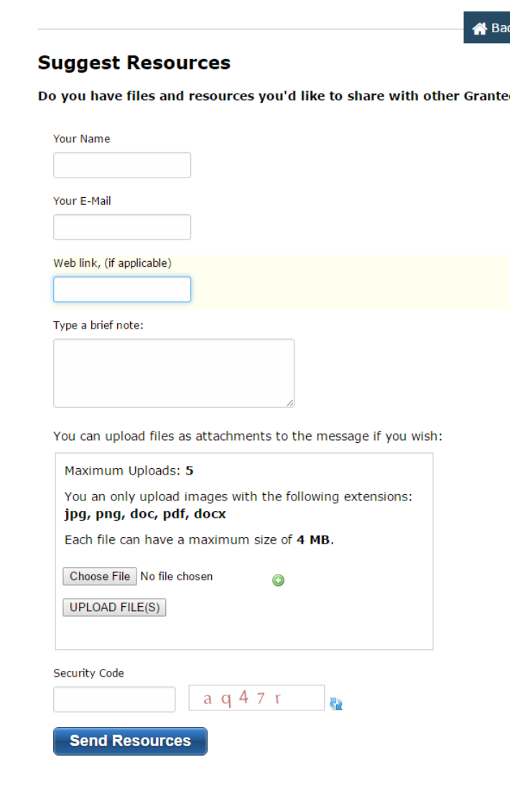
Grantee Role in Developing the Virtual Library
  In many areas, grantees have resources or examples that would be useful to others.
  The “Suggest a Resource” button allows grantees to submit resources to be added to the Virtual Library.
  Note: All resources are vetted by the PMIWG and OCS before being added to the Virtual Library.

Slide 23
Grantee Role in Developing the Virtual Library
The “Leave Feedback” button at the top of each page allows grantees to provide their suggestions or ideas.
For example:
Usability, Navigation—How could we make the Virtual Library easier to use?
Guided Search—Are there categories missing?
Resources—Are there gaps you can help fill? Were you expecting to see something, but didn’t?

Slide 24
Grantee Feedback

Slide 25
Discussion, Ideas, Questions
Tell us about your experience using the Virtual Library!
What was your favorite part of the tool? Why?
Are there improvements you’d like to see?
Questions?

Slide 26
Resources
Users with questions about using the Virtual Library can:
  Click the “Help” Button at the top of each page to generate a request for support.
  Contact the APPRISE Team directly:
    Trayvon Braxton
    Trayvon-Braxton@appriseinc.org
    609-252-9053
    Melissa Torgerson
    melissa@verveassociates.net
    503-706-2647

Slide 27
Questions and Answers

Slide 28
Roundtables
The next session is...

