Slide 1
2017 LIHEAP National Training LIHEAP Performance Management
April 3, 2017 – April 4, 2017
Presenters:
Holly Ravesloot (OCS)
Melissa Torgerson (VERVE)
Kevin McGrath (APPRISE)
David Carroll (APPRISE)
Notes:
Title Slide Option 1

Slide 2
LIHEAP Performance Management Introduction
Welcome and Introduction
Holly Ravesloot, OCS

Slide 3
LIHEAP Performance Management Introduction
LIHEAP Performance Measures were developed in response to:
Section 2605(b) of the Low Income Home Energy Assistance Act of 1981 (42 U.S.C. §8624(b)) as amended by Sec. 311(b) of the Human Services Amendments of 1994 (Public Law 103-252) requiring HHS to develop, in consultation with LIHEAP grantees, model performance goals that measure the success of each State’s LIHEAP activities.
Section 2610(b)(2) of the Low Income Home Energy Assistance Act of 1981 (42 U.S.C. §8629(b)(2)) requiring that HHS annually report to Congress on the impact LIHEAP is making on recipient and income eligible households.
Section 2605(b)(5) of the Low Income Home Energy Assistance Act of 1981 (42 U.S. C. §8624(b)(5)) requiring LIHEAP grantees to provide, in a timely manner, that the highest level of energy assistance will be furnished to those households that have the lowest incomes and the highest energy costs or needs in relation to income, taking into account family size.

Slide 4
LIHEAP Performance Management Introduction
LIHEAP Performance Measurement Timeline
2008-2010 | Performance Management Work Group (PMWG) Develops Performance Measurement Recommendations.
2010-2012 | Performance Management Implementation Work Group (PMIWG) transforms PMWG recommendations into concrete Performance Measures.
2012-2014 | Development of OLDC and Performance Measurement Website. OMB Approves PMIWG recommendations.
2014-2016 | PMIWG works with OCS and APPRISE Team on guidance and support. Grantees work on building systems to collect and report new data.
2016-2018 | Grantees start using LIHEAP Performance Measures data for Performance Management.

Slide 5
LIHEAP Performance Management Introduction
As of January 2017:
41 grantees submitted Performance Management data for FY 2016.
Many grantees are actively working with vendors to increase the amount of data included in their Performance Data Forms.
Grantees are using the LIHEAP Performance Management Website Data Warehouse and the Performance Measures data to update their program designs.
APPRISE will continue providing training and technical assistance to improve the quantity, accuracy, and reliability of data for FY 2017 LIHEAP reporting.

Slide 6
LIHEAP Performance Management Introduction
From Performance Measures to Performance Management
Summer 2013 | Performance Management Website Published for Grantees
Fall 2014 | OMB Approval of LIHEAP Performance Measures
Summer 2015 | PMIWG Launches LIHEAP Virtual Library and Data Warehouse Advanced Search Initiatives
Winter 2016 | Publication of LIHEAP Virtual Library and Data Warehouse Advanced Search Capabilities
Spring 2016 | Regional Training on Performance Management Techniques
Summer 2016 | NEUAC Presentation on FY 2015 Performance Measures Reports
Winter 2017 | Performance Management Website Goes Public
Spring 2017 | T&TA on Using LIHEAP Performance Management Data Reported by Grantees
FY 2018 | LIHEAP Model Plans Designed by Grantees with Performance Management in Mind

Slide 7
LIHEAP Performance Management Introduction
Charles Anderson | Connecticut
Jane Blank | Wisconsin
Debra Brown | California
Andrew Bryk | New York
Cecil Daniels | Washington
Kristen Hart | California
Heather Jones | Missouri
Jennifer Lee | Alabama
Susan Marshall | Alaska
Lorraine Portis | Mississippi
Paula Reynolds | Maryland
Michael Schmitz | Minnesota
Sheri Shepard | Montana
Jenni Sullivan | Montana
Vivian Ulibarri | New Mexico
PMIWG
Current Members

Slide 8
LIHEAP Performance Management Introduction
Presenters:
Melissa Torgerson, VERVE
Kevin McGrath, APPRISE
David Carroll, APPRISE

Slide 9
LIHEAP Performance Management Training Objectives
By the end of all three Performance Management Sessions, grantees will:
Understand how LIHEAP performance measures fit into larger performance management cycle
Have a systematic method for interpreting key client and program characteristics within their LIHEAP performance measure data
Be more comfortable using LIHEAP performance measure data to answer questions, think about their programs, and explore options for improvement
Know what tools and resources are available to help them implement performance management in their own states

Slide 10
LIHEAP Performance Management Training Agenda
Session I Agenda
Provide a brief overview of how LIHEAP performance measures data can be used with other information for Performance Management
Walk through systematic process grantees can use to analyze and interpret their performance measure data (using real-life grantee examples)
Demonstrate and outline tools and resources available to help grantees analyze and use their data to manage programs
Share key learning from work with grantees

Slide 11
LIHEAP Performance Management Training Agenda
Session II Agenda
State grantees will work with their colleagues in small groups during this session.
Each small group will be given a state scenario. The group will use the process outlined in Session I to review data, identify potential areas for improvement or change, and make recommendations.
Each small group will have a facilitator to help guide the process.

Slide 12
LIHEAP Performance Management Training Agenda
Session III Agenda
Each group will report on their key findings and recommendations from Session II.
All participants are encouraged to ask questions or provide alternative ideas regarding scenarios.
Grantees will have an opportunity to ask questions of APPRISE and OCS at the end of the session.

Slide 13

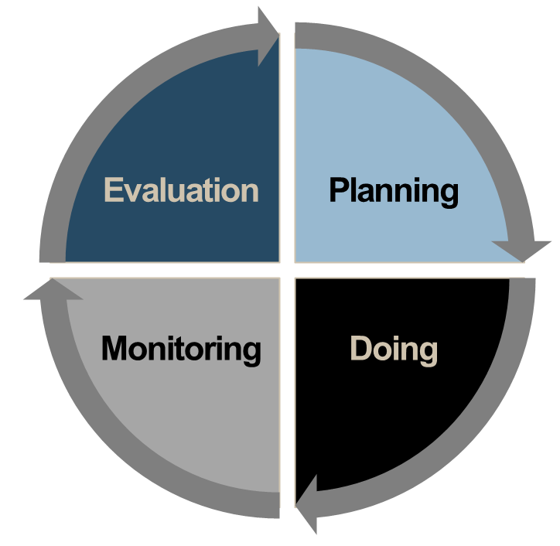
Performance Management Session I How LIHEAP Measures Fit Into Performance Management
Performance management is the process of evaluating data (together with other information) to make educated program decisions.
Performance Management is a cycle of continuous learning and improvement over time.

Slide 14


Performance Management Session I How LIHEAP Measures Fit Into Performance Management
Does our program design match the lived experiences of our clients and partners?
Do our program outcomes match expectations? Are we accomplishing what we wanted to do?
What changes have occurred? How does this impact our goals or outcomes?
What goals and priorities do we have for the coming year(s)?
What modifications are necessary to improve outcomes?
How will we implement changes based on our priorities, goals, limitations, and constraints?

Slide 15
Performance Management Session I How LIHEAP Measures Fit Into Performance Management
LIHEAP Grantees already have a suite of resources available to inform program evaluation and planning.
Required LIHEAP Reports
LIHEAP Model Plan
LIHEAP Household Report
LIHEAP Performance Data Form - Section I. Grantee Survey
Other Data Sources
LIHEAP Home Energy Notebook
American Community Survey (Census)
Residential Energy Consumption Survey (RECS)

Slide 16
Performance Management Session I How LIHEAP Measures Fit Into Performance Management
Information for Performance Management does not always look like “data.” Many grantees may already be using the following resources in evaluation and planning processes:
Internal LIHEAP Sources
LIHEAP Policy Manual
Subgrantee Agreements
Fair Hearing Transcripts
“Informal” Program Sources
Feedback from subgrantees, vendors
Client feedback, complaints
Leadership priorities, strategic plans
Agency Budget or Resource Documentation

Slide 17
Performance Management Session I How LIHEAP Measures Fit Into Performance Management
New Performance Measure data provides LIHEAP grantees with important additions to their “suite” of Performance Management tools.
Household characteristics to inform program planning
Average annual income by household fuel type
Average annual energy costs by household fuel type
Indicators to evaluate impact of LIHEAP on households
Average pre-LIHEAP Energy Burden by fuel type
Average post-LIHEAP Energy Burden by fuel type
Average energy burden reduction as a result of LIHEAP by fuel type
Instances of Home Energy Loss Prevention v. Restoration of Home Energy Service
Targeting Indices to evaluate effectiveness of program (compliance with statute)
Benefit Targeting Index
Burden Reduction Targeting Index

Slide 18
Performance Management Session I How LIHEAP Measures Fit Into Performance Management
Benefit Targeting Index
This measure tells us whether high energy burden households receive higher LIHEAP benefits than average households.
Why Does This Matter?
The LIHEAP Act requires grantees to provide the highest level of assistance to households with the highest energy burden (highest energy costs in relation to income and family size).

Slide 19
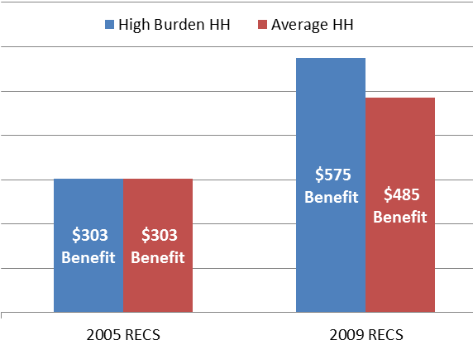
Performance Management Session I How LIHEAP Measures Fit Into Performance Management
Benefit Targeting Index Example
In 2005, high burden households received the same benefit as the average household.
[Index Score: 100]
In 2009, high burden households received a benefit 18.6% higher than the average household.
[Index Score: 118.6]
Does the LIHEAP program furnish higher benefits to high burden households?
Not in 2005. But, in 2009 the program did pay higher benefits to high burden households.

Slide 20
Performance Management Session I How LIHEAP Measures Fit Into Performance Management
Burden Reduction Targeting Index
This measure tells us whether high energy burden households have a larger share of their energy bill paid with LIHEAP than average households.
Why Does This Matter?
The LIHEAP Act requires grantees to provide the highest level of assistance to households with the highest energy burden. This measure goes beyond the size of the benefit to look at the share of the bill paid.

Slide 21
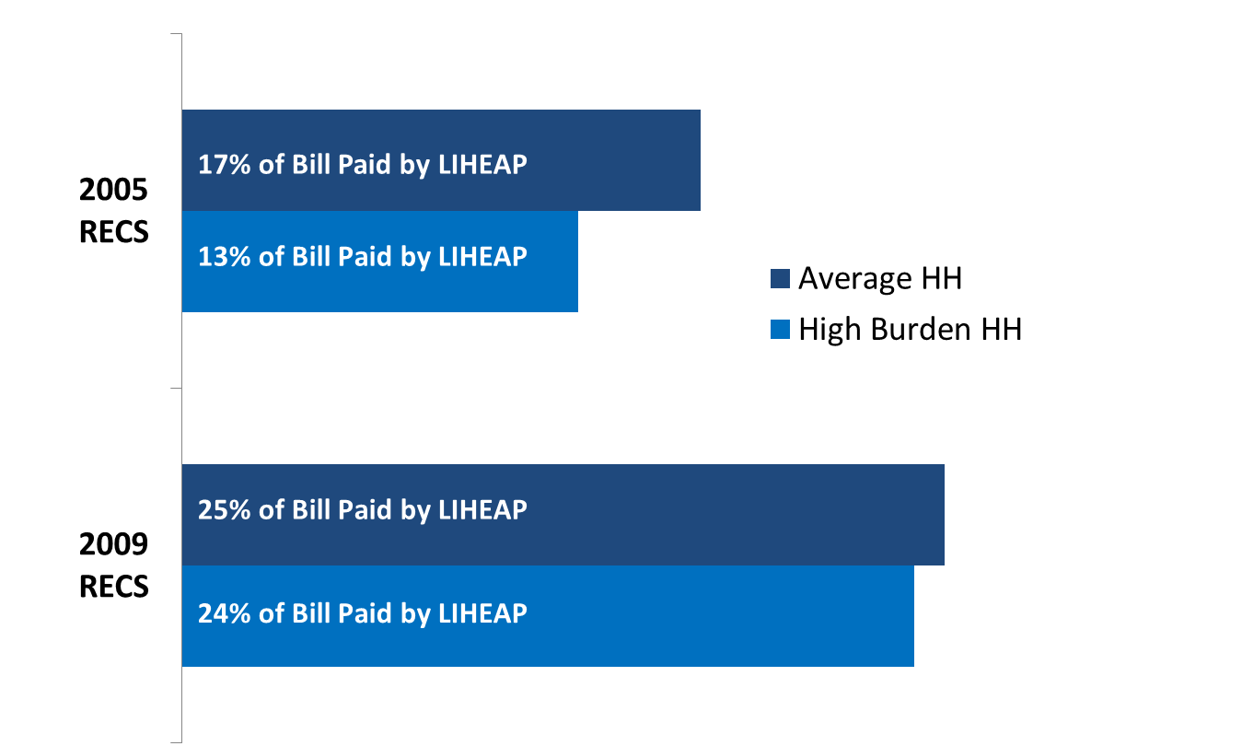
Performance Management Session I How LIHEAP Measures Fit Into Performance Management
Burden Reduction Targeting Index Example
In 2005, high burden households had 13% of their annual home energy bill paid, compared to the average of 17%.
[Index Score: 76]
In 2009, high burden households had 24% of their annual home energy bill paid, compared to the average of 25%.
[Index Score: 96]
Does LIHEAP pay a larger share of the home energy bill for high burden households?
No. In both 2005 and 2009, high burden households had a lower percentage of their home energy bill paid by the program than the average household. But, the program improved on this measure between 2005 and 2009.

Slide 22
Performance Management Session I How LIHEAP Measures Fit Into Performance Management
Demonstrating the difference between
Benefit Targeting and Burden Reduction Targeting Indices.

Slide 23
Performance Management Session I How LIHEAP Measures Fit Into Performance Management
Questions?

Slide 24
Performance Management Session I Grantee Examples
Analyzing and Interpreting LIHEAP Performance Measure Data
In previous trainings, we have demonstrated how data from existing reports can be used to answer key performance management questions.
In this training session, we will use real-life examples to demonstrate how grantees can systematically analyze LIHEAP Performance Measure data for planning and evaluation.
For each grantee example, we will walk through the following:
Grantee Benefit Matrix
Performance Data Form (data for all households, regardless of fuel type)
Performance Data Form (data for households across all fuel types)
State Performance Data Snapshot

Slide 25
Performance Management Session I Grantee Examples
Grantee Benefit Matrix
What factors are used to vary benefits among households (e.g., income, fuel type)?
Does the benefit matrix rely upon actual energy expenditures?
What other assumptions does the benefit matrix make?
Note: Examples in this training only include matrices for regular assistance. This is important to consider, because “annual LIHEAP benefit” data includes all bill payment assistance (including heating, cooling, crisis, and supplemental benefits).

Slide 26
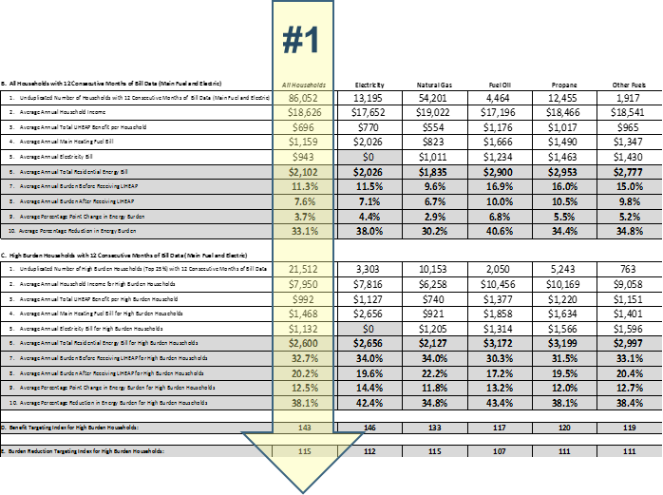
Performance Management Session I Grantee Examples
Data for ALL Households (Regardless of Fuel Type)
(Sections B & C, Column 2)
How do income and energy bills compare between average households and high burden households?
How does the pre-LIHEAP energy burden compare between average households and high burden households?
What is the difference in the LIHEAP benefit between high burden and average households?
How does post-LIHEAP burden compare between average households and high burden households?
What insight does this data give me about the benefit matrix?

Slide 27
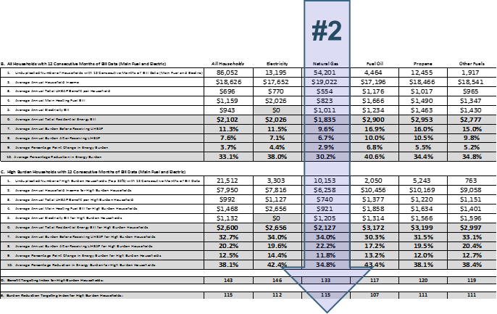
Performance Management Session I Grantee Examples
Data for Households by
Main Heating Fuel Type
(Sections B & C, Columns 3-8)
For a specific Main Heating Fuel:
How do income and energy bills compare between average households and high burden households?
How does the pre-LIHEAP energy burden compare between average households and high burden households?
What is the difference in the LIHEAP benefit between high burden and average households?
How does post-LIHEAP burden compare between average households and high burden households?
What insight does this data provide about the benefit matrix?

Slide 28
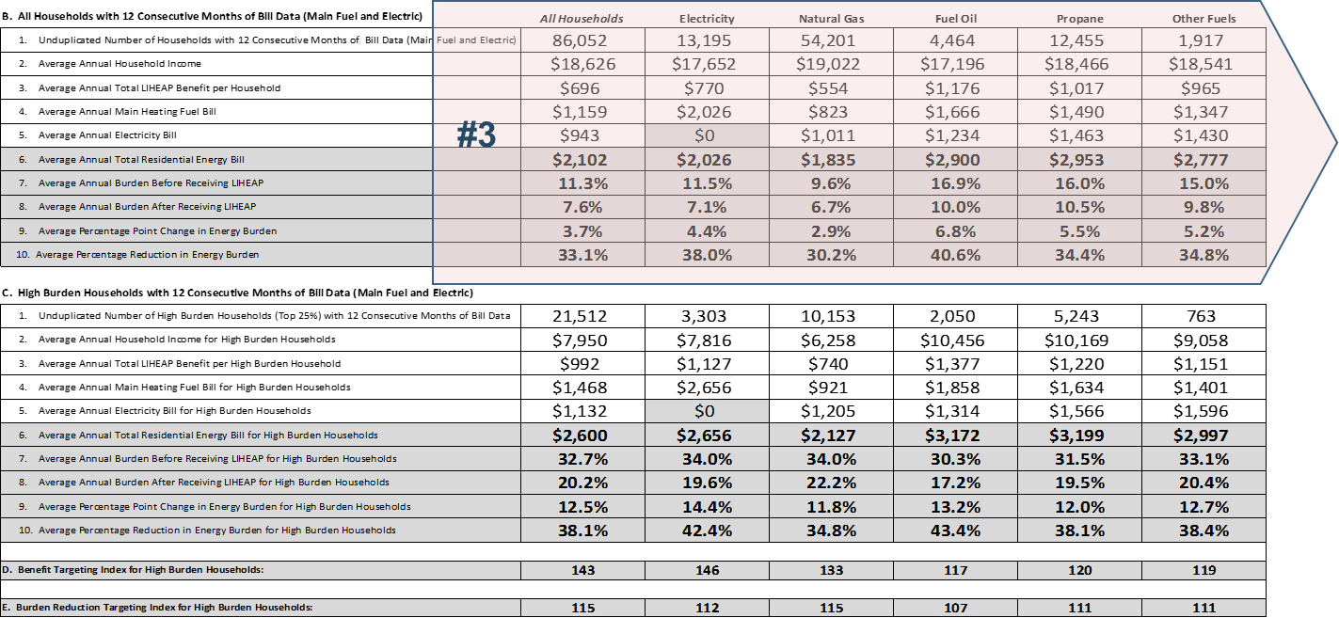
Performance Management Session I Grantee Examples
How do income and energy bills vary between main heating fuel types?
How does the pre-LIHEAP energy burden vary between main heating fuel types?
What is the difference in the LIHEAP benefit vary between main heating fuel types?
How does post-LIHEAP burden vary between main heating fuel types?
What insight does this data provide about the benefit matrix?
Data for ALL Households across Main Heating Fuel Types
Section B, All Rows

Slide 29
Performance Management Session I Grantee Examples
Example A

Slide 30
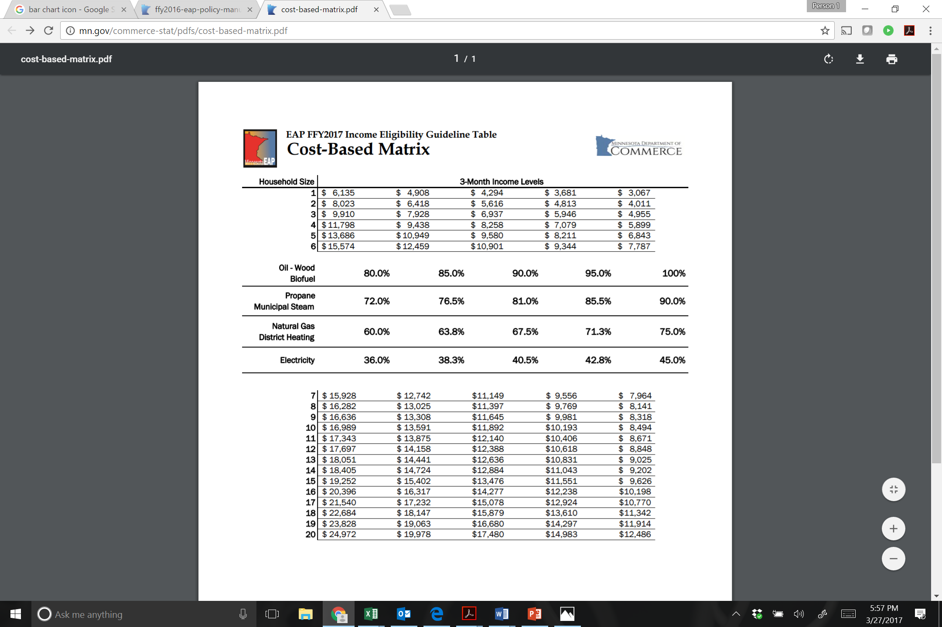
Performance Management Session I Example A—Benefit Matrix
How this matrix works:
Find the row with the household size.
Find the first column that is ≥ household income.
Move up or down that column to household fuel type.
Multiply fuel type percentage by last year’s fuel costs.
What factors are used to vary benefits?
Household Size
Income
Fuel Type
Does the benefit matrix rely on actual energy expenditures?
Yes. This grantee uses the previous year’s energy bills to determine the benefit at time of intake, as well as adjust percentages in the matrix each program year.

Slide 31
Performance Management Session I Example A—Income and Energy Costs (all households)
How does annual income compare between average households and high burden households?
The average annual income of all households is $18,626.
The average annual income of high burden households is $7950.
In other words, high burden households have an average annual income that is $10,676 or 57% less than average households.

Slide 32
Performance Management Session I Example A—Income and Energy Costs (all households)
How do annual energy bills compare between average households and high burden households?
The average annual energy bill of all households is $2102.
The average annual energy bill of high burden households is $2600.
In other words, high burden households have an average energy bill that is $498 or 24% greater than average households.

Slide 33
Performance Management Session I Example A—Income and Energy Costs (all households)
How does the pre-LIHEAP energy burden compare between average households and high burden households?
On average, annual energy burden for all households before LIHEAP is 11.3%
The average annual energy burden of high burden households before LIHEAP is 32.7%
In other words, high burden households are paying 2.9 times as much of their income toward energy costs than average households.

Slide 34
Performance Management Session I Example A—LIHEAP Impact (all households)
What is the difference in the annual LIHEAP benefit between high burden and average households?
The average annual LIHEAP benefit for all households is $696.
The average annual LIHEAP benefit among high burden households is $992.
High burden households receive an average annual LIHEAP benefit that is $296 or 43% higher than average households.

Slide 35
Performance Management Session I Example A—LIHEAP Impact (all households)
How does post-LIHEAP burden compare between average households and high burden households?
The average percentage burden reduction for all households is 33%
The average percentage burden reduction for high burden households is 38%
This means that on average, high burden households have 15% more of their energy burden covered with LIHEAP than average households.

Slide 36
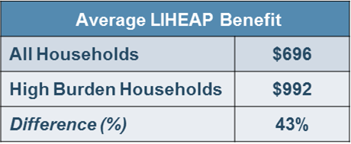
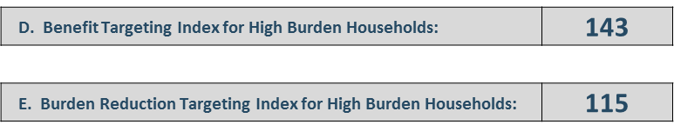
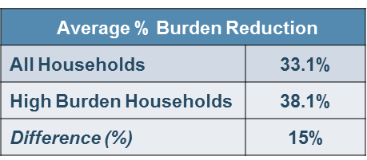
Performance Management Session I Example A—LIHEAP Impact (all households)
The percentage difference in benefits and burden reduction between all households and high burden households are reflected in the targeting index numbers.
On average, high burden households receive a 43% greater annual LIHEAP benefit than average households.
On average, high burden households have 15% more of their energy burden covered with LIHEAP than average households.

Slide 37
Performance Management Session I Example A—All Households Summary
ALL Households | Avg. Annual Energy Bill: $2,102 | ∕ | Avg. Annual Income: $18,626 | = | Avg. Annual Energy Burden 11.3% |  | Annual LIHEAP Benefit $696 |  | Energy Burden After LIHEAP 7.6% |  | Burden Reduction 33%
High Burden Households | Avg. Annual Energy Bill: $2,600 | ∕ | Avg. Annual Income: $7,950 | = | Avg. Annual Energy Burden 32.7% |  | Annual LIHEAP Benefit $992 |  | New Burden 20.2% |  | Burden Reduction 38%
 | High Burden HH energy bills are 24% higher than average households. |  | High Burden HH income is 57% lower than average households. |  | High Burden HH are paying 2.9x more of their income on home energy than average households. |  | High Burden HH are receiving a LIHEAP benefit that is 43% greater than average households. |  | After LIHEAP, High Burden HH are paying 2.7x more of their income on home energy than average HH. |  | High Burden HH have a 15% greater share of their energy burden offset with LIHEAP than average HH.
ALL HOUSEHOLDS Preliminary Observations | Differences in Energy Burden between average and high burden households are the result of both higher energy bills and lower income—although income appears to be a larger factor. |  |  |  |  |  | High Burden households receive higher benefits, and have a greater share of their energy burden offset by LIHEAP. This preliminarily suggests that the benefit matrix is effectively varying benefits based on income and energy costs.

Slide 38
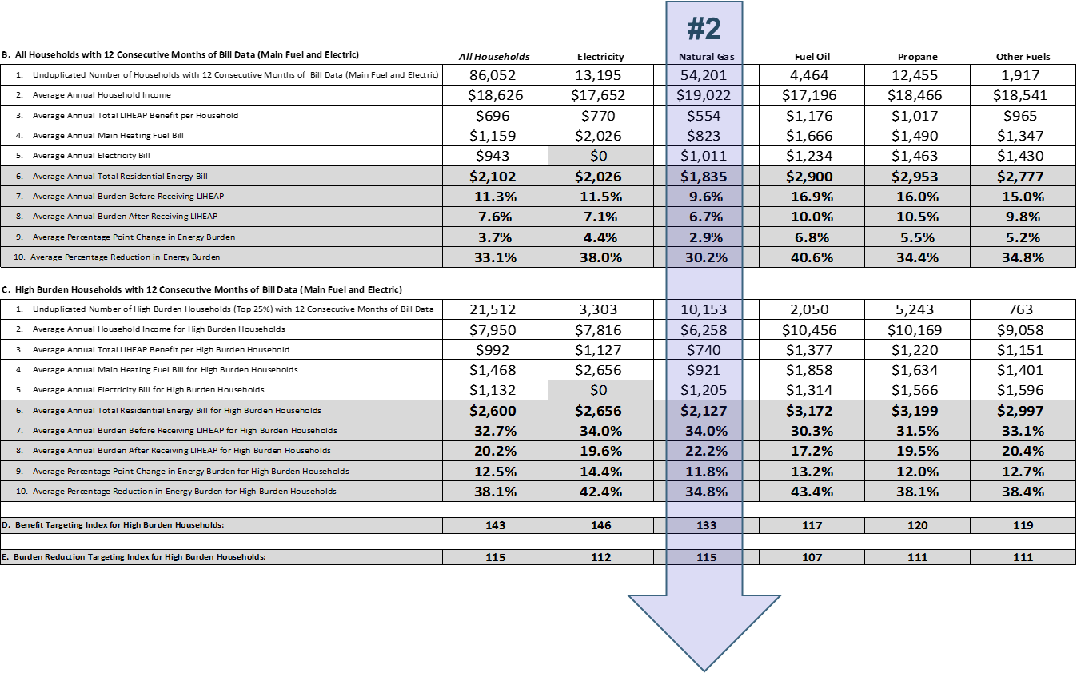
Performance Management Session I Example A—Step Two (Looking at Data by Fuel Type)
Step #2: Data by Main Heating Fuel Type

Slide 39
Performance Management Session I Example A—Income and Energy Costs (Natural Gas Main Heat HH)
How does income compare between average households and high burden households who use natural gas main heat?
The average annual income of all natural gas households is $19,022.
The average annual income of high burden natural gas households is $6,258.
In other words, high burden households have an average annual income that is $12,764 or 67% less than average households.

Slide 40
Performance Management Session I Example A—Income and Energy Costs (Natural Gas Main Heat HH)
How do annual energy bills compare between average households and high burden households who use natural gas main heat?
The average annual energy bill of all natural gas households is $1835.
The average annual energy bill of high burden natural gas households is $2127.
In other words, high burden households have an average energy bill that is $292 or 16% greater than average households.

Slide 41
Performance Management Session I Example A—Income and Energy Costs (Natural Gas Main Heat HH)
How does the pre-LIHEAP energy burden compare between average households and high burden households who use natural gas main heat?
On average, annual energy burden for all natural gas households before LIHEAP is 9.6%
The average annual energy burden of high burden natural gas households before LIHEAP is 34.0%
In other words, high burden households are paying 3.5x as much of their income toward energy costs than average households.

Slide 42
Performance Management Session I Example A—LIHEAP Impact (Natural Gas Main Heat HH)
What is the difference in the annual LIHEAP benefit between high burden and average households who use natural gas main heat?
The average annual LIHEAP benefit for all natural gas households is $554.
The average annual LIHEAP benefit among high burden natural gas households is $740.
High burden households receive an average annual LIHEAP benefit that is $186 or 33% higher than average households.

Slide 43
Performance Management Session I Example A—LIHEAP Impact (Natural Gas Main Heat HH)
How does post-LIHEAP burden compare between average households and high burden households who use natural gas main heat?
The average percentage burden reduction for all natural gas households is 30.2%
The average percentage burden reduction for high burden natural gas households is 34.8%
This means that on average, high burden households have 15% more of their energy burden covered with LIHEAP than average households.

Slide 44
Performance Management Session I Example A—LIHEAP Impact (Natural Gas Main Heat HH)
These difference in benefits and burden reduction between all households and high burden households are reflected in the targeting index numbers.
On average, high burden households receive a 33% greater annual LIHEAP benefit than average households.
On average, high burden households have 15% more of their energy burden covered with LIHEAP than average households.

Slide 45
Performance Management Session I Example A—Natural Gas Households Summary
ALL Households | Avg. Annual Energy Bill: $1,835 | ∕ | Avg. Annual Income: $19,022 | = | Avg. Annual Energy Burden 9.6% |  | Annual LIHEAP Benefit $554 |  | Energy Burden After LIHEAP 6.7% |  | Burden Reduction 30.2%
High Burden Households | Avg. Annual Energy Bill: $2,127 | ∕ | Avg. Annual Income: $6,258 | = | Avg. Annual Energy Burden 34% |  | Annual LIHEAP Benefit $740 |  | New Burden 22.2% |  | Burden Reduction 34.8%
 | High Burden HH energy bills are 16% higher than average households. |  | High Burden HH income is 67% lower than average households. |  | High Burden HH are paying 3.5x more of their income on home energy than average households. |  | High Burden HH are receiving a LIHEAP benefit that is 33% greater than average households. |  | After LIHEAP, High Burden HH are paying 3.3x more of their income on home energy than average HH. |  | High Burden HH have a 15% greater share of their energy burden offset with LIHEAP than average HH.
NATURAL GAS HOUSEHOLDS Preliminary Conclusions | Differences in energy burden between average and high burden households who heat with Natural Gas are the result of both higher energy bills and lower income—however income appears to be a much larger factor. |  |  |  |  |  | High Burden households receive Higher benefits, and have a greater share of their energy burden offset by LIHEAP. This suggests that the benefit matrix is effectively varying benefits among Natural Gas households based on income and energy costs.

Slide 46
Performance Management Session I Example A—Looking at Data across Fuel Type
Step #3: All Household Data Across Fuel Types

Slide 47
Performance Management Session I Example A—Income and Energy Costs (Across Fuel Types)
How does average annual income vary between main heating fuel types?
The average annual income of natural gas main heat households is $19,022.
The average annual income of fuel oil main heat households is $17,196.
In other words, fuel oil main heat households have slightly lower average annual income than natural gas main heat households - $1,826 or about 10 percent less.

Slide 48
Performance Management Session I Example A—Income and Energy Costs (Across Fuel Types)
How do average annual energy bills vary between main heating fuel types?
The average annual energy bill of natural gas main heat households is $1,835.
The average annual energy bill of fuel oil main heat households is $2,900.
In other words, fuel oil main heat households have a higher average energy bill than natural gas main heat households - $1,065 or 58 percent higher.

Slide 49
Performance Management Session I Example A—Income and Energy Costs (Across Fuel Types)
How does pre-LIHEAP energy burden vary between main heating fuel types?
The average pre-LIHEAP energy burden of natural gas main heat households is 9.6%
The average pre-LIHEAP energy burden of fuel oil main heat households is 16.9%
In other words, fuel oil main heat households are paying 1.75x more of their income towards energy costs than natural gas main heat households.

Slide 50
Performance Management Session I Example A—Income and Energy Costs (Across Fuel Types)
How do annual LIHEAP benefits vary between main heating fuel types?
The average annual LIHEAP benefit for natural gas main heat households is $554.
The average annual LIHEAP benefit for fuel oil main heat households is $1,176.
In other words, fuel oil main heat households receive an average annual LIHEAP benefit that is $622 or over 2x higher than natural gas main heat households.

Slide 51
Performance Management Session I Example A—Income and Energy Costs (Across Fuel Types)
How does post-LIHEAP burden vary between main heating fuel types?
The average percentage burden reduction for natural gas main heat households is 30.2%
The average percentage burden reduction for fuel oil main heat households is 40.6%
This means that on average, fuel oil main heat households have 34% more of their energy burden covered with LIHEAP than natural gas main heat households.
Notes:
This means that on average, high burden households have 15% more of their energy burden covered with LIHEAP than average households.

Slide 52
Performance Management Session I Example A—Multiple Fuel Types Summary
Natural Gas Households | Avg. Annual Energy Bill: $1,835 | ∕ | Avg. Annual Income: $19,022 | = | Avg. Annual Energy Burden 9.6% |  | Annual LIHEAP Benefit $554 |  | Energy Burden After LIHEAP 6.7% |  | Burden Reduction 30.2%
Fuel Oil Households | Avg. Annual Energy Bill: $2,900 | ∕ | Avg. Annual Income: $17,196 | = | Avg. Annual Energy Burden 16.9% |  | Annual LIHEAP Benefit $1176 |  | New Burden 10% |  | Burden Reduction 40.6%
 | Fuel Oil HH energy bills are 58% higher than Natural Gas households. |  | Fuel Oil HH income is 10% lower than Natural Gas households. |  | Fuel Oil HH are paying 1.75x more of their income on home energy than Natural Gas households. |  | Fuel Oil HH are receiving a LIHEAP benefit that is over 2x greater than Natural Gas households. |  | After LIHEAP, Fuel Oil HH are paying 1.5x more of their income on home energy than Natural Gas households. |  | Fuel Oil HH have a 34% greater share of their energy burden offset with LIHEAP than Natural Gas HH.
Preliminary Conclusions | Households who heat with fuel oil have energy bills that are 58% higher than households who heat with Natural Gas. However, Fuel Oil households are receiving a LIHEAP benefit that is 112% higher than Natural Gas households. |  |  |  |  |  | Because the benefit matrix uses actual energy expenditures, all households, regardless of fuel type, see their energy burden reduced by at least 30% However, the data shows that for some fuel types (e.g., oil)—this reduction is much more significant.

Slide 53
Performance Management Session I Example A—What Did the Data Tell Us?
How does energy burden reduction compare across fuel types?
On average, all households, regardless of fuel type, experience at least a 30% energy burden reduction as a result of LIHEAP. However, there is some variation in energy burden reduction among between fuel types. More specifically:
Fuel Oil households see the greatest percentage reduction in energy burden as a result of LIHEAP. This is true for all households (40.6%) and high burden households (43.4%)
Natural Gas households see the least reduction in energy burden as a result of LIHEAP. This is true for all households (30.2%) and high burden households (34.8%)
Do actual income and energy costs of LIHEAP assisted households align with the benefit matrix?
The matrix relies on actual energy costs, income, and household size to determine LIHEAP benefits. So all assisted households experience an average minimum 30% energy burden regardless of fuel type. However, as noted above, some fuel types see significantly higher burden reduction.
The matrix is based on main heating fuel—however the data shows that a significant amount of total home energy costs are related to electric. This could be a reason for variation in burden reduction, and may be an area for further analysis.

Slide 54
Performance Management Session I Example A—What Did the Data Tell Us?
Is this state targeting high burden households across all fuel types?
Yes. High burden households across all fuel types are receiving higher benefits and having a larger share of their energy burden reduced than average households. However, the extent of this targeting varies between fuel types.
In the case of fuel oil, LIHEAP benefits reduce energy burden for the average household by over 40% It would therefore be challenging to offer a significantly greater benefit to high burden households without exceeding the grantee’s maximum benefit cap.
As noted in the previous slide, non-electric main heating households are still paying a large share of their home energy costs toward electricity. If the benefit matrix is not adequately accounting for this, there could be inconsistency in energy burden reduction (among all households) and targeting index scores (among high burden households) among non-electric main heating fuel types.
 | All | Electric | Natural Gas | Fuel Oil | Propane | Other
D. Benefit Targeting Index | 143 | 146 | 133 | 117 | 120 | 119
E. Burden Reduction Targeting Index | 115 | 112 | 115 | 107 | 111 | 111

Slide 55
Performance Management Session I Example A—What Did the Data Tell Us?
Questions

Slide 56
Performance Management Session I Grantee Examples
Example B

Slide 57
Performance Management Session I Example B—Benefit Matrix
How this matrix works:
Base benefits are determined by fuel type category
An additional $25 is given to vulnerable households
An additional $25 is given to lowest income households
What factors are used to vary benefits?
Fuel Type
Income
Vulnerable Status
Does the benefit matrix rely on actual energy expenditures?
No. However, non-utility benefits are set higher to reflect greater deliverable fuel costs.
Energy Source | Base Benefit | Vulnerable Household | ≤ 130% FPL | Maximum Total
Electric, Natural Gas | $350 | + $25 | + $25 | $400
Wood, Pellets, Coal | $525 | + $25 | + $25 | $575
Oil, Propane | $575 | + $25 | + $25 | $625

Slide 58
Performance Management Session I Example B—Income and Energy Costs (all households)
B. Households with 12 Consecutive Months of Bill Data (Main Fuel and Electric) | All Households
1. Unduplicated Number of Households with 12 Months of Bill Data | 42,021
2. Average Annual Household Income | $22,966
3. Average Annual Total LIHEAP Benefit per Household | $391
4. Average Annual Main Heating Fuel Bill | $667
5. Average Annual Electricity Bill | $757
6. Average Annual Total Residential Energy Bill | $1,423
7. Average Annual Burden Before Receiving LIHEAP | 6.2%
8. Average Annual Burden After Receiving LIHEAP | 4.5%
9. Average Percentage Point Change in Energy Burden | 1.7%
10. Average Percentage Reduction in Energy Burden | 27.4%
C. High Burden Households with 12 Consecutive Months of Bill Data (Main Fuel and Electric)
1. Unduplicated Number of High Burden Households (Top 25%) | 10,506
2. Average Annual Household Income for High Burden Households | $15,078
3. Average Annual Total LIHEAP Benefit per High Burden Household | $417
4. Average Annual Main Heating Fuel Bill for High Burden Households | $1,041
5. Average Annual Electricity Bill for High Burden Households | $1,069
6. Average Annual Total Residential Energy Bill for High Burden Households | $2,110
7. Average Annual Burden Before Receiving LIHEAP for High Burden Households | 14.0%
8. Average Annual Burden After Receiving LIHEAP for High Burden Households | 11.2%
9. Average Percentage Point Change in Energy Burden for High Burden Households | 2.8%
10. Average Percentage Reduction in Energy Burden for High Burden Households | 19.8%
How does annual income compare between average households and high burden households?
The average annual income of all households is $22,966.
The average annual income of high burden households is $15,078.
In other words, high burden households have an annual income that is $7,888 or 34%
less than average households.

Slide 59
Performance Management Session I Example B—Income and Energy Costs (all households)
B. Households with 12 Consecutive Months of Bill Data (Main Fuel and Electric) | All Households
1. Unduplicated Number of Households with 12 Months of Bill Data | 42,021
2. Average Annual Household Income | $22,966
3. Average Annual Total LIHEAP Benefit per Household | $391
4. Average Annual Main Heating Fuel Bill | $667
5. Average Annual Electricity Bill | $757
6. Average Annual Total Residential Energy Bill | $1,423
7. Average Annual Burden Before Receiving LIHEAP | 6.2%
8. Average Annual Burden After Receiving LIHEAP | 4.5%
9. Average Percentage Point Change in Energy Burden | 1.7%
10. Average Percentage Reduction in Energy Burden | 27.4%
C. High Burden Households with 12 Consecutive Months of Bill Data (Main Fuel and Electric)
1. Unduplicated Number of High Burden Households (Top 25%) | 10,506
2. Average Annual Household Income for High Burden Households | $15,078
3. Average Annual Total LIHEAP Benefit per High Burden Household | $417
4. Average Annual Main Heating Fuel Bill for High Burden Households | $1,041
5. Average Annual Electricity Bill for High Burden Households | $1,069
6. Average Annual Total Residential Energy Bill for High Burden Households | $2,110
7. Average Annual Burden Before Receiving LIHEAP for High Burden Households | 14.0%
8. Average Annual Burden After Receiving LIHEAP for High Burden Households | 11.2%
9. Average Percentage Point Change in Energy Burden for High Burden Households | 2.8%
10. Average Percentage Reduction in Energy Burden for High Burden Households | 19.8%
How do annual energy bills compare between average households and high burden households?
The average annual energy bill of all households is $1423.
The average annual energy bill of high burden households is $2110.
In other words, high burden households have an average energy bill that is $687 or 48% greater than average households.

Slide 60
Performance Management Session I Example B—Income and Energy Costs (all households)
B. Households with 12 Consecutive Months of Bill Data (Main Fuel and Electric) | All Households
1. Unduplicated Number of Households with 12 Months of Bill Data | 42,021
2. Average Annual Household Income | $22,966
3. Average Annual Total LIHEAP Benefit per Household | $391
4. Average Annual Main Heating Fuel Bill | $667
5. Average Annual Electricity Bill | $757
6. Average Annual Total Residential Energy Bill | $1,423
7. Average Annual Burden Before Receiving LIHEAP | 6.2%
8. Average Annual Burden After Receiving LIHEAP | 4.5%
9. Average Percentage Point Change in Energy Burden | 1.7%
10. Average Percentage Reduction in Energy Burden | 27.4%
C. High Burden Households with 12 Consecutive Months of Bill Data (Main Fuel and Electric)
1. Unduplicated Number of High Burden Households (Top 25%) | 10,506
2. Average Annual Household Income for High Burden Households | $15,078
3. Average Annual Total LIHEAP Benefit per High Burden Household | $417
4. Average Annual Main Heating Fuel Bill for High Burden Households | $1,041
5. Average Annual Electricity Bill for High Burden Households | $1,069
6. Average Annual Total Residential Energy Bill for High Burden Households | $2,110
7. Average Annual Burden Before Receiving LIHEAP for High Burden Households | 14.0%
8. Average Annual Burden After Receiving LIHEAP for High Burden Households | 11.2%
9. Average Percentage Point Change in Energy Burden for High Burden Households | 2.8%
10. Average Percentage Reduction in Energy Burden for High Burden Households | 19.8%
How does annual pre-LIHEAP energy burden compare between average households and high burden households?
On average, annual energy burden for all households before LIHEAP is 6.2%
The average annual energy burden of high burden households before LIHEAP is 14%
In other words, high burden households are paying over twice as much of their income toward energy costs than average households.

Slide 61
Performance Management Session I Example B—LIHEAP Impact (all households)
B. Households with 12 Consecutive Months of Bill Data (Main Fuel and Electric) | All Households
1. Unduplicated Number of Households with 12 Months of Bill Data | 42,021
2. Average Annual Household Income | $22,966
3. Average Annual Total LIHEAP Benefit per Household | $391
4. Average Annual Main Heating Fuel Bill | $667
5. Average Annual Electricity Bill | $757
6. Average Annual Total Residential Energy Bill | $1,423
7. Average Annual Burden Before Receiving LIHEAP | 6.2%
8. Average Annual Burden After Receiving LIHEAP | 4.5%
9. Average Percentage Point Change in Energy Burden | 1.7%
10. Average Percentage Reduction in Energy Burden | 27.4%
C. High Burden Households with 12 Consecutive Months of Bill Data (Main Fuel and Electric)
1. Unduplicated Number of High Burden Households (Top 25%) | 10,506
2. Average Annual Household Income for High Burden Households | $15,078
3. Average Annual Total LIHEAP Benefit per High Burden Household | $417
4. Average Annual Main Heating Fuel Bill for High Burden Households | $1,041
5. Average Annual Electricity Bill for High Burden Households | $1,069
6. Average Annual Total Residential Energy Bill for High Burden Households | $2,110
7. Average Annual Burden Before Receiving LIHEAP for High Burden Households | 14.0%
8. Average Annual Burden After Receiving LIHEAP for High Burden Households | 11.2%
9. Average Percentage Point Change in Energy Burden for High Burden Households | 2.8%
10. Average Percentage Reduction in Energy Burden for High Burden Households | 19.8%
What is the difference in the annual LIHEAP benefit between high burden and average households?
The average annual LIHEAP benefit for all households is $391.
The average annual LIHEAP benefit among high burden households is $417.
High burden households receive an average annual LIHEAP benefit that is $26 or 7% higher than average households.

Slide 62
Performance Management Session I Example B—LIHEAP Impact (all households)
B. Households with 12 Consecutive Months of Bill Data (Main Fuel and Electric) | All Households
1. Unduplicated Number of Households with 12 Months of Bill Data | 42,021
2. Average Annual Household Income | $22,966
3. Average Annual Total LIHEAP Benefit per Household | $391
4. Average Annual Main Heating Fuel Bill | $667
5. Average Annual Electricity Bill | $757
6. Average Annual Total Residential Energy Bill | $1,423
7. Average Annual Burden Before Receiving LIHEAP | 6.2%
8. Average Annual Burden After Receiving LIHEAP | 4.5%
9. Average Percentage Point Change in Energy Burden | 1.7%
10. Average Percentage Reduction in Energy Burden | 27.4%
C. High Burden Households with 12 Consecutive Months of Bill Data (Main Fuel and Electric)
1. Unduplicated Number of High Burden Households (Top 25%) | 10,506
2. Average Annual Household Income for High Burden Households | $15,078
3. Average Annual Total LIHEAP Benefit per High Burden Household | $417
4. Average Annual Main Heating Fuel Bill for High Burden Households | $1,041
5. Average Annual Electricity Bill for High Burden Households | $1,069
6. Average Annual Total Residential Energy Bill for High Burden Households | $2,110
7. Average Annual Burden Before Receiving LIHEAP for High Burden Households | 14.0%
8. Average Annual Burden After Receiving LIHEAP for High Burden Households | 11.2%
9. Average Percentage Point Change in Energy Burden for High Burden Households | 2.8%
10. Average Percentage Reduction in Energy Burden for High Burden Households | 19.8%
How does post-LIHEAP burden compare between average households and high burden households?
The average percentage burden reduction for all households is 27.4%
The average percentage burden reduction for high burden households is 19.8%
This means that on average, high burden households have 28% less of their energy burden covered with LIHEAP than average households.

Slide 63
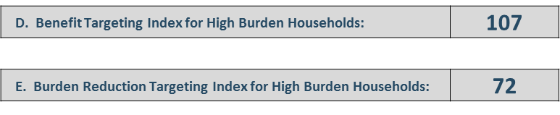
Performance Management Session I Example B—LIHEAP Impact (all households)
These difference in benefits and burden reduction between all households and high burden households are reflected in the targeting index numbers.
Average LIHEAP Benefit
All Households | $391
High Burden Households | $417
Difference (%) | 7%
Average % Burden Reduction
All Households | 27.4%
High Burden Households | 19.8%
Difference (%) | -28%
On average, high burden households receive a 7% greater annual LIHEAP benefit than average households.
On average, high burden households have 28% less of their energy burden covered with LIHEAP than average households.

Slide 64
Performance Management Session I Example B—All Households Summary
ALL Households | Avg. Annual Energy Bill: $1,423 | ∕ | Avg. Annual Income: $22,966 | = | Avg. Annual Energy Burden 6.2% |  | Annual LIHEAP Benefit $391 |  | Energy Burden After LIHEAP 4.5% |  | Burden Reduction 27.4%
High Burden Households | Avg. Annual Energy Bill: $2,110 | ∕ | Avg. Annual Income: $15,078 | = | Avg. Annual Energy Burden 14% |  | Annual LIHEAP Benefit $417 |  | New Burden 11.2% |  | Burden Reduction 19.8%
 | High Burden HH energy bills are 48% higher than average households. |  | High Burden HH income is 34% lower than average households. |  | High Burden HH are paying 2.3x more of their income on home energy than average households. |  | High Burden HH are receiving a LIHEAP benefit that is 7% greater than average households. |  | After LIHEAP, High Burden HH are paying 2.5x more of their income on home energy than average HH. |  | High Burden HH have a 28% lesser share of their energy burden offset with LIHEAP than average HH.
ALL HOUSEHOLDS Preliminary Conclusions | Differences in Energy Burden are the result of both higher energy bills and lower income among high burden HH — with income as a larger factor. High Burden households have energy bills that are 48% higher than average households, but only receive a 7% greater benefit. |  |  |  |  |  | Although the grantee is paying a slightly higher benefit to households with lower incomes, it does not appear to be enough to address the difference between high burden and average households in terms of income and energy costs.

Slide 65
Performance Management Session I Example B—Step Two (Looking at Data by Fuel Type)
Step #2: Data by Main Heating Fuel Type

Slide 66
Performance Management Session I Example B—Income and Energy Costs (Natural Gas Main Heat HH)
B. Households with 12 Consecutive Months of Bill Data (Main Fuel and Electric) | Natural Gas
1. Unduplicated Number of Households with 12 Months of Bill Data | 32,906
2. Average Annual Household Income | $23,465
3. Average Annual Total LIHEAP Benefit per Household | $377
4. Average Annual Main Heating Fuel Bill | $534
5. Average Annual Electricity Bill | $875
6. Average Annual Total Residential Energy Bill | $1,409
7. Average Annual Burden Before Receiving LIHEAP | 6.0%
8. Average Annual Burden After Receiving LIHEAP | 4.4%
9. Average Percentage Point Change in Energy Burden | 1.6%
10. Average Percentage Reduction in Energy Burden | 26.8%
C. High Burden Households with 12 Consecutive Months of Bill Data (Main Fuel and Electric)
1. Unduplicated Number of High Burden Households (Top 25%) | 7,630
2. Average Annual Household Income for High Burden Households | $14,347
3. Average Annual Total LIHEAP Benefit per High Burden Household | $385
4. Average Annual Main Heating Fuel Bill for High Burden Households | $787
5. Average Annual Electricity Bill for High Burden Households | $1,209
6. Average Annual Total Residential Energy Bill for High Burden Households | $1,996
7. Average Annual Burden Before Receiving LIHEAP for High Burden Households | 13.9%
8. Average Annual Burden After Receiving LIHEAP for High Burden Households | 11.2%
9. Average Percentage Point Change in Energy Burden for High Burden Households | 2.7%
10. Average Percentage Reduction in Energy Burden for High Burden Households | 19.3%
How does income compare between average households and high burden households who use natural gas main heat?
The average annual income of all natural gas households is $23,465.
The average annual income of high burden natural gas households is $14,347.
In other words, high burden households have an average annual income that is $9,117 or 39% less than average households.

Slide 67
Performance Management Session I Example B—Income and Energy Costs (Natural Gas Main Heat HH)
B. Households with 12 Consecutive Months of Bill Data (Main Fuel and Electric) | Natural Gas
1. Unduplicated Number of Households with 12 Months of Bill Data | 32,906
2. Average Annual Household Income | $23,465
3. Average Annual Total LIHEAP Benefit per Household | $377
4. Average Annual Main Heating Fuel Bill | $534
5. Average Annual Electricity Bill | $875
6. Average Annual Total Residential Energy Bill | $1,409
7. Average Annual Burden Before Receiving LIHEAP | 6.0%
8. Average Annual Burden After Receiving LIHEAP | 4.4%
9. Average Percentage Point Change in Energy Burden | 1.6%
10. Average Percentage Reduction in Energy Burden | 26.8%
C. High Burden Households with 12 Consecutive Months of Bill Data (Main Fuel and Electric)
1. Unduplicated Number of High Burden Households (Top 25%) | 7,630
2. Average Annual Household Income for High Burden Households | $14,347
3. Average Annual Total LIHEAP Benefit per High Burden Household | $385
4. Average Annual Main Heating Fuel Bill for High Burden Households | $787
5. Average Annual Electricity Bill for High Burden Households | $1,209
6. Average Annual Total Residential Energy Bill for High Burden Households | $1,996
7. Average Annual Burden Before Receiving LIHEAP for High Burden Households | 13.9%
8. Average Annual Burden After Receiving LIHEAP for High Burden Households | 11.2%
9. Average Percentage Point Change in Energy Burden for High Burden Households | 2.7%
10. Average Percentage Reduction in Energy Burden for High Burden Households | 19.3%
How do annual energy bills compare between average households and high burden households who use natural gas main heat?
The average annual energy bill of all natural gas households is $1409.
The average annual energy bill of high burden natural gas households is $1996.
In other words, high burden households have an average energy bill that is $587 or 42% greater than average households.

Slide 68
Performance Management Session I Example B—Income and Energy Costs (Natural Gas Main Heat HH)
B. Households with 12 Consecutive Months of Bill Data (Main Fuel and Electric) | Natural Gas
1. Unduplicated Number of Households with 12 Months of Bill Data | 32,906
2. Average Annual Household Income | $23,465
3. Average Annual Total LIHEAP Benefit per Household | $377
4. Average Annual Main Heating Fuel Bill | $534
5. Average Annual Electricity Bill | $875
6. Average Annual Total Residential Energy Bill | $1,409
7. Average Annual Burden Before Receiving LIHEAP | 6.0%
8. Average Annual Burden After Receiving LIHEAP | 4.4%
9. Average Percentage Point Change in Energy Burden | 1.6%
10. Average Percentage Reduction in Energy Burden | 26.8%
C. High Burden Households with 12 Consecutive Months of Bill Data (Main Fuel and Electric)
1. Unduplicated Number of High Burden Households (Top 25%) | 7,630
2. Average Annual Household Income for High Burden Households | $14,347
3. Average Annual Total LIHEAP Benefit per High Burden Household | $385
4. Average Annual Main Heating Fuel Bill for High Burden Households | $787
5. Average Annual Electricity Bill for High Burden Households | $1,209
6. Average Annual Total Residential Energy Bill for High Burden Households | $1,996
7. Average Annual Burden Before Receiving LIHEAP for High Burden Households | 13.9%
8. Average Annual Burden After Receiving LIHEAP for High Burden Households | 11.2%
9. Average Percentage Point Change in Energy Burden for High Burden Households | 2.7%
10. Average Percentage Reduction in Energy Burden for High Burden Households | 19.3%
How does the pre-LIHEAP energy burden compare between average households and high burden households who use natural gas main heat?
On average, annual energy burden for all natural gas households before LIHEAP is 6%
The average annual energy burden of high burden natural gas households before LIHEAP is 14%
In other words, high burden households are paying 2.3x as much of their income toward energy costs than average households.

Slide 69
Performance Management Session I Example B—LIHEAP Impact (Natural Gas Main Heat HH)
B. Households with 12 Consecutive Months of Bill Data (Main Fuel and Electric) | Natural Gas
1. Unduplicated Number of Households with 12 Months of Bill Data | 32,906
2. Average Annual Household Income | $23,465
3. Average Annual Total LIHEAP Benefit per Household | $377
4. Average Annual Main Heating Fuel Bill | $534
5. Average Annual Electricity Bill | $875
6. Average Annual Total Residential Energy Bill | $1,409
7. Average Annual Burden Before Receiving LIHEAP | 6.0%
8. Average Annual Burden After Receiving LIHEAP | 4.4%
9. Average Percentage Point Change in Energy Burden | 1.6%
10. Average Percentage Reduction in Energy Burden | 26.8%
C. High Burden Households with 12 Consecutive Months of Bill Data (Main Fuel and Electric)
1. Unduplicated Number of High Burden Households (Top 25%) | 7,630
2. Average Annual Household Income for High Burden Households | $14,347
3. Average Annual Total LIHEAP Benefit per High Burden Household | $385
4. Average Annual Main Heating Fuel Bill for High Burden Households | $787
5. Average Annual Electricity Bill for High Burden Households | $1,209
6. Average Annual Total Residential Energy Bill for High Burden Households | $1,996
7. Average Annual Burden Before Receiving LIHEAP for High Burden Households | 13.9%
8. Average Annual Burden After Receiving LIHEAP for High Burden Households | 11.2%
9. Average Percentage Point Change in Energy Burden for High Burden Households | 2.7%
10. Average Percentage Reduction in Energy Burden for High Burden Households | 19.3%
What is the difference in the annual LIHEAP benefit between high burden and average households who use natural gas main heat?
The average annual LIHEAP benefit for all natural gas households is $377.
The average annual LIHEAP benefit among high burden natural gas households is $385.
High burden households receive an average annual LIHEAP benefit that is $8 or 2% higher than average households.

Slide 70
Performance Management Session I Example B—LIHEAP Impact (Natural Gas Main Heat HH)
B. Households with 12 Consecutive Months of Bill Data (Main Fuel and Electric) | Natural Gas
1. Unduplicated Number of Households with 12 Months of Bill Data | 32,906
2. Average Annual Household Income | $23,465
3. Average Annual Total LIHEAP Benefit per Household | $377
4. Average Annual Main Heating Fuel Bill | $534
5. Average Annual Electricity Bill | $875
6. Average Annual Total Residential Energy Bill | $1,409
7. Average Annual Burden Before Receiving LIHEAP | 6.0%
8. Average Annual Burden After Receiving LIHEAP | 4.4%
9. Average Percentage Point Change in Energy Burden | 1.6%
10. Average Percentage Reduction in Energy Burden | 26.8%
C. High Burden Households with 12 Consecutive Months of Bill Data (Main Fuel and Electric)
1. Unduplicated Number of High Burden Households (Top 25%) | 7,630
2. Average Annual Household Income for High Burden Households | $14,347
3. Average Annual Total LIHEAP Benefit per High Burden Household | $385
4. Average Annual Main Heating Fuel Bill for High Burden Households | $787
5. Average Annual Electricity Bill for High Burden Households | $1,209
6. Average Annual Total Residential Energy Bill for High Burden Households | $1,996
7. Average Annual Burden Before Receiving LIHEAP for High Burden Households | 13.9%
8. Average Annual Burden After Receiving LIHEAP for High Burden Households | 11.2%
9. Average Percentage Point Change in Energy Burden for High Burden Households | 2.7%
10. Average Percentage Reduction in Energy Burden for High Burden Households | 19.3%
How does post-LIHEAP burden compare between average households and high burden households who use natural gas main heat?
The average percentage burden reduction for all natural gas households is 26.8%
The average percentage burden reduction for high burden natural gas households is 19.3%
This means that on average, high burden households have 28% less of their energy burden covered with LIHEAP than average households.

Slide 71
Performance Management Session I Example B—LIHEAP Impact (Natural Gas Main Heat HH)
These difference in benefits and burden reduction between all households and high burden households are reflected in the targeting index numbers.
Average LIHEAP Benefit
On average, high burden households receive a 2% greater annual LIHEAP benefit than average households.
All Households
$377
High Burden Households
$385
Difference (%)
2%
Average % Burden Reduction
On average, high burden households have 28% less of their energy burden covered with LIHEAP than average households.
All Households
26.8%
High Burden Households
19.3%
Difference (%)
-28%

Slide 72
Performance Management Session I Example B—Natural Gas Households Summary
ALL Natural Gas Households | Avg. Annual Energy Bill: $1,409 | ∕ | Avg. Annual Income: $23,465 | = | Avg. Annual Energy Burden 6% |  | Annual LIHEAP Benefit $377 |  | Energy Burden After LIHEAP 4.4% |  | Burden Reduction 26.8%
Natural Gas High Burden Households | Avg. Annual Energy Bill: $1,996 | ∕ | Avg. Annual Income: $14,347 | = | Avg. Annual Energy Burden 14% |  | Annual LIHEAP Benefit $385 |  | New Burden 11% |  | Burden Reduction 19.3%
 | High Burden HH energy bills are 42% higher than average households. |  | High Burden HH income is 39% lower than average households. |  | High Burden HH are paying 2.3x more of their income on home energy than average households. |  | High Burden HH are receiving a LIHEAP benefit that is 2% greater than average households. |  | After LIHEAP, High Burden HH are paying 2.6x more of their income on home energy than average HH. |  | High Burden HH have a 28% less of their energy burden offset with LIHEAP than average HH.
NATURAL GAS HOUSEHOLDS Preliminary Conclusions | High burden Natural Gas households have energy bills that are 42% higher and annual income that is 39% lower than average households. However, high burden households only receive a 2% greater LIHEAP benefit than average households. |  |  |  |  |  | The $25 additional benefit for low-income households 1) does not adequately address disparity of income between high burden and average households, and 2) does not account for higher energy bills among high burden households.

Slide 73
Performance Management Session I Example B—Looking at Data across Fuel Type
Step #3: All Household Data Across Fuel Types

Slide 74
Performance Management Session I Example B—Income and Energy Costs (Across Fuel Types)
How does average annual income vary between main heating fuel types?
The average annual income of natural gas main heat households is $23,645.
The average annual income of fuel oil main heat households is $23,430.
In other words, the difference between the average income of households using these two fuels is negligible.

Slide 75
Performance Management Session I Example B—Income and Energy Costs (Across Fuel Types)
How do average annual energy bills vary between main heating fuel types?
The average annual energy bill of natural gas main heat households is $1,409.
The average annual energy bill of fuel oil main heat households is $2,715.
In other words, fuel oil main heat households have a higher average energy bill than natural gas main heat households - $1,306 or 93% higher.

Slide 76
Performance Management Session I Example B—Income and Energy Costs (Across Fuel Types)
How does pre-LIHEAP energy burden vary between main heating fuel types?
The average pre-LIHEAP energy burden of natural gas main heat households is 6%
The average pre-LIHEAP energy burden of fuel oil main heat households is 11.6%
In other words, fuel oil main heat households are paying 1.9x more of their income towards energy costs than natural gas main heat households.

Slide 77
Performance Management Session I Example B—Income and Energy Costs (Across Fuel Types)
How do annual LIHEAP benefits vary between main heating fuel types?
The average annual LIHEAP benefit for natural gas main heat households is $377.
The average annual LIHEAP benefit for fuel oil main heat households is $603.
In other words, fuel oil main heat households receive an average annual LIHEAP benefit that is $226 or over 60% higher than natural gas main heat households.

Slide 78
Performance Management Session I Example B—Income and Energy Costs (Across Fuel Types)
How does post-LIHEAP burden vary between main heating fuel types?
The average percentage burden reduction for natural gas main heat households is 26.8%
The average percentage burden reduction for fuel oil main heat households is 22.2%
This means that on average, fuel oil main heat households have 17% less of their energy burden covered with LIHEAP than natural gas main heat households.
Notes:
This means that on average, high burden households have 15% more of their energy burden covered with LIHEAP than average households.

Slide 79
Performance Management Session I Example B—Multiple Fuel Types Summary
ALL Natural Gas Households | Avg. Annual Energy Bill: $1,409 | ∕ | Avg. Annual Income: $23,465 | = | Avg. Annual Energy Burden 6% |  | Annual LIHEAP Benefit $377 |  | Energy Burden After LIHEAP 4.4% |  | Burden Reduction 26.8%
ALL Fuel Oil Households | Avg. Annual Energy Bill: $2,715 | ∕ | Avg. Annual Income: $23,430 | = | Avg. Annual Energy Burden 11.6% |  | Annual LIHEAP Benefit $603 |  | New Burden 11% |  | Burden Reduction 22.2%
 | Fuel Oil HH energy bills are 93% higher than Natural Gas households. |  | Fuel Oil HH income is <1% lower than Natural Gas households. |  | Fuel Oil HH are paying 1.9x more of their income on home energy than Natural Gas households. |  | Fuel Oil HH are receiving a LIHEAP benefit that is 60% greater than Natural Gas HH. |  | After LIHEAP, Fuel Oil HH are paying over 2x more of their income on home energy than Natural Gas households. |  | Fuel Oil HH have a 17% less of their energy burden offset with LIHEAP than Natural Gas households.
Preliminary Conclusions | Fuel Oil households have energy bills that are 93% higher than Natural Gas households. However, Fuel Oil households only receive a 60% greater LIHEAP benefit than average households. |  |  |  |  |  | The matrix grants higher benefits to households with deliverable fuels—but the difference in benefit $ is not proportionate to actual cost differences. Therefore, although Natural Gas households get 60% lower benefits, they still have more of their energy burden reduced than Fuel Oil households.

Slide 80
Performance Management Session I Example B—What Did the Data Tell Us?
How does energy burden reduction compare across fuel types?
Average energy burden reduction among all households as a result of LIHEAP ranged from 22% to 35% depending on fuel type.
Do actual income and energy costs of LIHEAP assisted households align with the benefit matrix?
It is true that annual oil and propane costs are higher than other fuel types. Therefore, higher benefits for these households make sense.
Although the grantee is paying a slightly higher benefit ($25) to households with lower incomes, it is not nearly enough to address the difference between high burden and average households in terms of income and energy costs.
Additionally, there is no variation in the low-income “add-on” benefit between fuel types. For instance, high burden electric households experience 79% higher energy bills than average electric households, while high burden fuel oil households experience only 10% higher energy bills than average fuel oil households. However in both cases, the lowest income households receive the same $25 add-on to their base benefit.

Slide 81
Performance Management Session I Example B—What Did the Data Tell Us?
Is this state targeting high burden households across all fuel types?
In this example, high burden households are receiving benefits that are equal to or just slightly higher than the average household.
High burden households had a lower percentage of their home energy bill paid by the program than the average household. This is especially true for electric and natural gas households.
 | All | Electric | Natural Gas | Fuel Oil | Propane | Other
D. Benefit Targeting Index | 107 | 101 | 102 | 100 | 101 | 101
E. Burden Reduction Targeting Index | 72 | 57 | 72 | 91 | 90 | 91

Slide 82
Performance Management Session I Example B
Questions

Slide 83
Performance Management Session I Tools and Resources
There are a number of resources available to help grantees with Performance Management. These include, but are not limited to:
Performance Management Integration Guide
Performance Management Website
State Plans (LIHEAP Clearinghouse)
State Program Manuals (LIHEAP Clearinghouse)
Webinars and Presentations (ACF Training Website)
Individualized Training and Technical Assistance

Slide 84
Performance Management Session I Tools and Resources
Performance Management Integration Guide
The PMIWG Process Team is currently working with APPRISE to develop the Performance Management Integration Guide. The intent of this guide is to help grantees analyze, interpret, and use their data for program management.
Currently, the Performance Management Integration Guide contains the following resources:
Field Level Definitions are currently available on the Performance Management website.
Customized State Snapshots will be prepared for each state once their Performance Measure data has been corrected and finalized.
Customized What-If Scenario Tool will be prepared for each state once their Performance Measure data has been corrected and finalized.

Slide 85
Performance Management Session I Tools and Resources
Performance Management Integration Guide
Demonstration of State Snapshot and What-If Scenario Tool using Example B.

Slide 86
Performance Management Session I Tools and Resources
Other Tools and Resources
LIHEAP Performance Management Website
https://liheappm.acf.hhs.gov/
Includes grantee resources, data warehouse, and reporting tools. Also includes newsletters and updates from the Performance Management Implementation Work Group.
LIHEAP Virtual Library
https://liheappm.acf.hhs.gov/assessment/#nbb
Provides an easy to use interface that guides grantees to resources associated with different areas of program administration.

Slide 87
Performance Management Session I Tools and Resources
LIHEAP Clearinghouse
https://liheapch.acf.hhs.gov/stateplans.htm
Contains state model plans, state program manuals, and descriptions of various state program components.
ACF Training Resources Website
https://www.acf.hhs.gov/ocs/resource/liheap-trainings
Archived webinars, regional training, and national training sessions.
Individual Training and Technical Assistance
melissa@verveassociates.net, Kevin-McGrath@appriseinc.org
APPRISE will work with grantees to assist with data collection, reporting, vendor data exchanges, IT systems, and more.

Slide 88
Performance Management Session I Tools and Resources
Questions?

Slide 89
Performance Management Session I What We Have Learned
As grantees continue analyzing their data, they’ve had some important “a-ha” moments.

Slide 90
Performance Management Session I What We Have Learned
The targeting indices are necessary but not sufficient.
The Benefit and Burden Reduction Targeting Indices compare average LIHEAP benefits and average burden reduction between all households and high burden households.
However, these indices are blind to how well grantees are addressing energy burden in general.
In other words, grantees could be providing benefits that do very little to address energy burden, and still have a decent targeting index score.
Conversely, grantees could be providing benefits that significantly reduce energy burden for all households. But if there is little difference in burden reduction between average and high burden household, their burden reduction targeting index could be low.

Slide 91
Performance Management Session I What We Have Learned
Not all solutions lie in the benefit matrix.
In some cases, issues that arise in the Performance Data Form may be a result of program design or delivery.
Variation in “average LIHEAP benefit” may be the result of crisis or supplemental benefits that fall outside of the standard benefit matrix.
Some LIHEAP programs use state or ratepayer funding to supplement LIHEAP. Therefore, burden reduction impacts may not be fully realized in the Performance Data Form (since only LIHEAP funds are represented).

Slide 92
Performance Management Session I What We Have Learned
Tools won’t do all of the work for you.
The Process Team of the PMIWG is actively developing a “What-If” scenario tool that will help grantees identify how they can raise or lower benefits for particular households to reach targeting goals.
However, the tool cannot tell grantees how to change their matrix to achieve target benefit amounts. For example, a grantee may determine that electric households should receive higher benefits. However, they will need to figure out whether this requires adjusting the income or fuel type factor in their benefit matrix. In other words, deciding how to implement change will require grantees to understand why they need the change in the first place.
LIHEAP Performance Measures provide grantees with a powerful set of information. However this data isn’t useful without context. Knowledge of what is happening on the ground is necessary to fully understand the data, and to determine what program changes are feasible to improve outcomes.

Slide 93
Performance Management Session I What We Have Learned
Using data isn’t always intuitive, clean, or easy.
Sometimes it takes talking with others, additional learning, or several reviews before a pattern or solution emerges.
Sometimes stories hide between the numbers instead of jumping off the page. If you cannot find your story, it is time to ask for help.

Slide 94
Performance Management Session I What We Have Learned
Questions?

Slide 95
Performance Management Session I Sessions II and III
Preparing for Sessions II and III

Slide 96
Performance Management Session I Contact Information
For more information, please contact:
Melissa Torgerson
Melissa@verveassociates.net
503-706-2647
Kevin McGrath
Kevin-McGrath@appriseinc.org
609-252-2081
Dan Bausch
Daniel-Bausch@appriseinc.org
609-252-9050

Slide 97
Performance Management Session I Session II and III—Scenario One

Slide 98
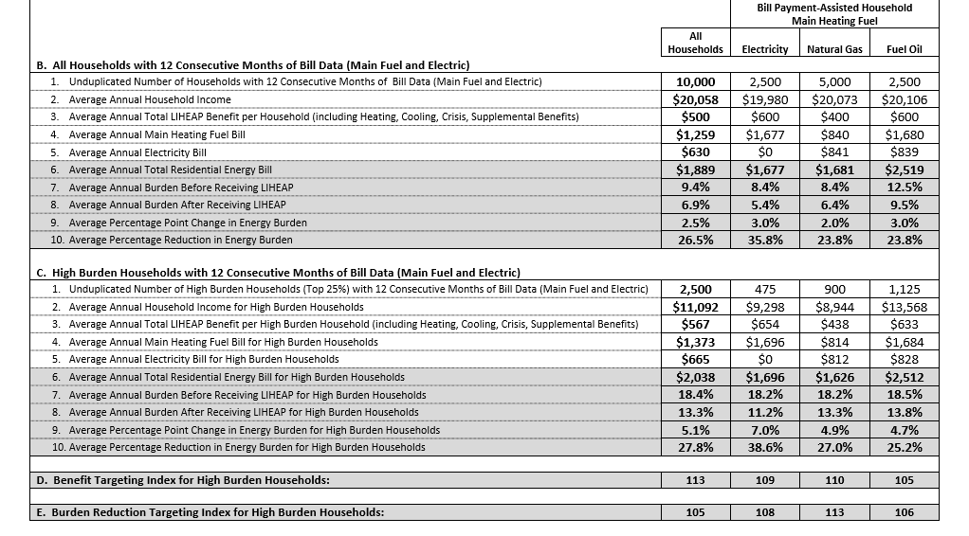
Performance Management Session I Session II and III—Scenario One

Slide 99
Performance Management Session I Session II and III—Scenario Two
State #2 - LIHEAP Benefit Matrix
Step #1 - Assign Main Heating Fuel Benefit
Electric Main Heat = $475
Natural Gas Main Heat = $475
Fuel Oil Main Heating = $575
Step #2 - Assign Income Adjustment
Income at or below Poverty - Multiply benefit by 1.1
Income Greater than 150% of Poverty - Multiply benefit by 0.9
Step #3 - Energy Expenditure Adjustment - Use Number of Bedrooms as a Proxy
2 bedrooms – Multiply benefit by 0.75
3 bedrooms – Multiply benefit by 1
4 bedrooms – Multiply benefit by 1.25
 | Main Heating Fuel
 | Electricity | Natural Gas | Fuel Oil
At or Below Poverty
Two bedrooms | $392 | $392 | $474
Three bedrooms | $523 | $523 | $633
Four bedrooms | $653 | $653 | $791
Poverty to 150% of Poverty
Two bedrooms | $356 | $356 | $431
Three bedrooms | $475 | $475 | $575
Four bedrooms | $594 | $594 | $719
Greater than 150% of Poverty
Two bedrooms | $321 | $321 | $388
Three bedrooms | $428 | $428 | $518
Four bedrooms | $534 | $534 | $647

Slide 100
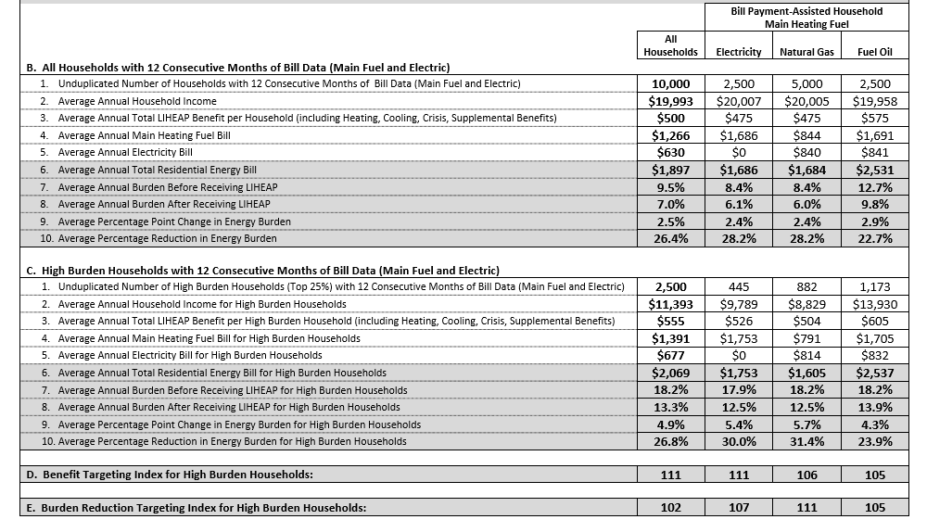
Performance Management Session I Session II and III—Scenario Two

Slide 101
Performance Management Session I Session II and III—Scenario Three

Slide 102
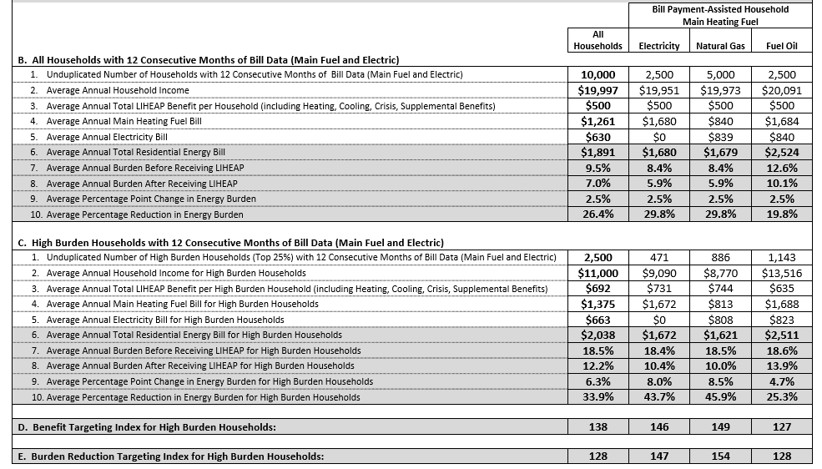
Performance Management Session I Session II and III—Scenario Three

Slide 103
Performance Management Session I Session II and III—Scenario Four

Slide 104
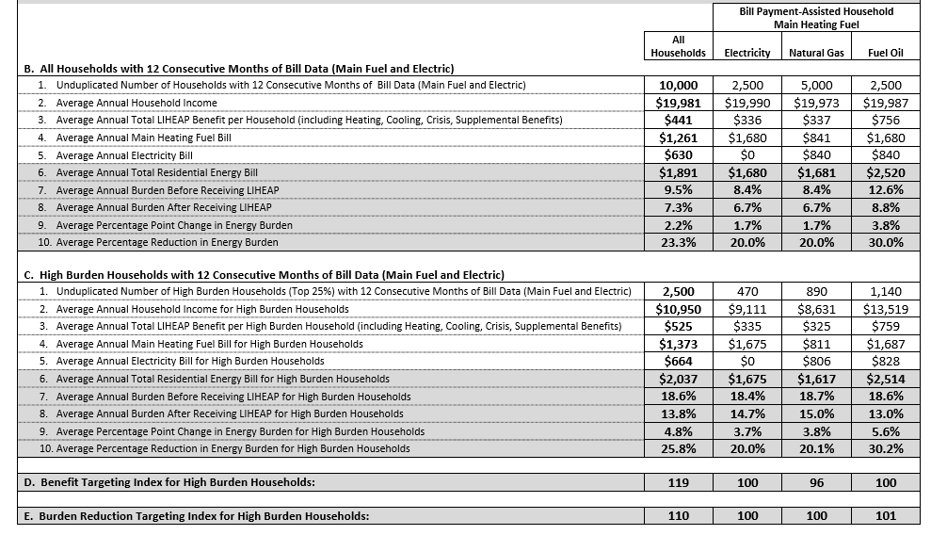
Performance Management Session I Session II and III—Scenario Four

Slide 105
Performance Management Session I Session II and III—Scenario Five

Slide 106
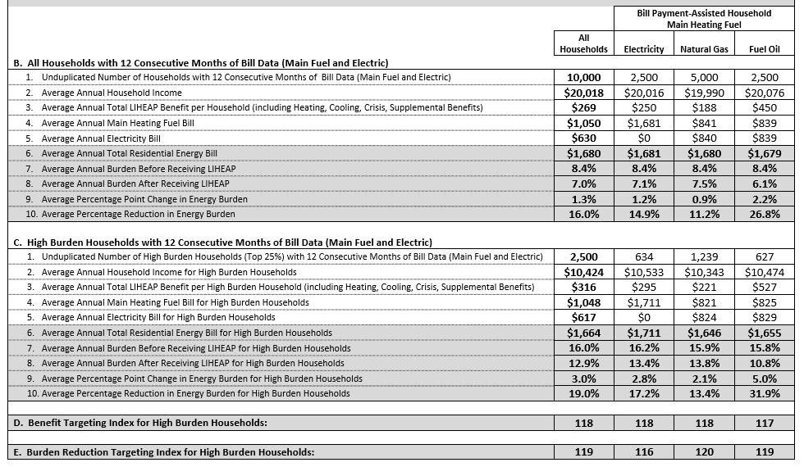
Performance Management Session I Session II and III—Scenario Five

