Slide 1
State Track: Performance Management
Melissa Torgerson
APPRISE

Slide 2
Objectives
Grantees will leave with a better understanding of:
The difference between Performance Measurement and Performance Management.
How to develop a Performance Management Framework.
Ways to use data for various aspects of Performance Management.
Resources available to help with Performance Management.

Slide 3
Agenda
Overview of Performance Management Framework
Performance Management Step One: Planning
Performance Management Step Two: Monitoring
Performance Management Step Three: Evaluation
Resources
Questions and Answers
3

Slide 4
Performance Measurement v. Performance Management
Performance measurement is the process of collecting and compiling data necessary to assess whether or not your program is doing what you intended it to do.
Performance management is the process of evaluating performance measurement data (both mandatory and voluntary), and then using this information to make informed program decisions.

Slide 5
Performance Management Process
The Performance Management Process uses information to facilitate continuous improvement over time.
PLANNING
Planning what we would like to happen. Periodically recalibrating based on new learning.
MONITORING
(Ongoing, Real-Time)
Regularly reviewing program processes and feedback. Course correcting as needed to assure program is meeting expected outcomes.
EVALUATION
Analyzing further to understand why we may or may not be on track to meet our expected outcomes.

Slide 6
Planning
Performance Management Framework Step One:
6
Notes:
15 minutes

Slide 7
LIHEAP Logic Model
To effectively manage your LIHEAP program, you need to act as if it is a new program that you are trying to design, implement, and evaluate.
You can start the Performance Management process by putting your program design into the Logic Model framework.

Slide 8
Performance Management: Planning
Logic Model components:
Problem Statement | What is the set of problems that the program is trying to address?
Inputs | What are the inputs to the program in terms of LIHEAP resources? Do leveraged funds also contribute to addressing the problem?
Outputs | What is the direct output from each service that is delivered?
Short-Term Outcomes | What target populations will be reached? What are the observable changes that you would expect to see as soon as each service is delivered?
Long-Term Impacts | What is the expected impact of the set of services that are delivered to clients? How will the client’s status will be changed as a result of the intervention?

Slide 9
Performance Management: Planning
You do not have to start from scratch to develop your LIHEAP logic model.
The Performance Measures Implementation Work Group (PMIWG) developed a comprehensive Logic Model for ALL LIHEAP components that you can adapt as you start the Performance Management process.
https://liheappm.acf.hhs.gov/sites/default/files/private/training/nat_training_2015/LIHEAP_Logic_Model.pdf

Slide 10
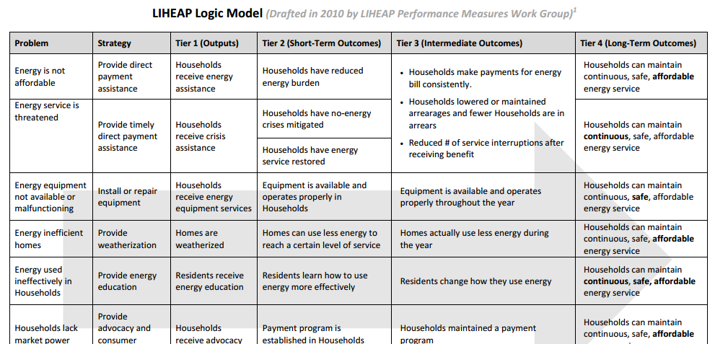
Performance Management: Planning

Slide 11
Performance Management: Planning
TIP: Do not start by proposing changes to the program. Start with an assessment of what the current program is already accomplishing.
In many states, the program purpose and design is documented, and data are available to assess the extent to which the program is actually achieving its stated purpose.
Most states have partially or fully integrated LIHEAP information systems that are used to manage their program and to report to HHS. In addition, HHS has made certain population data available for use by grantees in the Data Warehouse.

Slide 12
Performance Management: Planning
Problem Statement | What is the set of problems that the program is trying to address? |  | LIHEAP State Plan Eligible Population Data
Inputs | What resources are devoted to addressing the problem? |  | Performance Data Form Section I--Grantee Survey (Sources and Uses of Funds)
Outputs | What the direct output from each service that is delivered? |  | Performance Data Form Section I--Grantee Survey (Uses of Funds and Average Benefits) Household Report (Households Served)
Short-Term Outcomes | What target populations will be reached? What are the observable changes that you would expect to see as soon as each service is delivered? |  | Household Report (Vulnerable Household Targeting) Performance Data Form Section II--Performance Measures (Average Burden Reduction and Service Restoration)
Long-Term Impacts | What is the expected impact of the set of services that are delivered to clients? How will the client’s status will be changed as a result of the intervention? |  | Performance Data Form Section II--Performance Measures (Energy Burden Targeting and Service Loss Prevention)

Slide 13
Planning Example: Maryland
The new director of Maryland’s LIHEAP program needed to identify program goals (and a strategy to reach them).
He started by developing a logic model that reflects the current program design.
Now he is using existing LIHEAP data from federal reports, as well as information from his own state database, to identify additional potential strategies and outcomes.

Slide 14
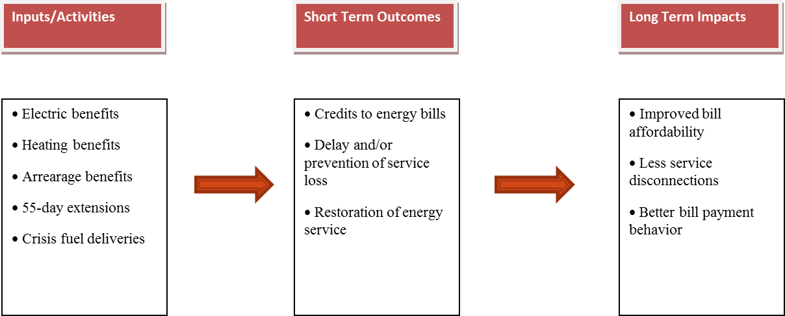
Planning Example: Maryland
Maryland started by creating a logic model that reflects current program design, strategies, and projected outcomes.

Slide 15
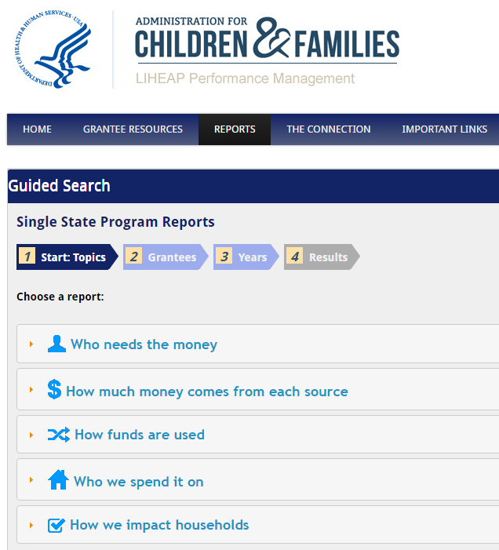
Planning Example: Maryland
To begin compiling his “current” logic model—Maryland used existing report data to understand how the state LIHEAP program has been structured over time.
The Data Warehouse on the LIHEAP Performance Management website compiles various grantee reports across multiple years.
Grantees can produce canned reports through the guided search, or can design ad hoc reports through the advanced search functions.

Slide 16
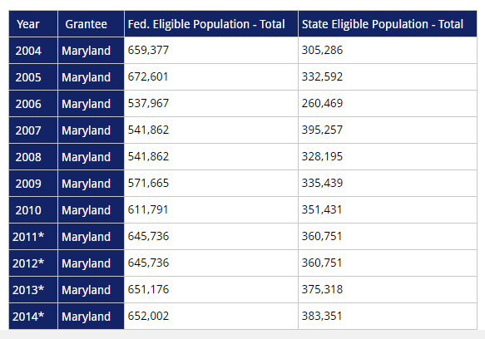
Planning Example: Maryland
Problem Statement: What is the need that the program is trying to address?
The data warehouse provides grantees with a historical overview of both the federally income eligible LIHEAP population and the state income eligible LIHEAP population.
The data for Maryland tells us that:
For the last five years, the federally income eligible LIHEAP population in Maryland has remained fairly static.
Maryland’s state income eligibility threshold for LIHEAP is lower than federal income eligibility guidelines. This means that in 2014, only the lower 60% of federally income eligible households could receive LIHEAP assistance in Maryland.

Slide 17
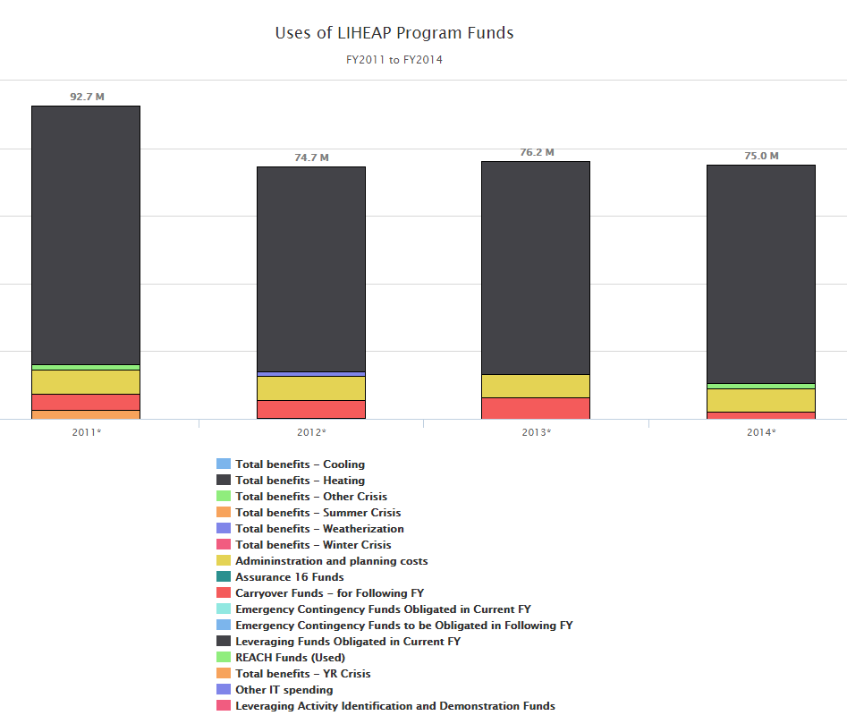
Planning Example: Maryland
Inputs: What resources are devoted to addressing needs?
The data warehouse provides grantees with a historical overview of program allocation and uses of funds.
The data for Maryland tells us:
Maryland does not currently allocate funding to Weatherization or Assurance 16 programs.
Maryland is currently devoting less funding to Winter Crisis benefits than in the past—however is now allocating resources to “Other Crisis” programs.

Slide 18
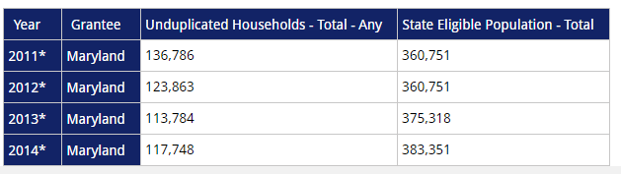
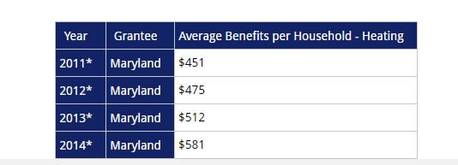
Planning Example: Maryland
Outputs: What is the direct output from each service that is delivered?
The data warehouse provides grantees with a historical overview of households served and average benefit levels.
The data for Maryland tells us:
Over the last four years, the percentage of state income eligible households served by LIHEAP has gradually decreased from 38% to 30%.
Between 2011 and 2014, the average household heating assistance benefit has gradually increased from $451 to $581. This is a 29% increase over the last four years.

Slide 19
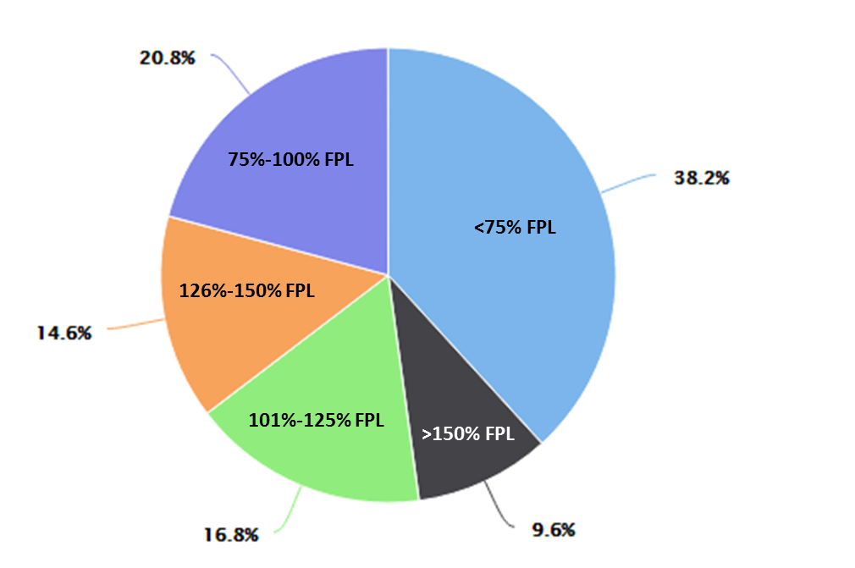
Planning Example: Maryland
Short Term Outcomes: What target populations will be reached? What are the observable changes that you would expect to see as soon as each service is delivered?
The data warehouse provides grantees with a historical overview of households served by federal poverty level (FPL).
The data for Maryland tells us:
In 2014, nearly 60% of LIHEAP assisted households in Maryland were at or below 100% Federal Poverty Level.
Households at higher percentages of FPL were served at much lower rates.
This would suggest that MD is targeting lower income households for participation.
FY 2014 Assisted Households by Percent
of Federal Poverty Level

Slide 20
Planning Example: Maryland
It is important for grantees to “ground-truth” LIHEAP report data based on unique aspects of their program and population served. This includes:
Data generated by local and state systems
Feedback from clients, subgrantees, vendors, and partners
Understanding of other influencing factors (leveraged $, state legislation)
For example, in addition to OCS reports, Maryland generated data from their state system identify additional areas for further research.

Slide 21
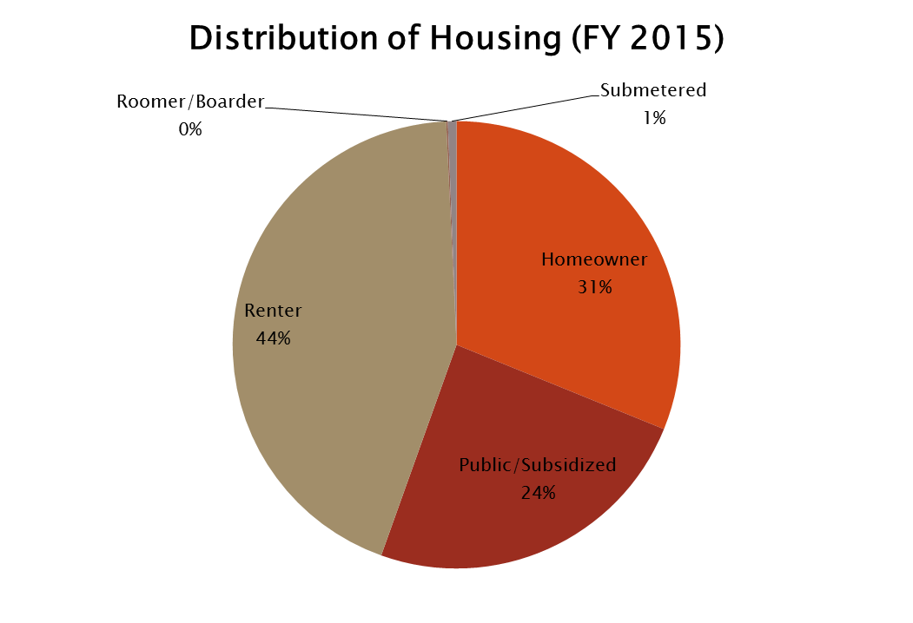
Planning Example: Maryland
Over 68% of LIHEAP Participants in MD are renters or live in subsidized housing.
How does energy usage or affordability vary among these groups?
How are benefits currently being targeted to meet household need across different housing types?
Does housing type impact delivery of services (e.g., public or rental housing and weatherization?)

Slide 22
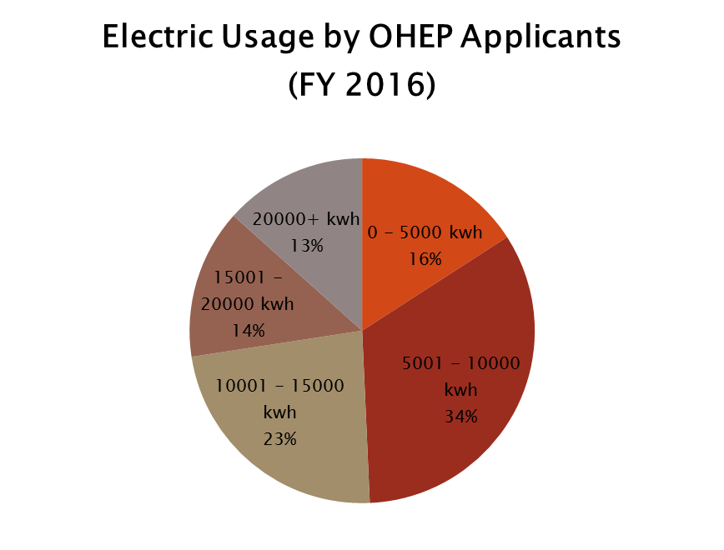
Planning Example: Maryland
Half of MD LIHEAP participants use over 10,000 kWh of electricity.
Is this consistent with fuel type? For example, do a large portion of LIHEAP households in Maryland use electric as primary heat?
Are those households using <5000 kWh keeping their homes at safe temperatures?

Slide 23
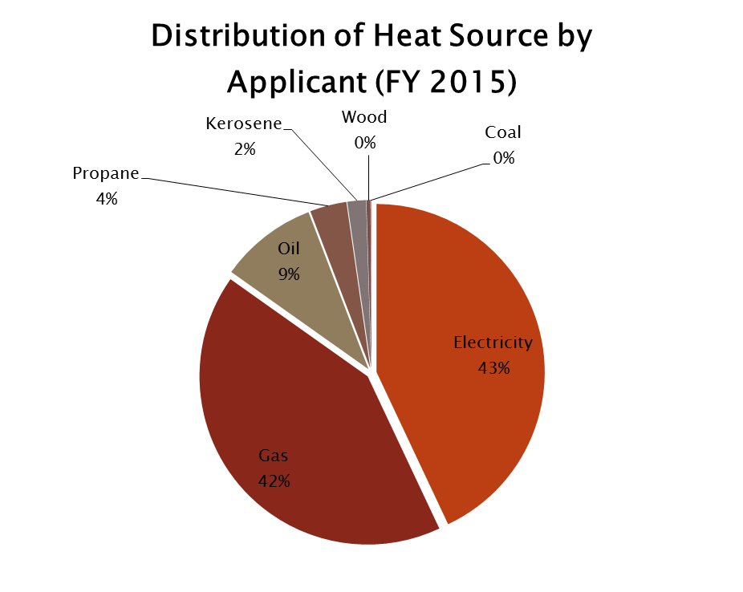
Planning Example: Maryland
Nearly 90% of Maryland LIHEAP households have electricity or gas as their primary heat source.
How can this data be combined with energy usage data (previous slide) to tell a more complete story?
For example, is high electric usage occurring in homes where natural gas is primary heat source? If so, is this a result of inefficient homes, equipment, usage or all three?

Slide 24
Performance Management: Planning
Reviewing existing data can help grantees 1) identify additional questions for research, 2) pinpoint need, 3) prioritize need, and 4) strategically design programs to meet that need. For example:
Before designing or implementing new strategies to address energy efficiency:
What are unique energy efficiency issues facing households across different housing types? Fuel types?
How is the grantee currently targeting services to meet these unique needs with their LIHEAP program?
How could grantee better target services to meet needs of various housing types? Fuel types?
Before designing or implementing new programs to reduce energy usage:
How can grantee use existing data (and new data) to identify “high energy consumption” households?
How can grantee do a better job of identifying cause of high usage (e.g., inefficient home, behavior, both)?
How can high usage households be linked to energy efficiency programs which target their specific need?
Before designing or implementing new strategies to encourage change in payment behaviors:
What payment patterns pose greatest challenge (e.g., arrearages, non-payment, inconsistent payments?)
Are payment issues disproportionately higher among particular groups (e.g., fuel type, housing type)?
How can strategies be prioritized or targeted based on specific payment issues grantee wish to address?

Slide 25
MONITORING
Performance Management Framework Step Two:
25
Notes:
15 minutes

Slide 26
Performance Management: Monitoring
When most people think of monitoring—they immediately think of compliance.
However, in Performance Management, ongoing monitoring of service delivery can help grantees:
Assess progress toward short term outcomes
Evaluate whether delivery process contributes to or deters from program objectives.
Identify unanticipated factors (internal or external).
Course correct as needed.

Slide 27
Performance Management: Monitoring
States monitor program processes in different ways. For example:
Applications received
Reflective of eligible households? Targeted households?
Spending
On target with state model plan?
Average Benefit
Higher or lower than previous years? Unexpected patterns?
Home Energy Status
Number of households already disconnected compared to those at risk?

Slide 28
Monitoring “Dashboard” Example
FY 2016 PROCESSED APPLICATIONS (to Date) |  | 40000
Applications by Vulnerable Pop | HH Count | % of All Applications | FY 2016 Target |  |  | FY 2015
Elderly | 4500 | 11.3% | ≥10% |  |  | 9.7%
Disabled | 3000 | 7.5% | ≥10% |  |  | 10.3%
Young Child | 17000 | 42.5% | ≥30% |  |  | 27%
Any Vulnerable | 20500 | 51.3% | -- |  |  | 41%
Applications by Income Level | HH Count | % of All Applications | FY 2016 Target |  |  | FY 2015
<75% Fed Poverty Level | 16000 | 40.0% | ≥40% |  |  | 32.3%
75-100% Fed Poverty Level | 12000 | 30.0% | ≥40% |  |  | 36.7%
101-125% Fed Poverty Level | 7000 | 17.5% | -- |  |  | 13.8%
126-150% Fed Poverty Level | 5000 | 12.5% | -- |  |  | 16.2%
> 150% Fed Poverty Level | 0 | 0.0% | -- |  |  | 1.0%
Applications by Home Energy Status | HH Count | % of All Applications | FY 2016 Target |  |  | FY 2015
Disconnected or Out of Fuel | 12750 | 32% | -- |  |  | --
Past Due, Shut-off Notice, or Nearly Out of Fuel | 15000 | 38% | > Disconnected/Out of Fuel |  |  | --
Spending By Program | HH Count | FY2016 Avg Benefit (to date) | FY2016 Total (to date)
Heating | 40000 | $350.00 | $ 14,000,000.00
Winter/Year-Round Crisis | 10000 | $500.00 | $ 5,000,000.00
Other Crisis | 2000 | $400.00 | $ 800,000.00

Slide 29
EVALUATION
Performance Management Framework Step Three:
29
Notes:
15 minutes

Slide 30
LIHEAP Performance Management
LIHEAP Performance Management makes use of the LIHEAP Logic Model to identify what the program intended to do.
LIHEAP Performance Measurement Data is used to assess how well you achieved intentions.
How can you use your LIHEAP Logic Model to identify the questions to be addressed with your Performance Measurement data?

Slide 31
LIHEAP Performance Measurement
Do not start by proposing changes to your information system. Start by mining your existing data to see what it can tell you about your program.
Consider how well the current and planned LIHEAP information systems capture the performance indicators needed to support LIHEAP Program Management.
LIHEAP Plan
Household Report
Performance Data Form Grantee Survey
Performance Data Form LIHEAP Performance Measures (planned)

Slide 32
Performance Management: Evaluation
Problem Statement
EXAMPLES
Energy is not affordable
Energy service is threatened
Energy equipment not available or malfunctioning
Energy inefficient homes
Energy used ineffectively in Households
Households lack market power
Shortage of or uncoordinated resources
Problem or Need Statement: Your program was designed to address a certain problem, or set of problems faced by your clients. To what extent do clients served by the program exhibit the problems that the program was designed to address?
Current Data: The current LIHEAP information system includes data regarding the eligible population in each state (using both federal and state eligibility thresholds).
Planned Data: Upcoming data collection will provide grantees with information on energy burden and service status for clients, and should enhance analysis of how well the services delivered align with client needs.

Slide 33
Performance Management: Evaluation
Input/Strategy
EXAMPLES
Inputs: You are allocating a certain share of your funds to each type of benefit. To what extent is your allocation of funds consistent with the needs of your clients?
Current Data: The current LIHEAP information system captures summary level information on inputs; the Grantee Survey reports on what funds you use to deliver each type of benefit. In combination with the Household Report, it tells you how much you invest in each client.
Planned Data: The planned data collection does not focus on the program inputs because they are already effectively captured by existing reports.
Provide direct payment assistance
Provide timely direct payment assistance
Install or repair equipment
Provide weatherization
Provide energy education
Provide advocacy and consumer education
Leverage resources

Slide 34
Performance Management: Evaluation
Output
EXAMPLES
Outputs: How many households are you serving with each type of benefit? How does that compare to the number of households that need services?
Current Data: The current LIHEAP information system captures summary level information on outputs; the Grantee Survey reports on the average benefit and the Household Report documents how many households you serve.
Planned Data: The planned data collection does not focus on outputs, since they are already effectively captured by the existing reports.
Households receive energy assistance
Households receive crisis assistance
Households receive energy equipment services
Homes are weatherized
Residents receive energy education
Households receive advocacy
Households receive additional resources

Slide 35
Performance Management: Evaluation
Short-Term Outcome
EXAMPLES
Short-Term Outcomes: What types of clients are served by the program? Is that consistent with what types of households are targeted by the program? Is the program serving the needs of the clients? Is the program changing conditions, behaviors, attitude, or knowledge of households as you anticipated?
Current Data: The current reporting system documents what types of households you serve. In combination with population data posted in the Data Warehouse by HHS, this allows you to document what share of households in need you are able to serve, and to determine whether those are consistent with your priorities.
Planned Data: The planned data collection and reporting enhances the outcome data available to LIHEAP grantees. It documents the baseline energy burden, the change in energy burden from all LIHEAP cash assistance, and the extent to which LIHEAP restores energy service or prevents loss of energy service.
Households have reduced energy burden
Households have no-energy crises prevented
Households have energy service restored
Homes can use less energy to reach a certain level of service
Residents use less energy during the year
Payment program is established in Households

Slide 36
Performance Management: Evaluation
Long-Term Impact
EXAMPLES
Program Impacts: Is the program moving clients in the direction of energy self-sufficiency? How could the set of program services and benefits be modified to enhance the effectiveness of the program in achieving that goal?
Measurement of program impacts requires collecting data for a group of clients who received a service and for a similar group of clients that did not receive the service, or received a different service.
The current and planned reporting systems DO NOT furnish data for impact evaluation. However, both furnish a framework for collecting program impact data.
Households maintain continuous home energy service
Households maintain safe home energy service
Households maintain affordable home energy service

Slide 37
Performance Management: Evaluation
Performance Management does not just happen.
Performance Management is Incremental. By focusing on available data, grantees can work to make incremental improvements in program performance. Experience suggests that those who use data for Performance Management develop the skills and resources over time to enhance their data systems and analysis skills.
Performance Management is Intentional. Many organizations set goals, make a plan, collect data, and even report or share data. However, Performance Management does not happen until time is taken to deliberately and systematically use the data. This includes analyzing information from all sources to design, develop, and re-design program plans.
Performance Management does not always result in change. Many people steer away from Performance Management because they believe their programs “are already doing a good job.” However systematically using data to evaluate your program can, in many cases, simply affirm that you are on the right track.

Slide 38
AVAILABLE RESOURCES FOR GRANTEES
38

Slide 39
Resources
Performance Management Website (including Data Warehouse)
https://liheappm.acf.hhs.gov/
LIHEAP Virtual Library
https://liheappm.acf.hhs.gov/assessment/#nbb
PMIWG Newsletter and Quarterly Conference Calls
If you are not already receiving the newsletter or information about conference calls, please contact Sherry Vogel at sherryv@ncat.org.
39

Slide 40
Resources
Access to Data Warehouse
Sherry Vogel at NCAT: sherryv@ncat.org
Assistance with the Data Warehouse
Kevin McGrath at APPRISE: kevin-mcgrath@appriseinc.org
Trayvon Braxton at APPRISE: Trayvon-Braxton@appriseinc.org
Assistance with Performance Management
Trayvon Braxton at APPRISE: Trayvon-Braxton@appriseinc.org
Melissa Torgerson at VERVE: melissa@verveassociates.net
40

Slide 41
Questions and Answers
41

Slide 42
LIHEAP Virtual Library
The next session is...
42

