Slide 1
The FY 2015 Performance Data Form Section I. Grantee Survey
Online Data Collection (OLDC) System
ACF LIHEAP Grantee Webinar
January 5th, 2016
Presenter
Melissa Torgerson (Verve Associates)
Trayvon Braxton (APPRISE)

Slide 2
Welcome
  Welcome and Introductions
  Leon Litow, OCS
  Webinar Speakers
    Melissa Torgerson, Verve Associates
    Trayvon Braxton, APPRISE
Presenter(s):
Leon Litow, Melissa Torgerson
2

Slide 3
Webinar Agenda
Introduction
SECTION 1: Completing the FY 2015 Performance Data Form in OLDC
SECTION 2: ‘Sources of Funds’ Part – Requirements & Common issues
SECTION 3: ‘Uses of Funds’ Part – Requirements & Common issues
SECTION 4: ‘Uses of Funds’ Part – Validation checks
FFY Performance Data Form Reporting Schedule
Resources
Questions
Presenter(s):
Melissa Torgerson
3

Slide 4
Introduction
What is the Performance Data Form?
OMB approved the Form in November of 2014.
The Form combines Grantee Survey and Performance Measures reporting into one report.
Three sections of the Form include:
Grantee Survey
Performance Measures
Optional Performance Measures.
Presenter(s):
Melissa Torgerson
4

Slide 5
Introduction
Reporting Requirements
For FY 2015—the Grantee Survey is the only required section. This must be completed by February 4, 2016.
This webinar will primarily focus on the Grantee Survey section of the Performance Data Form.
Performance Measure data is not required until FY 2016. However, grantees are encouraged to report any Performance Measure data that is available.
Presenter(s):
Melissa Torgerson
5

Slide 6
Section #1 – OLDC Access Interface
Previous webinars providing detailed instructions for OLDC access are located on the ACF website:
http://www.acf.hhs.gov/programs/ocs/resource/liheap-trainings
Presenter(s):
Trayvon Braxton
6

Slide 7
Section #1 – OLDC Access Interface
Reminder: OLDC Passwords must be changed every 60 days.
The Support Center provides assistance for OLDC customers.
Support team personnel are available Monday through Friday 8 a.m. to 6 p.m. ET
  app_support@acf.hhs.gov
  866-577-0771
Presenter(s):
Trayvon Braxton
7

Slide 8
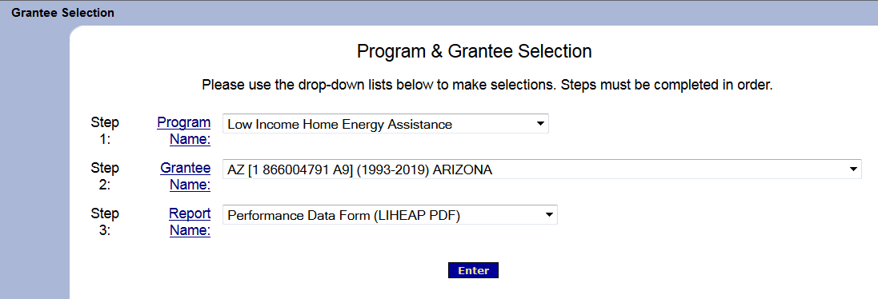
Section #1 – OLDC Access Interface
FY 2015 OLDC Access and Navigation for the Performance Data Form are the same as for FY 2014.
Grantees access the Performance Data Form by selecting the ‘Performance Data Form (LIHEAP PDF)’ and clicking ‘enter.’
Presenter(s):
Trayvon Braxton
8

Slide 9
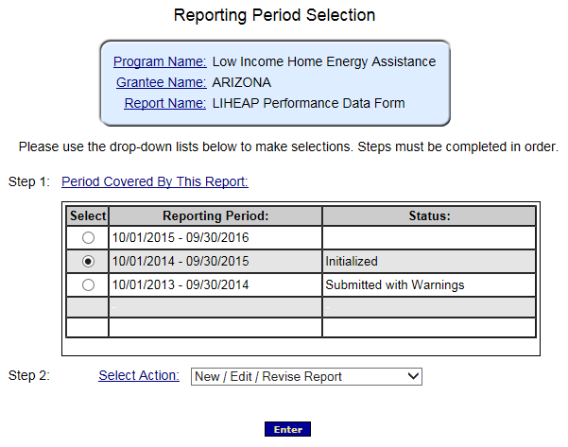
Section #1 – OLDC Access Interface: FY 2015
To access the FY 2015 report, please select the radial button for the FY 2015 reporting period.
Then, select “New/Edit/Revise Report” for Step 2 and click “Enter.”
Please contact your OCS liaison if your FY 2015 Report Form is not available for editing
Presenter(s):
Trayvon Braxton
9

Slide 10
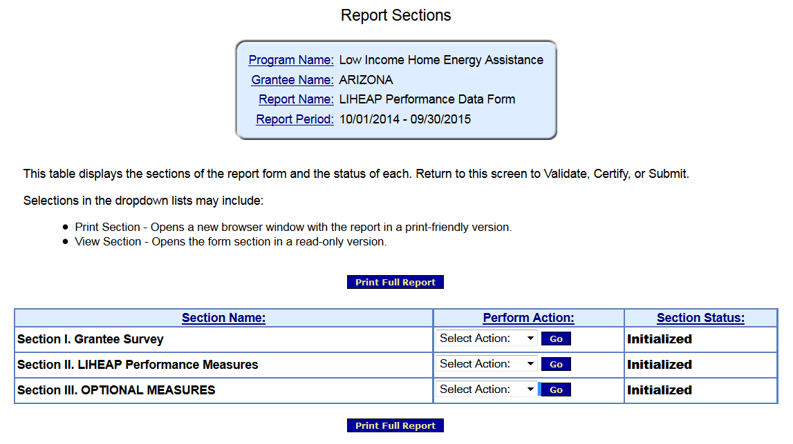
Section #1 – OLDC Access Interface
The Performance Data Form is split into three sections:
The Grantee Survey section – “Section I. Grantee Survey”
2. The Performance Measures section – “Section II. LIHEAP Performance Measures”
3. Optional Performance Measures Section – “Section III. OPTIONAL MEASURES”
Presenter(s):
Trayvon Braxton
10

Slide 11
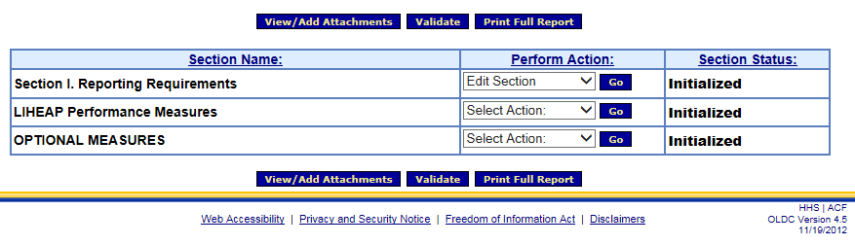
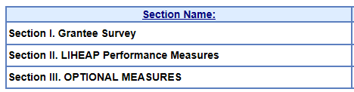
Section #1 – Completing the Grantee Survey
Only the Grantee Survey section of the Performance Data Form is required for FY 2015.
    The Performance Measures sections of the Performance Data Form are optional for FY 2015
The Grantee Survey section of the Performance Data Form can be accessed by selecting ‘Edit Section’ and then clicking ‘Go.’
Presenter(s):
Trayvon Braxton
11

Slide 12
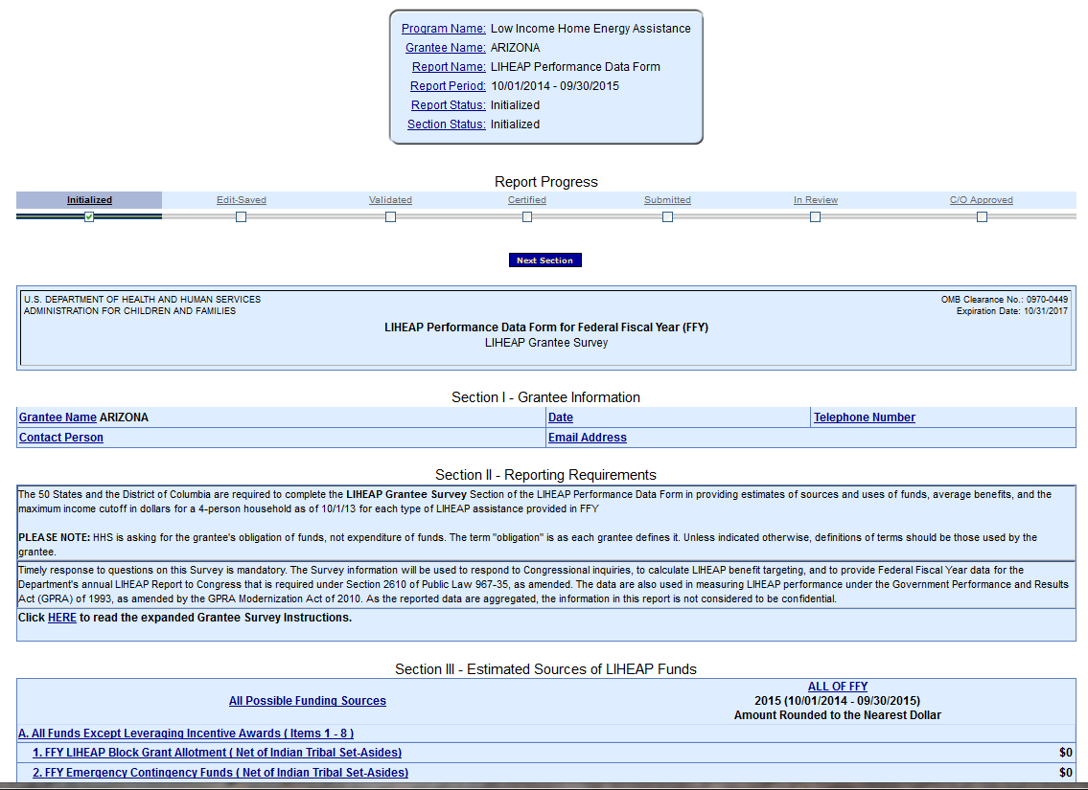
Section #1 – Completing the Grantee Survey
The following screen should appear. This is the Grantee Survey section of the Form.
Presenter(s):
Trayvon Braxton
12

Slide 13
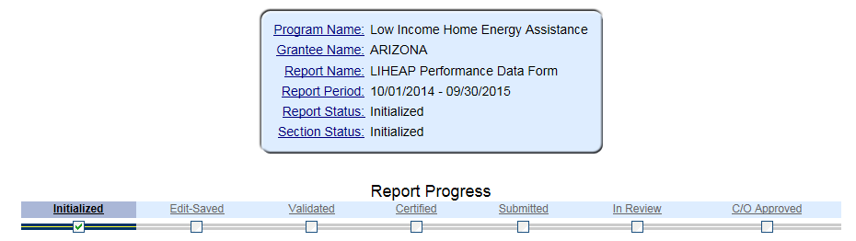
Section #1 – Data Submission and Review Procedures
This action will initialize the form
The form will now be available for editing. Please fill out, save, validate, certify, and submit the form.
Presenter(s):
Trayvon Braxton
13

Slide 14
Section #1 – Data Submission
Summary of Data Submission Process:
  Navigate to the FY 2015 Performance Data Form in OLDC.
  Select “New/Edit/Revise Report” to initialize the FY 2015 Performance Data Form .
  Fill out Section I. Grantee Survey
    Grantees should click “Save” to retain their recorded information.
  Click “Validate” – Run data validation checks and save data.
    NOTE: Validations will run on all sections of the Performance Data Form.
  Click “Certify” – Apply signature of authorizing agent to form.
  Click “Submit” – Submit form for OCS/APPRISE review
Presenter(s):
Trayvon Braxton
14

Slide 15
Section #1 – Data Submission and Review Procedures
FY 2015 Performance Data Form Review Process:
Following Grantees’ submission of their FY 2015 Performance Data forms, APPRISE will conduct a review of all Grantees’ forms to identify reporting issues requiring revision by grantees.
Once the items requiring revision have been confirmed with the Grantee’s LIHEAP office, the Grantee should make the appropriate revisions and re-submit its FY 2015 Performance Data form in OLDC.
Presenter(s):
Trayvon Braxton
15

Slide 16
Section #1 – Data Submission and Review Procedures
Submit – official submission to ACF
Form goes
forward
Certify – applies electronic signature
Form needs
editing
Validate – runs validation checks and updates automatic sums; saves data
Save - retains information
Presenter(s):
Trayvon Braxton
16
Notes:
Graphical overview of submission and revision process

Slide 17
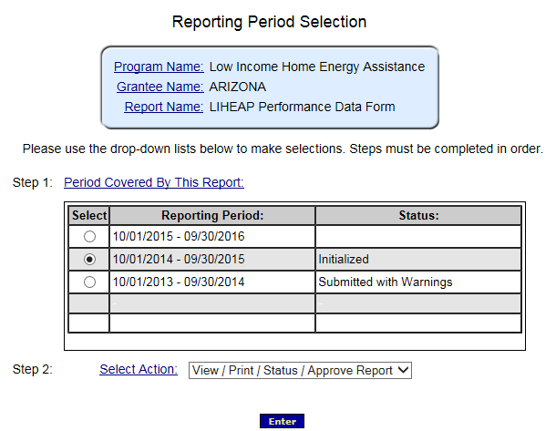
Section #1 – Data Revision and Re-Submission
FY 2015 Performance Data Form Revision Process:
In order to access a submitted report for editing, please select the radial button for the FY 2015 reporting period
Then, select “View/Print/Status/Approve Report” for Step 2 and click “Enter”
Please contact your OCS liaison if your FY 2015 Report Form is not available for editing
Presenter(s):
Trayvon Braxton
17

Slide 18
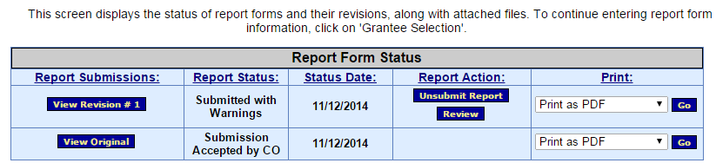
Section #1 – Data Revision and Re-Submission
The “Report Form Status” page will appear.
  Report Form Status: Contains button to View Original report or any Revisions, the Report Status, Status Date, Report Action, and Print option
  Click “Un-submit Report”
  Click “Edit Original”
  Click “Uncertify”
  The report will now be available for editing
1/12/2016
1/12/2016
Presenter(s):
Trayvon Braxton
18

Slide 19
Section #1 – Data Revision and Re-Submission
Summary of Data Revision and Re-Submission Process:
  Navigate to the FY 2015 Performance Data Form in OLDC.
  Select “View/Print/Status/Approve Report” to view the FY 2015 Performance Data Form “Report Form Status” page
  Click “Un-submit Report”
  Click “Edit Original”
  Click “Uncertify”
  Edit and Re-submit FY 2015 Performance Data Form
    Re-submit form using submission protocol outlined in previous slides.
Presenter(s):
Trayvon Braxton
19

Slide 20
Section #1 – Data Submission and Review Procedures
Submit – official submission to ACF
Form goes
forward
Certify – applies electronic signature
Form needs
editing
Validate – runs validation checks and updates automatic sums; saves data
Save - retains information
Presenter(s):
Trayvon Braxton
20
Notes:
Graphical overview of submission and revision process

Slide 21
Section #1 – OLDC Access Interface: View FY 2014 Report
During the completion of the FY 2015 Performance Data form, grantees may need to reference data from the FY 2014 Performance Data form.
Grantees may also wish to print off a copy of their FY 2014 Performance Data Form for reference.
Presenter(s):
Trayvon Braxton
21

Slide 22
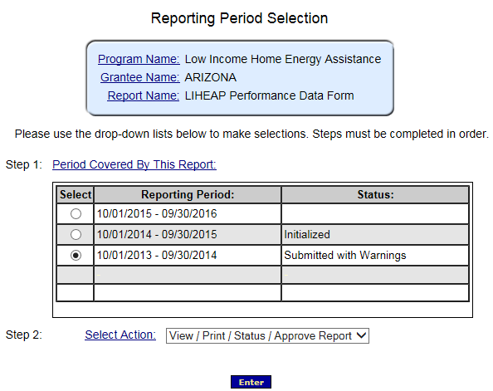
Section #1 – OLDC Access Interface: View FY 2014 Report
To view the FY 2014 report, select the radial button for the FY 2014 reporting period.
Then, select “View/Print/Status/Approve Report” for Step 2 and click “Enter.”
Presenter(s):
Trayvon Braxton
22

Slide 23
Section #1 – OLDC Access Interface: View FY 2014 Report
The “Report Form Status” page will appear.
  Report Form Status: Contains button to View Original report or any Revisions, the Report Status, Status Date, Report Action, and Print option
  View 2014 Report: Click “View Original” or most recent revision submitted by grantee under the “Report Submissions” column.
  Print 2014 Report: Click “Go” in the “Print” column.
Presenter(s):
Trayvon Braxton
23

Slide 24
Section #1 – Questions
Grantee Questions regarding accessing the FY 2015 Grantee Survey section of the Performance Data Form in OLDC?
Presenter(s):
Melissa Torgerson
24

Slide 25
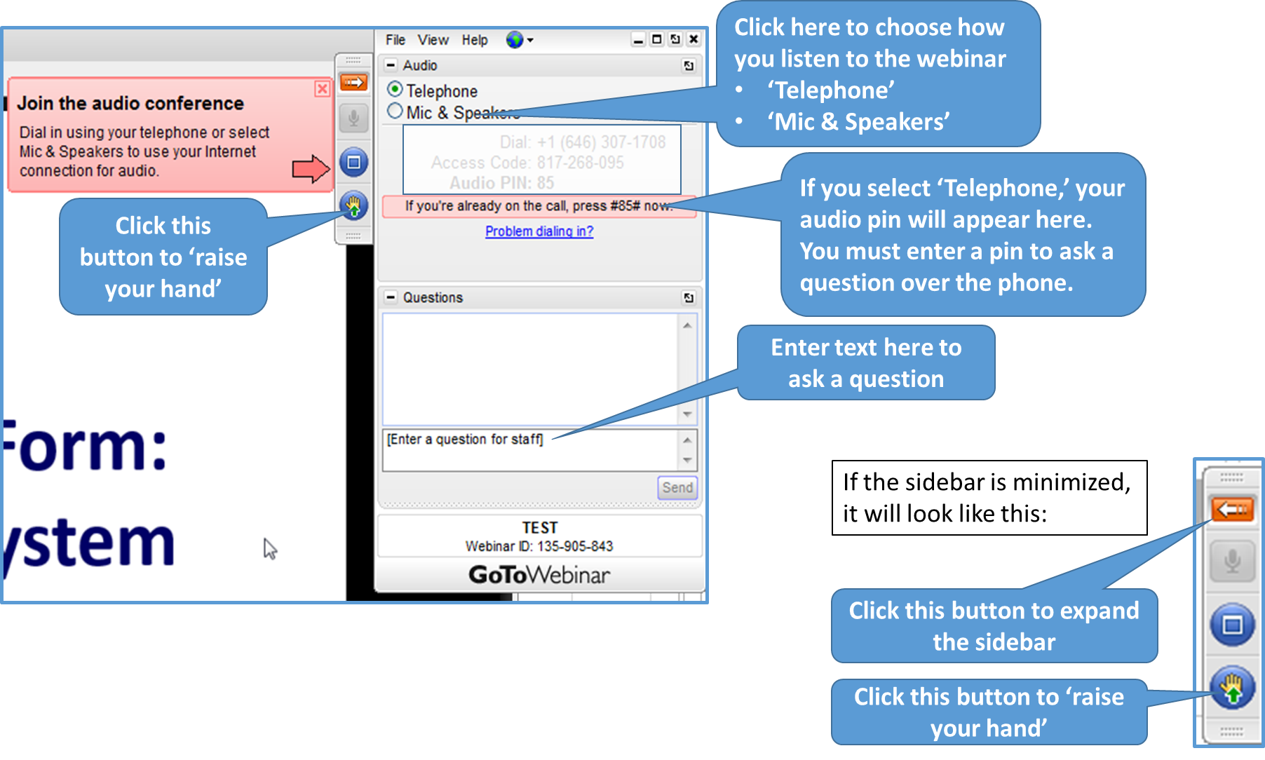
GoToWebinar – Asking a Question
25

Slide 26
Section #2: Sources of Funds
‘Sources of Funds’ Portion of the Grantee Survey Form
  Pre-Populated Data Fields
  Common Issues
  Carryover from FY 2014
Presenter(s):
Melissa Torgerson
26

Slide 27
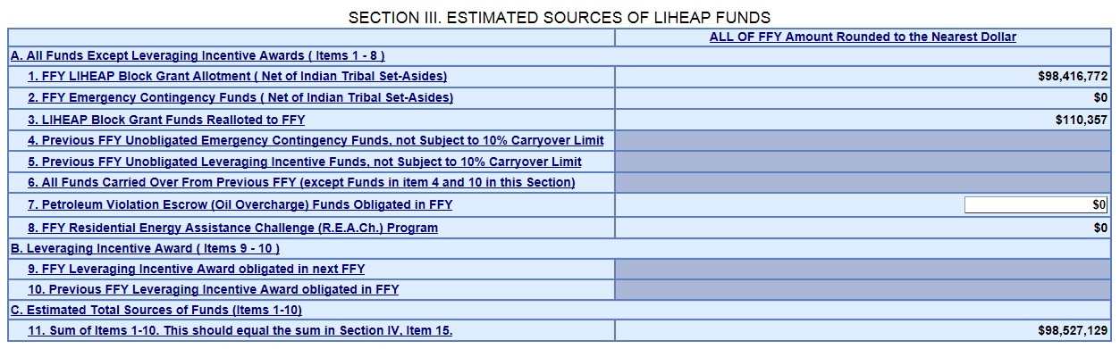
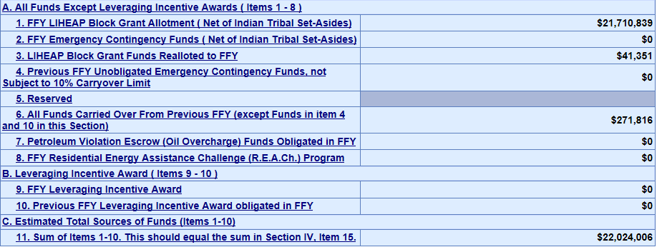
Section #2 – Pre-populated Data
  The Grantee Survey section of the Form will be populated with FY 2015 ‘Sources of Funds’ data, with the exception of Oil Overcharge funds.
Presenter(s):
Trayvon Braxton
27

Slide 28
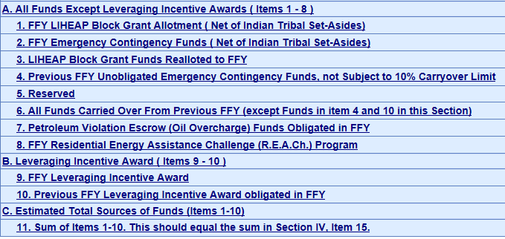
Section #2 – Pre-populated Data
Oil Overcharge and Carryover funds are available for editing in the Form
  Note: For FY 2015, Grantees’ pre-populated carryover amount (Section III, line 6) should reflect the carryover amount you reported in the FY 2014 Grantee Survey.
    If you believe that the pre-populated carryover value is incorrect please contact APPRISE prior to editing your FY 2014 Grantee Survey.
If you believe that other source values are incorrect, please contact your OCS liaison or APPRISE
Presenter(s):
Trayvon Braxton
28

Slide 29
Section #2 – Pre-populated Data: Carryover Funds
Prior to completing the Grantee Survey section of the FY 2015 Performance Data Form, APPRISE would advise grantees to first review their FY 2014 & FY 2015 Carryover and Re-allotment Reports to make sure they reflect the final values developed by your fiscal department.
      This will ensure that grantees’ reported carryover amounts match between their C&R Reports and FY 2015 Grantee Survey.
      This will also prevent follow-up contact from APPRISE.
Presenter(s):
Trayvon Braxton
29

Slide 30
Section #2 – Common Issues
Common issues with ‘Sources of Funds’
  The grantee did not draw down all available LIHEAP funds.
    The grantee should address this issue in the ‘Uses of Funds’ part of the form and the ‘Notes’ section.
  The grantee returned LIHEAP funds to the Federal Government.
    The grantee should address this issue in the ‘Uses of Funds’ part of the form and the ‘Notes’ section
Presenter(s):
Trayvon Braxton
30

Slide 31
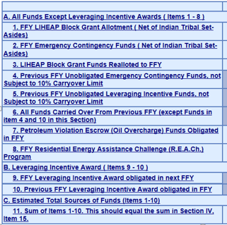
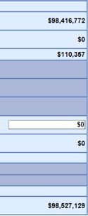
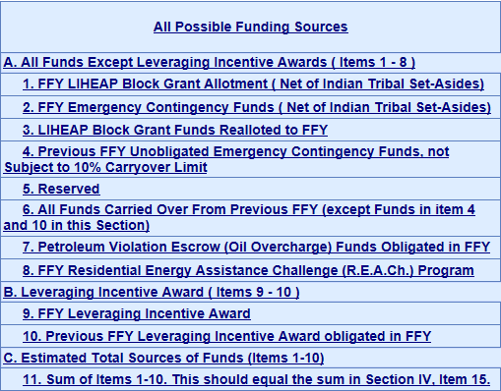
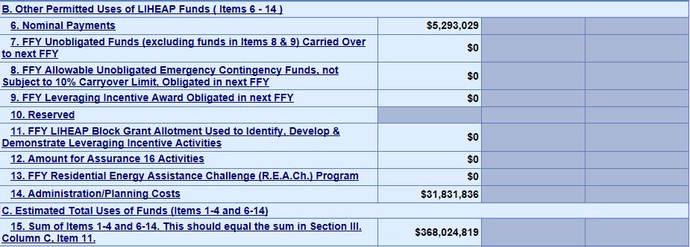

Section #2 – Carryover from FY 2014
Carryover from FY 2014
Data regarding unobligated funds carried over to FY 2015 in the FY 2014 Performance Data Form - Grantee Survey section need to match reports of carryover from FY 2014 in the FY 2015 Grantee Survey section of the Performance Data Form.
FY 2015 GS Section –
Sources of Funds
FY 2014 GS
31
Presenter(s):
Trayvon Braxton

Slide 32
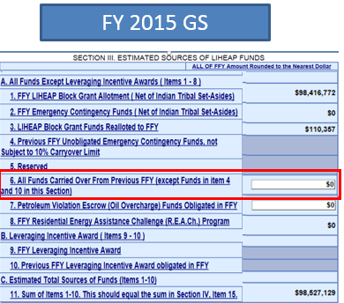
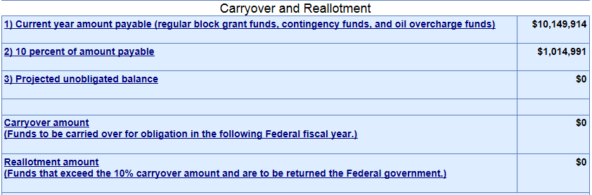
Section #2 – Carryover from FY 2014
The FY 2014 Carryover & Re-allotment report that grantees submitted August 1st, 2014 should match reports of carryover from FY 2014 in the FY 2015 Grantee Survey section of the Performance Data Form.
FY 2015 GS Section –
Sources of Funds
FY 2014 C&R Report
Presenter(s):
Trayvon Braxton
32

Slide 33
Section #2 – Carryover from FY 2014
Summary: Carryover from FY 2014
FY 2014 C&R Report
FY 2014 GS Section – ‘Uses’ of Funds
Pre-populated
FY 2015 GS Section – ‘Sources’ of Funds
Presenter(s):
Trayvon Braxton
33
Notes:
Overview of required consistency between FY 2014 to FY 2015 carryover amount reported in FY 2014 C&R Report, FY 2014 GS –’Uses’ of Funds, and FY 2015 GS–‘Sources’ of Funds

Slide 34
Section #2 – Carryover from FY 2014
Note: Carryover from FY 2014 should not include funds obligated in FY 2014 but not used until FY 2015.
Carryover amounts should only include unobligated FY 2014 funds.
Presenter(s):
Trayvon Braxton
34

Slide 35
Section #2 – Questions
Grantee Questions regarding the ‘Sources of Funds’ part of the Performance Data Form?
Presenter(s):
Melissa Torgerson
35

Slide 36
GoToWebinar – Asking a Question
36

Slide 37
Section #3: Uses of Funds
‘Uses of Funds’ Part of the Grantee Survey Form
Review of important items:
    Nominal benefits reporting
    Question 1: Obligation of funds
    Average benefit reporting
    Question 2: Average benefit calculation
    OPTIONAL: Average benefit by main heating fuel
  Common Issues
  Carryover to FY 2016
Presenter(s):
Melissa Torgerson
37

Slide 38
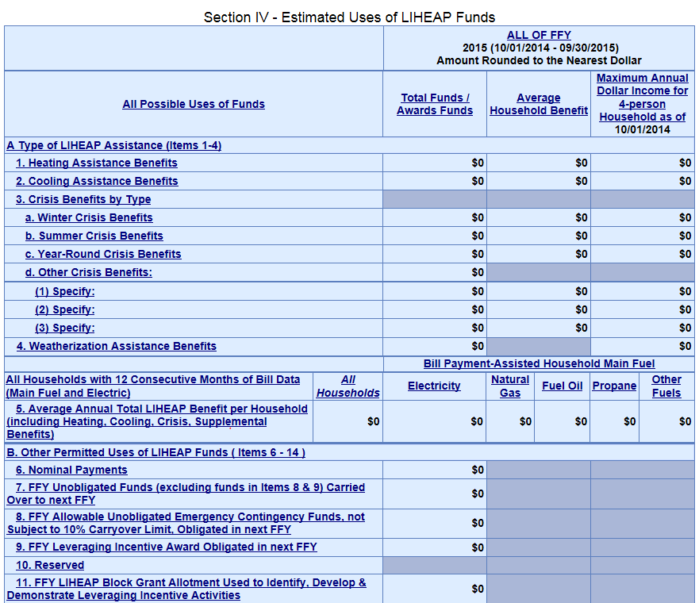
Section #3 – Nominal Benefits
Item #1: Nominal Payments
The Grantee Survey section of the Performance Data Form includes a separate field to capture nominal payments (any LIHEAP benefit $50 or less)
Grantees should report the total amount of funds obligated to nominal payments only in this line
Presenter(s):
Trayvon Braxton
38
Notes:
Nominal payment obligations should be consistent with nominal payment assisted households reported in grantee’s FY 2015 Household Report.

Slide 39
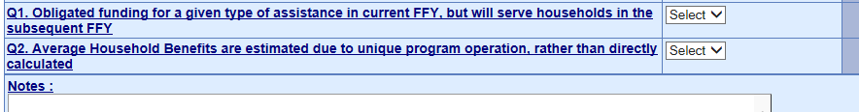
Section #3 – Question 1: Obligation of Funds
Item #2: Question 1 – Obligation of funds
The Grantee Survey section of the Performance Data Form includes a question to capture information on whether funds that were obligated in FY 2015 were not expended until the subsequent year (FY 2016).
Grantees should use the drop down menu in this field to select ‘yes’ or ‘no.’ Special cases should be described in the ‘Notes’ field at the end of the Form.
Presenter(s):
Trayvon Braxton
39

Slide 40
Section #3 – Average Benefit Reporting
Item #3: Average Benefit Reporting
The Grantee Survey section of the Performance Data Form includes a column in which grantees are to report on the “Average Household Benefit” for each type of LIHEAP benefit program operated by the grantee during the fiscal year.
  For FY 2015, if a grantee’s calculated average household benefit includes funds obligated for benefits other than bill payment assistance, the grantee should include a description of the benefit types included in its calculation in the Notes section.
Presenter(s):
Trayvon Braxton
40

Slide 41
  Section #3 – Question 2: Average Benefit
Item #4: Question 2 – Average Benefit Calculation
The Grantee Survey section of the Performance Data Form includes a question to capture whether the average benefit for one or more types of LIHEAP assistance was estimated, rather than directly calculated, due to difficulties in computing an average benefit because of unique program components.
Grantees should use the drop down menu in this field to select ‘yes’ or ‘no.’ Special cases should be described in the ‘Notes’ field at the end of the Form.
Presenter(s):
Trayvon Braxton
41

Slide 42
Section #3 – Average Benefit, by main heat
Item #5: Bill Payment-assisted average annual Total LIHEAP Benefit per household (including heating, cooling, crisis, and supplemental assistance) OPTIONAL FOR FY 2015
The Grantee Survey section of the Performance Data Form includes a line for grantees to report the bill payment-assisted average annual total LIHEAP benefit per household.
  Grantees should report the average annual total LIHEAP bill assistance benefit by Main Fuel Type.
  Grantees should only include households with 12 consecutive months of bill data (Main Fuel AND Electric) for this line.
Please note that these data are not required in FY 2015.
Presenter(s):
Trayvon Braxton
42

Slide 43
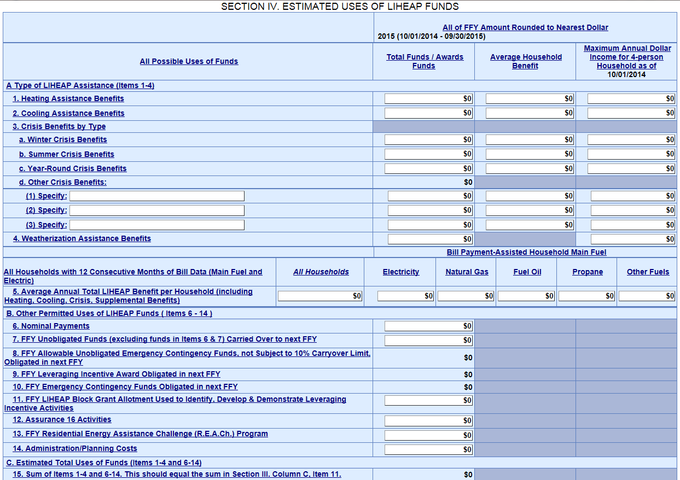
Section #3 – Average Benefit, by main heat
Bill Payment-assisted average annual Total LIHEAP Benefit per household (including heating, cooling, crisis, and supplemental assistance).
Presenter(s):
Trayvon Braxton
43

Slide 44
Section #3 – Common Issues
Common issues with ‘Uses of Funds’
  Reported “Maximum Annual Dollar Income for 4-person Household” threshold is inconsistent with Federal Poverty Guidelines or State Median Income Guidelines in effect at the start of the fiscal year.
    For FY 2015, reported amounts should reflect the 2014 HHS Poverty Guidelines or 2015 State Median Income Guidelines in effect on 10/1/2014.
  Note: If a Grantee’s LIHEAP program component began after the release of the 2015 HHS Federal Poverty Guidelines, the grantee may choose to use the 2015 Guidelines in its FY 2015 Grantee Survey reporting.
    If applicable, grantee should include a note of this in the ‘Notes’ section of the form.
Presenter(s):
Trayvon Braxton
44

Slide 45
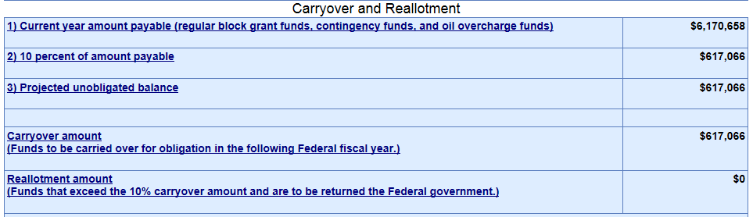

Section #3 – Carryover to FY 2016
The FY 2015 Carryover & Re-allotment report that grantees submitted December 1st, 2015 should match reports of carryover from FY 2015 in the FY 2015 Grantee Survey section of the Performance Data Form.
FY 2015 C&R Report
FY 2015 GS Section –
Uses of Funds
Presenter(s):
Trayvon Braxton
45

Slide 46
Section #3 – Carryover to FY 2016
Summary: Carryover to FY 2016
FY 2015 C&R Report
FY 2015 GS Section – ‘Uses’ of Funds
Presenter(s):
Trayvon Braxton
46
Notes:
Overview of required consistency between FY 2015 to FY 2016 carryover amount reported in FY 2015 C&R Report and FY 2015 GS–‘Uses’ of Funds

Slide 47
Section #3 – Questions
Grantee Questions regarding the requirements in the ‘Uses of Funds’ part of the Grantee Survey section?
Presenter(s):
Melissa Torgerson
47

Slide 48
GoToWebinar – Asking a Question
48

Slide 49
Section #4: ‘Uses of Funds’ - Validations
I. Current Validations in OLDC
  Comparison of Carryover Report to Grantee Survey
  Comparison of Household Report to Grantee Survey
  Comparison of FY 2014 Grantee Survey to FY 2015 Grantee Survey
  Comparison of ‘Sources of Funds’ and ‘Uses of Funds’
  II. Manual Validations by APPRISE
  Comparison of State Plan to Income Thresholds
  Comparison of State Plan to Grantee Survey
Presenter(s):
Melissa Torgerson
49

Slide 50
Section #4: Fatal Errors vs. Warnings
Fatal Error Messages versus Warning Messages
  Fatal Error Messages indicate inconsistent data that must be corrected before states are able to submit their Grantee Survey in OLDC
  Warning Messages indicate data that may be correct but requires confirmation through additional explanation in the “Notes” field of the form.
    Notes will prevent follow-up contact from APPRISE.
Presenter(s):
Trayvon Braxton
50

Slide 51
I. Current Validations in OLDC: Carryover Report Comparison
The Grantee Survey section of the LIHEAP Performance Data Form contains automated checks to compare FY 2015 Grantee Survey data with FY 2014 and FY 2015 Carryover & Re-allotment Report data.
  The amount of carryover reported from FY 2014 in the ‘Sources of Funds’ section of the FY 2015 Grantee Survey should match the carryover amount reported in the FY 2014 Carryover & Re-allotment report.
  The amount of carryover to FY 2016 reported in the ‘Uses of Funds’ section of the FY 2015 Grantee Survey should match the carryover amount reported in the FY 2015 Carryover & Re-allotment report.
  NOTE: If the two reports do not match, OLDC issues a WARNING
Example – next slide
Presenter(s):
Trayvon Braxton
51

Slide 52
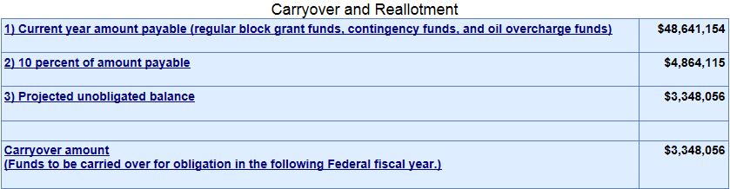
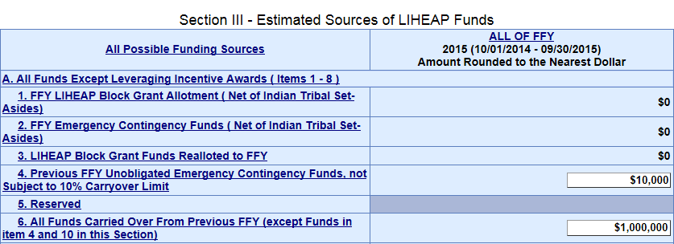

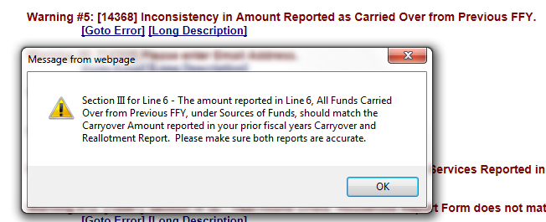
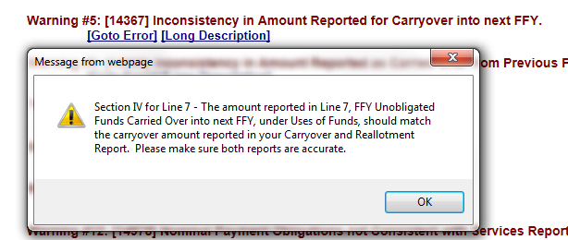

I. Current Validations in OLDC: Carryover Report Comparison
FY 2014 C&R Report
FY 2015 GS Section –
Sources of Funds
FY 2015 C&R Report
FY 2015 GS Section –
Uses of Funds
Presenter(s):
Trayvon Braxton
52

Slide 53
I. Current Validations in OLDC: Household Report Comparison
The Grantee Survey section of the LIHEAP Performance Data Form contains automated checks to compare FY 2015 Grantee Survey data with FY 2015 Household Report data.
  If a state obligates funds for a given assistance, then the state should have assisted households with that particular type of assistance
  If a state assists households with a given assistance, then the state should have obligated funds for that particular type of assistance
  NOTE: If the two reports do not match, OLDC issues a WARNING
Example – next slide
Presenter(s):
Trayvon Braxton
53

Slide 54
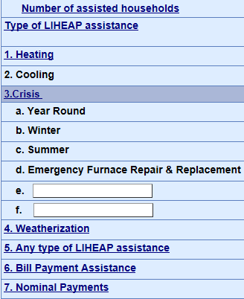
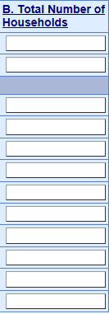
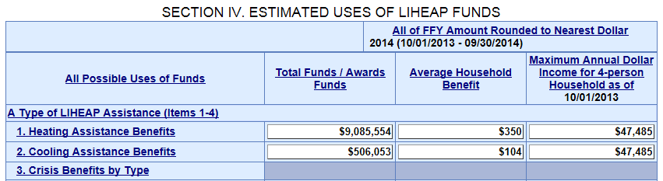
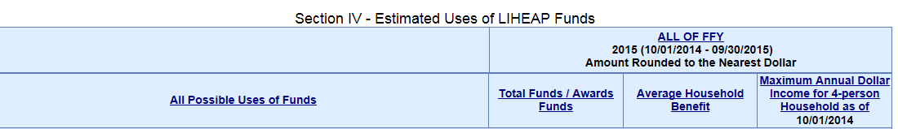
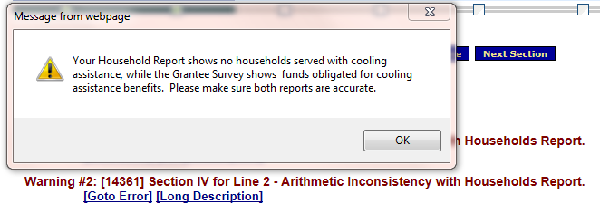
I. Current Validations in OLDC: Household Report Comparison
FY 2015 Household Report
FY 2015 Grantee Survey
22,000
Presenter(s):
Trayvon Braxton
54

Slide 55
I. Current Validations in OLDC: FY 2014 vs. FY 2015 Comparison
The Grantee Survey section of the LIHEAP Performance Data Form contains automated checks to compare FY 2014 Grantee Survey data with FY 2015 Grantee Survey data.
  If a state obligates funds for a given assistance in FY 2014, then the state should have obligated funds for that particular type of assistance in FY 2015.
  If a state obligates funds for a given assistance in FY 2015, then the state should have obligated funds for that particular type of assistance in FY 2014.
  NOTE: If the two reports do not match, OLDC issues a WARNING
Example – next slide
Presenter(s):
Trayvon Braxton
55

Slide 56

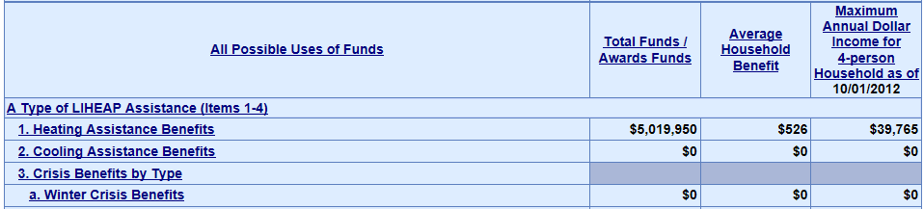
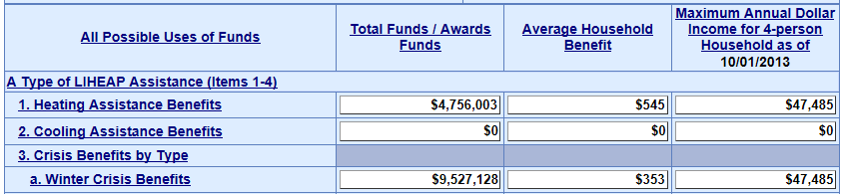
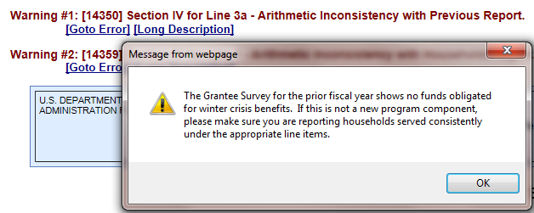
I. Current Validations in OLDC: FY 2014 vs. FY 2015 Comparison
FY 2014 Grantee Survey
FY 2015 Grantee Survey
Presenter(s):
Trayvon Braxton
56

Slide 57
I. Current Validations in OLDC: Sources of Funds vs. Uses of Funds
The Grantee Survey section of the LIHEAP Performance Data Form contains an automated check to compare a grantee’s reported total ‘Sources of Funds’ in Section III with its total ‘Uses of Funds’ in Section IV
  Grantees’ total ‘Sources of Funds’ (Section III: Line 11) should equal grantees’ total ‘Uses of Funds’ (Section IV: Line 15)
  NOTE: If the two line items do not match, OLDC issues a WARNING
Example – next slide
Presenter(s):
Trayvon Braxton
57

Slide 58
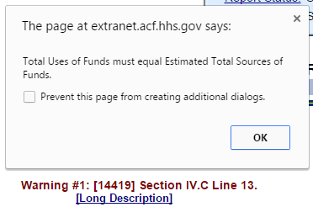
I. Current Validations in OLDC: Sources of Funds vs. Uses of Funds
FY 2015 GS Section –
Sources of Funds
FY 2015 GS Section –
Uses of Funds
$98,300,000
Presenter(s):
Trayvon Braxton
58

Slide 59
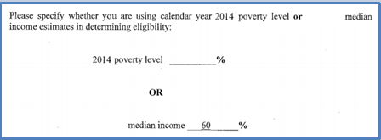
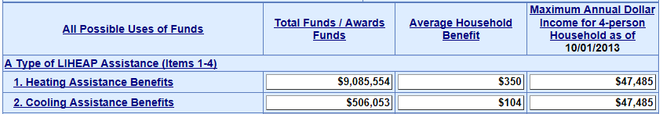
II. Manual Validations by APPRISE: State Plan Income Threshold Comparison
After states submit their Grantee Survey section of the Performance Data Form, APPRISE will compare reported income thresholds in the FY 2015 Grantee Survey to income thresholds reported in the FY 2015 State Plan.
Please be sure to report Income Thresholds using the Poverty Guidelines or State Median Income available at the beginning of the FFY.
- FY 2014 HHS Poverty Guidelines
- FY 2015 State Median Income
FY 2015
FY 2015
Presenter(s):
Trayvon Braxton
59

Slide 60
II. Manual Validations by APPRISE: State Plan Comparison
After states submit their Grantee Survey section of the Performance Data Form, APPRISE will also manually compare grantees’ FY 2015 State Plan data with their FY 2015 Grantee Survey data.
  If a state reports providing assistance for a particular type of assistance for FY 2015 in its State Plan, then the state should have obligated funds for that particular type of assistance in its Grantee Survey.
  If a state obligated funds for a given assistance in its Grantee Survey, then the state should have reported providing assistance for that particular type of assistance in its State Plan.
Example – next slide
Presenter(s):
Trayvon Braxton
60

Slide 61
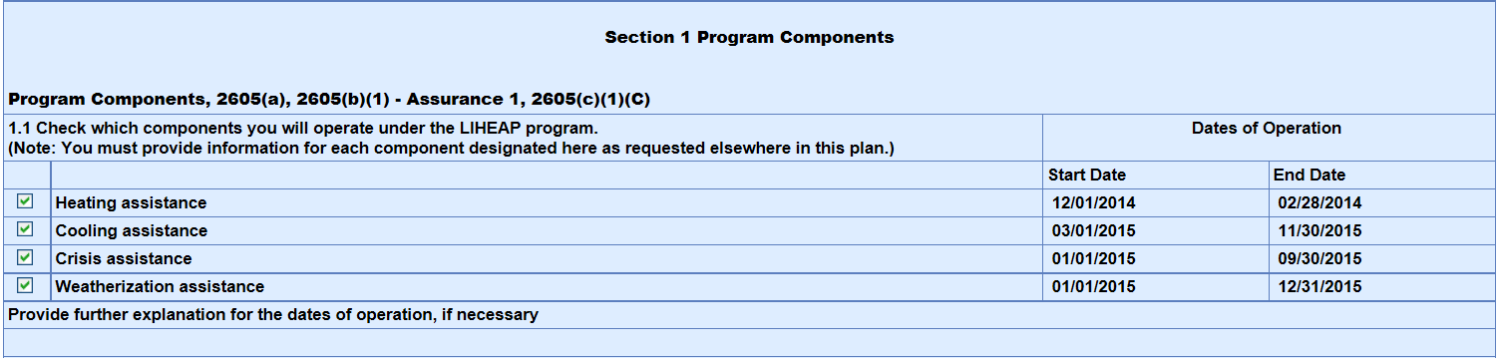
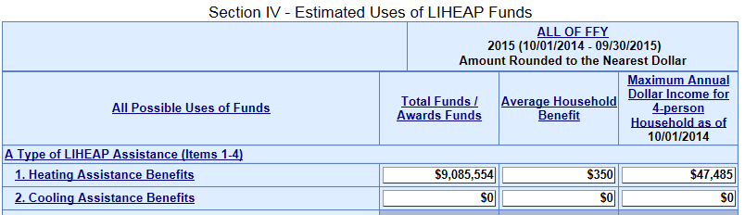
II. Manual Validations by APPRISE: State Plan Comparison
FY 2015 – Model Plan
FY 2015 – Grantee Survey
Presenter(s):
Trayvon Braxton
61

Slide 62
Section #4 – Questions
Grantee Questions regarding the validations in the ‘Uses of Funds’ part of the Grantee Survey section?
Presenter(s):
Melissa Torgerson
62

Slide 63
GoToWebinar – Asking a Question
63

Slide 64
Upcoming Reporting Deadlines
Final FY 2015 Household Report Data
  Submitted in OLDC on December 31th, 2015
FY 2015 Performance Data Form
  FY 2015 Grantee Survey data portion must be submitted in OLDC by February 4th, 2016.
  FY 2015 Performance Measures data portion is OPTIONAL for grantees to submit for FY 2015.
Presenter(s):
Melissa Torgerson
64

Slide 65
Resources: Grantee Support
OCS liaisons
  http://www.acf.hhs.gov/programs/ocs/resource/division-of-energy-assistance-federal-staff
OLDC Support Center
  app_support@acf.hhs.gov or 866-577-0771
APPRISE Team
  Trayvon Braxton, Trayvon-Braxton@appriseinc.org 609-252-9053
  Gina Talt, Gina-Talt@appriseinc.org 609-252-9052
  Melissa Torgerson, melissa@verveassociates.net
Presenter(s):
Melissa Torgerson
65

Slide 66
FY 2015 Performance Data Form – Questions
Grantee Questions?
Presenter(s):
Melissa Torgerson
66

Slide 67
GoToWebinar – Asking a Question
67

