Slide 1
LIHEAP Performance Measures
Data Collection
LIHEAP Grantee Webinar
March 31, 2016

Slide 2
Webinar Speakers
Melissa Torgerson
Verve Associates
Trayvon Braxton
APPRISE

Slide 3
Webinar Objectives
After this webinar, attendees will:
Know what data are required for each measure
Understand the procedures that must be implemented to collect required data
Know the timeline for Performance Measures data collection and reporting
Understand what LIHEAP Performance Measures resources are available

Slide 4
Introduction: Webinar Overview
  Section I: Energy Burden Measure Data Collection and Reporting
  What Data Do You Need? What are Some Issues related to this Data?
  Steps for Collecting the Data
  Section II: Restoration and Prevention Data Collection and Reporting
  What Data Do You Need? What are Some Issues Related to this Data?
  Steps for Collecting the Data
  Section III: Summary of Implementation Steps by Program Area
  Section IV : Timeline for Collecting and Reporting Performance Measures
  Section V : Performance Measures Resources

Slide 5
Introduction: Referenced Resources
LIHEAP Performance Measure Data Collection Guide
Overview: “LIHEAP Performance Measures Data Collection Guide”
Supplement: “Client Waiver”
Supplement: “Vendor Selection”
Supplement: “Vendor Agreement”
Supplement: “Vendor Data Exchange Templates”
Supplement: “Subgrantee Data Exchange Templates”
Supplement: “Criteria for Determining Service Restoration”
Supplement: “Criteria for Determining “At-Risk” Clients”
These resources will be available on the LIHEAP Virtual Library shortly after this webinar at: http://chdev.ncat.org.

Slide 6
Section I: Energy Burden Measures
Section I of this webinar focuses on LIHEAP Performance Measures related to Home Energy Burden. More specifically, this section hones in on the following questions:
What data do you need?
What are some of the issues related to this data?
What are the steps in collecting the data?

Slide 7
Section I: Energy Burden Measures
What Data Do You Need?
Data Required for Energy Burden Measures:
Main Heating Fuel Type (Application)
Average Annual Household Income (Application)
Average Annual LIHEAP Benefit (Management System)
Average Annual Household Main Heating Fuel Bill (Vendors)
Average Annual Household Electricity Bill (Vendors)

Slide 8
Section I: Energy Burden Measures
What Data Do You Need?
Main Heating Fuel Type. At the time of application, grantees will need to ask households to identify their main heating fuel type (Natural Gas, Electricity, Fuel Oil, Propane, or Other Fuels).
  Record the fuel that the client says they use most to heat their home; in some cases, this may not be the fuel where the benefit is applied (e.g., some grantees allow clients to assign their benefit to their electric company, even if they heat with natural gas).
  Cooling States and Main Heating Fuel Type. Grantees who offer cooling programs should still ask households for their main heating fuel type.

Slide 9
Section I: Energy Burden Measures
What Data Do You Need?
Average Annual Household Income. Annual household income should be calculated in the same way it is calculated for the annual LIHEAP Household Report Form, using gross income.
  Zero Income Households. Zero income households should also be included. States should record the energy burden for these households as 100% of household income.
  Grantees should calculate the annualized household income for LIHEAP clients. For example, states that do their income verification based on client’s 1-month income prior to application should multiply the household’s income by 12 to get their annual income.
  Categorically Eligible Households. Grantees who use categorical eligibility determination should still collect income information for these households.

Slide 10
Section I: Energy Burden Measures
What Data Do You Need?
Average Annual LIHEAP Bill-Payment Assistance Benefit. This includes the total LIHEAP bill payment assistance granted to the household during the reporting period.
  This includes heating, cooling, and crisis assistance (cash/bill-payment only).
  In some cases, the annual LIHEAP bill payment assistance benefit will include more than one type of assistance—for example regular + crisis.

Slide 11
Section 1: Energy Burden Measures
What Data Do You Need?
Average Annual Energy Bills for Main Heating Fuel. Grantees will need to collect annual household energy cost data for main heating fuel. Grantees should collect the amount billed by each vendor during the 12-month reporting period.
  The reporting period does not need to match the federal fiscal year.
  Need to collect 12 months of fuel data, but can collect at different times of year.
  Maine – Collects expenditure data from all Fuel Oil vendors in the Summer
  Texas – Collects expenditure data for households at time of intake
  Minnesota – Collects expenditure data for ALL households in July
  Arizona – Collects expenditure data for ALL households in November

Slide 12
Section 1: Energy Burden Measures
What Data Do You Need?
Average Annual Electric Bill. Grantees will need to collect annual household energy cost data for electricity. Grantees should collect the amount billed by each vendor during the 12-month reporting period. The reporting period does not need to match the federal fiscal year.
  It is important to look at the whole home energy bill for ALL clients, including cooling bills for households that are assisted with natural gas, propane, or fuel oil heating bills AND heating bills for clients that are assisted with cooling costs.

Slide 13
Section I: Energy Burden Measures
What Data Do You Need?
Questions

Slide 14
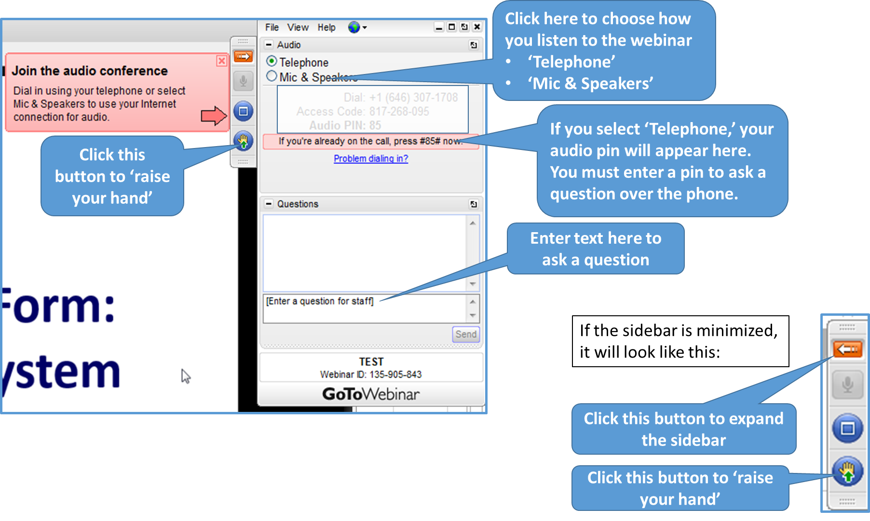
GoToWebinar – Asking a Question

Slide 15
Section I: Energy Burden Measure Data Collection
Steps for Collecting the Data
Steps you need to take for collecting Energy Burden data.

Slide 16
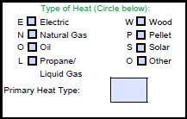
Section I: Energy Burden Measures
Steps for Collecting the Data
Add Main Heating Fuel Type to the Client Application. At minimum, this should include Natural Gas, Electricity, Fuel Oil, Propane, and “Other.”
  Clients who only receive a cooling assistance grant should still be asked for their main heating fuel.
  Clients who say that they do not heat their homes should be coded as having Electricity as their main heating fuel.
Examples:
State of Oregon Client Application (left)
State of Missouri Client Application (below)

Slide 17
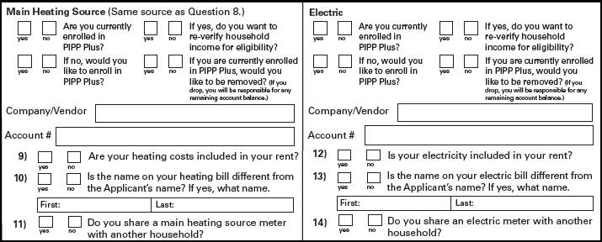
Section I: Energy Burden Measures
Steps for Collecting the Data
Add Vendor Account Numbers to Client Application for both Main Heating Fuel and Electricity. The grantee should collect expenditure data from both the client's main heating fuel vendor and their electric vendor, even if no benefit is paid on the electric account.
Example: State of Ohio

Slide 18
Section I: Energy Burden Measures
Steps for Collecting the Data
Add Waiver (Release of Information) to the Client Application. This will assure that data exchanges can occur once vendor agreements are in place. Due to increased privacy restrictions, it is important to involve both vendors and attorneys in the development of waiver language.
Considerations include the following:
Waivers should allow for release of both main fuel AND electricity data.
Waiver language should allow grantees to report the data to others.
Waiver language should protect the vendor from disclosure liability.
The following examples can be found in the "LIHEAP Performance Measures Data Collection Guide - Client Waiver Supplement."

Slide 19
Section I: Energy Burden Measures
Steps for Collecting the Data
Example #1: Waiver language that was added to a client application that did NOT have previous language.
Alabama
“I authorize my utility provider and/or my fuel supplier to disclose my customer data (including, but not limited to, energy cost, consumption and billing data) to the Alabama Department of Economic and Community Affairs for the purposes of verification, analysis and reporting.”
“I agree to hold harmless and/or release such companies from and against any claims, losses, demands, damages or liability of any kind caused by or allegedly caused by such disclosure.”
Notes:
Special Considerations: Some states’ client applications may not have existing waiver language while other states’ applications may have waiver language, but need additional language to meet required data reporting for performance measures. Choose the approach that best suites your state’s unique situation:

Slide 20
Section I: Energy Burden Measures
Steps for Collecting the Data
Example #2: Supplemental waiver language that was added to a client application that already had most of the necessary language for data collection.
New Mexico
“I understand that by providing the account numbers for my household energy supplier(s) I am authorizing the energy provider(s) to provide details about the account and energy use to HSD for the purposes of eligibility and determination of this and future applications, benefit determination, and program evaluation and analysis.”
“I understand that by providing application information I am authorizing HSD and its authorized agents to share and report the data provided against federal, state, county, energy provider, employer and landlord databases or records.”
“I understand the information collected on this form may be disclosed to energy programs operating under HSD. HSD may share and use information for purposes of referral, research, evaluation and analysis.”
“I understand that my utility companies will not have control over the data disclosed pursuant to this consent, and will not be responsible for monitoring or taking steps to ensure that HSD maintains the confidentiality of the data or uses the data as authorized.”

Slide 21
Section I: Energy Burden Measures
Steps for Collecting the Data
Example #3: Applications with waiver language that goes beyond data sharing for heating fuel and electricity, and also includes disclosure liability language.
Wisconsin
“I understand that by providing the account numbers for my household energy suppliers(s) I am authorizing the energy provider(s) to provide details about the account and energy use to the Wisconsin Department of Administration for the purposes of eligibility determination of this and future applications, benefit determination, and program evaluation and analysis including before and after receiving any weatherization services.”
Massachusetts
“I give the AGENCY and/or DHCD permission to obtain and share any data about my annual energy consumption, cost, usage data, utility charges, payment history and other account information from my primary and/or secondary heating and energy company(ies). I authorize the company(ies) to provide this information to the AGENCY and/or DHCD. I agree to hold the company(ies) harmless and release them from and against loss, demands, damages, or liability caused by such disclosure.”

Slide 22
Section I: Energy Burden Measures
Steps for Collecting the Data
Identification of Top Five/Top Ten Vendors. To reduce the burden associated with vendor data collection, grantees are only required to collect data from the largest vendors in their state. This includes the top five natural gas vendors, top five electric vendors, top ten fuel oil vendors (if applicable), top ten propane vendors, and top ten other fuel vendors (if applicable).
  How to identify the largest fuel vendors?
  Count the number of clients who heat/cool with that fuel.
  Among those clients, identify the five/ten fuel vendors that have the most clients.

Slide 23
Section I: Energy Burden Measures
Steps for Collecting the Data
OCS is expecting all states to collect data for all fuels used by LIHEAP clients. However, some states are facing challenges in working with vendors to establish agreements and information exchanges that may make it difficult for them to collect data for all fuels for FY 2016.
For any state facing those difficulties, APPRISE makes the following recommendations with respect to prioritization of fuels:
  Priority #1: Collect expenditure data for the fuel that represents the greatest share of home energy expenditures for low-income households.
  Priority #2: If electricity is not Priority #1, then collect electricity data as Priority #2.
  Priority #3: Attempt to cover at least 90 percent of clients by adding a third fuel.

Slide 24
Section I: Energy Burden Measures
Steps for Collecting the Data
Where do I get low-income home energy expenditure statistics for my state?
  APPRISE has developed an interactive Excel spreadsheet that gives you the needed information.
  https://liheappm.ncat.org/sites/default/files/private/training/L-I_Energy_Expenditure_Data_By_State.xlsx

Slide 25
Section I: Energy Burden Measures
Steps for Collecting the Data
Prioritization of Fuels Example: Iowa
We recommend that Iowa prioritize data collection from the state’s gas vendors, the fuel that represents the greatest share of home energy expenditures for low-income households in the state
We recommend that Iowa then work to collect electricity data for all clients
Finally, we recommend that Iowa attempt to collect data from the state’s LPG vendors since they also represent a large share of LIHEAP clients.
Fuel Type | Percent of Total Low-Income Household Expenditures for Heating/Cooling
Electric | 26.1%
Gas | 43.5%
Fuel Oil | 3.0%
LPG | 25.8%
Wood | 0.8%
Coal | 0.9%
TOTAL | 100%
Source: LIHEAP Allocation Formula

Slide 26
Section I: Energy Burden Measures
Steps for Collecting the Data
Prioritization of Vendors
OCS is expecting all states to collect data for the target number of vendors for each fuel. However, in some states, while the grantee is able to collect data for most of their clients from one or two vendors, they may face challenges with their smaller vendors.
  Example: One state has an electric company that serves 92 percent of all clients. The next four largest electric companies each serve about 1 percent of clients. While it was relatively easy for the state to get a vendor agreement and set up data exchange procedures for the largest company, the state had more challenges with the smaller electric vendors.

Slide 27
Section I: Energy Burden Measures
Steps for Collecting the Data
For any state facing this difficulty, APPRISE makes the following recommendations with respect to prioritization of vendors:
Electric Vendors - Attempt to collect data from five vendors or for the vendors that serve 90 percent of clients, whichever is less.
Natural Gas Vendors - Attempt to collect data from five vendors or for the vendors that serve 90 percent of the clients that use natural gas, whichever is less.
Delivered Fuel Vendors - For each delivered fuel, attempt to collect data from ten vendors or for the vendors that serve 50 percent of the clients that use that delivered fuel, whichever is less.

Slide 28
Section I: Energy Burden Measures
Steps for Collecting the Data
Special Exception 1: Fewer Vendors.
In some states, fewer than five companies serve LIHEAP clients. For example, in the District of Columbia, there is only one electric company and one natural gas company. In these cases, states do not need to meet the minimum requirements.
Special Exception 2: Fuels Not Used
In some states, certain listed fuels are not used. For example, in the District of Columbia, no clients use propane, while in Texas, no clients use fuel oil. In these cases, states do not need to meet the minimum requirements.
    More information can be found in the "LIHEAP Performance Measures Data Collection Guide – Vendor Selection Supplement."

Slide 29
Section I: Energy Burden Measures
Steps for Collecting the Data
Vendor Agreements. Work with targeted vendors to develop language that requires them to provide annual expenditures for LIHEAP recipients. The agreement should also include:
  Timeline for data collection
  Method of data exchange
  How the agency uses the data
  Client confidentiality
  Utility disclosure liability waiver

Slide 30
Section I: Energy Burden Measures
Steps for Collecting the Data
  In states where subgrantees are responsible for vendor agreements, one best practice is to create a “minimum standard” template in collaboration with major vendors at the state level that all subgrantees can adopt.
  Example Vendor Agreement language and more information is available in the "LIHEAP Performance Measures Data Collection Guide - Vendor Agreement Supplement.“

Slide 31
Section I: Energy Burden Measures
Steps for Collecting the Data
  Example #1: Alaska
As authorized by the client’s Heating Assistance Application for benefits, the Vendor shall provide, at no cost to HAP or the client, and within a timeframe specified by the Alaska HAP, a record of annual energy consumption in dollars and units of fuel/product, payment frequency, disconnection information, and arrearage amounts for the 12 month period of July to June. If the client has been a customer for less than 12 months, the Vendor will provide HAP with the requested data and notify HAP about the number of months that the data supports.
Vendor agrees not to disconnect service for at least 30 days after receiving any payment or verification of payment from the State of Alaska Heating Assistance Program.
The vendor agrees that all employees that have access to client information are required to sign a confidentiality statement.

Slide 32
Section I: Energy Burden Measures
Steps for Collecting the Data
Example #2: Massachusetts
Provide, at no cost to the Certified Customers, the Agency, DHCD, or their designees, the primary and secondary fuel and electricity data for Certified Customers, including the customer specific general energy usage data for the past 12 months collected by the Vendor. This may also include confidential information, pre- and post-weatherization services, if the Certified Customer had an arrearage and the amount, if the Certified Customer was enrolled in and/or successfully completed an arrearage forgiveness program, if the Certified Customer received at least one shut off notice or had their service shut off. The Vendor shall provide this data to the Agency and/or DHCD in a secured and timely manner, pursuant to the guidance issued by DHCD. This data may be used for a variety of program purposes including: Program planning, program capacity building, assessing the impact of LIHEAP and other home energy related benefits on low-income households and households with high energy burdens, and supporting funding decisions.
As authorized by the Certified Customer in his/her application for LIHEAP benefits, if requested by the Agency, the Vendor, at no cost to the Agency, shall provide, within a time frame specified by the Agency, a record of annual energy consumption, energy cost, payment frequency, disconnection information, and arrearage amounts for Certified Customers.

Slide 33
Section I: Energy Burden Measures
Steps for Collecting the Data
Developing Data Exchange Systems.
  Intake-Based Systems. Some grantees use energy bills as part of the benefit determination process. Some systems include:
    Automated Data Exchange: Automated information system; program database sends information to the vendor and the vendor’s information system sends information back to the program.
    On-Line Data Entry: Data request sent to vendor on a daily basis. Vendor enters client information on-line within a target time period.
    Subgrantee Access: Vendor gives subgrantee access to summary information about customers.
    Telephone Contact: Subgrantee calls vendor to obtain information.
  Year End Systems (Least-Burden). Some grantees collect information from vendors at the end of the program year.
    Excel File: Most vendors accepted an excel file with the required client information.
    Secure Transfer: Most vendors required a secure transfer protocol; FTP site or password protected or encrypted data.

Slide 34
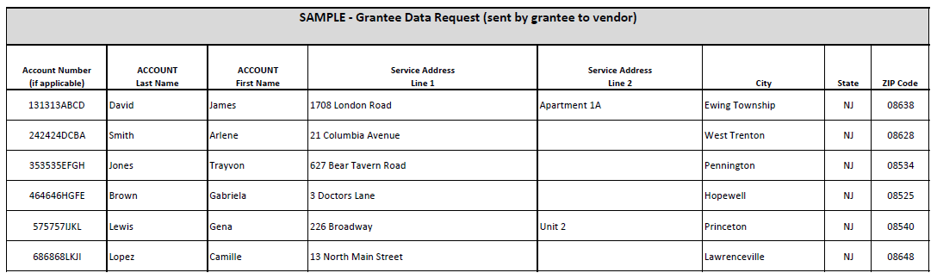
Section I: Energy Burden Measures
Steps for Collecting the Data
How can grantees request data?
Grantees may find it helpful to refer to the “LIHEAP Performance Measures Data Collection Guide—Vendor Data Exchange Templates” as they work with vendors to develop data exchange processes.

Slide 35
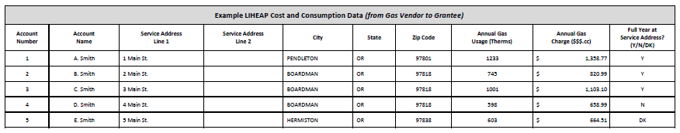
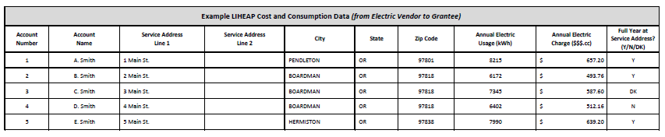
Section I: Energy Burden Measures
Steps for Collecting the Data
How can data be sent back to the grantee?
Natural Gas
Electric

Slide 36
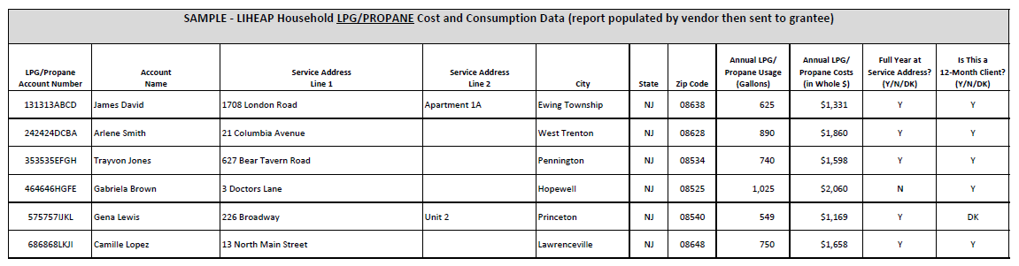
Section I: Energy Burden Measures
Steps for Collecting the Data
How can data be sent back to the grantee?
LPG/Propane

Slide 37
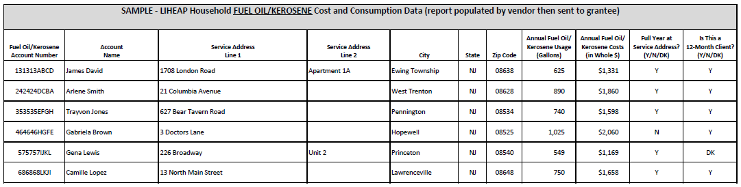
Section I: Energy Burden Measures
Steps for Collecting the Data
How can data be sent back to the grantee?
Fuel Oil/Kerosene

Slide 38
Section I: Energy Burden Measures
Steps for Collecting the Data
Questions

Slide 39
GoToWebinar – Asking a Question

Slide 40
Section II: Restoration and Prevention Measures
Section II of this webinar focuses on Performance Measures related to Restoration of Home Energy Service and Prevention of Loss of Home Energy. More specifically, this section hones in on the following questions:
What data do you need?
What are some of the issues related to this data?
What are the steps for reporting these data?

Slide 41
Section II: Restoration and Prevention Measures
What Data Do You Need?
Data needed for Restoration and Prevention Measures:
At the time of the application, was the Household without Home Energy Service?
At the time of the application, was the Household at “Imminent Risk” of Losing Home Energy Service?
If either without service or at “imminent risk”, to which energy source (e.g. electric, gas, fuel oil, propane) was the LIHEAP benefit applied?

Slide 42
Section II: Restoration and Prevention Measures
What Data Do You Need?
Status of Home Energy Service at Time of Application
    Household is without Energy Service. This includes whether a household is Disconnected, Out of Fuel, or has Inoperable Equipment.
    “Inoperable” includes red-tagged equipment, or equipment that if powered on, will result in injury or death.
    Note: Households that heat or cool their home in “some other way” still count if they can’t use their main system.
    For more information, including examples, please see "LIHEAP Performance Measures Data Collection Guide - Criteria for Determining Service Restoration.”

Slide 43
Section II: Restoration and Prevention Measures
What Data Do You Need?
Status of Home Energy Service at Time of Application
Household is at “Imminent Risk” of Losing Home Energy Service. This includes whether a household has a utility Past Due or Shut-Off Notice, is Nearly Out of Fuel, or has equipment that is still operable, but places them at imminent risk of losing their home energy service.
“Imminent risk” should be defined by the grantee based on local conditions, and should correspond with existing state definitions used to determine home energy emergencies (as outlined in the grantee’s State Plan and/or policy manuals).

Slide 44
Section II: Restoration and Prevention Measures
What Data Do You Need?
Energy Source
  Fuel type (Electric, Gas, Fuel Oil, Propane or Other) where the household LIHEAP benefit is applied. In some cases, this may not be the household’s primary fuel source.
  Example #1: If the household is at “imminent risk” of running out of propane for heating, the energy source is propane.
  Example #2: If the household has had their electric disconnected and cannot run their propane furnace, the energy source is electric.
  Example #3: If the household’s propane furnace is repaired or replaced, the energy source is propane.

Slide 45
Section II: Restoration and Prevention Measures
Steps for Collecting the Data
Steps you need to take for collecting Restoration and Prevention data.

Slide 46
Section II: Restoration and Prevention Measures
Steps for Collecting the Data
Check that you have policies in place to assure that a LIHEAP benefit was actually used to restore home energy or prevent home energy loss.
      If you want to report that a LIHEAP benefit restored home energy or prevented home energy loss, then you must have some assurance that the benefit was successful in restoring or preventing loss of home heating or cooling service.
      Most grantees have policies in place that would allow them to reasonably assume LIHEAP benefit restored home energy or prevented home energy loss. Examples include requiring copies of most recent billing at intake, or verifying account information with vendors before authorizing benefit.

Slide 47
Section II: Restoration and Prevention Measures
Steps for Collecting the Data
In some circumstances, collecting account status at the time of application may not be sufficient to report that the LIHEAP benefit successfully prevented home energy loss. Examples include:
Cases where a long period of time lapses between the application and benefit.
Cases where the benefit amount is not sufficient to prevent home energy loss or restore home energy.
In these cases, extra steps should be taken to assure accurate reporting of prevention and restoration performance measures.
For more information, see "LIHEAP Performance Measures Data Collection Guide - Criteria for Determining Service Restoration.”

Slide 48
Section II: Restoration and Prevention Measures
Steps for Collecting the Data
Determine your state’s criteria for “Imminent Risk.” In other words—when should a LIHEAP benefit be considered preventive? This criteria should correspond with your policy manuals and model plan.
  Some states simply ask applicants to self-declare whether or not they are “nearly out of fuel.” Others are more specific. For example:
Maine: Less than 3-day supply of fuel (e.g. reading of 1/8 tank or less on a standard 275 gallon heating oil tank; reading of 25% or less on a propane tank). “3-day or less” supply standard applies to other delivered fuel types.
Michigan: A residential fuel tank must not contain more than 25% of its heating fuel capacity.
  For more information, see "LIHEAP Performance Measures Data Collection Guide - Criteria for Determining At Risk Clients.”

Slide 49
Section II: Restoration and Prevention Measures
Steps for Collecting the Data
To determine when heating and cooling equipment pose an “imminent risk” of home energy loss--some grantees build upon health and safety criteria already used by weatherization subgrantees within their state.
Other factors may include:
Model, year and make of equipment
Whether equipment is listed on the obsolete furnace/equipment list
How the equipment tests in terms of performance
Anticipated failure (e.g., “in all likelihood will fail in the next 12-18 months”)
Whether equipment is legally banned (e.g., wood stove restrictions)
The following should not be counted as preventing “imminent risk” of home energy loss:
Operable equipment that is repaired or replaced strictly for energy efficiency gains.
Annual equipment tune-ups or filter changes.

Slide 50
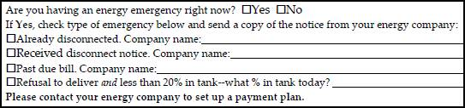
Section II: Restoration and Prevention Measures
Steps for Collecting the Data
Add Home Energy Status to Client Application.
Examples include Disconnected, Out of Fuel, Inoperable Equipment, Past Due, Shut-off Notice, Nearly Out of Fuel, Unsafe Equipment, etc.
Example: Minnesota Client Application

Slide 51
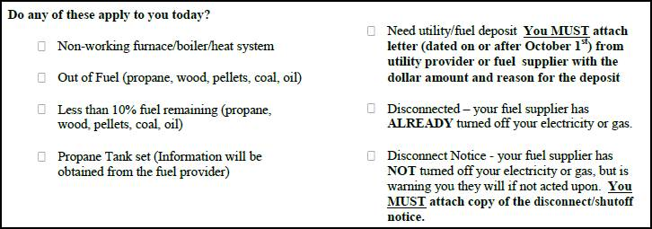
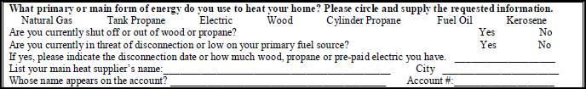
Section II: Restoration and Prevention Measures
Steps for Collecting the Data
Example: Wyoming Client Application
Example: Missouri Client Application

Slide 52
Section II: Restoration and Prevention Measures
Steps for Collecting the Data
Establish Equipment Repair and Replacement Criteria related to “Restoration and Prevention” with LIHEAP Weatherization Contractors and subgrantees.
In many cases, repair or replacement of heating/cooling equipment is administered by weatherization contractors. Therefore, grantees may need to coordinate with their Weatherization partners to establish criteria to determine when LIHEAP funds are used to restore home energy versus prevent home energy loss.
Coordinate Reporting of “Restoration and Prevention” with LIHEAP Weatherization Contractors.
This could be as straightforward as asking weatherization contractors to specify on invoices, work orders, or audit reports whether equipment repair/replacement is necessary to restore home energy or prevent home energy loss.

Slide 53
Section II: Restoration and Prevention Measures
Steps for Collecting the Data
Questions

Slide 54
GoToWebinar – Asking a Question

Slide 55
Section III: LIHEAP Performance Measures
Implementation Steps by Program Area
Section III of this webinar breaks out LIHEAP Performance Measurement implementation by key program area:
Client Applications
Data Systems
Vendor Partnerships
Policy and Coordination of Service Delivery

Slide 56
Section III: LIHEAP Performance Measures
Implementation Steps by Program Area
CLIENT APPLICATION
Add Main Heating Fuel Type to the Client Application. At minimum, this includes Natural Gas, Electricity, Fuel Oil/Kerosene, Propane, and Other.
Add Vendor Account Number Fields to Client Application for both Main Heating Fuel and Electricity.
Add or Modify Waiver (Release of Information) on Client Application. This will assure that data exchanges can occur once vendor agreements are in place.
Add Home Energy Status to Application. Includes disconnected, out of fuel, inoperable equipment, past-due or shut-off notice, nearly out of fuel, and other circumstances determined to be important.

Slide 57
Section III: LIHEAP Performance Measures
Implementation Steps by Program Area
DATA SYSTEMS
Develop Vendor Data Exchange Systems. This could start with sending a list of account numbers to utilities at year end to request data (via electronic spreadsheet) in return. Over time, capacity could increase for automated exchanges.
Data Reporting. Grantees have a variation of database systems. Over time, grantees can build capacity for data collection and reporting using a centralized system.

Slide 58
Section III: LIHEAP Performance Measures
Implementation Steps by Program Area
VENDOR PARTNERSHIPS
Identification of Top Vendors. Grantees will need to identify the largest 5 gas vendors, largest 5 electric vendors, largest 10 propane vendors, largest 10 fuel oil/kerosene vendors, and largest 10 other vendors within the state.
Vendor Agreements. This includes outlining expectations in terms of providing annual bill data, data exchange processes and timeline, as well as use of data.

Slide 59
Section III: LIHEAP Performance Measures
Implementation Steps by Program Area
Policy and Coordination of Service Delivery
Determine criteria for "service restoration." Determine how you will assure that the LIHEAP grant actually restored service.
Determine criteria for “imminent risk.” At-risk criteria should correspond with grantee’s existing policy manuals, state plan.
Establish Equipment Repair and Replacement Criteria related to “Restoration and Prevention” with LIHEAP Weatherization Contractors. This includes establishing when LIHEAP is used to restore home energy versus prevent home energy loss.
Coordinate Reporting of “Restoration and Prevention” with LIHEAP Weatherization Contractors. This includes asking contractors to specify on invoices, work orders, audits, or databases whether equipment repair or replacement actually restored service or prevented loss of service.

Slide 60
Section IV: LIHEAP Performance Measures
Timeline for Data Collection and Reporting
This section of the webinar provides a detailed timeline for implementing data collection and reporting of LIHEAP Performance Measures.
FFY 2015: Prepare for Data Collection
FFY 2016: Collect Data and Develop Reporting Systems
FFY 2017: Report FFY 2016 Performance Measures Data (January 2017) and Use Data for Performance Management.

Slide 61
Section IV: LIHEAP Performance Measures
Timeline for Data Collection and Reporting
FFY 2015: Prepare for Data Collection
  Engage Stakeholders
  Develop Policy
    Prevention and Restoration Measures
    Energy Burden Measures
  Engage IT Systems Departments
    Update Specifications
    Implement Applicant Processing Systems Updates
  Subgrantee Agreements - Update for FFY 2016
  Application Forms – Update for FFY 2016
  Vendor Agreements – Update for FFY 2016
  Weatherization Agency – Specification for Information Exchange

Slide 62
Section IV: LIHEAP Performance Measures
Timeline for Data Collection and Reporting
FFY 2016: Collect Data and Develop Reporting Systems
  Furnish Updates to Stakeholders
  Implement Policies
  IT Systems
      Develop Energy Data System Specifications
      Implement Energy Data System
      Update Reporting System Specifications
      Implement Reporting System Updates
  Application Forms
    Process Assessment
    Data Quality Review
  Subgrantee Training
  Vendor Data Exchange Development
  Weatherization Agency Data Exchange Development

Slide 63
Section IV: LIHEAP Performance Measures
Timeline for Data Collection and Reporting
FFY 2017: Report and Use (!!) Data
  Furnish Reports to Stakeholders
  Assess Policies
  IT Systems
    Data Exchange with Subgrantees / Vendors / Weatherization Agency
    Prepare Reports
  Subgrantee Data Exchange
  Vendor Data Exchange
  Weatherization Agency Data Exchange
  Use Performance Management Information

Slide 64
Section IV: LIHEAP Performance Measures
Timeline for Data Collection and Reporting
Questions

Slide 65
GoToWebinar – Asking a Question

Slide 66
Section V: Performance Measures Resources
Resources for Grantees
  Webinars
  LIHEAP Performance Measurement Data Collection Guide
  Performance Data Form and Instructions
  LIHEAP Performance Management Website
  Training and Technical Assistance Contacts

Slide 67
Section V: Performance Measures Resources
Webinars
FY 2015 Household Report
  https://www.youtube.com/watch?v=Z6gty6BSGVs
FY 2015 Performance Data Form
  https://www.youtube.com/watch?v=PtXQs8zewVs
Delivered Fuels
  https://liheappm.ncat.org/sites/default/files/private/training/webinars/DeliveredFuelVendorsPerformanceMeasuresData_061115.php

Slide 68
Section V: Performance Measures Resources
LIHEAP Performance Measure Data Collection Guide
Overview: “LIHEAP Performance Measures Data Collection Guide”
Supplement: “Client Waiver”
Supplement: “Vendor Selection”
Supplement: “Vendor Agreement”
Supplement: “Vendor Data Exchange Templates”
Supplement: “Subgrantee Data Exchange Templates”
Supplement: “Criteria for Determining Service Restoration”
Supplement: “Criteria for Determining “At-Risk” Clients”
These resources will be available on the LIHEAP Virtual Library shortly after this webinar at: http://chdev.ncat.org.

Slide 69
Section V: Performance Measures Resources
Performance Data Form and Instructions
  Performance Data Form Instructions
  https://www.acf.hhs.gov/sites/default/files/ocs/liheap_performance_data_form_instructions_2015.pdf
  Performance Data Form FAQ
    http://chdev.ncat.org/docs/LIHEAP_Performance_Measurement_FAQ.pdf

Slide 70
Section V: Performance Measures Resources
Performance Management Website
  https://liheappm.ncat.org/
  If you need assistance accessing the Performance Management website, please contact:
    Sherry Vogel
    sherryv@ncat.org

Slide 71
Section V: Performance Measures Resources
For more information, please contact:
  Trayvon Braxton
  APPRISE
  Trayvon-Braxton@appriseinc.org | 609-252-9053
  Melissa Torgerson
    VERVE
    melissa@verveassociates.net | 503-706-2647

Slide 72
Section V: Performance Measures Resources
Questions

Slide 73
GoToWebinar – Asking a Question

