Slide 1
LIHEAP Performance Measures
Data Reporting
LIHEAP Grantee Webinar
September 8, 2016

Slide 2
Webinar Speakers
David Carroll
APPRISE
Trayvon Braxton
APPRISE
Kevin McGrath
APPRISE

Slide 3
Introduction: Webinar Overview
  Section I: Filing Requirements
  Section II: Completing the Energy Burden Measures Section
  Topic 1 – Bill Payment Assistance Households
  Topic 2 – High Burden Households
  Topic 3 – Targeting Indices
  Section III: Completing the Restoration and Prevention Measures Section
  Restoration Measures
  Prevention Measures
  Section IV: Performance Measures Resources
  Using the data form
  PM Resources

Slide 4
Section I: Filing Requirements
The Following sections of the Performance Data Form are required for FY 2016:
  Section I – Grantee Survey
  Section II – LIHEAP Performance Measures
  Note: Section III – Optional Measures [optional for FY 2016]
Submission Deadline: January 31, 2017
This webinar will primarily focus on the reporting requirements for the LIHEAP Performance Measures section of the Performance Data Form.

Slide 5
Performance Measures – Data Collection
For detailed information on Performance Measures data collection for the new mandatory LIHEAP Performance Measures, please refer to the following resources available on the LIHEAP Performance Management Website.
PM Data Collection Webinar
  https://liheappm.acf.hhs.gov/sites/default/files/private/training/pm_webinar/PM_Data_Collection_Webinar_033116.mp4
LIHEAP Performance Measure Data Collection Guide
  https://liheappm.acf.hhs.gov/sites/default/files/private/training/pm_webinar/LIHEAP-PM-Data-Collection-Guide_July2016.docx

Slide 6
Section II: Completing the Energy Burden Measures Section Overview
Energy Burden Section – Overview
The Energy Burden Section consists of the following three sections:
Section A – All Bill Payment Assistance Clients
Section B – All Bill Payment Assistance Clients with complete heating AND electric expenditures for the targeted 12-month period
Section C – High Burden Bill Payment Assistance clients with complete heating AND electric expenditures for the targeted 12-month period

Slide 7
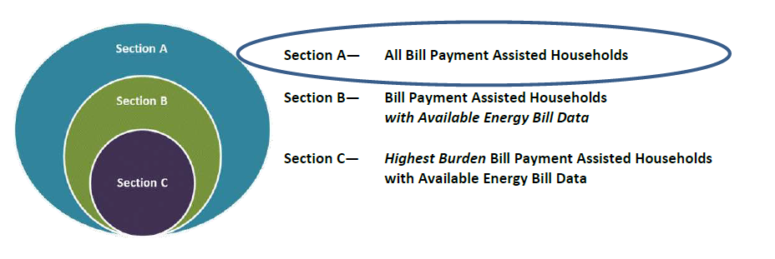
Section II: Completing the Energy Burden Measures Section Overview
Energy Burden Section – Overview
Section A – All Bill Payment Assistance Clients

Slide 8
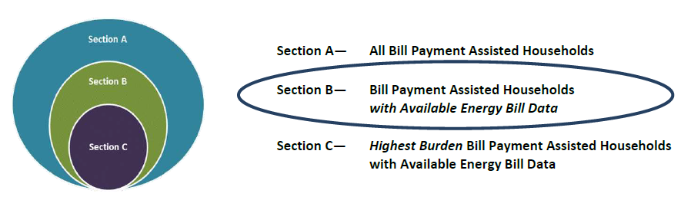
Section II: Completing the Energy Burden Measures Section Overview
Energy Burden Section – Overview
Section B – All Bill Payment Assistance Clients with complete heating AND electric expenditures for the targeted 12-month period

Slide 9
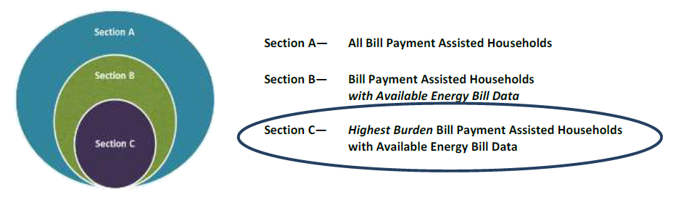
Section II: Completing the Energy Burden Measures Section Overview
Energy Burden Section – Overview
Section C – High Burden Bill Payment Assistance clients with complete heating AND electric expenditures for the targeted 12-month period

Slide 10
Section II: Completing the Energy Burden Measures Section Overview
Questions

Slide 11
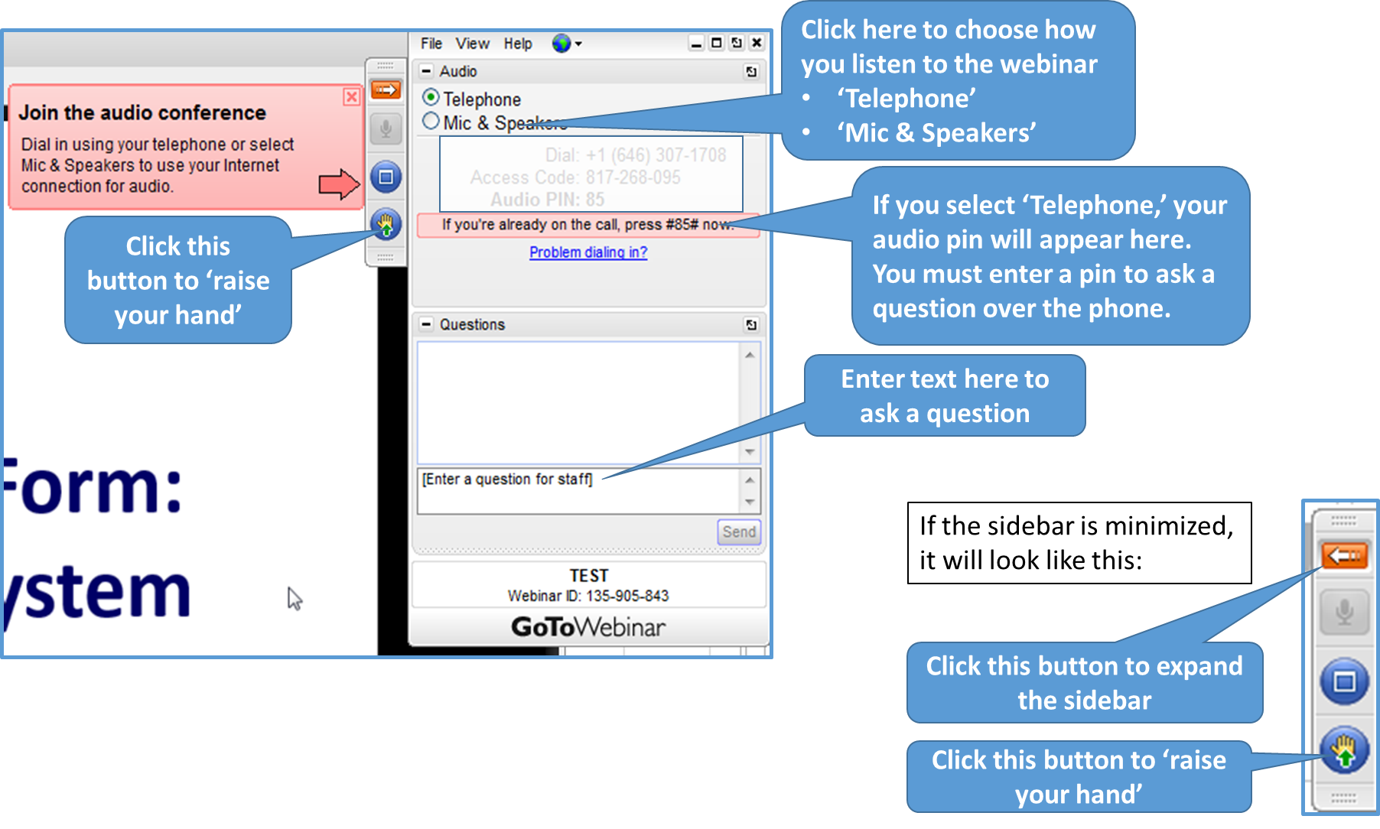
GoToWebinar – Asking a Question

Slide 12
Section II: Completing the Energy Burden Measures Section Section A
Which Households should be included in the Energy Burden Section (Section V)?
The Energy Burden Targeting section of the Performance Data Form should include those households who received “Bill Payment Assistance” during the fiscal year.
“Bill Payment Assistance” – includes all households who received a LIHEAP benefit that was used to pay a share of the household’s energy bills, including utility deposits.
  Includes: heating, cooling, crisis, and supplemental assistance
  Excludes: Households receiving only Weatherization assistance or energy related home repair (e.g. equipment repair/replacement); OR SNAP households that received nominal LIHEAP benefits

Slide 13
Section II: Completing the Energy Burden Measures Section Section A
Section A – All Bill Payment Assistance Clients

Slide 14
Section II: Completing the Energy Burden Measures Section Section A
Section A – Unduplicated Number of LIHEAP Bill Payment Assisted Households. Grantees should report on all households that received LIHEAP Bill Payment Assistance during the fiscal year. [Example State: PA]
  Note: The “All Household” column of Section A should match the Bill Payment Assistance households count reported in grantees’ LIHEAP Household Report.
V. ENERGY BURDEN TARGETING
 |  |  | Bill Payment-Assisted Household Main Fuel
 | All Households |  | Electricity | Natural Gas | Fuel Oil | Propane | Other Fuels
A. Unduplicated Number of LIHEAP Bill Payment-Assisted Households | 390,708 |  | 83,916 | 212,925 | 77,472 | 11,822 | 4,573

Slide 15


Section II: Completing the Energy Burden Measures Section Section A
Section A – Unduplicated Number of LIHEAP Bill Payment Assisted Households. [Example State: PA]
Household Report
Performance Measures Section

Slide 16
Section II: Completing the Energy Burden Measures Section Section B
Section B – All Bill Payment Assistance Clients with complete heating AND electric expenditures for the targeted 12-month period
Note: Section B will include fewer clients than Section A. This is because Section A includes all Bill Payment Assistance households – whereas Section B includes all LIHEAP Bill Payment Assistance households for which grantees were able to obtain complete heating AND electric expenditure data for the targeted 12-month period.

Slide 17
Section II: Completing the Energy Burden Measures Section Section B
Section B – All Bill Payment Assistance Clients with complete heating AND electric expenditures for the targeted 12-month period

Slide 18
Section II: Completing the Energy Burden Measures Section Section B
Example #1: [Example State: MA]
  Percent of Bill Payment Households with Available Energy Data
  *Section B includes fewer clients than Section A.
V. ENERGY BURDEN TARGETING
 |  | Bill Payment-Assisted Household Main Fuel
 | All Households | Electricity | Natural Gas | Fuel Oil | Propane | Other Fuels
A. Unduplicated Number of LIHEAP Bill Payment-Assisted Households | 180,010 | 18,123 | 97,106 | 49,678 | 4,068 | 11,035
B. All Households with 12 Consecutive Months of Bill Data (Main Fuel and Electric)
1. Unduplicated Number of Households with 12 Consecutive Months of Bill Data (Main Fuel and Electric) | 82,601 | 8,954 | 38,983 | 30,755 | 2,269 | 1,640
All Households | Electricity | Natural Gas | Fuel Oil | Propane | Other Fuel
46% | 49% | 40% | 62% | 56% | 15%

Slide 19
Section II: Completing the Energy Burden Measures Section Section B
Example #2: [Example State: MT]
  Percent of Bill Payment Households with Available Energy Data
  *Section B includes fewer clients than Section A.
V. ENERGY BURDEN TARGETING
 |  | Bill Payment-Assisted Household Main Fuel
 | All Households | Electricity | Natural Gas | Fuel Oil | Propane | Other Fuels
A. Unduplicated Number of LIHEAP Bill Payment-Assisted Households | 18,506 | 4,531 | 10,535 | 316 | 2,491 | 633
B. All Households with 12 Consecutive Months of Bill Data (Main Fuel and Electric)
1. Unduplicated Number of Households with 12 Consecutive Months of Bill Data (Main Fuel and Electric) | 11,412 | 3,162 | 8,250 | 0 | 0 | 0
All Households | Electricity | Natural Gas | Fuel Oil | Propane | Other Fuel
62% | 70% | 78% | N/A | N/A | N/A

Slide 20
Section II: Completing the Energy Burden Measures Section Section B
  How to Calculate the “All Household” columns for Section B?
  The “All Households” columns need to be computed based on the population of clients eligible for Section B (weighted average). It IS NOT a simple average of the values reported in the 5 ‘Main Heating Fuel’ columns for each line.
  “All Households” = weighted average for all electricity, natural gas, fuel oil, propane, and other fuel LIHEAP Bill Payment clients with complete Energy Bill Data.
  Note: Grantees should note that some, but not all, of the “All Households” columns in Section B are currently auto-calculated in OLDC. However, it is still important to understand the formulas used in these calculations.

Slide 21
Section II: Completing the Energy Burden Measures Section Section B
  Example: Average Annual Total LIHEAP Benefit per Household [Example State: MT]
V. ENERGY BURDEN TARGETING
 |  | Bill Payment-Assisted Household Main Fuel
 | All Households | Electricity | Natural Gas | Fuel Oil | Propane | Other Fuels
B. All Households with 12 Consecutive Months of Bill Data (Main Fuel and Electric)
1. Unduplicated Number of Households with 12 Consecutive Months of Bill Data (Main Fuel and Electric) | 11,412 | 3,162 | 8,250 | 0 | 0 | 0
2. Average Annual Household Income | $14,120 | $13,242 | $14,456 | $0 | $0 | $0
3. Average Annual Total LIHEAP Benefit per Household (including Heating, Cooling, Crisis, Supplemental Benefits) | $488 | $594 | $448 | $0 | $0 | $0
4. Average Annual Main Heating Fuel Bill | $583 | $960 | $438 | $0 | $0 | $0
5. Average Annual Electricity Bill | $445 | $0 | $615 | $0 | $0 | $0

Slide 22
Section II: Completing the Energy Burden Measures Section Section B
  Formula:
  [(Avg. LIHEAP benefit for electric HHs*# of Electric HHs with complete data) + (Avg. LIHEAP benefit for N.Gas HHs*# of N.Gas HHs with complete data)]
  Total # of Bill Payment HHs with complete Energy Bill Data
  Calculation
  ($594*3,162) + ($448*8,250)
  11,412
  For more detailed information on the calculations utilized in the LIHEAP Performance Data Form-Performance Measures section, please refer to the following document developed by APPRISE: https://liheappm.ncat.org/node/781
V. ENERGY BURDEN TARGETING
 |  | Bill Payment-Assisted Household Main Fuel
 | All Households | Electricity | Natural Gas | Fuel Oil | Propane | Other Fuels
B. All Households with 12 Consecutive Months of Bill Data (Main Fuel and Electric)
1. Unduplicated Number of Households with 12 Consecutive Months of Bill Data (Main Fuel and Electric) | 11,412 | 3,162 | 8,250 | 0 | 0 | 0
2. Average Annual Household Income | $14,120 | $13,242 | $14,456 | $0 | $0 | $0
3. Average Annual Total LIHEAP Benefit per Household (including Heating, Cooling, Crisis, Supplemental Benefits) | $488 | $594 | $448 | $0 | $0 | $0
4. Average Annual Main Heating Fuel Bill | $583 | $960 | $438 | $0 | $0 | $0
5. Average Annual Electricity Bill | $445 | $0 | $615 | $0 | $0 | $0
= $488

Slide 23
Section II: Completing the Energy Burden Measures Section Section B
  How to Calculate the “Average Annual Main Heating Fuel Bill” and “Average Annual Electricity Bill”?
  The “All Households” column for Part B can be confusing since, for electric main heat households, both baseload electric and electric heating expenditures are included in the electric bill. Those expenditures are only recorded once – under “Average Annual Main Heating Fuel Bill”.
    That makes the “Average Annual Main Heating Fuel Bill” for “All Households” appear higher than it is, and the “Average Annual Electricity Bill” for “All Households” appear lower than it is.
    For reporting in FY 2016, we are proposing a change to the form to better reflect baseload electric and electric heating expenditures for electric main heat households.

Slide 24
Section II: Completing the Energy Burden Measures Section Section B
  Current procedure for calculating “Average Annual Main Heating Fuel Bill” and “Average Annual Electricity Bill” for electric main heat households:
  Compute the average annual electric expenditures for electric main heat households.
  Enter full amount of the average annual electric expenditures for electric main heat households in the row for “Average Annual Main Heating Fuel Bill”.
  Leave blank (locked for editing) the average annual electric expenditures for electric main heat households in the row for “Average Annual Electricity Bill”.

Slide 25
Section II: Completing the Energy Burden Measures Section Section B
  Current procedure for calculating “Average Annual Main Heating Fuel Bill” and “Average Annual Electricity Bill” for electric main heat households [Example State: WY]
  Compute the average annual electric expenditures for electric main heat households
  Enter full amount ($1,828) as “Average Annual Main Heating Fuel Bill”
  Leave blank (locked for editing) “Average Annual Electricity Bill” – treated as $0
B. All Households with 12 Consecutive Months of Bill Data (Main Fuel and Electric) | Electricity
1. Unduplicated Number of Households with 12 Consecutive Months of Bill Data (Main Fuel and Electric) | 543
2. Average Annual Household Income | $19,829
3. Average Annual Total LIHEAP Benefit per Household (including Heating, Cooling, Crisis, Supplemental Benefits) | $530
4. Average Annual Main Heating Fuel Bill | $1,828
5. Average Annual Electricity Bill | $0
6. Average Annual Total Residential Energy Bill | $1,828

Slide 26
Section II: Completing the Energy Burden Measures Section Section B
  Proposed change for calculating “Average Annual Main Heating Fuel Bill” and “Average Annual Electricity Bill” for electric main heat households:
  Compute the average annual electric expenditures for electric main heat households. (Same as before - $1,828)
  Enter one-third (1/3) of the average annual electric expenditures for electric main heat households in the row for “Average Annual Main Heating Fuel Bill”. (1/3 * $1,828 = $609)
  Enter two-thirds (2/3) of the average annual electric expenditures for electric main heat households in the row for “Average Annual Electricity Bill”. (2/3 * $1,828 = $1,219)

Slide 27
Section II: Completing the Energy Burden Measures Section Section B
  Proposed change for calculating “Average Annual Main Heating Fuel Bill” and “Average Annual Electricity Bill” for electric main heat households [Example State: WY]
  Compute the average annual electric expenditures for electric main heat households
  Enter 1/3 as “Average Annual Main Heating Fuel Bill” – 1/3 * $1,828 = $609
  Enter 2/3 as “Average Annual Electricity Bill” – 2/3 * $1,828 = $1,219
B. All Households with 12 Consecutive Months of Bill Data (Main Fuel and Electric) | Electricity
1. Unduplicated Number of Households with 12 Consecutive Months of Bill Data (Main Fuel and Electric) | 543
2. Average Annual Household Income | $19,829
3. Average Annual Total LIHEAP Benefit per Household (including Heating, Cooling, Crisis, Supplemental Benefits) | $530
4. Average Annual Main Heating Fuel Bill | $609
5. Average Annual Electricity Bill | $1,219
6. Average Annual Total Residential Energy Bill | $1,828

Slide 28
Section II: Completing the Energy Burden Measures Section Section B
  Current procedure for calculating “Average Annual Electricity Bill” for “All Households”:
  Formula:
  ∑(Avg. Annual Elec. Bill by Heating Fuel*# of HHs w/ complete data by Heating Fuel) ÷ Total # of Bill Payment HHs w/ complete Energy Bill Data
  Calculation:
  ($0*543) + ($796*2,362) + ($1,023*1) + ($1,230*284) + ($1,722*10) = $702
  3,200
 |  | Bill Payment-Assisted Household Main Fuel
B. All Households with 12 Consecutive Months of Bill Data (Main Fuel and Electric) | All Households | Electricity | Natural Gas | Fuel Oil | Propane | Other Fuels
1. Unduplicated Number of Households with 12 Consecutive Months of Bill Data (Main Fuel and Electric) | 3,200 | 543 | 2,362 | 1 | 284 | 10
4. Average Annual Main Heating Fuel Bill | $973 | $1,828 | $736 | $767 | $1,319 | $553
5. Average Annual Electricity Bill | $702 | $0 | $796 | $1,023 | $1,230 | $1,722
6. Average Annual Total Residential Energy Bill | $1,675 | $1,828 | $1,533 | $1,790 | $2,549 | $2,276

Slide 29
Section II: Completing the Energy Burden Measures Section Section B
  Proposed change for calculating “Average Annual Electricity Bill” for “All Households”:
  Formula:
  Remains the same, except now the numbers have changed because the “Average Annual Electricity Bill” for electric main heat households is no longer treated as $0. As a result, the “Average Annual Electricity Bill” for “All Households” has increased ($806), the “Average Annual Heating Bill” for “All Households” has decreased ($869), and the “Total Bill” for “All Households” remains the same ($1,675).
  Calculation:
  ($1,219*543) + ($796*2,362) + ($1,023*1) + ($1,230*284) + ($1,722*10) = $909
  3,200
 |  | Bill Payment-Assisted Household Main Fuel
B. All Households with 12 Consecutive Months of Bill Data (Main Fuel and Electric) | All Households | Electricity | Natural Gas | Fuel Oil | Propane | Other Fuels
1. Unduplicated Number of Households with 12 Consecutive Months of Bill Data (Main Fuel and Electric) | 3,200 | 543 | 2,362 | 1 | 284 | 10
4. Average Annual Main Heating Fuel Bill | $766 | $609 | $736 | $767 | $1,319 | $553
5. Average Annual Electricity Bill | $909 | $1,219 | $796 | $1,023 | $1,230 | $1,722
6. Average Annual Total Residential Energy Bill | $1,675 | $1,828 | $1,533 | $1,790 | $2,549 | $2,276

Slide 30
Section II: Completing the Energy Burden Measures Section Section B
  What can Section B tell you about your LIHEAP clients?
  Among all clients, are there differences in average annual burden according to heating fuel type?
    Are the differences in average annual burden driven by differences in income, differences in residential energy bills, or both?
  Among all clients, are there differences in average annual total LIHEAP benefits by heating fuel type?
    Do the differences make sense based on differences in average annual burden by heating fuel type?
  How large of an impact does LIHEAP have in reducing the energy burden of all clients?
  For more detailed information and analysis of what Section B can tell you about your LIHEAP clients, see the following presentation given at the 2016 NEUAC Annual Conference: https://liheappm.acf.hhs.gov/sites/default/files/private/training/presentations/2016/Session6G_LIHEAPPM-McGrath.pptx

Slide 31
Section II: Completing the Energy Burden Measures Section Section B
Questions

Slide 32
GoToWebinar – Asking a Question

Slide 33
Section II: Completing the Energy Burden Measures Section Section C - High Burden Households
Section C – High Burden Bill Payment Assistance clients with complete heating AND electric expenditures for the targeted 12-month period
For Section C, grantees will need to identify and report on those Bill Payment Assistance households with the top 25% energy burden for which grantees were able to obtain complete heating AND electric expenditure data for the targeted 12-month period.
  Section C should include the top 25% of all clients from Section B with the highest energy burden
  Section C should NOT simply include 25% of the clients from each Main Heating Fuel type.
Note: Zero Income Households. Zero income households should also be included. States should record the energy burden for these households as 100% of household income.

Slide 34
Section II: Completing the Energy Burden Measures Section Section C - High Burden Households
Section C – High Burden Bill Payment Assistance clients with complete heating AND electric expenditures for the targeted 12-month period

Slide 35
Section II: Completing the Energy Burden Measures Section Section C - High Burden Households
  Example: Incorrectly completing the Energy Burden Measures Section C for High Burden Households [Fictional State]
V. ENERGY BURDEN TARGETING
 |  | Bill Payment-Assisted Household Main Fuel
 | All Households | Electricity | Natural Gas | Fuel Oil | Propane | Other Fuels
B. All Households with 12 Consecutive Months of Bill Data (Main Fuel and Electric)
1. Unduplicated Number of Households with 12 Consecutive Months of Bill Data (Main Fuel and Electric) | 100,000 | 40,000 | 40,000 | 8,000 | 8,000 | 4,000
7. Average Annual Burden Before Receiving LIHEAP | 9.0% | 9.0% | 8.0% | 11.7% | 11.4% | 11.5%
High Burden Households with 12 Consecutive Months of Bill Data (Main Fuel and Electric)
1. Unduplicated Number of High Burden Households (Top 25%) with 12 Consecutive Months of Bill Data (Main Fuel and Electric) | 25,000 | 10,000 | 10,000 | 2,000 | 2,000 | 1,000
7. Average Annual Burden Before Receiving LIHEAP for High Burden Households | 21.5% | 21.3% | 19.2% | 28.3% | 27.5% | 27.5%
Should not simply be 25% of clients for each heating fuel (10,000 ÷ 40,000 electric HHs = 25%), but instead, top 25% highest energy burden clients overall (regardless of fuel type)
25%

Slide 36
Section II: Completing the Energy Burden Measures Section Section C - High Burden Households
  Example: Correctly completing the Energy Burden Measures Section C for High Burden Households [Example State: IA]
V. ENERGY BURDEN TARGETING
 |  | Bill Payment-Assisted Household Main Fuel
 | All Households | Electricity | Natural Gas | Fuel Oil | Propane | Other Fuels
B. All Households with 12 Consecutive Months of Bill Data (Main Fuel and Electric)
1. Unduplicated Number of Households with 12 Consecutive Months of Bill Data (Main Fuel and Electric) | 45,240 | 8,673 | 36,408 | 0 | 159 | 0
7. Average Annual Burden Before Receiving LIHEAP | 11.4% | 9.5% | 11.7% | N/A | 17.7% | N/A
High Burden Households with 12 Consecutive Months of Bill Data (Main Fuel and Electric)
1. Unduplicated Number of High Burden Households (Top 25%) with 12 Consecutive Months of Bill Data (Main Fuel and Electric) | 11,310 | 1,666 | 9,541 | 0 | 103 | 0
7. Average Annual Burden Before Receiving LIHEAP for High Burden Households | 28.5% | 29.0% | 28.5% | N/A | 25.3% | N/A
Average Annual Burden Before Receiving LIHEAP for High Burden Households is more uniform across fuel types when Section C - High Burden Households is completed correctly
25%
19%
26%
65%

Slide 37
Section II: Completing the Energy Burden Measures Section Section C - High Burden Households
  What can Section C tell you about your high burden LIHEAP clients?
  Do high burden clients tend to use one heating fuel type versus another when compared to all clients?
  What differences in average income and residential energy bills are observed between high burden clients and all clients?
  Among high burden clients, are there differences in average annual total LIHEAP benefits by heating fuel type?
  How large of an impact does LIHEAP have in reducing the energy burden of high burden clients?
  For more detailed information and analysis of what Section C can tell you about your high burden LIHEAP clients, see the following presentation given at the 2016 NEUAC Annual Conference: https://liheappm.acf.hhs.gov/sites/default/files/private/training/presentations/2016/Session6G_LIHEAPPM-McGrath.pptx

Slide 38
Section II: Completing the Energy Burden Measures Section Section C - High Burden Households
Questions

Slide 39
GoToWebinar – Asking a Question

Slide 40
Section II: Completing the Energy Burden Measures Section Targeting Indices
Benefit Targeting Index for High Burden Households. This measure tells us whether high energy burden households receive higher LIHEAP benefits than average households.
Burden Reduction Targeting Index for High Burden Households. This measure tells us whether high energy burden households have a larger share of their energy bill paid with LIHEAP than average households.
Note: The ‘Benefit Targeting’ and ‘Benefit Reduction Targeting’ Indices are auto-calculated using data from Sections A-C of the Energy Burden Measures section. For more detailed information on the calculations utilized in the LIHEAP Performance Data Form-Performance Measures section, please refer to the following document developed by APPRISE: https://liheappm.ncat.org/node/781
APPRISE provided information on the interpretation of these statistics at the 2016 NEUAC Meeting. We will be scheduling another Webinar to present this information to all grantees.
V. ENERGY BURDEN TARGETING
 |  | Bill Payment-Assisted Household Main Fuel
 | All Households | Electricity | Natural Gas | Fuel Oil | Propane | Other Fuels
D. Benefit Targeting Index for High Burden Households: | 176 | 181 | 172 | 126 | 127 | 107
E. Burden Reduction Targeting Index for High Burden Households: | 125 | 122 | 138 | 104 | 102 | 84
Notes:
For more information about how to interpret the targeting index, please see pages 38-40 of the FY 2009 Home Energy Notebook available at: http://www.acf.hhs.gov/sites/default/files/ocs/fy2009_liheap_notebook.pdf

Slide 41
Section II: Completing the Energy Burden Measures Section Targeting Indices
Questions

Slide 42
GoToWebinar – Asking a Question

Slide 43
Section III: Completing the Restoration and Prevention Measures Section
What households do I count for the ‘Restoration of Home Energy Service’ Section (Section VI)?
The sample for Section VI should include ALL LIHEAP households for which LIHEAP assistance led to the restoration of a household’s energy service during the fiscal year. This may differ from the sample used for the Energy Burden Section (Section V).
  Energy Burden Measures (Section V) – Only included households who received Bill Payment Assistance
  Restoration Measures (Section VI) – Includes ALL LIHEAP households (Bill Payment Assistance + Weatherization + Equipment Repair/Replacement)

Slide 44
Section III: Completing the Restoration and Prevention Measures Section
What data should be reported in the ‘Restoration of Home Energy Service’ Section (Section VI)?
The data fields in Section VI require specific information on the number of occurrences in which LIHEAP assistance led to the restoration of a household’s energy service during the fiscal year.
Grantees are required to report on the number of times LIHEAP was used to restore service in the following situations:
  Energy Service Restored After Disconnection
  Fuel Delivered to Home that Ran Out of Fuel
  Repair/Replacement of Inoperable Home Energy Equipment
For more information on the data collection guidelines for the Restoration Measures, please see the "LIHEAP Performance Measures Data Collection Guide - Criteria for Determining Service Restoration” supplement on the Performance Management Website

Slide 45
Section III: Completing the Restoration and Prevention Measures Section
Energy Service Restored After Disconnection. Grantees should report on the number of occurrences during the fiscal year in which LIHEAP assistance led to the restoration of a household’s energy service after a disconnection.
Energy Source – Breakdown of the number of occurrences in which LIHEAP assistance was used to restore a disconnected household’s energy service, based on the fuel source where the LIHEAP benefit was applied. Please note that in some cases this may not be the household’s primary fuel source.
  Note: Fuel Oil, Propane, and Other Fuels columns are “blacked-out” because these are delivered fuels. Also, households could have experienced multiple instances in which LIHEAP assistance was used to restore their energy service. Please note that each separate occurrence should be reported on in this section.
All Occurrences – This is a sum of the total number of instances in which LIHEAP assistance was used to restore a household’s energy service after disconnection, during the fiscal year.
  Note: The All Occurrences field will be auto-calculated “on-the-fly” as grantees input data into the Energy Source columns.
VI. RESTORATION OF HOME ENERGY SERVICE
 |  | Energy Source (where LIHEAP benefit was applied)
A. All Occurrences of LIHEAP Households that Had: | All Occurrences | Electricity | Natural Gas | Fuel Oil | Propane | Other Fuels
1. Energy Service Restored After Disconnection | 12,732 | 4,013 | 8,719
2. Fuel Delivered to Home that Ran Out of Fuel | 28,520 |  |  | 23,888 | 3,238 | 1,394
3. Repair/Replacement of Inoperable Home Energy Equipment | 8,050 | 219 | 3,379 | 3,950 | 325 | 177
Notes:
Note: Households for whom the primary energy service was restored should be counted even if they were able to heat or cool their home in another way.

Slide 46
Section III: Completing the Restoration and Prevention Measures Section
Fuel Delivered to Home that Ran Out of Fuel . Grantees should report on the number of occurrences during the fiscal year in which LIHEAP assistance resulted in the delivery of fuel to a home after the household had run out of fuel.
Energy Source – Breakdown of the number of occurrences in which LIHEAP assistance was used to restore energy service to a household that had run out of fuel, based on the fuel source where the LIHEAP benefit was applied. Please note that in some cases this may not be the household’s primary fuel source.
  Note: Electricity and Natural Gas columns are “blacked-out” because these are utility fuel sources. Also, households could have experienced multiple instances in which LIHEAP assistance was used to restore their energy service. Please note that each separate occurrence should be reported on in this section.
All Occurrences – This is a sum of the total number of instances in which LIHEAP assistance was used to deliver fuel to a household that had run our of fuel.
  Note: The All Occurrences field will be auto-calculated “on-the-fly” as grantees input data into the Energy Source columns.
Pre-pay Clients – For FY 2016, electric pre-pay clients whose account ran out of funds, and who had their energy service restored with a LIHEAP benefit should be reported in Line 1 (“Disconnection”) under electricity. If applicable, grantees should include a note of this in their form. Please note that this guidance may change for FY 2017.
VI. RESTORATION OF HOME ENERGY SERVICE
 |  | Energy Source (where LIHEAP benefit was applied)
A. All Occurrences of LIHEAP Households that Had: | All Occurrences | Electricity | Natural Gas | Fuel Oil | Propane | Other Fuels
1. Energy Service Restored After Disconnection | 12,732 | 4,013 | 8,719
2. Fuel Delivered to Home that Ran Out of Fuel | 28,520 |  |  | 23,888 | 3,238 | 1,394
3. Repair/Replacement of Inoperable Home Energy Equipment | 8,050 | 219 | 3,379 | 3,950 | 325 | 177
Notes:
Note: Households for whom the primary energy service was restored should be counted even if they were able to heat or cool their home in another way.

Slide 47
Section III: Completing the Restoration and Prevention Measures Section
Repair/Replacement of Inoperable Home Energy Equipment. Grantees should report on the number of occurrences during the fiscal year in which households had inoperable heating or cooling equipment repaired or replaced using LIHEAP funds.
Energy Source – Breakdown of the number of occurrences in which LIHEAP assistance was used to repair/replace a household’s inoperable home energy equipment, based on the fuel source for the equipment that was repaired or replaced. This should always be the household’s primary heating or electric source (e.g. AC).
  Note: Households could have experienced multiple instances in which LIHEAP assistance was used to repair/replace a household’s inoperable home energy equipment. Please note that each separate occurrence should be reported on in this section.
All Occurrences – This is a sum of the total number of instances in which LIHEAP assistance was used to repair/replace a household’s inoperable home energy equipment.
  Note: The All Occurrences field will be auto-calculated “on-the-fly” as grantees input data into the Energy Source columns.
VI. RESTORATION OF HOME ENERGY SERVICE
 |  | Energy Source (where LIHEAP benefit was applied)
A. All Occurrences of LIHEAP Households that Had: | All Occurrences | Electricity | Natural Gas | Fuel Oil | Propane | Other Fuels
1. Energy Service Restored After Disconnection | 12,732 | 4,013 | 8,719
2. Fuel Delivered to Home that Ran Out of Fuel | 28,520 |  |  | 23,888 | 3,238 | 1,394
3. Repair/Replacement of Inoperable Home Energy Equipment | 8,050 | 219 | 3,379 | 3,950 | 325 | 177
Notes:
Note: Households for whom the primary energy service was restored should be counted even if they were able to heat or cool their home in another way.

Slide 48
Section III: Completing the Restoration and Prevention Measures Section
Questions

Slide 49
GoToWebinar – Asking a Question

Slide 50
Section III: Completing the Restoration and Prevention Measures Section
What households do I count for the ‘Prevention of Loss of Home Energy Service’ Section (Section VII)?
The sample for Section VII should include ALL LIHEAP households for which LIHEAP assistance led to the prevention of a household’s loss of energy service, during the fiscal year. This may also differ from the sample used for the Energy Burden Section (Section V).
  Energy Burden Measures (Section V) – Only included households who received Bill Payment Assistance
  Prevention Measures (Section VII) – Includes ALL LIHEAP households (Bill Payment Assistance + Weatherization + Equipment Repair/Replacement)

Slide 51
Section III: Completing the Restoration and Prevention Measures Section
What data should be reported in the ‘Prevention of Loss of Home Energy Service’ Section (Section VII)?
The data fields in Section VII require specific information on the number of occurrences in which LIHEAP assistance prevented the loss of energy service for a household at risk of losing their home energy service, during the fiscal year.
Grantees are required to report on the number of times LIHEAP was used to prevent service loss under the following conditions:
  Households with a Utility Past Due or Disconnect Notice
  Households with Limited Fuel
  Households in need of Equipment Repair/Replacement
Note: The Criteria for ‘Prevention of home energy loss’ are defined by each Grantee.
For more information on the data collection guidelines for the Prevention Measures, please see the "LIHEAP Performance Measures Data Collection Guide - Criteria for Determining At Risk Clients” supplement on the Performance Management Website.

Slide 52
Section III: Completing the Restoration and Prevention Measures Section
Past Due or Utility Disconnect Notice. Grantees should report on the number of occurrences in which households had a past due or disconnect notice at the time of application and receipt of LIHEAP assistance resulted in the continuance of home energy service. Households who are already disconnected should not be counted in this section.
Energy Source – Breakdown of the number of occurrences in which LIHEAP assistance was used to prevent the loss of home energy service for a household that received a past due or disconnect notice, based on the fuel source where the LIHEAP benefit was applied. Please note that in some cases this may not be the household’s primary fuel source.
  Note: Fuel Oil, Propane, and Other Fuels columns are “blacked-out” because these are delivered fuels. Also, households could have experienced multiple instances in which LIHEAP assistance was used to prevent the loss of their energy service. Please note that each separate occurrence should be reported on in this section.
All Occurrences – This is a sum of the total number of instances in which LIHEAP assistance was used to prevent a household with a past due or disconnect notice from losing their home energy service during the fiscal year.
  Note: The All Occurrences field will be auto-calculated “on-the-fly” as grantees input data into the Energy Source columns.
VII. PREVENTION OF LOSS OF HOME ENERGY SERVICE
 |  | Energy Source (where LIHEAP benefit was applied)
A. All Occurrences of LIHEAP Households that Had: | All Occurrences | Electricity | Natural Gas | Fuel Oil | Propane | Other Fuels
1. Past Due Notice or Utility Disconnect Notice | 73,140 | 27,167 | 45,973
2. Imminent Risk of Running out of Fuel | 53,124 |  |  | 44,404 | 6,490 | 2,230
3. Repair/Replacement of Operable Equipment to Prevent Imminent Home Energy Loss | 0 | 0 | 0 | 0 | 0 | 0
Notes:
Note: Households for whom the primary energy service was restored should be counted even if they were able to heat or cool their home in another way.

Slide 53
Section III: Completing the Restoration and Prevention Measures Section
Imminent Risk of Running out of Fuel. Grantees should report on the number of occurrences in which households were at imminent risk of running out of fuel at the time of application and receipt of LIHEAP assistance resulted in the delivery of fuel. Households who are already out of fuel should not be counted in this section.
Energy Source – Breakdown of the number of occurrences in which LIHEAP assistance was used to prevent a household in imminent risk of running out of fuel from losing their home energy service, based on the fuel source where the LIHEAP benefit was applied. Please note that in some cases this may not be the household’s primary fuel source.
  Note: Electricity and Natural Gas columns are “blacked-out” because these are utility fuel sources. Also, households could have experienced multiple instances in which LIHEAP assistance was used to prevent the loss of their energy service. Please note that each separate occurrence should be reported on in this section.
All Occurrences – This is a sum of the total number of instances in which LIHEAP assistance was used to deliver fuel to a household at risk of running out of fuel during the fiscal year.
  Note: The All Occurrences field will be auto-calculated “on-the-fly” as grantees input data into the Energy Source columns.
  Pre-pay Clients – For FY 2016, electric pre-pay clients whose account was low on funds, and who received a LIHEAP benefit that prevented the loss of their energy service should be reported in Line 1 (“Past Due or Disconnect Notice”) under electricity. If applicable, grantees should include a note of this in their form. Please note that this guidance may change for FY 2017.
VII. PREVENTION OF LOSS OF HOME ENERGY SERVICE
 |  | Energy Source (where LIHEAP benefit was applied)
A. All Occurrences of LIHEAP Households that Had: | All Occurrences | Electricity | Natural Gas | Fuel Oil | Propane | Other Fuels
1. Past Due Notice or Utility Disconnect Notice | 73,140 | 27,167 | 45,973
2. Imminent Risk of Running out of Fuel | 53,124 |  |  | 44,404 | 6,490 | 2,230
3. Repair/Replacement of Operable Equipment to Prevent Imminent Home Energy Loss | 0 | 0 | 0 | 0 | 0 | 0
Notes:
Note: Households for whom the primary energy service was restored should be counted even if they were able to heat or cool their home in another way.

Slide 54
Section III: Completing the Restoration and Prevention Measures Section
Repair/Replacement of Operable Equipment to Prevent Imminent Home Energy Loss. Grantees should report on the number of occurrences in which LIHEAP Heating/Cooling equipment repair or replacement prevented a household’s loss of energy service. Households whose heating or cooling equipment is inoperable (or red-tagged) at the time of application or home energy audit should not be counted in this section.
Energy Source – Grantees should provide a breakdown of the number of occurrences in which LIHEAP assistance was used to repair/replace a household’s operable home energy equipment, based on the fuel source for the equipment that was repaired or replaced. This should always be the household’s primary heating or electric source (e.g. AC).
  Note: Households could have experienced multiple instances in which LIHEAP was used to repair/replace a household’s operable home energy equipment to prevent loss of energy service. Please note that each separate occurrence should be reported on in this section.
All Occurrences – This is a sum of the total number of instances in which LIHEAP was used to repair/replace a household’s operable heating or cooling equipment to prevent loss of home energy service during the fiscal year.
  Note: The All Occurrences field will be auto-calculated “on-the-fly” as grantees input data into the Energy Source columns.
VII. PREVENTION OF LOSS OF HOME ENERGY SERVICE
 |  | Energy Source (where LIHEAP benefit was applied)
A. All Occurrences of LIHEAP Households that Had: | All Occurrences | Electricity | Natural Gas | Fuel Oil | Propane | Other Fuels
1. Past Due Notice or Utility Disconnect Notice | 73,140 | 27,167 | 45,973
2. Imminent Risk of Running out of Fuel | 53,124 |  |  | 44,404 | 6,490 | 2,230
3. Repair/Replacement of Operable Equipment to Prevent Imminent Home Energy Loss | 0 | 0 | 0 | 0 | 0 | 0
Notes:
Note: Households for whom the primary energy service was restored should be counted even if they were able to heat or cool their home in another way.

Slide 55
Section III: Completing the Restoration and Prevention Measures Section
Questions

Slide 56
GoToWebinar – Asking a Question

Slide 57
Section IV: Performance Measures Resources
Resources for Grantees
  Webinars
  LIHEAP Performance Measurement Data Collection Guide
  Performance Data Form and Instructions
  LIHEAP Performance Management Website
  Training and Technical Assistance Contacts

Slide 58
Section IV: Performance Measures Resources
Webinars
FY 2015 Household Report
  https://www.youtube.com/watch?v=Z6gty6BSGVs
FY 2015 Performance Data Form
  https://www.youtube.com/watch?v=PtXQs8zewVs
PM Data Collection
https://liheappm.acf.hhs.gov/sites/default/files/private/training/pm_webinar/PM_Data_Collection_Webinar_033116.mp4

Slide 59
Section IV: Performance Measures Resources
Performance Data Form and Instructions
  Performance Data Form
  https://liheappm.acf.hhs.gov/sites/default/files/private/grantee_tools/requirements/liheap_performance_data_form_for_federal_fiscal_year_2015_updated.xlsx
  Performance Data Form Instructions
  http://www.acf.hhs.gov/sites/default/files/ocs/revised_liheap_performance_data_form_instructions_2015.pdf
  Performance Data Form FAQ
    https://liheappm.acf.hhs.gov/faq

Slide 60
Section IV: Performance Measures Resources
Performance Management Website
  https://liheappm.acf.hhs.gov/
  If you need assistance accessing the Performance Management website, please contact:
    Sherry Vogel
    sherryv@ncat.org

Slide 61
Section IV: Performance Measures Resources
For more information, please contact:
  Trayvon Braxton
  APPRISE
  Trayvon-Braxton@appriseinc.org | 609-252-9053
  Melissa Torgerson
    VERVE
    melissa@verveassociates.net | 503-706-2647

Slide 62
Section IV: Performance Measures Resources
Questions

Slide 63
GoToWebinar – Asking a Question

