Slide 1
FY 2016 LIHEAP Performance Data Form LIHEAP Grantee Survey (Sections I – IV)
LIHEAP Webinar presented by the Office of Community Services (OCS) in the Administration for Families and Children (ACF) hosted by APPRISE under contract to OCS
December 20, 2016
Presenters:
Leon Litow (OCS Staff)
Melissa Torgerson (Verve Associates)
Notes:
Title Slide Option 1

Slide 2
Welcome
Welcome and Introductions
Leon Litow, OCS
Webinar Speaker
Melissa Torgerson, Verve Associates
Presenter(s):
Leon Litow & Melissa Torgerson

Slide 3
Webinar Agenda
Introduction
TOPIC 1: Completing the FY 2016 LIHEAP Performance Data Form in OLDC
TOPIC 2: ‘Section III – Estimated Sources of LIHEAP Funds’ – Requirements & Common issues
TOPIC 3: ‘Section IV – Estimated Uses of LIHEAP Funds’ – Requirements & Common issues
TOPIC 4: ‘Section IV – Estimated Uses of LIHEAP Funds’ – Validation checks
FFY LIHEAP Performance Data Form Reporting Schedule
Resources
Questions
Presenter(s):
Melissa Torgerson

Slide 4
Introduction
What is the LIHEAP Performance Data Form?
OMB approved the Form in November of 2014.
The Form combines the LIHEAP Grantee Survey and the LIHEAP Performance Measures reporting into one report.
Three sections of the Form include:
LIHEAP Grantee Survey
LIHEAP Performance Measures
Optional Measures
Presenter(s):
Melissa Torgerson

Slide 5
Introduction
Reporting Requirements
For FY 2016, the LIHEAP Grantee Survey AND LIHEAP Performance Measures sections are required. This must be completed by January 31, 2017.
This webinar will primarily focus on the LIHEAP Grantee Survey section of the LIHEAP Performance Data Form.
APPRISE will be conducting another webinar on the LIHEAP Performance Measures section of the LIHEAP Performance Data form on January 5, 2017.
Presenter(s):
Melissa Torgerson

Slide 6
Topic #1 – OLDC Access Interface
Previous webinars providing detailed instructions for OLDC access are located on the ACF website:
http://www.acf.hhs.gov/ocs/resource/liheap-trainings
Presenter(s):
Melissa Torgerson

Slide 7
Topic #1 – OLDC Access Interface
OLDC is accessed through Grant Solutions.
Log-in to Grant Solutions at https://www.grantsolutions.gov/gs
Once logged in, click “OLDC” in the top taskbar to access the OLDC homepage.
When completing the Report in OLDC, changes and updates will only be recorded when “Save” is clicked. Therefore, it is important to regularly click “Save” to retain newly recorded information and prevent the loss of information.
If you need assistance, please contact Grants Center Of Excellence Systems Help Desk:
(202) 401-5282 or (866) 577-0771
help@grantsolutions.gov
Presenter(s):
Melissa Torgerson

Slide 8
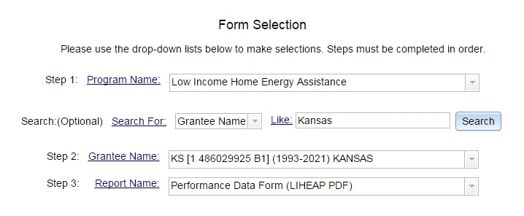
Topic #1 – OLDC Access Interface
Grantees access the LIHEAP Performance Data Form by selecting the ‘Performance Data Form (LIHEAP PDF)’
Presenter(s):
Melissa Torgerson

Slide 9
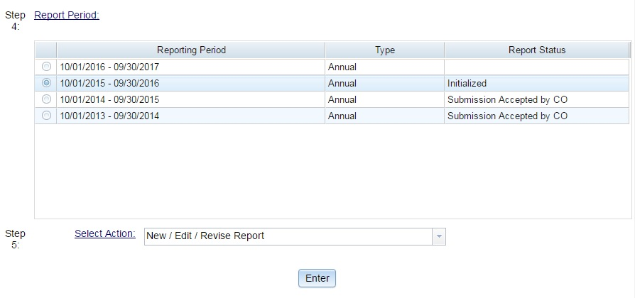
Topic #1 – OLDC Access Interface
To access the FY 2016 report, please select the radial button for the FY 2016 reporting period.
Then, select “New/Edit/Revise Report” for Step 5 and click “Enter.”
Please contact your OCS liaison if your FY 2016 Report Form is not available for editing
Presenter(s):
Melissa Torgerson

Slide 10
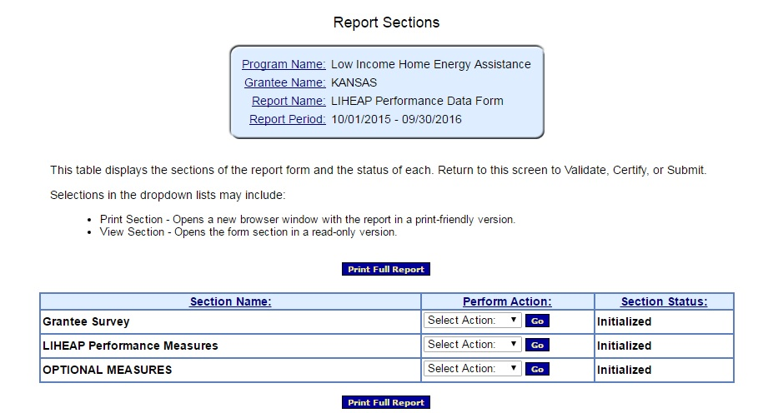
Topic #1 – OLDC Access Interface
The LIHEAP Performance Data Form is split into three modules:
1. The LIHEAP Grantee Survey module – “Grantee Survey”
2. The LIHEAP Performance Measures module – “LIHEAP Performance Measures”
3. Optional Measures module – “Optional Measures”
Presenter(s):
Melissa Torgerson

Slide 11
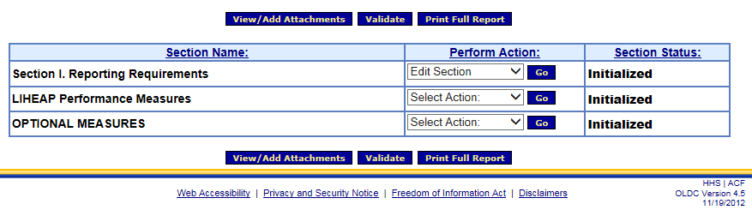
Topic #1 – Completing the LIHEAP Grantee Survey
The LIHEAP Grantee Survey AND the LIHEAP Performance Measures sections of the LIHEAP Performance Data Form are required for 2016.
This webinar will focus on the LIHEAP Grantee Survey
The LIHEAP Grantee Survey section of the LIHEAP Performance Data Form can be accessed by selecting ‘Edit Section’ and then clicking ‘Go.’
Presenter(s):
Melissa Torgerson

Slide 12
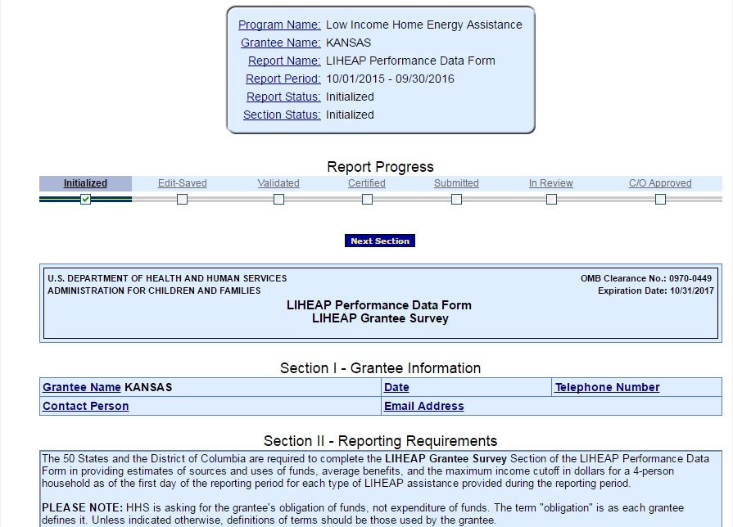
Topic #1 – Completing the LIHEAP Grantee Survey
The following screen should appear. This is the LIHEAP Grantee Survey section of the Form.
Presenter(s):
Melissa Torgerson

Slide 13
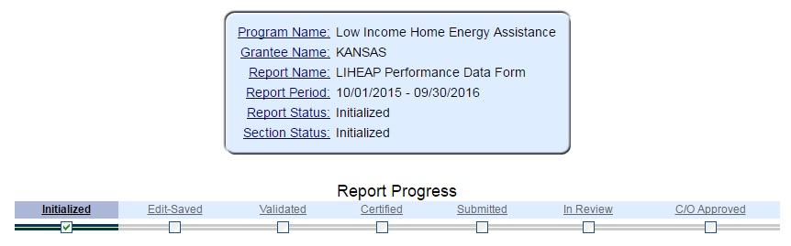
Topic #1 – Data Submission and Review Procedures
This action will initialize the form
The form will now be available for editing. Please fill out, save, validate, certify, and submit the form.
Presenter(s):
Melissa Torgerson

Slide 14
Topic #1 – Data Submission
Summary of Data Submission Process:
Navigate to the FY 2016 LIHEAP Performance Data Form in OLDC.
Select “New/Edit/Revise Report” to initialize the FY 2016 LIHEAP Performance Data Form.
Fill out Section I. LIHEAP Grantee Survey
Grantees should click “Save” to retain their recorded information.
Click “Validate” – Run data validation checks and save data.
NOTE: Validations will run on all sections of the LIHEAP Performance Data Form.
Click “Certify” – Apply signature of authorizing agent to form.
Click “Submit” – Submit form for OCS/APPRISE review.
Presenter(s):
Melissa Torgerson

Slide 15
Topic #1 – Data Submission and Review Procedures
FY 2016 LIHEAP Performance Data Form Review Process:
Following Grantees’ submission of their FY 2016 LIHEAP Performance Data forms, APPRISE will conduct a review of all Grantees’ forms to identify reporting issues requiring revision by Grantees.
Once the items requiring revision have been confirmed with the Grantee’s LIHEAP office, the Grantee should make the appropriate revisions and re-submit its FY 2016 LIHEAP Performance Data form in OLDC.
Presenter(s):
Melissa Torgerson

Slide 16
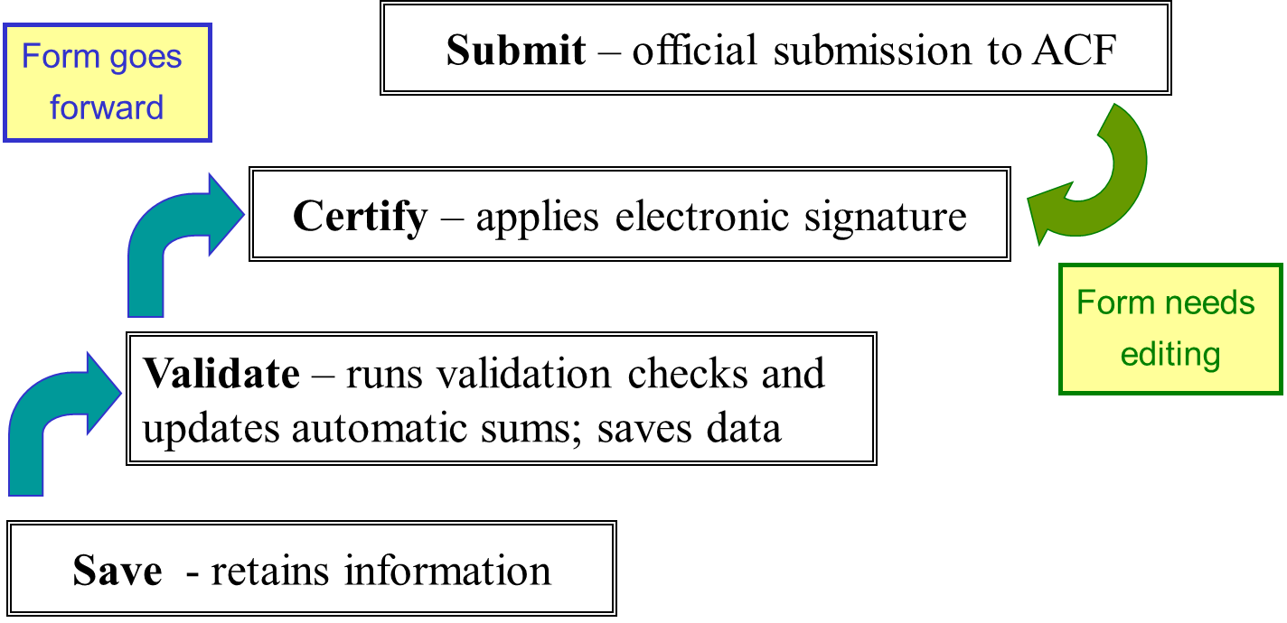
Topic #1 – Data Submission and Review Procedures
Presenter(s):
Melissa Torgerson

Slide 17
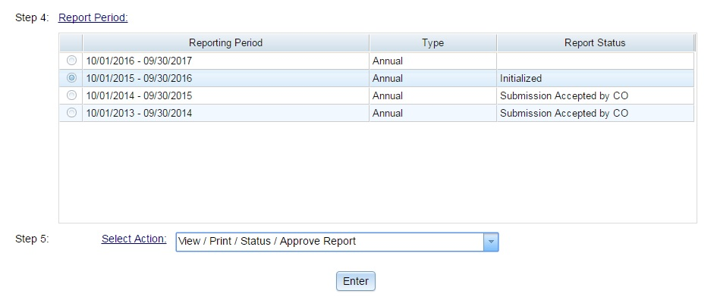
Topic #1 – Data Revision and Re-Submission
FY 2016 LIHEAP Performance Data Form Revision Process:
In order to access a submitted report for editing, please select the radial button for the FY 2016 reporting period
Then, select “View/Print/Status/Approve Report” for Step 5 and click “Enter”
Presenter(s):
Melissa Torgerson

Slide 18
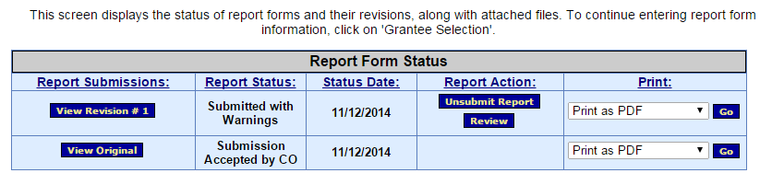
Topic #1 – Data Revision and Re-Submission
The “Report Form Status” page will appear.
Report Form Status: Contains button to View Original report or any Revisions, the Report Status, Status Date, Report Action, and Print option
Click “Un-submit Report”
Click “Edit Original”
Click “Uncertify”
The report will now be available for editing
Presenter(s):
Melissa Torgerson

Slide 19
Topic #1 – Data Revision and Re-Submission
Summary of Data Revision and Re-Submission Process:
Navigate to the FY 2016 LIHEAP Performance Data Form in OLDC.
Select “View/Print/Status/Approve Report” to view the FY 2016 LIHEAP Performance Data Form “Report Form Status” page
Click “Un-submit Report”
Click “Edit Original”
Click “Uncertify”
Edit and Re-submit FY 2016 LIHEAP Performance Data Form
Re-submit form using submission protocol outlined in previous slides.
Presenter(s):
Melissa Torgerson

Slide 20
Topic #1 – Data Submission and Review Procedures
Presenter(s):
Melissa Torgerson

Slide 21
Topic #1 – OLDC Access Interface: View FY 2015 Report
During the completion of the FY 2016 LIHEAP Performance Data form, grantees may need to reference data from the FY 2015 LIHEAP Performance Data form.
Grantees may also wish to print off a copy of their FY 2015 LIHEAP Performance Data Form for reference.
Presenter(s):
Melissa Torgerson

Slide 22
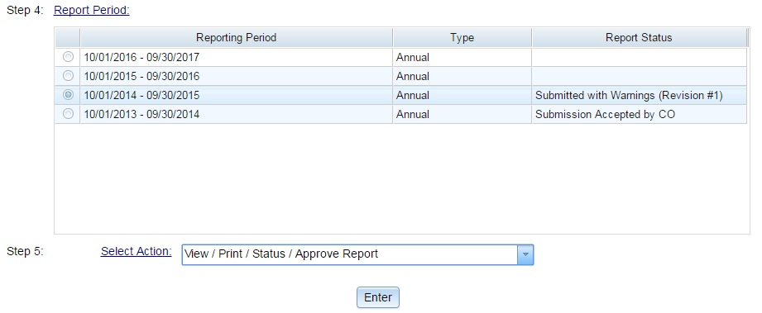
Topic #1 – OLDC Access Interface: View FY 2015 Report
To view the FY 2015 report, select the radial button for the FY 2015 reporting period.
Then, select “View/Print/Status/Approve Report” for Step 5 and click “Enter.”
Presenter(s):
Melissa Torgerson

Slide 23
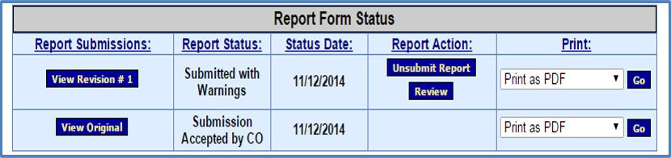
Topic #1 – OLDC Access Interface: View FY 2015 Report
The “Report Form Status” page will appear.
Report Form Status: Contains button to View Original report or any Revisions, the Report Status, Status Date, Report Action, and Print option
View 2015 Report: Click “View Original” or most recent revision submitted by grantee under the “Report Submissions” column.
Print 2015 Report: Click “Go” in the “Print” column.
Presenter(s):
Melissa Torgerson

Slide 24
Topic #1 – Questions
Grantee Questions regarding accessing the FY 2016 LIHEAP Grantee Survey section of the LIHEAP Performance Data Form in OLDC?
Presenter(s):
Melissa Torgerson

Slide 25
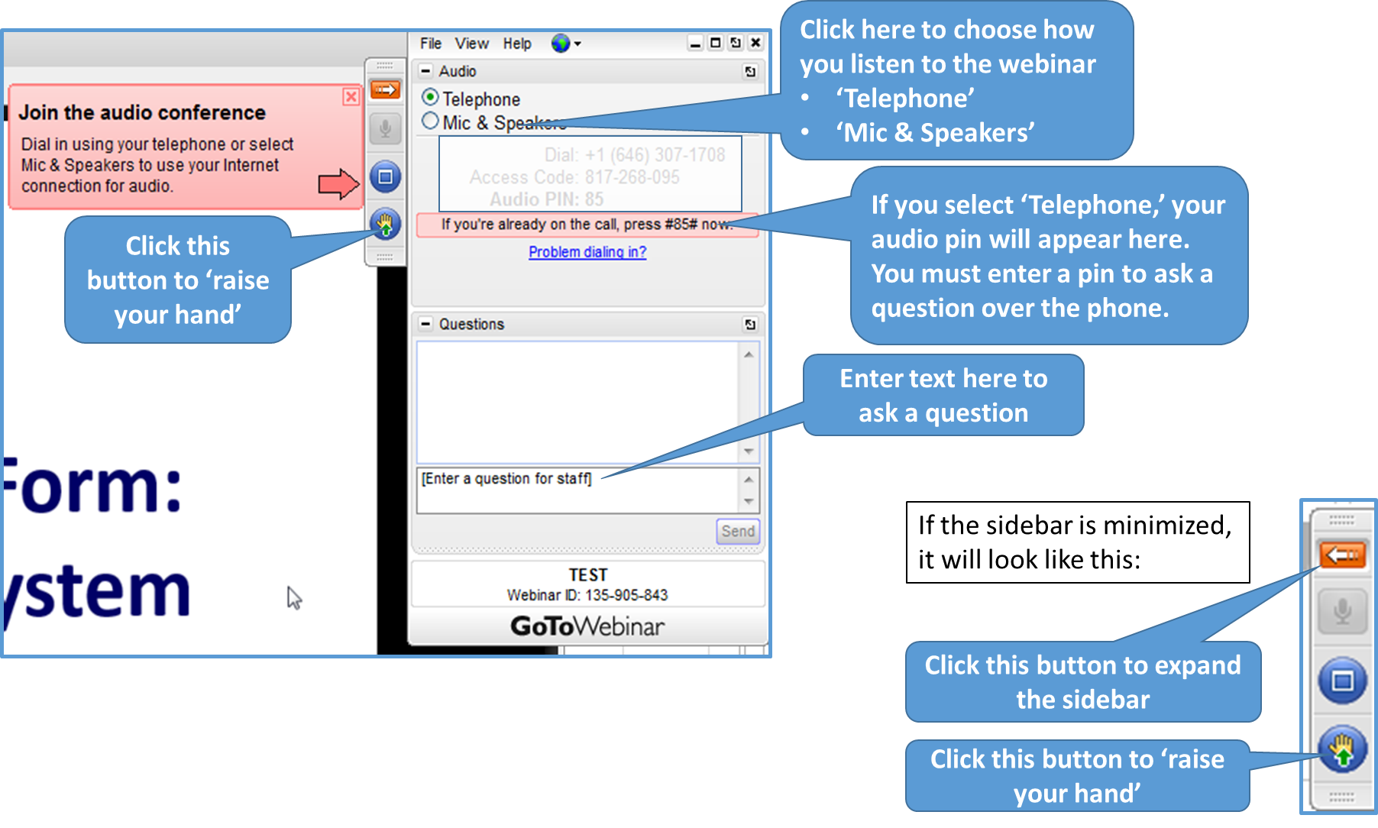
GoToWebinar – Asking a Question
If you wish to call in and ask a question, you MUST call in by phone rather than connect your audio through your computer

Slide 26
Topic #2 – Sources of Funds
‘Section III – Estimated Sources of LIHEAP Funds’ of the LIHEAP Grantee Survey Form
Pre-Populated Data Fields
Common Issues
Carryover from FY 2015
Presenter(s):
Melissa Torgerson

Slide 27
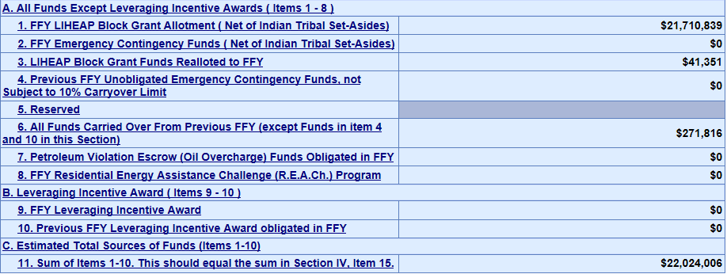
Topic #2 – Pre-populated Data
The LIHEAP Grantee Survey section of the Form will be populated with FY 2016 ‘Estimated Sources of LIHEAP Funds’ data, with the exception of Oil Overcharge funds.
Presenter(s):
Melissa Torgerson

Slide 28
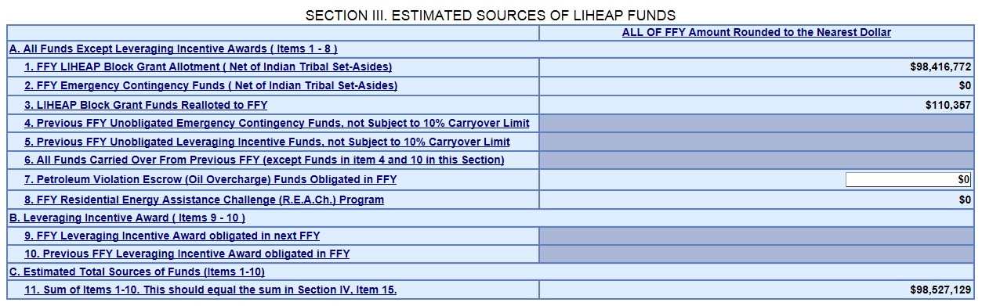
Topic #2 – Pre-populated Data
Oil Overcharge and Carryover funds are available for editing in the Form
Note: For FY 2016, Grantees’ pre-populated carryover amount (Section III, line 6) should reflect the carryover amount you reported in the FY 2015 LIHEAP Grantee Survey.
If you believe that the pre-populated carryover value is incorrect please contact APPRISE prior to editing your FY 2016 LIHEAP Grantee Survey.
If you believe that other source values are incorrect, please contact your OCS liaison or APPRISE.
Presenter(s):
Melissa Torgerson

Slide 29
Topic #2 – Pre-populated Data: Carryover Funds
Prior to completing the LIHEAP Grantee Survey section of the FY 2016 LIHEAP Performance Data Form, APPRISE would advise grantees to first review their FY 2015 & FY 2016 Carryover and Re-allotment Reports to make sure they reflect the final values developed by your fiscal department.
This will ensure that grantees’ reported carryover amounts match between their C&R Reports and FY 2016 LIHEAP Grantee Survey.
This will also prevent follow-up contact from APPRISE.
Presenter(s):
Melissa Torgerson

Slide 30
Topic #2 – Common Issues
Common issues with ‘Section III – Estimated Sources of LIHEAP Funds’
The grantee did not draw down all available LIHEAP funds.
The grantee should address this issue in ‘Section IV – Estimated Uses of LIHEAP Funds’ and the ‘Notes’ section.
The grantee returned LIHEAP funds to the Federal Government.
The grantee should address this issue in ‘Section IV – Estimated Uses of LIHEAP Funds’ and the ‘Notes’ section.
Presenter(s):
Melissa Torgerson

Slide 31
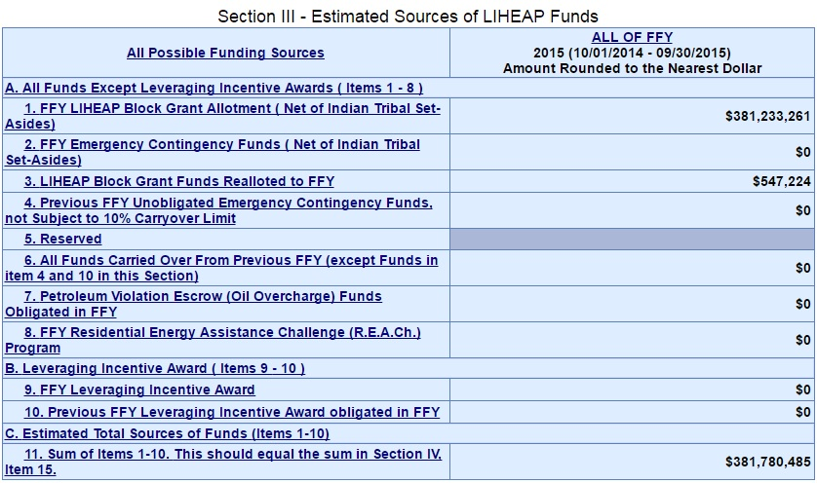
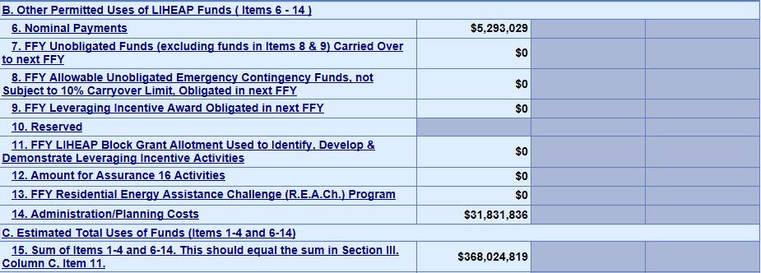
Topic #2 – Carryover from FY 2015
Carryover from FY 2015
Data regarding unobligated funds carried over to FY 2016 in the FY 2015 LIHEAP Performance Data Form – LIHEAP Grantee Survey section need to match reports of carryover from FY 2015 in the FY 2016 LIHEAP Grantee Survey section of the LIHEAP Performance Data Form.
FY 2016 GS Section –
Sources of Funds
FY 2015 GS
Presenter(s):
Melissa Torgerson

Slide 32
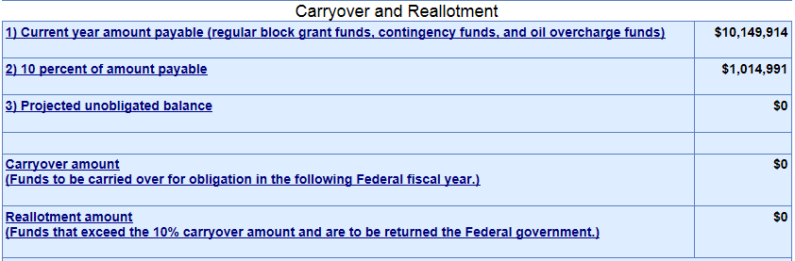
Topic #2 – Carryover from FY 2015
The FY 2015 Carryover & Re-allotment report that grantees submitted August 1st, 2015 should match reports of carryover from FY 2015 in the FY 2016 LIHEAP Grantee Survey section of the LIHEAP Performance Data Form.
FY 2016 GS Section –
Sources of Funds
FY 2015 C&R Report
Presenter(s):
Melissa Torgerson

Slide 33
Topic #2 – Carryover from FY 2015
Summary: Carryover from FY 2015
FY 2015 C&R Report
FY 2015 GS Section IV – ‘Uses’ of Funds
Pre-populated
FY 2016 GS Section III– ‘Sources’ of Funds
Presenter(s):
Melissa Torgerson

Slide 34
Topic #2 – Carryover from FY 2015
Note: Carryover from FY 2015 should not include funds obligated in FY 2015 but not used until FY 2016.
Carryover amounts should only include unobligated FY 2015 funds.
Presenter(s):
Melissa Torgerson

Slide 35
Topic #2 – Questions
Grantee Questions regarding ‘Section III – Estimated Sources of LIHEAP Funds’ of the LIHEAP Grantee Survey?
Presenter(s):
Melissa Torgerson

Slide 36
GoToWebinar – Asking a Question
If you wish to call in and ask a question, you MUST call in by phone rather than connect your audio through your computer

Slide 37
Topic #3 – Uses of Funds
‘Section IV – Estimated Uses of LIHEAP Funds’ of the LIHEAP Grantee Survey Form
Review of important items:
Nominal benefits reporting
Question 1: Obligation of funds
Average benefit reporting
Question 2: Average benefit calculation
REQUIRED: Average benefit by main heating fuel
Common Issues
Carryover to FY 2017
Presenter(s):
Melissa Torgerson

Slide 38
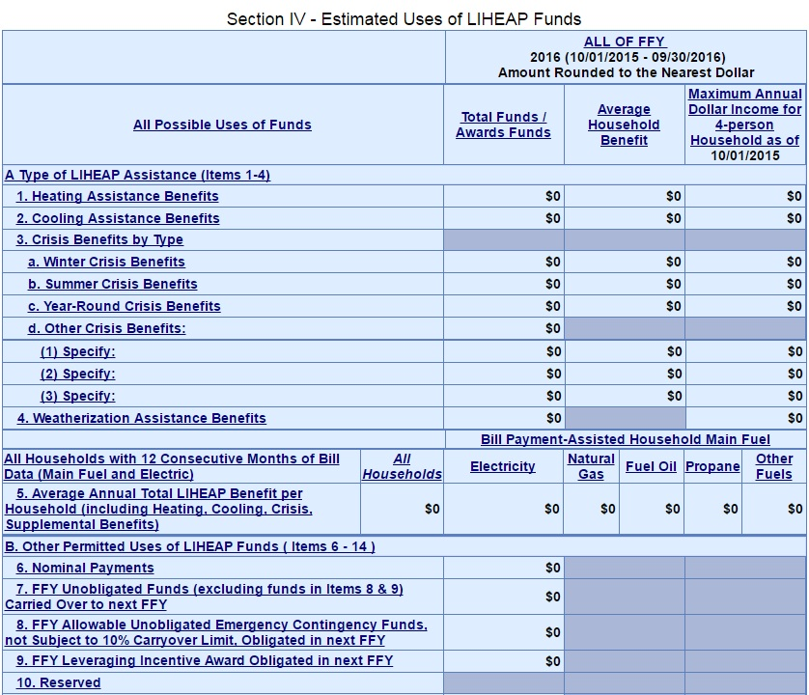
Topic #3 – Nominal Benefits
Item #1: Nominal Payments
The LIHEAP Grantee Survey section of the LIHEAP Performance Data Form includes a separate field to capture nominal payments (any nominal LIHEAP benefit received by SNAP households)
Grantees should report the total amount of funds obligated to nominal payments only in this line
Presenter(s):
Melissa Torgerson

Slide 39
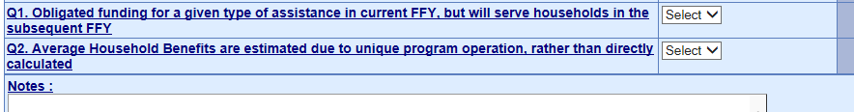
Topic #3 – Question 1: Obligation of Funds
Item #2: Question 1 – Obligation of funds
The LIHEAP Grantee Survey section of the LIHEAP Performance Data Form includes a question to capture information on whether funds that were obligated in FY 2016 were not expended until the subsequent year (FY 2017).
Grantees should use the drop down menu in this field to select ‘yes’ or ‘no.’ Special cases should be described in the ‘Notes’ field at the end of the Form.
Presenter(s):
Melissa Torgerson

Slide 40
Topic #3 – Average Benefit Reporting
Item #3: Average Benefit Reporting
The LIHEAP Grantee Survey section of the LIHEAP Performance Data Form includes a column in which grantees are to report on the “Average Household Benefit” for each type of LIHEAP benefit program operated by the grantee during the fiscal year.
For FY 2016, if a grantee’s calculated average household benefit includes funds obligated for benefits other than bill payment assistance, the grantee should include a description of the benefit types included in its calculation in the Notes section.
Presenter(s):
Melissa Torgerson

Slide 41
Topic #3 – Question 2: Average Benefit
Item #4: Question 2 – Average Benefit Calculation
The LIHEAP Grantee Survey section of the LIHEAP Performance Data Form includes a question to capture whether the average benefit for one or more types of LIHEAP assistance was estimated, rather than directly calculated, due to difficulties in computing an average benefit because of unique program components.
Grantees should use the drop down menu in this field to select ‘yes’ or ‘no.’ Special cases should be described in the ‘Notes’ field at the end of the Form.
Presenter(s):
Melissa Torgerson

Slide 42
Topic #3 – Average Benefit, by main heat
Item #5: Bill Payment-assisted average annual Total LIHEAP Benefit per household (including heating, cooling, crisis, and supplemental assistance) MANDATORY FOR FY 2016
The LIHEAP Grantee Survey section of the LIHEAP Performance Data Form includes a line for grantees to report the bill payment-assisted average annual total LIHEAP benefit per household.
Grantees should report the average annual total LIHEAP bill assistance benefit by Main Fuel Type.
Grantees should only include households with bill data (Main Fuel AND Electric) for the 12-month reporting period.
NOTE: This data is also reported in Section V of the LIHEAP Performance Data Form (LIHEAP Performance Measures section).
Please note that these data are required in FY 2016.
Presenter(s):
Melissa Torgerson

Slide 43
Topic #3 – Average Benefit, by main heat
Bill Payment-assisted average annual Total LIHEAP Benefit per household (including heating, cooling, crisis, and supplemental assistance).
Presenter(s):
Melissa Torgerson

Slide 44
Topic #3 – Common Issues
Common issues with ‘Section IV – Estimated Uses of LIHEAP Funds’
Reported “Maximum Annual Dollar Income for 4-person Household” threshold is inconsistent with Federal Poverty Guidelines or State Median Income Guidelines in effect at the start of the fiscal year.
For FY 2016, reported amounts should reflect the 2015 HHS Poverty Guidelines or 2016 State Median Income Guidelines in effect on 10/1/2015.
Note: If a Grantee’s LIHEAP program component began after the release of the 2016 HHS Federal Poverty Guidelines, the grantee may choose to use the 2016 Guidelines in its FY 2016 LIHEAP Grantee Survey reporting.
If applicable, grantees should include a note of this in the ‘Notes’ section of the form.
Presenter(s):
Melissa Torgerson

Slide 45
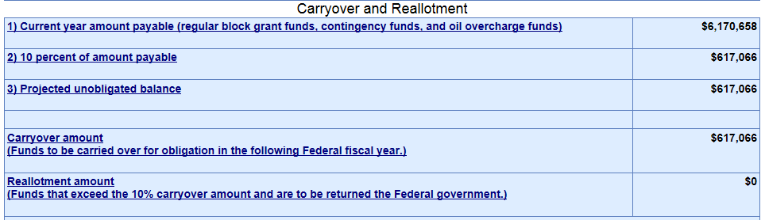

Topic #3 – Carryover to FY 2017
The FY 2016 Carryover & Re-allotment report that was required to be submitted on August 1, 2016 should match reports of carryover from FY 2016 in the FY 2016 LIHEAP Grantee Survey section of the LIHEAP Performance Data Form.
FY 2016 C&R Report
FY 2016 GS Section –
Uses of Funds
Presenter(s):
Melissa Torgerson

Slide 46
Topic #3 – Carryover to FY 2017
Summary: Carryover to FY 2017
FY 2016 C&R Report
FY 2016 GS Section IV – ‘Uses’ of Funds
Presenter(s):
Melissa Torgerson

Slide 47
Topic #3 – Questions
Grantee Questions regarding ‘Section IV – Estimated Uses of LIHEAP Funds’ of the LIHEAP Grantee Survey?
Presenter(s):
Melissa Torgerson

Slide 48
GoToWebinar – Asking a Question
If you wish to call in and ask a question, you MUST call in by phone rather than connect your audio through your computer

Slide 49
Topic #4 – ‘Section IV – Estimated Uses of LIHEAP Funds’ Validations
I. Current Validations in OLDC
Comparison of Carryover Report to LIHEAP Grantee Survey
Comparison of Household Report to LIHEAP Grantee Survey
Comparison of FY 2015 LIHEAP Grantee Survey to FY 2016 LIHEAP Grantee Survey
Comparison of ‘Section III – Estimated Sources of LIHEAP Funds’ and ‘Section IV – Estimated Uses of LIHEAP Funds’
II. Manual Validations by APPRISE
Comparison of State Plan to Income Thresholds
Comparison of State Plan to LIHEAP Grantee Survey
Presenter(s):
Melissa Torgerson

Slide 50
Topic #4 – Fatal Errors vs. Warnings
Fatal Error Messages versus Warning Messages
Fatal Error Messages indicate inconsistent data that must be corrected before states are able to submit their LIHEAP Grantee Survey in OLDC.
Warning Messages indicate data that may be correct but requires confirmation through additional explanation in the “Notes” field of the form.
Notes will prevent follow-up contact from APPRISE.
Presenter(s):
Melissa Torgerson

Slide 51
I. Current Validations in OLDC: Carryover Report Comparison
The LIHEAP Grantee Survey section of the LIHEAP Performance Data Form contains automated checks to compare FY 2016 LIHEAP Grantee Survey data with FY 2015 and FY 2016 Carryover & Re-allotment Report data.
The amount of carryover reported from FY 2015 in ‘Section III –Estimated Sources of LIHEAP Funds’ of the FY 2016 LIHEAP Grantee Survey should match the carryover amount reported in the FY 2015 Carryover & Re-allotment report.
The amount of carryover to FY 2017 reported in ‘Section IV – Estimated Uses of LIHEAP Funds’ of the FY 2016 LIHEAP Grantee Survey should match the carryover amount reported in the FY 2016 Carryover & Re-allotment report.
NOTE: If the two reports do not match, OLDC issues a WARNING
Example – next slide
Presenter(s):
Melissa Torgerson

Slide 52
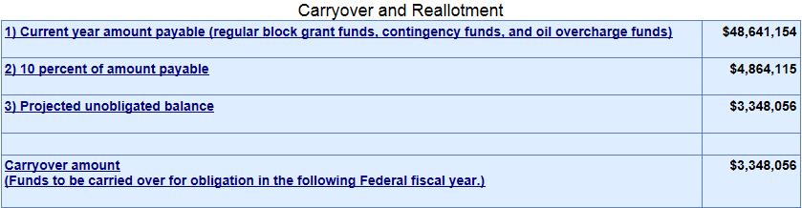
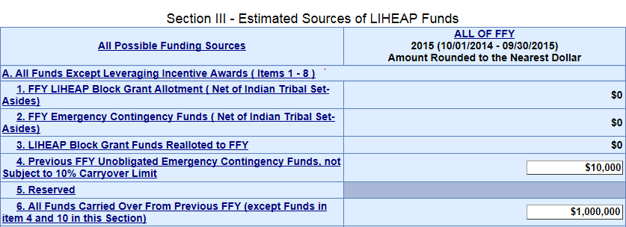
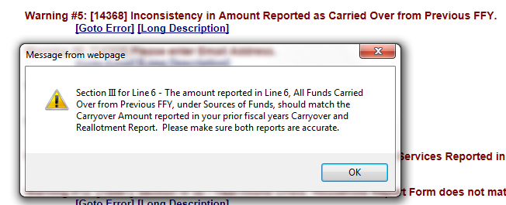
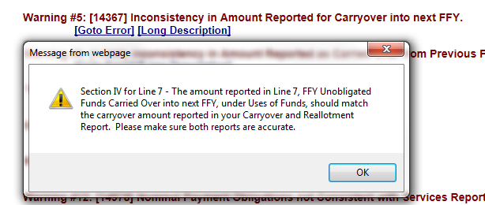

I. Current Validations in OLDC: Carryover Report Comparison
FY 2015 C&R Report
FY 2016 GS Section –
Sources of Funds
FY 2016 C&R Report
FY 2016 GS Section –
Uses of Funds
Presenter(s):
Melissa Torgerson

Slide 53
I. Current Validations in OLDC: Household Report Comparison
The LIHEAP Grantee Survey section of the LIHEAP Performance Data Form contains automated checks to compare FY 2016 LIHEAP Grantee Survey data with FY 2016 Household Report data.
If a state obligates funds for a given assistance, then the state should have assisted households with that particular type of assistance
If a state assists households with a given assistance, then the state should have obligated funds for that particular type of assistance
NOTE: If the two reports do not match, OLDC issues a WARNING
Example – next slide
Presenter(s):
Melissa Torgerson

Slide 54
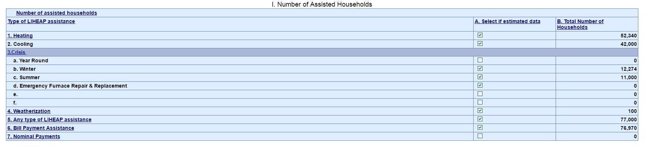

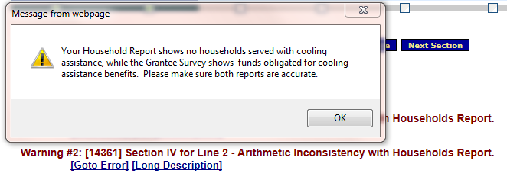
I. Current Validations in OLDC: Household Report Comparison
FY 2016 Household Report
FY 2016 Grantee Survey
22,000
800
145
500
22,536
22,050
Presenter(s):
Melissa Torgerson

Slide 55
I. Current Validations in OLDC: FY 2015 vs. FY 2016 Comparison
The LIHEAP Grantee Survey section of the LIHEAP Performance Data Form contains automated checks to compare FY 2015 LIHEAP Grantee Survey data with FY 2016 LIHEAP Grantee Survey data.
If a state obligates funds for a given assistance in FY 2015, then the state should have obligated funds for that particular type of assistance in FY 2016.
If a state obligates funds for a given assistance in FY 2016, then the state should have obligated funds for that particular type of assistance in FY 2015.
NOTE: If the two reports do not match, OLDC issues a WARNING
Example – next slide
Presenter(s):
Melissa Torgerson

Slide 56
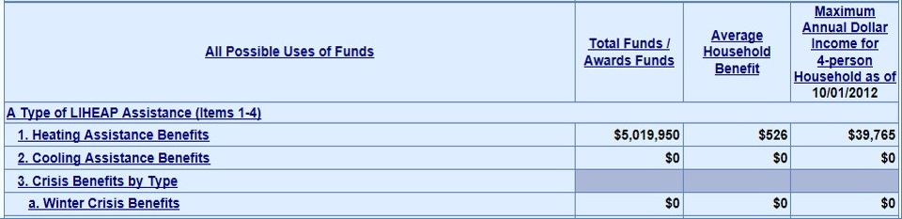
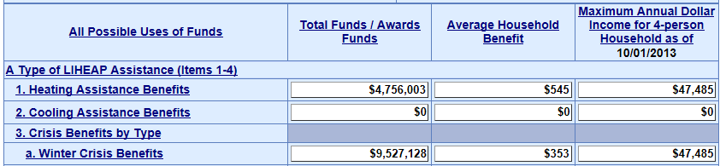
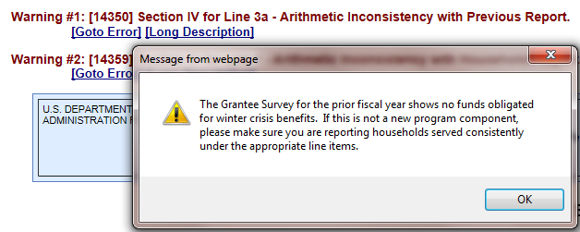
I. Current Validations in OLDC: FY 2015 vs. FY 2016 Comparison
FY 2015 Grantee Survey
FY 2016 Grantee Survey
Presenter(s):
Melissa Torgerson

Slide 57
I. Current Validations in OLDC: Sources of Funds vs. Uses of Funds
The LIHEAP Grantee Survey section of the LIHEAP Performance Data Form contains an automated check to compare a grantee’s reported ‘Estimated Total Sources of Funds’ in Section III with its ‘Estimated Total Uses of Funds’ in Section IV
Grantees’ ‘Estimated Total Sources of Funds’ (Section III: Line 11) should equal grantees’ ‘Estimated Total Uses of Funds’ (Section IV: Line 15)
NOTE: If the two line items do not match, OLDC issues a WARNING
Example – next slide
Presenter(s):
Melissa Torgerson

Slide 58
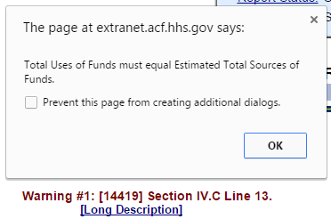
I. Current Validations in OLDC: Sources of Funds vs. Uses of Funds
FY 2016 GS Section –
Sources of Funds
FY 2016 GS Section –
Uses of Funds
Presenter(s):
Melissa Torgerson

Slide 59
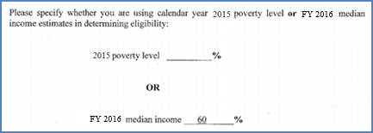
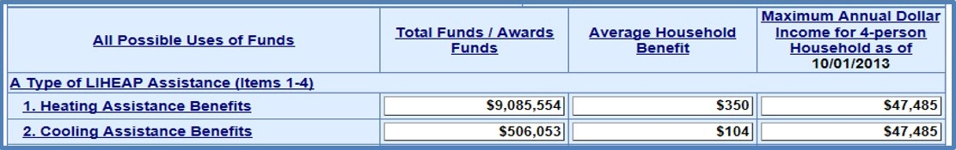
II. Manual Validations by APPRISE: State Plan Income Threshold Comparison
After states submit their LIHEAP Grantee Survey section of the LIHEAP Performance Data Form, APPRISE will compare reported income thresholds in the FY 2016 LIHEAP Grantee Survey to income thresholds reported in the FY 2016 State Plan.
Please be sure to report Income Thresholds using the Poverty Guidelines or State Median Income available at the beginning of the FFY.
- FY 2015 HHS Poverty Guidelines
- FY 2016 State Median Income
Presenter(s):
Melissa Torgerson

Slide 60
II. Manual Validations by APPRISE: State Plan Comparison
After states submit their LIHEAP Grantee Survey section of the LIHEAP Performance Data Form, APPRISE will also manually compare grantees’ FY 2016 State Plan data with their FY 2016 LIHEAP Grantee Survey data.
If a state reports providing assistance for a particular type of assistance for FY 2016 in its State Plan, then the state should have obligated funds for that particular type of assistance in its LIHEAP Grantee Survey.
If a state obligated funds for a given assistance in its LIHEAP Grantee Survey, then the state should have reported providing assistance for that particular type of assistance in its State Plan.
Example – next slide
Presenter(s):
Melissa Torgerson

Slide 61
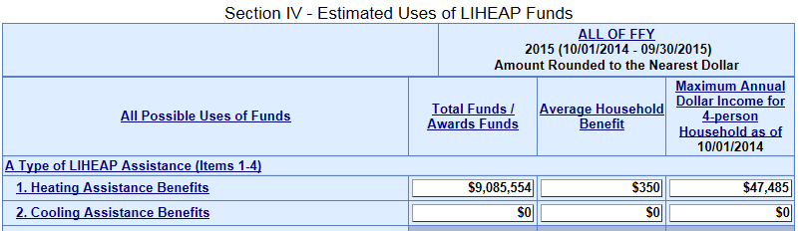
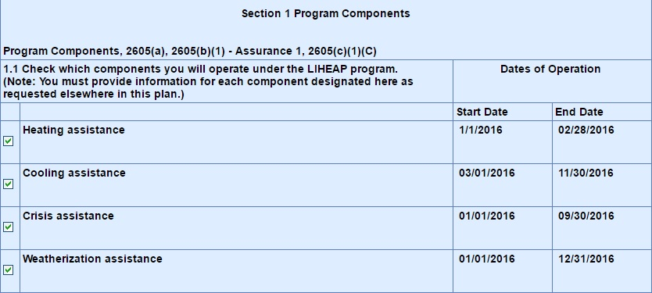
II. Manual Validations by APPRISE: State Plan Comparison
FY 2016 – Grantee Survey
FY 2016 – Model Plan
Presenter(s):
Melissa Torgerson

Slide 62
Section #4 – Questions
Grantee Questions regarding the validations in ‘Section IV - Estimated Uses of LIHEAP Funds’ of the LIHEAP Grantee Survey?
Presenter(s):
Melissa Torgerson

Slide 63
GoToWebinar – Asking a Question
If you wish to call in and ask a question, you MUST call in by phone rather than connect your audio through your computer

Slide 64
Upcoming Reporting Deadlines
Final FY 2016 Household Report Data
Submitted in OLDC on December 16, 2016.
FY 2016 LIHEAP Performance Data Form
FY 2016 LIHEAP Performance Data Form must be submitted in OLDC by January 31, 2017.
FY 2016 LIHEAP Performance Measures data portion is MANDATORY for grantees to submit for FY 2016.
APPRISE will be conducting a webinar on January 5, 2017 focusing on the LIHEAP Performance Measures data portion.
Presenter(s):
Melissa Torgerson

Slide 65
Resources: Grantee Support
OCS liaisons
http://www.acf.hhs.gov/programs/ocs/resource/division-of-energy-assistance-federal-staff
Grants Center Of Excellence systems Help Desk
help@grantsolutions.gov
(202) 401-5282 or (866) 577-0771
APPRISE Team
Daniel Bausch, Daniel-Bausch@appriseinc.org; 609-252-9050
Sonia Guior, Sonia-Guior@appriseinc.org; 609-252-0005
Jorge Mancilla, Jorge-MancillaUribe@appriseinc.org; 609-252-9009
Melissa Torgerson, melissa@verveassociates.net
Michelle Wadolowski, Michelle-Wadolowski@appriseinc.org; 609-252-9057
Presenter(s):
Melissa Torgerson

Slide 66
FY 2016 LIHEAP Grantee Survey – Questions
Grantee Questions?
Presenter(s):
Melissa Torgerson

Slide 67
GoToWebinar – Asking a Question
If you wish to call in and ask a question, you MUST call in by phone rather than connect your audio through your computer

