Slide 1
FY 2016 LIHEAP Performance Data Form
LIHEAP Performance Measures (Sections V-VII)
LIHEAP Webinar presented by the Office of Community Services (OCS) in the Administration for Families and Children (ACF) hosted by APPRISE under contract to OCS
January 5, 2017
Presenters:
Leon Litow (OCS Staff)
Melissa Torgerson (Verve)
Kevin McGrath (APPRISE)
Notes:
Title Slide Option 1

Slide 2
Welcome
Welcome and Introductions
  Leon Litow, OCS
Webinar Speaker
  Melissa Torgerson, Verve Associates
Webinar Speaker
  Kevin McGrath, APPRISE
Presenter(s):
Leon Litow & Kevin McGrath

Slide 3
Webinar Agenda
Introduction
TOPIC 1: Completing the Energy Burden Measures
  1A – Bill Payment Assistance Households
  1B – High Burden Households
  1C – Targeting Indices
TOPIC 2: Completing the Restoration and Prevention Measures
  2A – Restoration Measures
  2B – Prevention Measures
TOPIC 3: Completing the Optional Performance Measures
Resources
Questions

Slide 4
Introduction
What is the LIHEAP Performance Data Form?
OMB approved the Form in November of 2014.
The Form combines the LIHEAP Grantee Survey and the LIHEAP Performance Measures reporting into one report.
Three sections of the Form include:
  LIHEAP Grantee Survey
  Mandatory LIHEAP Performance Measures
  Optional LIHEAP Performance Measures

Slide 5
Introduction
Reporting Requirements
For FY 2016, the LIHEAP Grantee Survey AND Mandatory LIHEAP Performance Measures sections are required. This must be completed by January 31, 2017.
On December 20, we provided information on how to begin the Performance Data Form. If you need assistance with this, please contact APPRISE.
This webinar will primarily focus on the Mandatory LIHEAP Performance Measures section of the LIHEAP Performance Data Form.
The webinar will also cover the Optional LIHEAP Performance Measures section of the form, for grantees choosing to complete this section.

Slide 6
What are the LIHEAP Performance Measures?
The Performance Measures Section asks all state grantees to report on the following LIHEAP outcomes:
Reduction of Home Energy Burden
  Evaluates LIHEAP impact on energy burden using Change in Energy Burden Indicators, Benefit Targeting Index, and Burden Reduction Targeting Index
Restoration of Home Energy Service
  Measures the impact of LIHEAP on restoration of home energy service, which can eliminate health and safety risks
Prevention of Loss of Home Energy Service
  Measures the impact of LIHEAP on preventing loss of home energy service, which can eliminate costs of restoration and minimize health and safety risks

Slide 7
Performance Measures – Data Collection
For detailed information on Performance Measures data collection for the new mandatory LIHEAP Performance Measures, please refer to the following resources available on the LIHEAP Performance Management Website.
PM Data Collection Webinar
  https://liheappm.acf.hhs.gov/sites/default/files/private/training/pm_webinar/PM_Data_Collection_Webinar_033116.mp4
LIHEAP Performance Measure Data Collection Guide
  https://liheappm.acf.hhs.gov/sites/default/files/private/training/pm_webinar/LIHEAP-PM-Data-Collection-Guide_July2016.docx

Slide 8
Topic #1: Completing the Energy Burden Measures Overview
Energy Burden Measures – Overview
The Energy Burden Measures (Section V. Energy Burden Targeting) consists of the following three sections:
  Section A – All Bill Payment Assistance Clients
  Section B – All Bill Payment Assistance Clients with complete heating AND electric expenditures for the targeted 12-month period
  Section C – High Burden Bill Payment Assistance clients with complete heating AND electric expenditures for the targeted 12-month period

Slide 9
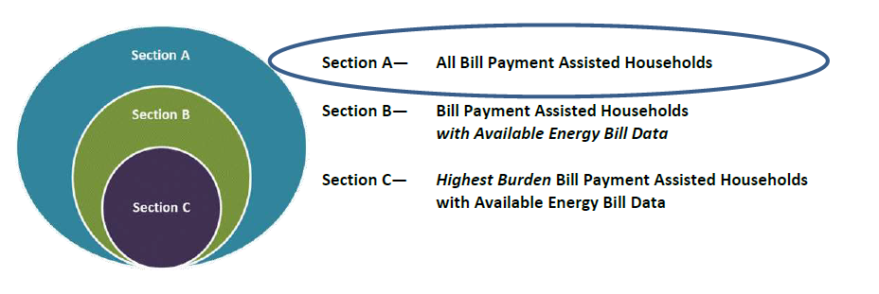
Topic #1: Completing the Energy Burden Measures Overview
Energy Burden Section – Overview
Section A – All Bill Payment Assistance Clients

Slide 10
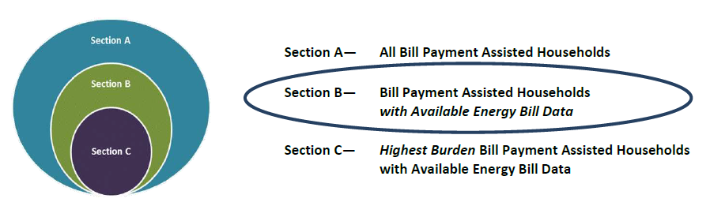
Topic #1: Completing the Energy Burden Measures Overview
Energy Burden Section – Overview
Section B – All Bill Payment Assistance Clients with complete heating AND electric expenditures for the targeted 12-month period

Slide 11
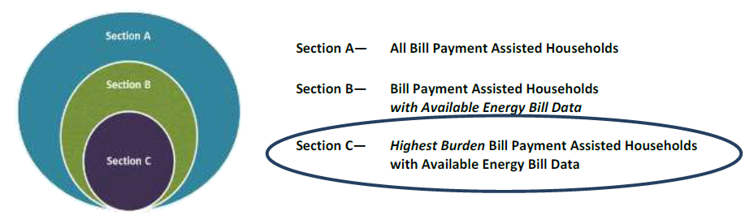
Topic #1: Completing the Energy Burden Measures Overview
Energy Burden Section – Overview
Section C – High Burden Bill Payment Assistance clients with complete heating AND electric expenditures for the targeted 12-month period

Slide 12
Topic #1 – Questions
Grantee Questions regarding the overview for completing the Energy Burden Measures?

Slide 13
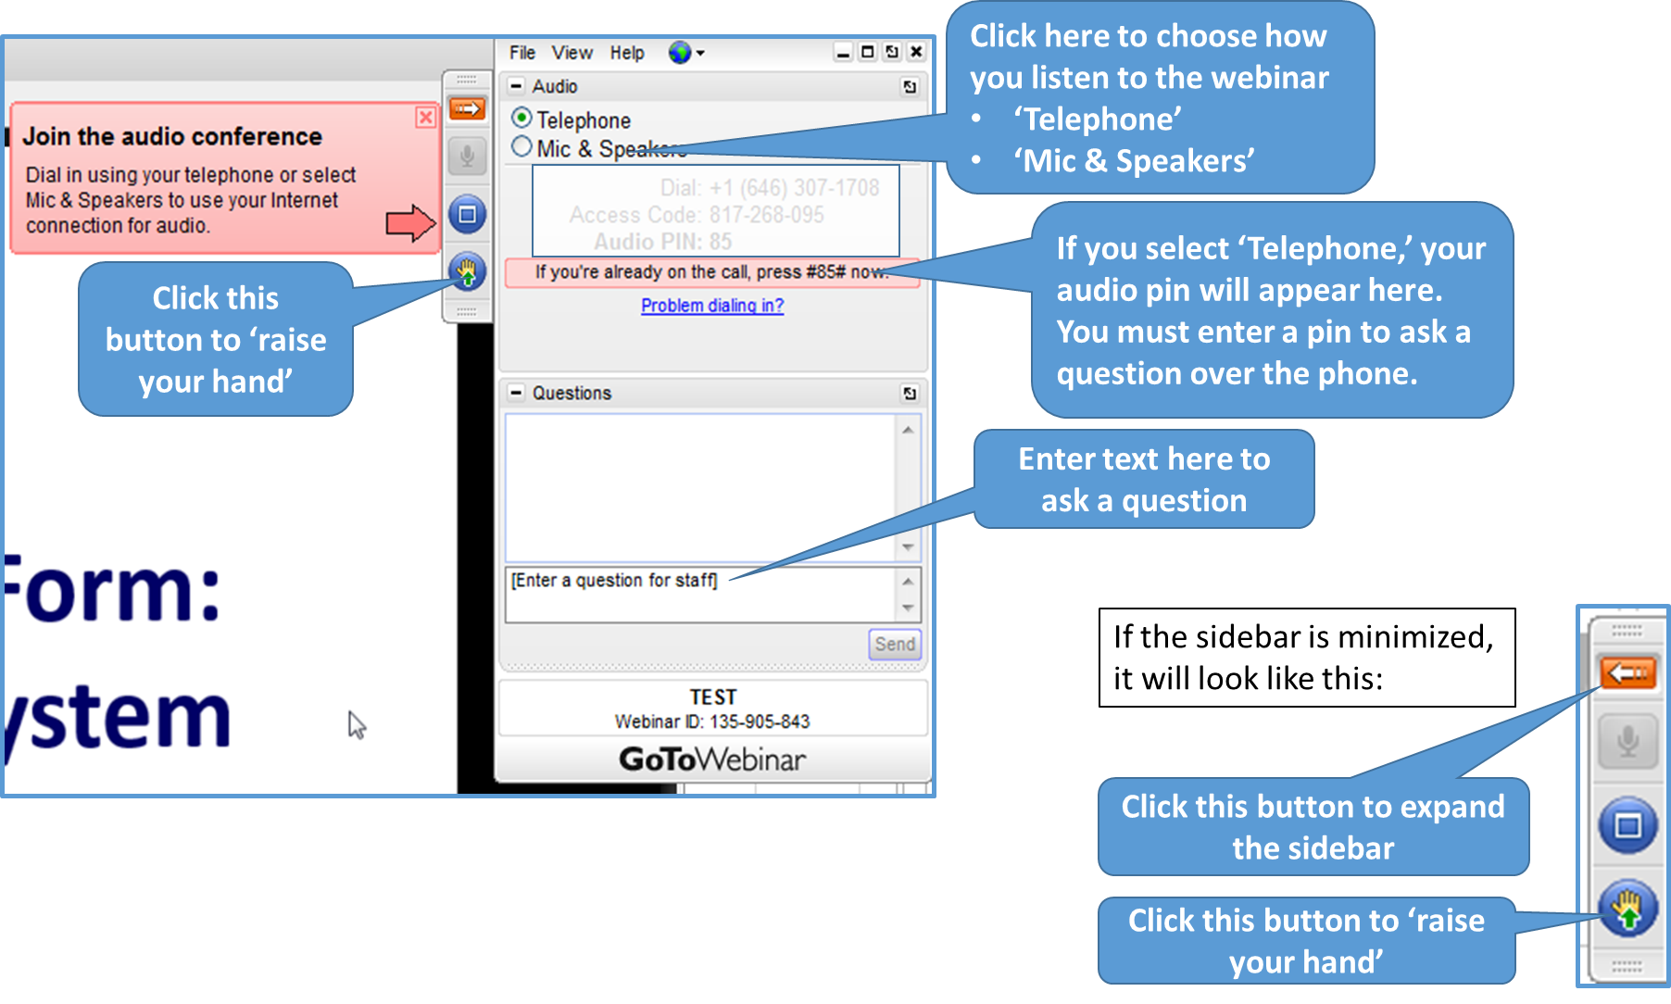
GoToWebinar – Asking a Question
If you wish to call in and ask a question, you MUST call in by phone rather than connect your audio through your computer

Slide 14
Topic #1: Completing the Energy Burden Measures
Which Households should be included under Energy Burden Targeting (Section V)?
This section should include those households who received “Bill Payment Assistance” during the fiscal year.
“Bill Payment Assistance” – includes all households who received a LIHEAP benefit that was used to pay a share of the household’s energy bills, including utility deposits.
  Includes: heating, cooling, crisis, and supplemental assistance
  Excludes: Households receiving only non-bill payment assistance (e.g. weatherization assistance, equipment repair/replacement, nominal payments to SNAP households)

Slide 15
Topic #1A: Completing the Energy Burden Measures Section A – Unduplicated Bill Payment Households
Section A – All Bill Payment Assistance Clients

Slide 16
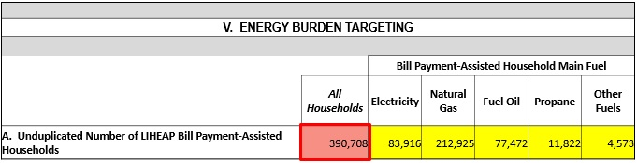
Topic #1A: Completing the Energy Burden Measures Section A
Section A – Unduplicated Number of LIHEAP Bill Payment-Assisted Households. Grantees should report on all households that received LIHEAP Bill Payment Assistance during the fiscal year, by main heating fuel type.
Note: The “All Households” field in Section A is auto-calculated from the counts reported for each main heating fuel type. The “All Households” field should match the Bill Payment Assistance households count reported in grantees’ LIHEAP Household Report.

Slide 17


Topic #1A: Completing the Energy Burden Measures Section A
Section A – Unduplicated Number of LIHEAP Bill Payment-Assisted Households.
Household Report
Performance Measures Section

Slide 18
Topic #1A: Completing the Energy Burden Measures Section B – All Households
Section B – All Bill Payment Assistance Clients with complete heating AND electric expenditures for the targeted 12-month period

Slide 19
Topic #1A: Completing the Energy Burden Measures Section B
Section B – All Households with 12 Consecutive Months of Bill Data (Main Fuel and Electric).
Grantees should report on all LIHEAP Bill Payment Assistance Households for whom they were able to collect complete heating AND electric expenditure data for the targeted 12-month period.
  Note: Section B is a subset of households from Section A, and will likely include fewer households.

Slide 20
Topic #1A: Completing the Energy Burden Measures Section B
EXAMPLE:
Percent of all Bill Payment-Assisted Households (Section A) with Complete Energy Expenditures Data (Section B)
  *Section B includes fewer households than Section A.
V. ENERGY BURDEN TARGETING
 |  | Bill Payment-Assisted Household Main Fuel
 | All Households | Electricity | Natural Gas | Fuel Oil | Propane | Other Fuels
A. Unduplicated Number of LIHEAP Bill Payment-Assisted Households | 107,970 | 20,520 | 72,000 | 5,325 | 6,075 | 4,050
B. All Households with 12 Consecutive Months of Bill Data (Main Fuel and Electric)
1. Unduplicated Number of Households with 12 Consecutive Months of Bill Data (Main Fuel and Electric) | 82,000 | 15,000 | 60,000 | 2,500 | 2,500 | 2,000
All Households | Electricity | Natural Gas | Fuel Oil | Propane | Other Fuels
76% | 73% | 83% | 47% | 41% | 49%

Slide 21
Topic #1A: Completing the Energy Burden Measures Section B
  How to Calculate the “Average Annual Main Heating Fuel Bill” and “Average Annual Electricity Bill” for Electric Main Heat Households in Section B?
Calculate average annual electricity expenditures for electric main heat households.
  Report the full amount calculated under “Average Annual Main Heating Fuel Bill” (Row B4).
  Report zero dollars ($0) under “Average Annual Electricity Bill” (Row B5).

Slide 22
Topic #1A: Completing the Energy Burden Measures Section B
  Example: Reporting “Average Annual Main Heating Fuel Bill” and “Average Annual Electricity Bill” for electric main heat households
You compute average annual electric expenditures of $1,950 for electric main heat households.
Enter full amount ($1,950) as “Average Annual Main Heating Fuel Bill”
Enter zero dollars ($0) as “Average Annual Electricity Bill”
B. All Households with 12 Consecutive Months of Bill Data (Main Fuel and Electric) | Electricity
1. Unduplicated Number of Households with 12 Consecutive Months of Bill Data (Main Fuel and Electric) | 12,000
2. Average Annual Household Income | $20,500
3. Average Annual Total LIHEAP Benefit per Household (including Heating, Cooling, Crisis, Supplemental Benefits) | $520
4. Average Annual Main Heating Fuel Bill | $1,950
5. Average Annual Electricity Bill | $0
6. Average Annual Total Residential Energy Bill | $1,950

Slide 23
Topic #1A: Completing the Energy Burden Measures Section B
  Which “All Households” fields in Section B are calculated by grantees?
  Average Annual Household Income (Row B2)
  Average Annual Total LIHEAP Benefit per Household (Row B3)
  Average Annual Main Heating Fuel Bill (Row B4)
  Average Annual Electricity Bill (Row B5)
  Note: Rows B1, B6-B10 are auto-calculated in OLDC. For further information on how these fields are calculated, see: https://liheappm.acf.hhs.gov/node/781

Slide 24
Topic #1A: Completing the Energy Burden Measures Section B
  Calculating Average Annual Household Income for “All Households” (Row B2)
  For each household included in Section B, calculate their annual household income (e.g., if monthly income collected, multiple by 12 months).
  Then, take the simple average annual household income for all households included in Section B. Report this value in the “All Households” field.

Slide 25
Topic #1A: Completing the Energy Burden Measures Section B
  Calculating Average Annual Total LIHEAP Benefit per Household for “All Households” (Row B3)
  For each household included in Section B, calculate their annual total LIHEAP benefit – the sum of all heating, cooling, crisis, and supplemental benefits used for bill payment assistance.
  Then, take the simple average annual total LIHEAP benefit for all households included in Section B. Report this value in the “All Households” field.
    Note: Row B3 in the Energy Burden Measures should match what is reported in Section IV, Row 5 of the Grantee Survey, for “All Households” and all main heating fuel types.

Slide 26
Topic #1A: Completing the Energy Burden Measures Section B
  Calculating Average Annual Main Heating Fuel Bill for “All Households” (Row B4)
  For each household included in Section B, create a variable for “annual main heating fuel bill” =
    Annual electric bill if electric main heat, or
    Annual natural gas bill if natural gas main heat, or
    Annual fuel oil bill if fuel oil main heat, or
    Annual propane bill if propane main heat, or
    Annual “other fuels” bill if other fuel main heat.
  Then, take the simple average “annual main heating fuel bill” for all households included in Section B. Report this value in the “All Households” field.

Slide 27
Topic #1A: Completing the Energy Burden Measures Section B
  Calculating Average Annual Electricity Bill for “All Households” (Row B5)
  For each household included in Section B, create a variable for “annual non-heat electric bill” =
    Annual electric bill if non-electric main heat (i.e., natural gas, fuel oil, propane, or “other fuels” main heat), or
    Zero dollars ($0) if electric main heat*
  Then, take the simple average “annual non-heat electric bill” for all households included in Section B. Report this value in the “All Households” field.
    *Note: Electric expenditures of electric main heat households are counted as heating expenditures.

Slide 28

Topic #1A: Completing the Energy Burden Measures Section B
A convenient check to make sure that the “All Households” fields for “average annual” values are calculated correctly is to calculate the weighted average across main heating fuel types.
Example: “All Households” Average Annual Total LIHEAP Benefit per Household for a grantee with bill data on electric main heat households (EL hhlds) and natural gas main heat households (NG hhlds)
B. All Households with 12 Consecutive Months of Bill Data (Main Fuel and Electric) | All Households | Electricity | Natural Gas
1. Unduplicated Number of Households with 12 Consecutive Months of Bill Data (Main Fuel and Electric) | 57,000 | 12,000 | 45,000
2. Average Annual Household Income | $21,092 | $20,500 | $21,250
3. Average Annual Total LIHEAP Benefit per Household (including Heating, Cooling, Crisis, Supplemental Benefits) | $544 | $520 | $550
4. Average Annual Main Heating Fuel Bill | $1,516 | $1,950 | $1,400
5. Average Annual Electricity Bill | $632 | $0 | $800
6. Average Annual Total Residential Energy Bill | $2,147 | $1,950 | $2,200
  Average annual total LIHEAP benefit per household for “All Households” =
  $$\frac{\text{(}\text{\$520 }\text{×}\text{ 12,000 }\text{EL} \text{hhlds}\text{) + (}\text{\$550 }\text{×}\text{ 45,000 }\text{NG} \text{hhlds}\text{)}}{\text{12,000 }\text{EL} \text{hhlds}\text{ + 45,000 }\text{NG} \text{hhlds}}\text{= \$544}$$

Slide 29
Topic #1A: Completing the Energy Burden Measures Section B
  The Energy Burden Measures section is not just a reporting tool – these measures can tell you a lot about your LIHEAP clients. What can Section B tell you?
Among all bill payment-assisted households, are there differences in average annual burden according to heating fuel type?
  Are the differences in average annual burden driven by differences in income, differences in residential energy bills, or both?
Among all bill payment-assisted households, are there differences in average annual total LIHEAP benefits by heating fuel type?
  Do the differences make sense based on differences in average annual burden by heating fuel type?
How large of an impact does LIHEAP have in reducing the energy burden of all bill payment-assisted households?
For more detailed information and analysis of what Section B can tell you about your LIHEAP clients, see the following presentation given at the 2016 NEUAC Annual Conference: https://liheappm.acf.hhs.gov/sites/default/files/private/training/presentations/2016/Session6G_LIHEAPPM-McGrath.pptx

Slide 30
Topic #1A – Questions
Grantee Questions regarding completing the Energy Burden Measures section for all bill payment-assisted households (Section V, Section B)?

Slide 31
GoToWebinar – Asking a Question
If you wish to call in and ask a question, you MUST call in by phone rather than connect your audio through your computer

Slide 32
Topic #1B: Completing the Energy Burden Measures Section C
Section C – High Burden Bill Payment Assistance clients with complete heating AND electric expenditures for the targeted 12-month period

Slide 33
Topic #1B: Completing the Energy Burden Measures Section C
Section C – High Burden Households with 12 Consecutive Months of Bill Data (Main Fuel and Electric).
Taking the bill payment-assisted households from Section B, grantees should identify and report on those households with the top 25% energy burden in Section C.
  Energy burden = (annual main heating fuel expenditures + annual electricity expenditures) ÷ annual household income
  Note: Zero Income Households. Zero income households should also be included. Grantees should record the energy burden for these households as 100% of household income.

Slide 34
Topic #1B: Completing the Energy Burden Measures Section C
Section C – High Burden Households with 12 Consecutive Months of Bill Data (Main Fuel and Electric).
Section C should include the top 25% of Section B households, based on highest energy burden, regardless of main heating fuel type.
Section C should NOT simply include 25% of Section B households for each main heating fuel type.
Grantees can perform a visual check of the data reported in Section B and Section C to help determine if high burden households were identified and reported on correctly.

Slide 35
Topic #1B: Completing the Energy Burden Measures Section C
Example: Incorrectly completing Section C for High Burden Households
V. ENERGY BURDEN TARGETING
 |  | Bill Payment-Assisted Household Main Fuel
 | All Households | Electricity | Natural Gas | Fuel Oil | Propane | Other Fuels
B. All Households with 12 Consecutive Months of Bill Data (Main Fuel & Electric)
1. Unduplicated Number of Households with 12 Consecutive Months of Bill Data (Main Fuel and Electric) | 82,000 | 15,000 | 60,000 | 2,500 | 2,500 | 2,000
7. Average Annual Burden Before Receiving LIHEAP | 10.2% | 10.0% | 9.5% | 17.5% | 17.0% | 15.0%
High Burden Households with 12 Consecutive Months of Bill Data (Main Fuel & Electric)
1. Unduplicated Number of High Burden Households (Top 25%) with 12 Consecutive Months of Bill Data (Main Fuel and Electric) | 20,500 | 3,750 | 15,000 | 625 | 625 | 500
7. Average Annual Burden Before Receiving LIHEAP for High Burden Households | 18.3% | 18.0% | 17.5% | 27.0% | 26.0% | 24.0%
25%
25%
Here, we see that 25% of bill payment-assisted households were reported on for each main heating fuel type. This is an unlikely scenario.
In addition, we would expect average annual burden before receiving LIHEAP for high burden households (Row C7) to be fairly uniform across main heating fuel types, but we see substantial variation.

Slide 36
Topic #1B: Completing the Energy Burden Measures Section C
Example: Correctly completing Section C for High Burden Households
V. ENERGY BURDEN TARGETING
 |  | Bill Payment-Assisted Household Main Fuel
 | All Households | Electricity | Natural Gas | Fuel Oil | Propane | Other Fuels
B. All Households with 12 Consecutive Months of Bill Data (Main Fuel & Electric)
1. Unduplicated Number of Households with 12 Consecutive Months of Bill Data (Main Fuel and Electric) | 82,000 | 15,000 | 60,000 | 2,500 | 2,500 | 2,000
7. Average Annual Burden Before Receiving LIHEAP | 10.2% | 10.0% | 9.5% | 17.5% | 17.0% | 15.0%
 |  | 20% | 21% | 70% | 68% | 63%
High Burden Households with 12 Consecutive Months of Bill Data (Main Fuel & Electric)
1. Unduplicated Number of High Burden Households (Top 25%) with 12 Consecutive Months of Bill Data (Main Fuel and Electric) | 20,500 | 3,000 | 12,800 | 1,750 | 1,700 | 1,200
7. Average Annual Burden Before Receiving LIHEAP for High Burden Households | 23.2% | 22.7% | 23.0% | 23.8% | 24.2% | 23.6%
25%
Here, we see 25% of all Section B households were reported on, but substantial variation by main heating fuel type. This scenario is likely.
In addition, average annual burden before receiving LIHEAP for high burden households (Row C7) is fairly uniform across main heating fuel types.

Slide 37
Topic #1A: Completing the Energy Burden Measures Section C
  How to Calculate the “Average Annual Main Heating Fuel Bill” and “Average Annual Electricity Bill” for Electric Main Heat Households in Section C?
Calculate average annual electricity expenditures for electric main heat high burden households.
  Report the full amount calculated under “Average Annual Main Heating Fuel Bill for Household Burden Households” (Row C4).
  Report zero dollars ($0) under “Average Annual Electricity Bill for High Burden Households” (Row C5).
  Note: This is the same procedure used for all bill payment-assisted households in Section B.

Slide 38
Topic #1A: Completing the Energy Burden Measures Section C
  Which “All Households” fields in Section C are calculated by grantees?
  Average Annual Household Income for High Burden Households (Row C2)
  Average Annual Total LIHEAP Benefit per Household for High Burden Households (Row C3)
  Average Annual Main Heating Fuel Bill for High Burden Households (Row C4)
  Average Annual Electricity Bill for High Burden Households (Row C5)
  Note: Rows C1, C6-C10 are auto-calculated in OLDC. For further information on how these fields are calculated, see: https://liheappm.acf.hhs.gov/node/781

Slide 39
Topic #1A: Completing the Energy Burden Measures Section C
  Calculating Average Annual Household Income for High Burden Households for “All Households” (Row C2)
  Take the simple average annual household income for all high burden households included in Section C. Report this value in the “All Households” field.

Slide 40
Topic #1A: Completing the Energy Burden Measures Section C
  Calculating Average Annual Total LIHEAP Benefit per Household for High Burden Households for High Burden Households for “All Households” (Row C3)
  Take the simple average annual total LIHEAP benefit for all high burden households included in Section C. Report this value in the “All Households” field.

Slide 41
Topic #1A: Completing the Energy Burden Measures Section C
  Calculating Average Annual Main Heating Fuel Bill for High Burden Households for “All Households” (Row C4)
  Take the simple average “annual main heating fuel bill” for all high burden households included in Section C. Report this value in the “All Households” field.
    Note: The “annual main heating fuel bill” variable was created for use in Section B (Row B4). Use that variable again here, just with the households included in Section C.

Slide 42
Topic #1A: Completing the Energy Burden Measures Section C
  Calculating Average Annual Electricity Bill for “All Households” (Row C5)
  Take the simple average “annual non-heat electric bill” for all high burden households included in Section B. Report this value in the “All Households” field.
    Note: The “annual non-heat electric bill” variable was created for use in Section B (Row B5). Use that variable again here, just with the households included in Section C.

Slide 43
Topic #1B: Completing the Energy Burden Measures Section C
  The Energy Burden Measures Section is not just a reporting tool – these measures can tell you a lot about your LIHEAP clients. What can Section C tell you?
Do high burden bill payment-assisted households tend to use one heating fuel type versus another when compared to all bill payment-assisted households?
What differences in average income and residential energy bills are observed between high burden bill payment-assisted households and all bill payment-assisted households?
Among high burden bill payment-assisted households, are there differences in average annual total LIHEAP benefits by heating fuel type?
How large of an impact does LIHEAP have in reducing the energy burden of high burden bill payment-assisted households?
For more detailed information and analysis of what Section C can tell you about your high burden LIHEAP clients, see the following presentation given at the 2016 NEUAC Annual Conference: https://liheappm.acf.hhs.gov/sites/default/files/private/training/presentations/2016/Session6G_LIHEAPPM-McGrath.pptx

Slide 44
Topic #1B – Questions
Grantee Questions regarding completing the Energy Burden Measures section for high burden bill payment-assisted households (Section V, Section C)?

Slide 45
GoToWebinar – Asking a Question
If you wish to call in and ask a question, you MUST call in by phone rather than connect your audio through your computer

Slide 46
Topic #1C: Completing the Energy Burden Measures Targeting Indices
Section D and Section E are auto-calculated for grantees, upon completion of Section B and Section C of the Energy Burden Measures.
  Section D – Benefit Targeting Index for High Burden Households. This measure tells us whether high energy burden households receive higher LIHEAP benefits than average households.
    It compares Row C3 to Row B3 [index score = (Row C3 ÷ Row B3) x 100, for each column]
  Section E – Burden Reduction Targeting Index for High Burden Households. This measure tells us whether high energy burden households have a larger share of their energy bill paid with LIHEAP than average households.
    It compares Row C10 to Row B10 [index score = (Row C10 ÷ Row B10) x 100, for each column]

Slide 47
Topic #1C: Completing the Energy Burden Measures Targeting Indices
Example: Benefit Targeting Index for High Burden Households (Section D)
V. ENERGY BURDEN TARGETING
 |  | Bill Payment-Assisted Household Main Fuel
 | All Households | Electricity | Natural Gas | Fuel Oil | Propane | Other Fuels
B. All Households with 12 Consecutive Months of Bill Data (Main Fuel and Electric)
3. Average Annual Total LIHEAP Benefit per Household (including Heating, Cooling, Crisis, Supplemental Benefits) | $491 | $450 | $500 | $650 | $550 | $250
C. High Burden Households with 12 Consecutive Months of Bill Data (Main Fuel and Electric)
3. Average Annual Total LIHEAP Benefit per High Burden Household (including Heating, Cooling, Crisis, Supplemental Benefits) | $583 | $565 | $595 | $700 | $625 | $285
D. Benefit Targeting Index for High Burden Households: | 119 | 126 | 119 | 108 | 114 | 114
Note: The Benefit Targeting Index is auto-calculated using data from Section B and Section C of the Energy Burden Measures. For more detailed information on the calculations used in the Benefit Targeting Index, see: https://liheappm.acf.hhs.gov/node/781

Slide 48
Topic #1C: Completing the Energy Burden Measures Targeting Indices
Example: Burden Reduction Targeting Index for High Burden Households (Section E)
V. ENERGY BURDEN TARGETING
 |  | Bill Payment-Assisted Household Main Fuel
 | All Households | Electricity | Natural Gas | Fuel Oil | Propane | Other Fuels
B. All Households with 12 Consecutive Months of Bill Data (Main Fuel and Electric)
10. Average Percentage Reduction in Energy Burden | 22.1% | 24.3% | 22.0% | 23.6% | 20.4% | 12.2%
C. High Burden Households with 12 Consecutive Months of Bill Data (Main Fuel and Electric)
10. Average Percentage Reduction in Energy Burden for High Burden Households | 22.4% | 27.6% | 23.1% | 21.2% | 19.5% | 11.4%
D. Burden Reduction Targeting Index for High Burden Households: | 101 | 113 | 105 | 90 | 96 | 93
Note: The Burden Reduction Targeting Index is auto-calculated using data from Section B and Section C of the Energy Burden Measures. For more detailed information on the calculations used in the Burden Reduction Targeting Index, see: https://liheappm.acf.hhs.gov/node/781

Slide 49
Topic #2C – Questions
Grantee Questions regarding completing the Energy Burden Measures Targeting Indices (Section D and Section E in Section V)?

Slide 50
GoToWebinar – Asking a Question
If you wish to call in and ask a question, you MUST call in by phone rather than connect your audio through your computer

Slide 51
Topic #2: Completing the Restoration and Prevention Measures
What households do I count under ‘Restoration of Home Energy Service’ (Section VI)?
The sample for Section VI should include ALL LIHEAP households for which LIHEAP assistance led to the restoration of a household’s energy service during the fiscal year. This may differ from the sample used for the Energy Burden Measures Section (Section V).
  Energy Burden Measures (Section V) – Only included households who received Bill Payment Assistance
  Restoration Measures (Section VI) – Includes ALL LIHEAP households (Bill Payment Assistance + Weatherization + Equipment Repair/Replacement)
    Note: Excludes households only receiving SNAP nominal payments

Slide 52
Topic #2A: Completing the Restoration of Home Energy Service Measures
What data should be reported under ‘Restoration of Home Energy Service’ (Section VI)?
The data fields in Section VI require specific information on the number of occurrences in which LIHEAP assistance led to the restoration of a household’s energy service during the fiscal year.
Grantees are required to report on the number of times LIHEAP was used to restore service in the following situations:
  Energy Service Restored After Disconnection
  Fuel Delivered to Home that Ran Out of Fuel
  Repair/Replacement of Inoperable Home Energy Equipment
For more information on the data collection guidelines for the Restoration Measures, please see the "LIHEAP Performance Measures Data Collection Guide - Criteria for Determining Service Restoration” supplement on the Performance Management Website

Slide 53
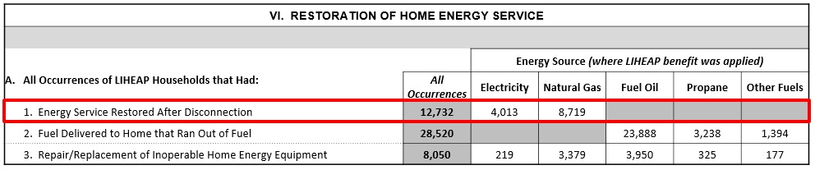
Topic #2A: Completing the Restoration of Home Energy Service Measures
Energy Service Restored After Disconnection (Row A1). Grantees should report on the number of occurrences during the fiscal year in which LIHEAP assistance led to the restoration of a household’s energy service after a disconnection.

Slide 54
Topic #2A: Completing the Restoration of Home Energy Service Measures
Energy Source – Grantees should report the number of occurrences in which LIHEAP assistance was used to restore a disconnected household’s energy service, based on the energy source where the LIHEAP benefit was applied. Please note that in some cases, this may not be the household’s primary fuel source.
  Note: Households could have experienced multiple instances in which LIHEAP assistance was used to restore their energy service during the fiscal year. Each separate occurrence should be reported on in this section.
  Note: Fuel Oil, Propane, and Other Fuels columns are “blacked-out” because these data should be reported in Row A2 (for instances where household ran out of fuel).
All Occurrences – The column for ‘All Occurrences’ is the sum of the counts reported for each energy source. This column is auto-calculated “on-the-fly” as grantees input data into the fields for each energy source.
Pre-pay Clients – For FY 2016, electric pre-pay clients whose account ran out of funds, and who had their energy service restored with a LIHEAP benefit should be reported in Row A1 (“Disconnection”) under electricity. If applicable, grantees should include a note of this in their form. Please note that this guidance may change for FY 2017.

Slide 55
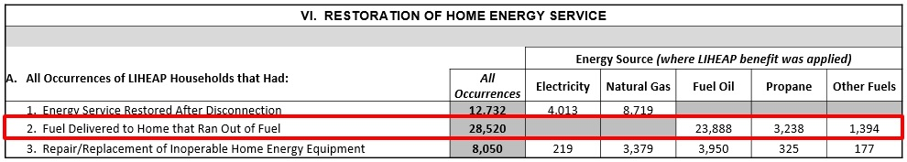
Topic #2A: Completing the Restoration of Home Energy Service Measures
Fuel Delivered to Home that Ran Out of Fuel (Row A2). Grantees should report on the number of occurrences during the fiscal year in which LIHEAP assistance resulted in the delivery of fuel to a home after the household had run out of fuel.

Slide 56
Topic #2A: Completing the Restoration of Home Energy Service Measures
Energy Source – Grantees should report the number of occurrences in which LIHEAP assistance was used to restore energy service to a household that ran out of fuel, based on the energy source where the LIHEAP benefit was applied. Please note that in some cases, this may not be the household’s primary fuel source.
  Note: Households could have experienced multiple instances in which LIHEAP assistance was used to restore their energy service during the fiscal year. Each separate occurrence should be reported on in this section.
  Note: Electricity and Natural Gas columns are “blacked-out” because these data should be reported in Row A1 (for instances where household’s energy service was disconnected).
All Occurrences – The column for ‘All Occurrences’ is the sum of the counts reported for each energy source (fuel oil, propane, and other fuels). This column is auto-calculated “on-the-fly” as grantees input data into the fields for each energy source.

Slide 57
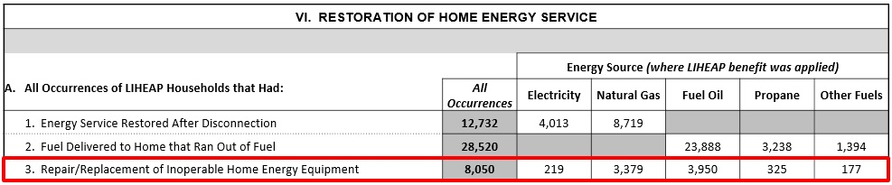
Topic #2A: Completing the Restoration of Home Energy Service Measures
Repair/Replacement of Inoperable Home Energy Equipment (Row A3). Grantees should report on the number of occurrences during the fiscal year in which households had inoperable heating or cooling equipment repaired or replaced using LIHEAP funds.

Slide 58
Topic #2A: Completing the Restoration of Home Energy Service Measures
Energy Source – Grantees should report the number of occurrences in which LIHEAP assistance was used to repair/replace a households inoperable home energy equipment, based on the fuel source for the equipment that was repaired or replaced. This should always be the household’s primary heating or electric source (e.g. AC).
  Note: Households could have experienced multiple instances in which LIHEAP assistance was used to repair/replace a household’s inoperable. Each separate occurrence should be reported on in this section.
All Occurrences – This is a sum of the total number of instances in which LIHEAP assistance was used to repair/replace a household’s inoperable home energy equipment. This column is auto-calculated “on-the-fly” as grantees input data into the fields for each energy source.

Slide 59
Topic #2A – Questions
Grantee Questions regarding completing the Restoration of Home Energy Service Measures (Section VI)?

Slide 60
GoToWebinar – Asking a Question
If you wish to call in and ask a question, you MUST call in by phone rather than connect your audio through your computer

Slide 61
Topic #2: Completing the Restoration and Prevention Measures
What households do I count under ‘Prevention of Loss of Home Energy Service’ (Section VII)?
The sample for Section VII should include ALL LIHEAP households for which LIHEAP assistance led to the prevention of a household’s loss of energy service, during the fiscal year. This may also differ from the sample used for the Energy Burden Section (Section V).
  Energy Burden Measures (Section V) – Only includes households who received Bill Payment Assistance
  Prevention Measures (Section VII) – Includes ALL LIHEAP households (Bill Payment Assistance + Weatherization + Equipment Repair/Replacement)
    Note: Excludes households only receiving SNAP nominal payments

Slide 62
Topic #2B: Completing the Prevention of Loss of Home Energy Service Measures
What data should be reported under ‘Prevention of Loss of Home Energy Service’ (Section VII)?
The data fields in Section VII require specific information on the number of occurrences in which LIHEAP assistance prevented the loss of energy service for a household at risk of losing their home energy service, during the fiscal year.
Grantees are required to report on the number of times LIHEAP was used to prevent service loss under the following conditions:
  Households with a Utility Past Due or Disconnect Notice
  Households with Limited Fuel
  Households in need of Equipment Repair/Replacement
Note: The Criteria for ‘Prevention of home energy loss’ are defined by each Grantee.
For more information on the data collection guidelines for the Prevention Measures, please see the "LIHEAP Performance Measures Data Collection Guide - Criteria for Determining At Risk Clients” supplement on the Performance Management Website.

Slide 63
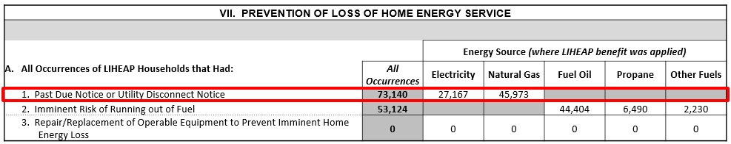
Topic #2B: Completing the Prevention of Loss of Home Energy Service Measures
Past Due or Utility Disconnect Notice (Row A1). Grantees should report on the number of occurrences in which households had a past due or disconnect notice at the time of application and receipt of LIHEAP assistance resulted in the continuance of home energy service. Households who are already disconnected should not be counted in this section.

Slide 64
Topic #2B: Completing the Prevention of Loss of Home Energy Service Measures
Energy Source – Grantees should report the number of occurrences in which LIHEAP assistance was used to prevent the loss of home energy service for a household that received a past due or disconnect notice, based on the energy source where the LIHEAP benefit was applied. Please note that in some cases, this may not be the household’s primary fuel source.
  Note: Households could have experienced multiple instances in which LIHEAP assistance was used to prevent loss of home energy service during the fiscal year. Each separate occurrence should be reported on in this section.
  Note: Fuel Oil, Propane, and Other Fuels columns are “blacked-out” because these data should be reported in Row A2 (for instances where households were at imminent risk of running out of fuel).
All Occurrences – The column for ‘All Occurrences’ is the sum of the counts reported for each energy source. This column is auto-calculated “on-the-fly” as grantees input data into the fields for each energy source.
Pre-pay Clients – For FY 2016, electric pre-pay clients whose account was low on funds, and who received a LIHEAP benefit that prevented the loss of their energy service should be reported in Row A1 (“Past Due or Disconnect Notice”) under electricity. If applicable, grantees should include a note of this in their form. Please note that this guidance may change for FY 2017.

Slide 65
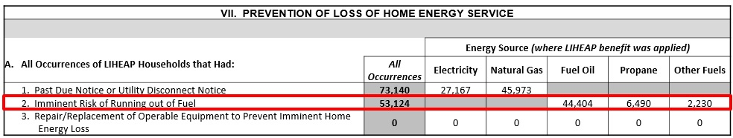
Topic #2B: Completing the Prevention of Loss of Home Energy Service Measures
Imminent Risk of Running out of Fuel (Row A2). Grantees should report on the number of occurrences in which households were at imminent risk of running out of fuel at the time of application and receipt of LIHEAP assistance resulted in the delivery of fuel. Households who are already out of fuel should not be counted in this section.

Slide 66
Topic #2B: Completing the Prevention of Loss of Home Energy Service Measures
Energy Source – Grantees should report the number of occurrences in which LIHEAP assistance was used to prevent a household in imminent risk of running out of fuel from losing their home energy service, based on the energy source where the LIHEAP benefit was applied. Please note that in some cases, this may not be the household’s primary fuel source.
  Note: Households could have experienced multiple instances in which LIHEAP assistance was used to prevent loss of home energy service during the fiscal year. Each separate occurrence should be reported on in this section.
  Note: Electricity and Natural Gas columns are “blacked-out” because these data should be reported in Row A1 (for instances where households received a past due notice of utility disconnect notice).
All Occurrences – The column for ‘All Occurrences’ is the sum of the counts reported for each energy source. This column is auto-calculated “on-the-fly” as grantees input data into the fields for each energy source.

Slide 67
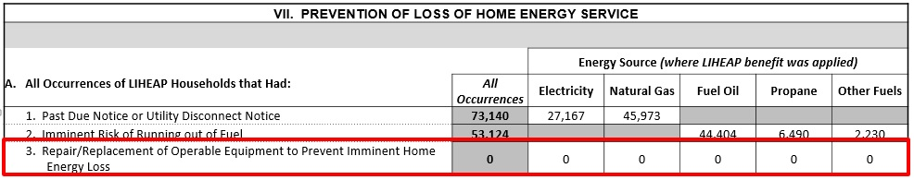
Topic #2B: Completing the Prevention of Loss of Home Energy Service Measures
Repair/Replacement of Operable Equipment to Prevent Imminent Home Energy Loss. Grantees should report on the number of occurrences in which LIHEAP Heating/Cooling equipment repair or replacement prevented a household’s loss of energy service. Households whose heating or cooling equipment is inoperable (or red-tagged) at the time of application or home energy audit should not be counted in this section.

Slide 68
Topic #2B: Completing the Prevention of Loss of Home Energy Service Measures
Energy Source – Grantees should report the number of occurrences in which LIHEAP assistance was used to repair/replace a household’s operable home energy equipment, based on the fuel source for the equipment that was repaired or replaced. This should always be the household’s primary heating or electric source (e.g. AC).
  Note: Households could have experienced multiple instances in which LIHEAP assistance was used to prevent loss of home energy service during the fiscal year. Each separate occurrence should be reported on in this section.
All Occurrences – This is a sum of the total number of instances in which LIHEAP assistance was used to repair/replace a household’s operable home energy equipment to prevent loss of home energy service during the fiscal year. This column is auto-calculated “on-the-fly” as grantees input data into the fields for each energy source.

Slide 69
Topic #2B – Questions
Grantee Questions regarding completing the Prevention of Loss of Home Energy Service Measures (Section VII)?

Slide 70
GoToWebinar – Asking a Question
If you wish to call in and ask a question, you MUST call in by phone rather than connect your audio through your computer

Slide 71
Topic #3: Optional Performance Measures
For FY 2016, Grantees have the option to report additional, non-mandatory Performance Measures:
Energy consumption data by main heating fuel type:
  All bill payment-assisted households (same households as reported on in Section B for energy bill data)
  High burden bill payment-assisted households (same households as reported on in Section C for energy bill data)
Unduplicated counts of bill payment-assisted households using electric, wood, or other fuels for supplemental heating, by main heating fuel type
Unduplicated counts of bill payment-assisted households using central AC or window/wall AC for cooling, by main heating fuel type
Unduplicated counts of LIHEAP assisted households for whom energy service was restored or energy service loss was prevented, by energy source

Slide 72
Topic #3: Optional Performance Measures
Reporting the Optional Performance Measures:
For grantees intending to report the Optional Performance Measures for FY 2016, we will send further information after the PMIWG meetings (Jan. 10-12), where we will be discussing guidance for these measures with the Data Team.

Slide 73
Resources
Resources for Grantees
Webinars
LIHEAP Performance Measurement Data Collection Guide
Performance Data Form and Instructions
LIHEAP Performance Management Website
Training and Technical Assistance Contacts

Slide 74
Resources
Webinars
FY 2016 Household Report
  https://youtu.be/XYb1BXww3GM
FY 2015 Performance Data Form – Grantee Survey
  https://www.youtube.com/watch?v=PtXQs8zewVs
PM Data Collection
  https://youtu.be/hf6uYWsk8ik\
FY 2016 Performance Data Form – Grantee Survey
  Coming Soon

Slide 75
Resources
Performance Data Form and Instructions
  Performance Data Form
    https://www.acf.hhs.gov/sites/default/files/ocs/liheap_at_2017_1_perf_data_form_121916.pdf
  Performance Data Form Instructions
    https://www.acf.hhs.gov/sites/default/files/ocs/liheap_performance_data_form_instructions_for_fy2016_19dec2016_0.pdf
  Performance Data Form FAQ
    https://liheappm.acf.hhs.gov/faq

Slide 76
Resources
Performance Management Website
https://liheappm.acf.hhs.gov/
If you need assistance accessing the Performance Management website, please contact:
  Travis McAdam (travism@ncat.org)

Slide 77
Resources
For more information, please contact:
Melissa Torgerson
  Melissa@verevassociates.net
  503-706-2647
Michelle Wadolowski
  Michelle-Wadolowski@appriseinc.org
  609-252-9057
Kevin McGrath
  Kevin-McGrath@appriseinc.org
  609-252-2081

Slide 78
Wrap Up – Questions
Outstanding Questions?

Slide 79
GoToWebinar – Asking a Question
If you wish to call in and ask a question, you MUST call in by phone rather than connect your audio through your computer

