Slide 1
The FY 2016 Household Report Form
LIHEAP Webinar presented by the Office of Community Services (OCS) in the Administration for Families and Children (ACF) hosted by APPRISE under contract to OCS
November 30, 2016
Presenters:
Leon Litow (OCS Staff)
Melissa Torgerson (Verve Associates)

Slide 2
Introduction

Slide 3
Introduction
Webinar Presenters
  Welcome
    Leon Litow, OCS staff
  T&TA Manager & OLDC Details
    Melissa Torgerson, Verve Associates
Presenter(s):
Melissa Torgerson

Slide 4
Introduction
APPRISE T&TA Team
  T&TA Manager
    Melissa Torgerson, Verve Associates
      melissa@verveassociates.net
  T&TA Staff
    Daniel Bausch, APPRISE
      Daniel-Bausch@appriseinc.org
    Sonia Guior, APPRISE
      Sonia-Guior@appriseinc.org
    Jorge Mancilla, APPRISE
      Jorge-MancillaUribe@appriseinc.org
    Michelle Wadolowski, APPRISE
      Michelle-Wadolowski@appriseinc.org
Presenter(s):
Melissa Torgerson

Slide 5
Overview
Topic #1: What’s Different in the FY 2016 Household Report Form in OLDC?
  Nominal Benefit Reporting Update
  Mandatory Bill Payment Assistance Reporting
Topic #2: Completing the FY 2016 Household Report Form in OLDC
  OLDC Access
  Data Submission and Review Procedures
Topic #3: What are the Data Checks in the FY 2016 Household Report Form in OLDC?
  Validation Checks
  Fatal Errors vs. Warning Messages
Topic #4: Common Issues
  Household Report vs. State Plan Inconsistencies
  Unduplicated Count Issues
  Weatherization Data
  Bill Payment Assistance Reporting
Presenter(s):
Melissa Torgerson

Slide 6
Topic #1

Slide 7
Topic #1
What’s Different in the FY 2016 Household Report Form in OLDC?
  Nominal Benefit Reporting Update
  Mandatory LIHEAP Bill Payment Assistance Reporting
Presenter(s):
Melissa Torgerson

Slide 8
Topic #1 – What’s Different in the FY 2016 Household Report Form in OLDC?
There are two items grantees should be particularly aware of when completing the FY 2016 Household Report Form:
  Clarification of Nominal Benefits Definition
  Mandatory Reporting of Bill Payment Assistance Households
Presenter(s):
Melissa Torgerson

Slide 9
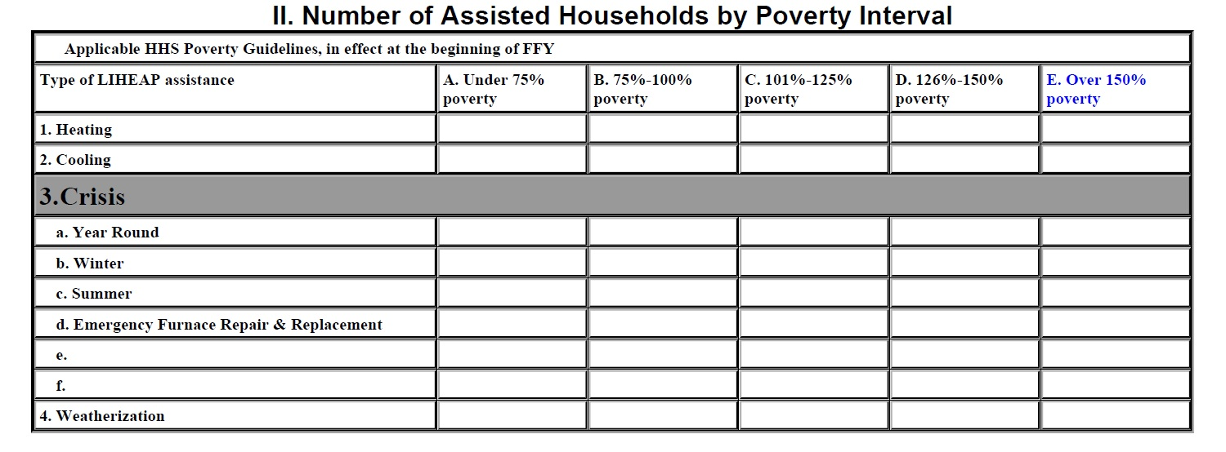
FY 2016 Household Report Form: Section II
Percent of Poverty Distributions REQUIRED for:
Heating
Cooling
Year Round Crisis
Winter Crisis
Summer Crisis
Other Types of Crisis
Emergency Furnace Repair & Replacement
Weatherization
Percent of Poverty Distributions NOT required for:
Any Type of LIHEAP Benefit
Any Type of Bill Payment Assistance
Nominal Benefits
Presenter(s):
Melissa Torgerson

Slide 10
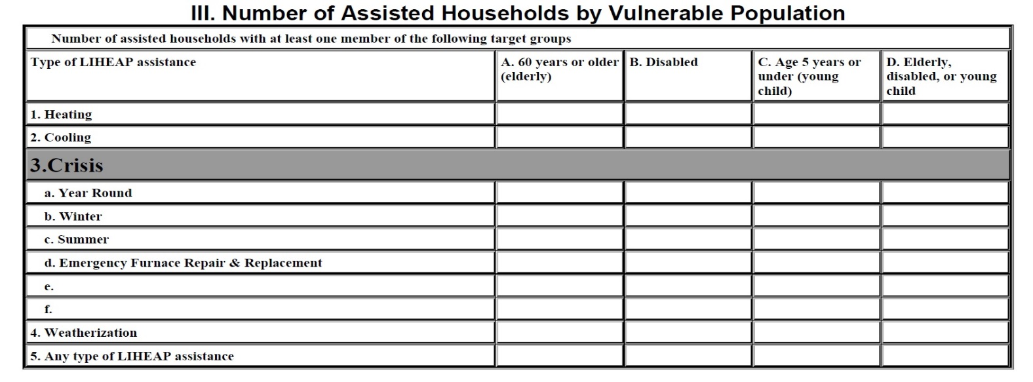
FY 2016 Household Report Form: Section III
Vulnerable Population counts are REQUIRED for:
Heating
Cooling
Year Round Crisis
Winter Crisis
Summer Crisis
Other Types of Crisis
Emergency Furnace Repair & Replacement
Weatherization
Any Type of LIHEAP Benefit
Vulnerable Population counts are NOT required for:
Any Type of Bill Payment Assistance
Nominal Benefits
Presenter(s):
Melissa Torgerson

Slide 11
Topic #1 – Nominal Benefit Reporting Update
Old Definition: For FY 2015 reporting, OCS initially indicated that Nominal Payment Assisted Households would include all households provided with a LIHEAP benefit of less than $51.
Updated Definition: However, the final instructions from OCS clarified that Nominal Payment Assisted Households should include only SNAP households assisted with a “nominal” LIHEAP benefit. This was consistent with the historical definition of nominal benefit households.
  This updated definition is remaining unchanged for FY 2016. Nominal Payment Assisted Households are defined as all SNAP households that received a nominal LIHEAP benefit during FY 2016.
  Grantees are required to report on the total number of these households in the “Nominal Payments” field in Section I of the FY 2016 Household Report (Item 7).
    Includes households provided with a nominal LIHEAP grant as part of a partnership with the SNAP program (“Heat & Eat” or “Cool & Eat” households).
    This is a total, NOT unduplicated, count of assisted households
  Grantees should also include a note in the “Notes” section of their FY 2015 LIHEAP Household Report form that details:
    The amount of the nominal benefit provided per household.
    A brief description of the nominal benefit programs operated by the state, if the state operates more than 1 of these types of programs.
Presenter(s):
Melissa Torgerson

Slide 12
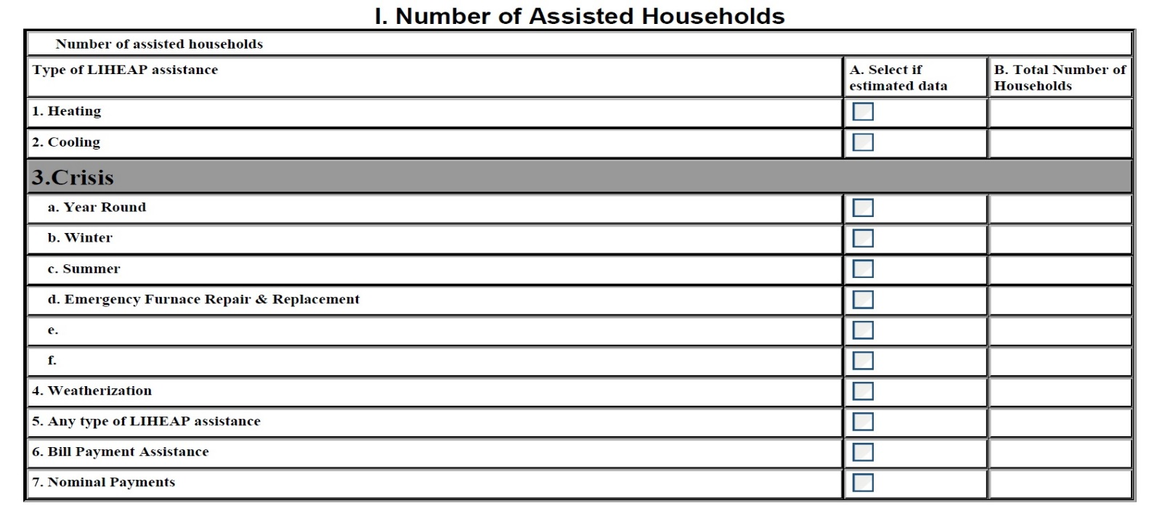
Nominal Benefit Reporting - Example
1
NYS issued a $21 nominal “Heat & Eat” benefit to 1 household in FY 2016
Example: For FY 2016, a SNAP household provided with a “Heat & Eat” benefit of $21 would be reported in the “Nominal Payments” count in Section I of the Report (Item 7). The grantee would also report on the amount of the nominal “Heat & Eat” benefit provided per SNAP household in the “Notes” section of the FY 2016 Household Report.
Presenter(s):
Melissa Torgerson

Slide 13
Topic #1 – Mandatory Reporting of “Bill Payment Assistance” Households
“Bill Payment Assistance” households are defined as any household provided with a cash LIHEAP benefit used to pay a share of a household’s energy bills and utility deposits
  For FY 2015, reporting on the total unduplicated number of bill payment assistance households in the FY 2015 Household Report (Item 6) was optional.
  However, for FY 2016, grantees are now required to report on the total unduplicated number of bill payment assistance households under the “Bill Payment Assistance” field in Section I of the FY 2016 Household Report (Item 6)
      This should include households receiving heating, cooling, and crisis assistance benefits
      This should exclude households receiving only LIHEAP weatherization assistance or energy-related equipment repair or replacement services
      This should exclude nominal payment households (if applicable)
Presenter(s):
Melissa Torgerson

Slide 14
Topic #1 – Mandatory Reporting of Bill Payment Assistance Households
Additional Notes:
Many grantees allow households to receive more than one type of LIHEAP bill payment assistance, such as receiving both crisis assistance and heating assistance.
    Note: If that is the case, then the unduplicated count of “bill payment assistance” households (Section I, Item 6) should be less than the sum of the household counts for each separate assistance type.
Many grantees provide weatherization or equipment repair/replacement through LIHEAP.
    Note: If that is the case, then the unduplicated count of “bill payment assistance” households (Section I, Item 6) should be less than the total unduplicated count for any type of LIHEAP assistance (Section I, Item 5).
Presenter(s):
Melissa Torgerson

Slide 15
Topic #1 – Potential Programming Changes
Important Considerations:
Run normal OLDC programs on the households in Heating, Cooling, Year Round Crisis, Winter Crisis, Summer Crisis, Other Crisis, Equipment Repair and Replacement, Weatherization, and Any Type of LIHEAP Benefit
Bill Payment Reporting: Prepare NEW program to develop an unduplicated count of households receiving “Bill Payment Assistance,” defined as any cash LIHEAP benefit used to pay a share of a household’s energy bills and utility deposits
    Includes: Heating, Cooling, Year Round Crisis, Winter Crisis, Summer Crisis and Other Crisis
    Does not Include: Households that only received LIHEAP weatherization or energy-related repair/replacement assistance; or households that received nominal LIHEAP grants.
    This data element is MANDATORY for FY 2016
Nominal Payment Reporting: Report on the TOTAL (NOT unduplicated) number of SNAP households assisted with a nominal LIHEAP benefit
Presenter(s):
Melissa Torgerson

Slide 16
Topic #1 – Summary
What’s Different in the FY 2016 Household Report Form in OLDC?
  Nominal Benefit Reporting Update
  Mandatory LIHEAP Bill Payment Assistance Reporting
New reporting guidelines are specified in the FY 2016 Household Report Instructions
  http://www.acf.hhs.gov/ocs/resource/liheap-action-transmittals
Presenter(s):
Melissa Torgerson

Slide 17
Topic #1 – Questions
Grantee questions regarding what’s different in the FY 2016 Household Report Form in OLDC?
Presenter(s):
Melissa Torgerson

Slide 18
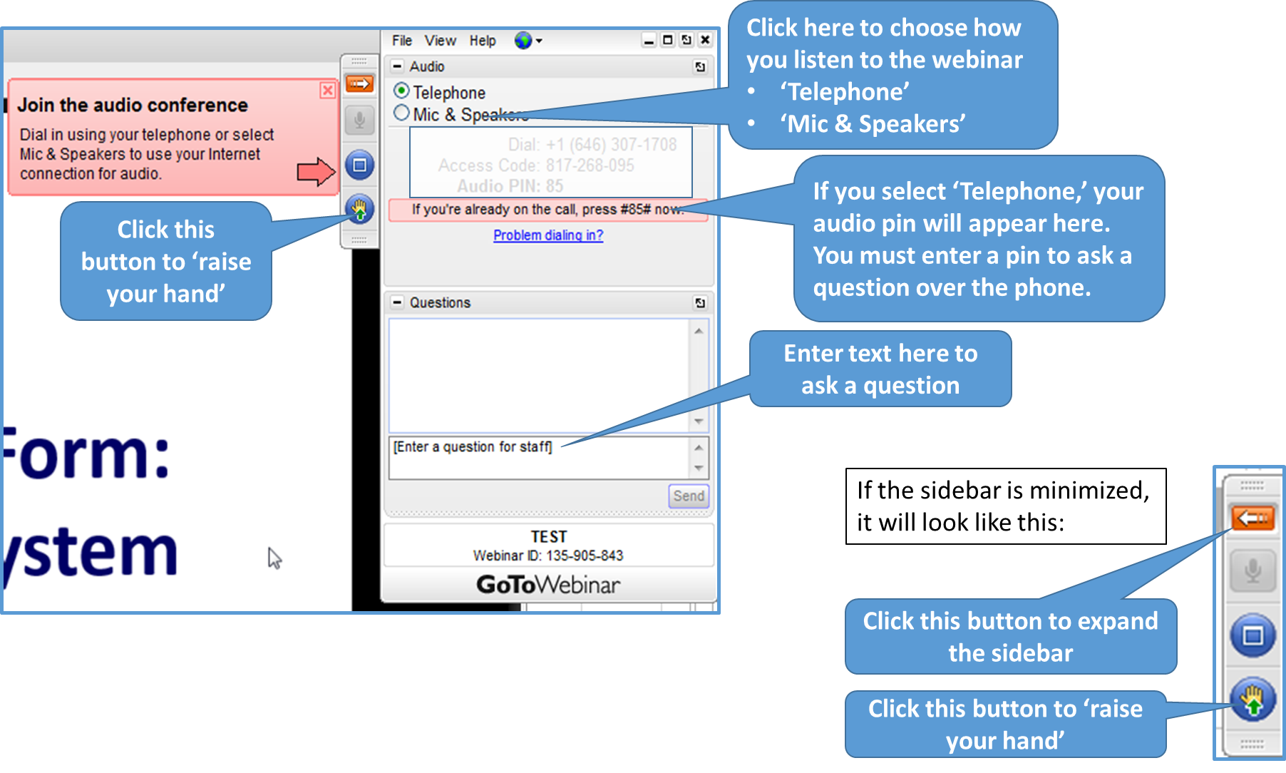
GoToWebinar – Asking a Question

Slide 19
Topic #2
Notes:
Title Slide Option 1

Slide 20
Topic #2
Completing the FY 2016 Household Report Form in OLDC
  OLDC Access
  Data Submission and Review Procedures
Presenter(s):
Melissa Torgerson

Slide 21
Topic #2 – OLDC Access
Previous webinars providing detailed instructions for OLDC access are located on the ACF website:
  http://www.acf.hhs.gov/programs/ocs/resource/liheap-trainings
Presenter(s):
Melissa Torgerson

Slide 22
Topic #2 – OLDC Access
OLDC is accessed through Grant Solutions.
Log-in to Grant Solutions at https://www.grantsolutions.gov/gs
Once logged in, click “OLDC” in the top taskbar to access the OLDC homepage.
If you need assistance, please contact Grants Center Of Excellence systems Help Desk:
  (202) 401-5282 or (866) 577-0771
  help@grantsolutions.gov
Presenter(s):
Melissa Torgerson

Slide 23
Topic #2 – Data Submission and Review Procedures
Household Report Data Submission Schedule
FY 2015
  Final Household Report Form (12/31/15)
FY 2016
  Preliminary Household Report Form (8/31/16)
  Final Household Report Form (12/16/16)
FY 2017
  Preliminary Household Report Form (8/31/17)
  Final Household Report Form (12/15/17)
Presenter(s):
Melissa Torgerson

Slide 24
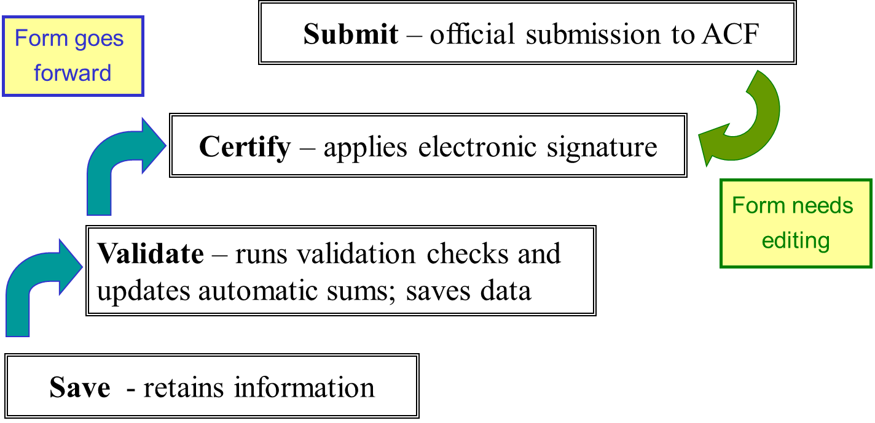
Topic #2 – Data Submission and Review Procedures
Presenter(s):
Melissa Torgerson

Slide 25
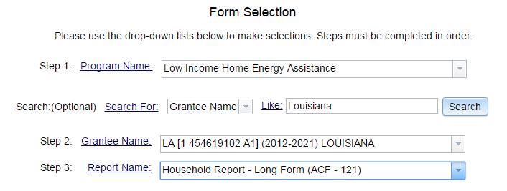
Topic #2 – Data Submission and Review Procedures
FY 2016 Household Report Submission Process:
For FY 2016, Grantees access the Household Report Form by selecting the ‘Household Report – Long Form (ACF-121)’ and clicking ‘enter.’
Presenter(s):
Melissa Torgerson

Slide 26
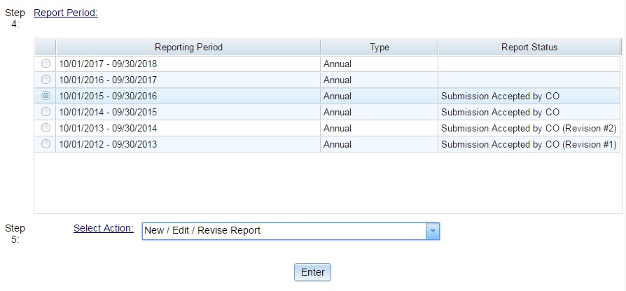
Topic #2 – Data Submission and Review Procedures
In order to access your report, please select the radial button for the FY 2016 reporting period
Then, select “New/Edit/Revise Report” for Step 5 and click “Enter”
Presenter(s):
Melissa Torgerson

Slide 27
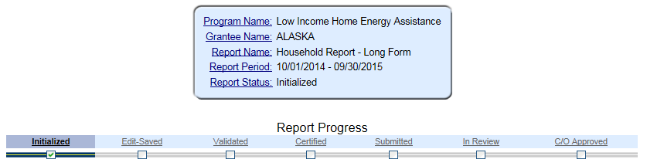
Topic #2 – Data Submission and Review Procedures
This action will initialize the form
The form will now be available for editing. Please fill out, save, validate, certify, and submit the form.
Presenter(s):
Melissa Torgerson

Slide 28
Topic #2 – Data Submission
Summary of Data Submission Process:
  Navigate to the FY 2016 Household Report Form in OLDC.
  Select “New/Edit/Revise Report” to initialize the FY 2016 Household Report Form.
  Fill out the Household Report Form
      Grantees should click “Save” to retain their recorded information.
  Click “Validate” – Run data validation checks and save data.
  Click “Certify” – Apply signature of authorizing agent to form.
  Click “Submit” – Submit form for OCS/APPRISE review
Presenter(s):
Melissa Torgerson

Slide 29
Topic #2 – Data Submission and Review Procedures
FY 2016 Household Report Review Process:
Following Grantees’ submission of their FY 2016 Household Report Forms, APPRISE will conduct a review of all Grantees’ forms to identify reporting issues requiring revision by grantees.
Once the items requiring revision have been confirmed with the Grantee’s LIHEAP office, the Grantee should make the appropriate revisions and re-submit its FY 2016 Household Report Form in OLDC.
Presenter(s):
Melissa Torgerson

Slide 30
Topic #2 – Data Submission and Review Procedures
Presenter(s):
Melissa Torgerson

Slide 31
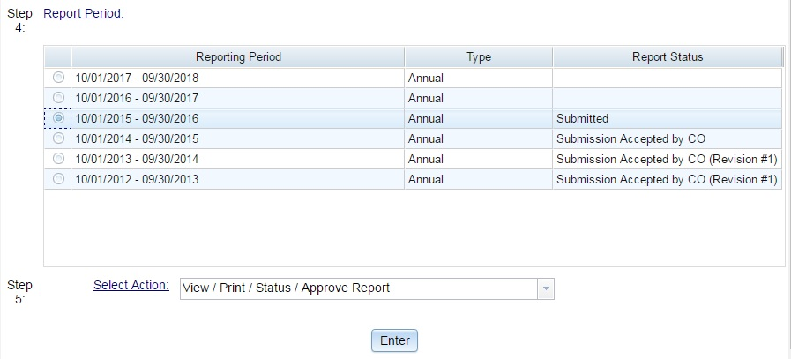
Topic #2 – Data Revision and Resubmission
FY 2016 Household Report Revision Process:
In order to access a submitted report for editing, please select the radial button for the FY 2016 reporting period
Then, select “View/Print/Status/Approve Report”
Please contact your OCS liaison if your FY 2016 Household Report is not available for editing.
Presenter(s):
Melissa Torgerson

Slide 32
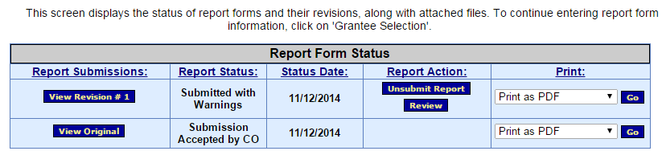
Topic #2 – Data Revision and Resubmission
The “Report Form Status” page will appear.
  Report Form Status: Contains button to View Original report or any Revisions, the Report Status, Status Date, Report Action, and Print option
  Click “Un-submit Report”
  Click “Edit Original”
  Click “Uncertify”
  The report will now be available for editing
Presenter(s):
Melissa Torgerson

Slide 33
Topic #2 – Data Revision and Resubmission
Summary of Data Revision and Resubmission Process:
  Navigate to the FY 2016 Household Report Form in OLDC.
  Select “View/Print/Status/Approve Report” to view the FY 2016 Household Report Form “Report Form Status” page
  Click “Un-submit Report”
  Click “Edit Original”
  Click “Uncertify”
  Edit and Re-submit FY 2016 Household Report
      Re-submit form using submission protocol outlined in previous slides.
Presenter(s):
Melissa Torgerson

Slide 34
Topic #2 – Data Submission and Review Procedures
Presenter(s):
Melissa Torgerson

Slide 35
Topic #2 – Summary
Completing the FY 2016 Household Report Form in OLDC
  OLDC Access
  Data Submission and Review Procedures
    Please contact your OCS liaison if your FY 2016 Household Report is not available for editing
Presenter(s):
Melissa Torgerson

Slide 36
Topic #2 – Questions
Grantee Questions regarding completing the FY 2016 Household Report Form in OLDC?
Presenter(s):
Melissa Torgerson

Slide 37
GoToWebinar – Asking a Question

Slide 38
Topic #3
Notes:
Title Slide Option 1

Slide 39
Topic #3
What are the Data Checks in the FY 2016 Household Report Form in OLDC?
  Validation checks
  Fatal errors vs. warning messages
Presenter(s):
Melissa Torgerson

Slide 40
Topic #3 – Validation Checks
Two important validation checks in the LIHEAP Household Report Form are:
  Outlier checks
  Year-to-year consistency checks
  FY 15 ↔ FY 16
  These checks compare FY 2015 Household Report data to FY 2016 Household Report data
Presenter(s):
Melissa Torgerson

Slide 41
Topic #3 – Validation Checks
Outlier checks
  If the reported number of households for a particular type of assistance for FFY 2016 is more than 10X the reported number of households for that type of assistance for FFY 2015, OLDC issues a warning.
  If the reported number of households for a particular type of assistance for FFY 2016 is less than 1/10th the number of households for that type of assistance for FFY 2015, OLDC issues a warning.
Presenter(s):
Melissa Torgerson

Slide 42
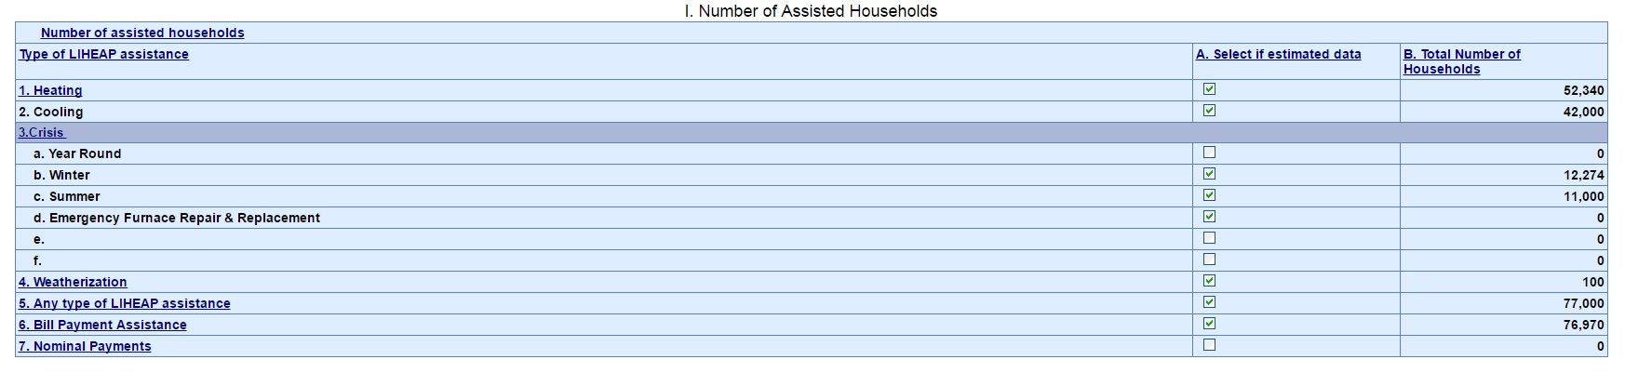
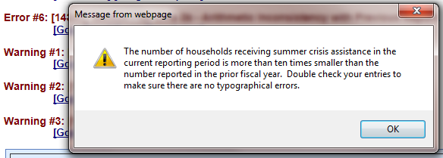
Topic #3 – Validation Checks
Example – Outlier Check:
FY 2015
FY 2016
25,800
22,000
890
800
1,500
145
350
500
26,050
22,536
22,050
Presenter(s):
Melissa Torgerson

Slide 43
Topic #3 – Validation Checks
Year-to-year consistency checks
  If a grantee reports a non-zero number of households for a particular type of assistance for FFY 2016, but had reported zero households for that type of assistance in FFY 2015, OLDC issues a warning.
  If a grantee reports a zero number of households for a particular type of assistance for FFY 2016, but had reported a non-zero number of households for that type of assistance in FFY 2015, OLDC issues a warning.
Presenter(s):
Melissa Torgerson

Slide 44
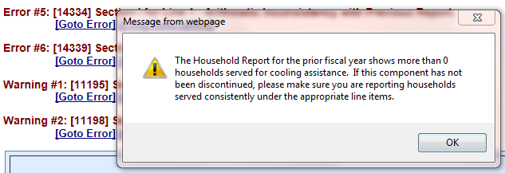
Topic #3 – Validation Checks
Example – Year-to-Year consistency Check:
FY 2015
FY 2016
25,800
22,000
900
890
800
1,500
145
350
500
26,050
22,536
22,050
Presenter(s):
Melissa Torgerson

Slide 45
Topic #3 – Validation Checks
Another important data validation check for the FY 2016 Household Report Form is:
  Form-to-form consistency check
  FY 16 ↔ FY 16
  This check compares FY 2016 Household Report data to FY 2016 Model Plan data.
Presenter(s):
Melissa Torgerson

Slide 46
Topic #3 – Validation Checks
Form-to-form consistency checks
  If a grantee reports providing assistance for a particular type of assistance for FFY 2016 in its Model Plan, but reports zero households for that type of assistance in its FFY 2016 Household Report, OLDC issues a warning.
Presenter(s):
Melissa Torgerson

Slide 47
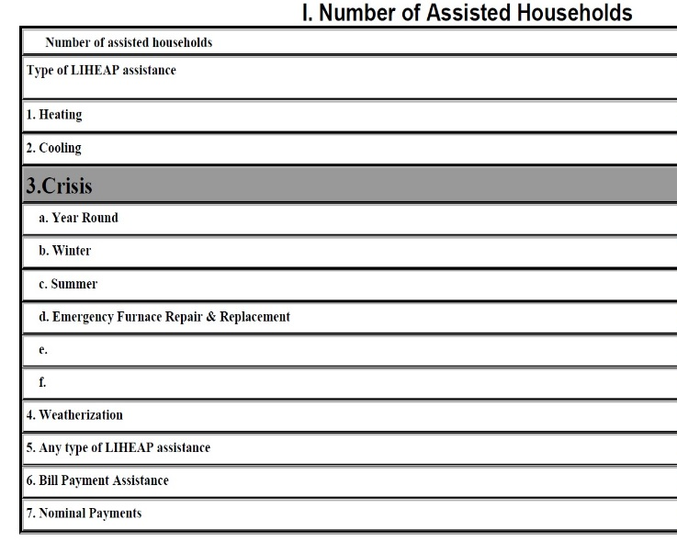
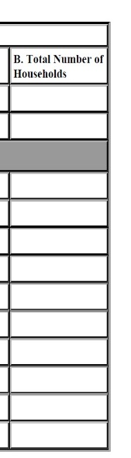
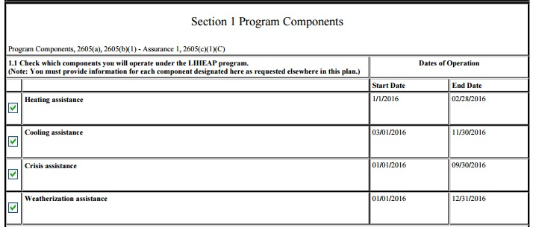
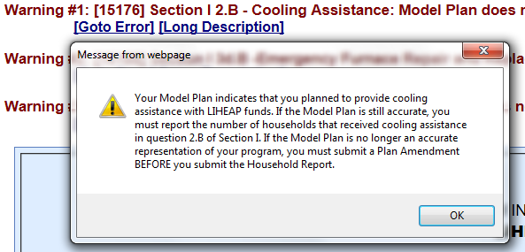
Topic #3 – Validation Checks
Example – Form-to-Form Consistency Check:
FY 2016 – Model Plan
FY 2016 - HHR
22,000
145
500
22,536
22,050
Presenter(s):
Melissa Torgerson

Slide 48
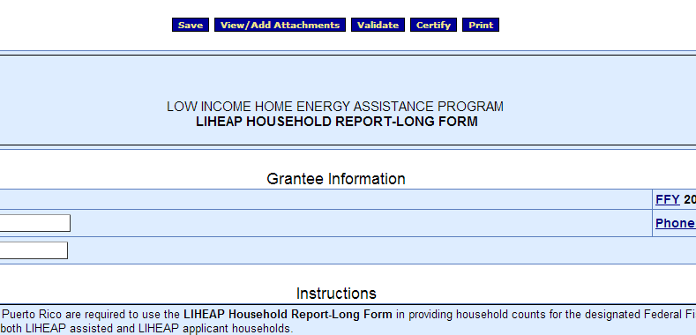
Topic #3 – Fatal errors vs. warning messages
Clicking the “Validate” button will run validation checks on the Household Report Form.
Presenter(s):
Melissa Torgerson

Slide 49
Topic #3 – Fatal errors vs. warning messages
Fatal Error Messages versus Warning Messages
  Fatal Error Messages indicate inconsistent data that must be corrected before grantees are able to submit their Household Report in OLDC
  Warning Messages indicate data that may be correct but require confirmation and additional explanation in the “Notes” field of the form
Presenter(s):
Melissa Torgerson

Slide 50

Topic #3 – Fatal errors vs. warning messages
Reports with warnings or errors display a message with a short description of the issue just below the Action buttons
  Click the “Go to Error” link to jump to the field on the screen in question
  Click the “Long Description” link for more detailed information about the issue
Presenter(s):
Melissa Torgerson

Slide 51
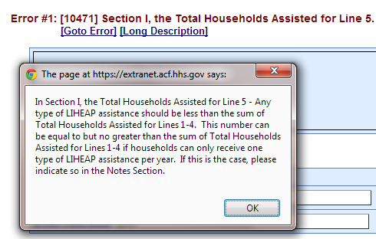
Topic #3 – Fatal errors vs. warning messages
Example: If the number of households that received “Any type of LIHEAP assistance” exceeds the sum of households that received each type of assistance, the following Error message will appear:
22,000
1,000
145
500
40,000
22,050
Presenter(s):
Melissa Torgerson

Slide 52
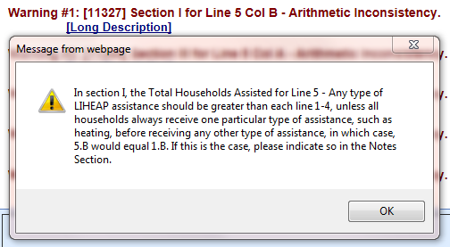
Topic #3 – Fatal errors vs. warning messages
Example: If the number of heating assisted households is equal to the number of households that received any type of LIHEAP assistance, OLDC issues a warning:
22,000
1,000
500
22,000
21,650
Presenter(s):
Melissa Torgerson

Slide 53
Topic #3 – Fatal errors vs. warning messages
If the stated warning message is correct, but the State’s LIHEAP program data in the Report is accurate, please include an explanation in the “Notes” field of the reporting form.
  This will prevent follow-up contact from APPRISE
Note: Year-to-year alterations in reporting may lead to confusion:
  Ex. Other Crisis assistance reporting
Presenter(s):
Melissa Torgerson

Slide 54
Topic #3 – Summary
What are the Data Checks in the FY 2016 Household Report Form in OLDC?
  Validation checks
    Outlier checks
    Year-to-year consistency checks
    Form-to-form consistency checks
  Fatal errors vs. warning messages
    Fatal Errors - Please revise and re-validate the form in order to correct the error.
    Warnings - If necessary, please include explanations in the “Notes” field of the reporting form.
Presenter(s):
Melissa Torgerson

Slide 55
Topic #3 – Questions
    Grantee questions regarding data validation checks in the FY 2016 Household Report Form in OLDC?
Presenter(s):
Melissa Torgerson

Slide 56
GoToWebinar – Asking a Question

Slide 57
Topic #4
Notes:
Title Slide Option 1

Slide 58
Topic #4
Common Issues
  Household Report vs. State Plan Inconsistencies
  Unduplicated Count Issues
  Weatherization Data
  Bill Payment Assistance Reporting
Presenter(s):
Melissa Torgerson

Slide 59
Topic #4 – HHR vs. State Plan Inconsistencies
Grantees’ FY 2016 Household Reports and FY 2016 State Plans should be consistent.
  Example: In the State Plan, it is reported that the grantee plans to operate a Year Round Crisis program. Once LIHEAP funds are received, the grantee decides to change to a Winter Crisis program and a Summer Crisis program with different eligibility criteria because of funding limits. The State Plan needs to be updated to reflect that change. The FY 2016 Household Report should report on Winter Crisis and Summer Crisis households.
Presenter(s):
Melissa Torgerson

Slide 60
Topic #4 – Unduplicated Count Issues
Example: If households always receive heating assistance before receiving any other type of LIHEAP assistance, please include a note in the “Notes” section of the form.
22,000
1,000
500
22,000
21,650
Presenter(s):
Melissa Torgerson

Slide 61
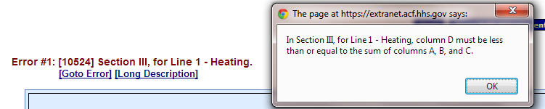

Topic #4 – Unduplicated Count Issues
Example: The number of households with at least one vulnerable member must be less than or equal to the sum of households with at least one elderly, at least one disabled, and at least one young child member.
Presenter(s):
Melissa Torgerson

Slide 62

Topic #4 – Weatherization Data
A common unduplicated count issue that many grantees face relates to the incorporation of LIHEAP-funded Weatherization data with LIHEAP fuel assistance data
        WAP is often administered by a separate State agency, making coordination and data sharing difficult
Presenter(s):
Melissa Torgerson

Slide 63
Topic #4 – Weatherization Data
Weatherization data incorporation solutions:
  If grantees need assistance regarding deduplication of weatherization and LIHEAP data, APPRISE will work with the State’s LIHEAP team to provide Training and Technical Assistance
  If facilitation between State WAP and LIHEAP offices is needed, APPRISE will work to schedule a meeting with the State LIHEAP team, State WAP team, and OCS staff
Presenter(s):
Melissa Torgerson

Slide 64
Topic #4 – Bill Payment Assistance Reporting
In FY 2016, grantees will now report the total unduplicated number of households provided with a cash LIHEAP benefit used to pay a share of the household’s energy bills and utility deposits under the “Bill Payment Assistance” field in Section I of the FY 2016 Household Report (Item 6)
  APPRISE will provide Training and Technical Assistance if grantees need assistance with the new Bill Payment Assistance reporting requirement
Presenter(s):
Melissa Torgerson

Slide 65
Topic #4 – Summary
Common Issues
  HHR vs. State Plan Inconsistencies: Make sure that the State Plan is updated to reflect any program changes implemented during the fiscal year.
  Unduplicated Count Issues: OLDC includes checks for common unduplicated count issues. If needed, contact APPRISE for Training and Technical Assistance.
  Weatherization Data: APPRISE can assist grantees with the deduplication of client records or facilitation between WAP and LIHEAP offices.
  Bill Payment Assistance Reporting: The Bill Payment Assistance field is now required for FY 2016.
Presenter(s):
Melissa Torgerson

Slide 66
Topic #4 – Questions
Grantee questions regarding common reporting issues with the Household Report Form?
Presenter(s):
Melissa Torgerson

Slide 67
GoToWebinar – Asking a Question

Slide 68
Resources: Support
OCS liaisons
  http://www.acf.hhs.gov/programs/ocs/resource/division-of-energy-assistance-federal-staff
Grants Center Of Excellence systems Help Desk
  help@grantsolutions.gov
  (202) 401-5282 or (866) 577-0771
APPRISE Team
  Daniel Bausch, Daniel-Bausch@appriseinc.org; 609-252-9050
  Sonia Guior, Sonia-Guior@appriseinc.org; 609-252-0005
  Jorge Mancilla, Jorge-MancillaUribe@appriseinc.org; 609-252-9009
  Melissa Torgerson, melissa@verveassociates.net
  Michelle Wadolowski, Michelle-Wadolowski@appriseinc.org; 609-252-9057
Presenter(s):
Melissa Torgerson

Slide 69
Grantee Questions?
Notes:
Title Slide Option 1

Slide 70
GoToWebinar – Asking a Question

Slide 71
Future Webinars
LIHEAP Performance Data Form: Grantee Survey
  Tuesday, December 20, 2016
LIHEAP Performance Data Form: Performance Measures
  Thursday, January 5, 2017
Presenter(s):
Melissa Torgerson

