Slide 1
The FY 2015 Household Report: Online Data Collection (OLDC) System
ACF LIHEAP Grantee Webinar
December 10, 2015
Presenters
Melissa Torgerson (Verve Associates)

Slide 2
Agenda
Introduction
Topic #1: Completing the FY 2015 Household Report Form in OLDC
Topic #2: What’s New in the FY 2015 Household Report Form in OLDC?
Topic #3: What are the New Data Checks in the FY 2015 Household Report Form in OLDC?
Topic #4: Common Issues
Questions
Future Webinars
Presenter(s):
Melissa Torgerson
2

Slide 3
Introduction
3

Slide 4
Introduction
Webinar Presenters
Welcome
Leon Litow, OCS staff
T&TA Manager & OLDC Details
Melissa Torgerson, Verve Associates
Presenter(s):
Melissa Torgerson and Leon Litow
4

Slide 5
Introduction
APPRISE T&TA Team
T&TA Manager
Melissa Torgerson, Verve Associates
melissa@verveassociates.net
T&TA Staff
Trayvon Braxton, APPRISE
Trayvon-braxton@appriseinc.org / 609-252-9053
Gina Talt, APPRISE
Gina-talt@appriseinc.org / 609-252-9052
Presenter(s):
Melissa Torgerson
5

Slide 6
Introduction
Topic #1: Completing the FY 2015 Household Report Form in OLDC
OLDC Access
Data Submission and Review Procedures
Topic #2: What’s New in the FY 2015 Household Report Form in OLDC?
Improvements in Crisis Benefit Reporting/Alignment with Grantee Survey Reporting
New Nominal Benefit Reporting
Change in the Definition of LIHEAP Assistance Benefits
Addition of LIHEAP Bill Payment Assistance Line Item
Topic #3: What are the New Data Checks in the FY 2015 Household Report Form in OLDC?
Basic validation checks
New validation checks
Fatal errors vs. warning messages
Topic #4: Common Issues
Program Operations vs. State Plan
Unduplicated Count Issues
Weatherization data
Nominal Benefit Reporting
Presenter(s):
Melissa Torgerson
6

Slide 7
Topic #1
7

Slide 8
Topic #1
Completing the FY 2015 Household Report Form in OLDC
OLDC Access
Data Submission and Review Procedures
Presenter(s):
Melissa Torgerson
8

Slide 9
Topic #1 – OLDC Access
Previous webinars providing detailed instructions for OLDC access are located on the ACF website:
http://www.acf.hhs.gov/programs/ocs/resource/liheap-trainings
Presenter(s):
Melissa Torgerson
9

Slide 10
Topic #1 – OLDC Access
Reminder: OLDC Passwords must be changed every 60 days
The Support Center provides assistance for OLDC customers
Support team personnel are available Monday through Friday 8 a.m. to 6 p.m. ET
app_support@acf.hhs.gov
866-577-0771
Presenter(s):
Melissa Torgerson
10

Slide 11
Topic #1 – Data Submission and Review Procedures
Household Report Data Submission Schedule:
FY 2014
Preliminary Household Report Form (8/31/14)
Final Household Report Form (12/15/14)
FY 2015
Final Household Report Form (12/31/15)
FY 2016
Preliminary Household Report Form (8/31/16)
Final Household Report Form (12/15/16)
Presenter(s):
Melissa Torgerson
11
Notes:
Note: No Preliminary Household Report for FY 2015 due to delays in OMB clearance process.

Slide 12
Topic #1 – Data Submission and Review Procedures
Submit – official submission to ACF
Form goes
forward
Certify – applies electronic signature
Form needs
editing
Validate – runs validation checks and updates automatic sums; saves data
Save - retains information
Presenter(s):
Melissa Torgerson
12
Notes:
Graphical overview of submission and revision process

Slide 13
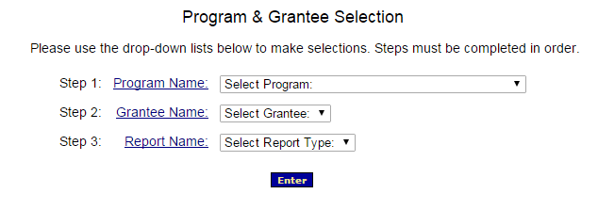
Topic #1 – Data Submission and Review Procedures
FY 2015 Household Report Submission Process:
For FY 2015, Grantees access the Household Report Form by selecting the ‘Household Report – Long Form (ACF-121)’ and clicking ‘enter.’
Presenter(s):
Melissa Torgerson
13

Slide 14
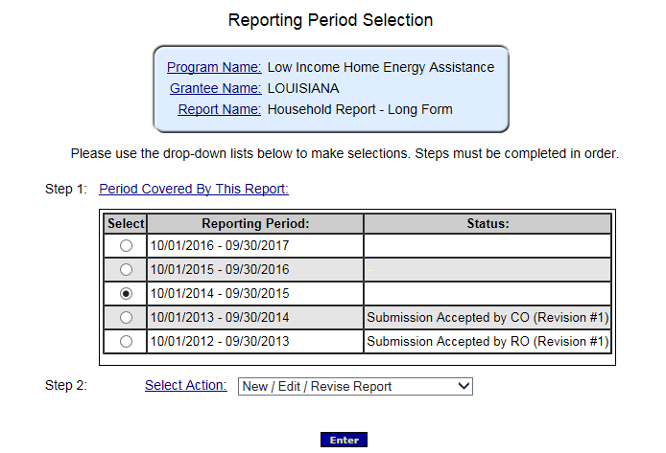
Topic #1 – Data Submission and Review Procedures
In order to access your report, please select the radial button for the FY 2015 reporting period
Then, select “New/Edit/Revise Report” for Step 2 and click “Enter”
Presenter(s):
Melissa Torgerson
14

Slide 15
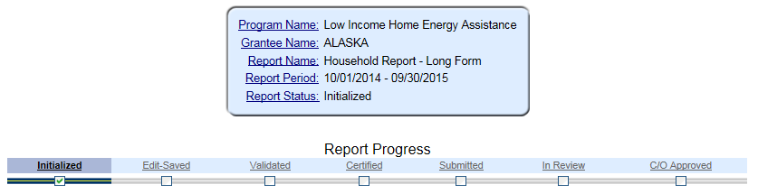
Topic #1 – Data Submission and Review Procedures
This action will initialize the form
The form will now be available for editing. Please fill out, save, validate, certify, and submit the form.
Presenter(s):
Melissa Torgerson
15

Slide 16
Topic #1 – Data Submission
Summary of Data Submission Process:
Navigate to the FY 2015 Household Report Form in OLDC.
Select “New/Edit/Revise Report” to initialize the FY 2015 Household Report Form.
Fill out the Household Report Form
Grantees should click “Save” to retain their recorded information.
Click “Validate” – Run data validation checks and save data.
Click “Certify” – Apply signature of authorizing agent to form.
Click “Submit” – Submit form for OCS/APPRISE review
Presenter(s):
Melissa Torgerson
16

Slide 17
Topic #1 – Data Submission and Review Procedures
FY 2015 Household Report Review Process:
Following Grantees’ submission of their FY 2015 Household Report Forms, APPRISE will conduct a review of all Grantees’ forms to identify reporting issues requiring revision by grantees.
Once the items requiring revision have been confirmed with the Grantee’s LIHEAP office, the Grantee should make the appropriate revisions and re-submit its FY 2015 Household Report Form in OLDC.
Presenter(s):
Melissa Torgerson
17

Slide 18
Topic #1 – Data Submission and Review Procedures
Submit – official submission to ACF
Form goes
forward
Certify – applies electronic signature
Form needs
editing
Validate – runs validation checks and updates automatic sums; saves data
Save - retains information
Presenter(s):
Melissa Torgerson
18
Notes:
Graphical overview of submission and revision process

Slide 19
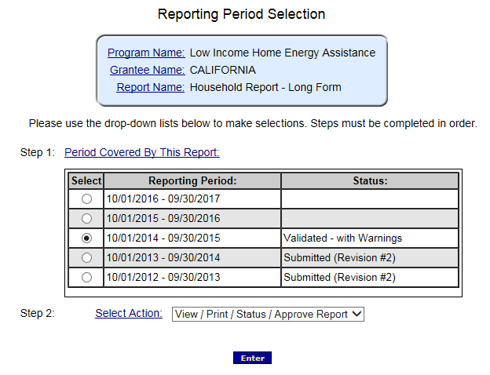
Topic #1 – Data Revision and Re-Submission
FY 2015 Household Report Revision Process:
In order to access a submitted report for editing, please select the radial button for the FY 2015 reporting period
Then, select “View/Print/Status/Approve Report” for Step 2 and click “Enter”
Please contact your OCS liaison if your FY 2015 Household Report is not available for editing
Presenter(s):
Melissa Torgerson
19

Slide 20
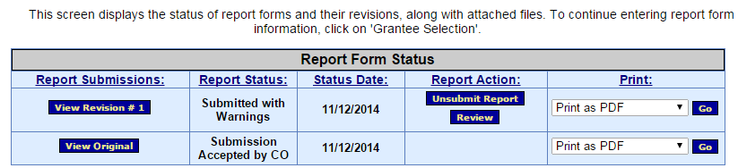
Topic #1 – Data Revision and Re-Submission
The “Report Form Status” page will appear.
Report Form Status: Contains button to View Original report or any Revisions, the Report Status, Status Date, Report Action, and Print option
Click “Un-submit Report”
Click “Edit Original”
Click “Uncertify”
The report will now be available for editing
11/12/2015
11/12/2015
Presenter(s):
Melissa Torgerson
20

Slide 21
Topic #1 – Data Revision and Re-Submission
Summary of Data Revision and Re-Submission Process:
Navigate to the FY 2015 Household Report Form in OLDC.
Select “View/Print/Status/Approve Report” to view the FY 2015 Household Report Form “Report Form Status” page
Click “Un-submit Report”
Click “Edit Original”
Click “Uncertify”
Edit and Re-submit FY 2015 Household Report
Re-submit form using submission protocol outlined in previous slides.
Presenter(s):
Melissa Torgerson
21

Slide 22
Topic #1 – Data Submission and Review Procedures
Submit – official submission to ACF
Form goes
forward
Certify – applies electronic signature
Form needs
editing
Validate – runs validation checks and updates automatic sums; saves data
Save - retains information
Presenter(s):
Melissa Torgerson
22
Notes:
Graphical overview of submission and revision process

Slide 23
Topic #1 – Summary
Completing the FY 2015 Household Report Form in OLDC
OLDC Access
Data Submission and Review Procedures
Please contact your OCS liaison if your FY 2015 Household Report is not available for editing
Presenter(s):
Melissa Torgerson
23

Slide 24
Topic #1 – Questions
Grantee Questions regarding completing the FY 2015 Household Report Form in OLDC?
Presenter(s):
Melissa Torgerson
24

Slide 25
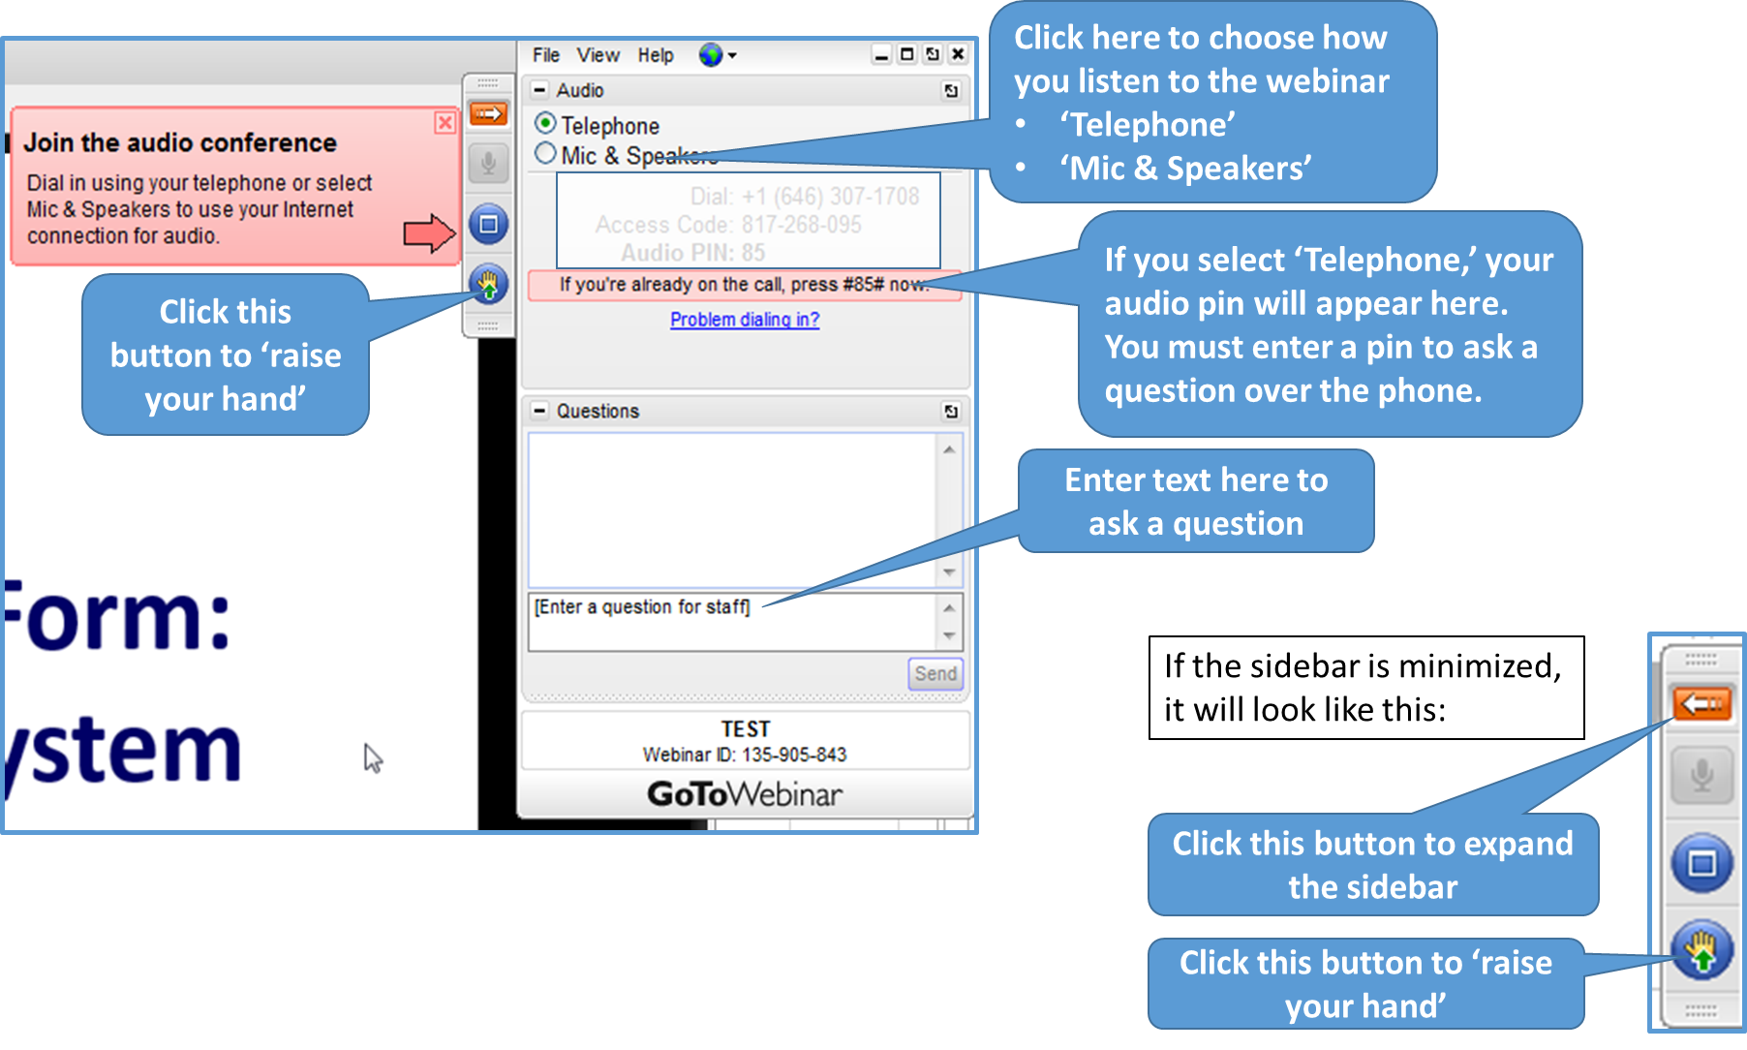
GoToWebinar – Asking a Question
25

Slide 26
Topic #2
26

Slide 27
Topic #2
What’s New in the FY 2015 Household Report Form in OLDC?
Improvements in Crisis Benefit Reporting/Alignment with Grantee Survey Reporting
New Nominal Benefit Reporting
Change in the Definition of LIHEAP Assistance Benefits
Addition of LIHEAP Bill Payment Assistance Line Item
Presenter(s):
Melissa Torgerson
27

Slide 28
Topic #2: What’s New in the FY 2015 Household Report Form in OLDC?
For FY 2015, several changes have been made to the FY 2015 Household Report Form.
Separation of winter and year round crisis households
Change in the definition and reporting of “nominal” benefit households ($50 or less)
Change in the definition of LIHEAP assistance benefits (greater than $50)
[OPTIONAL for FY 2015] Reporting of “bill payment assistance” households
Presenter(s):
Melissa Torgerson
28

Slide 29
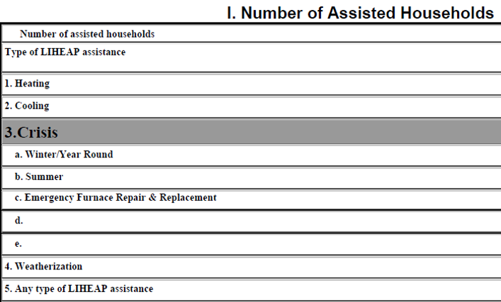
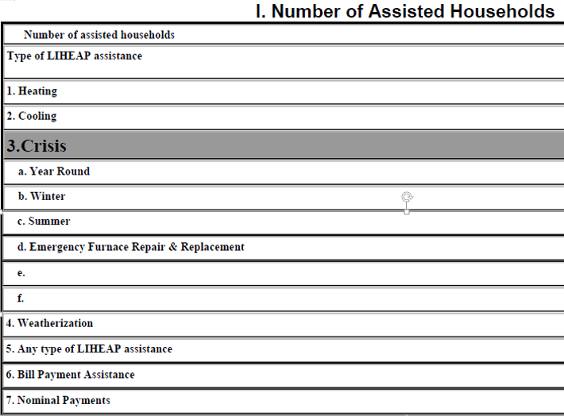
FY 2014 vs. FY 2015 Household Report Form
FY 2014
FY 2015
ALL grantees
SPECIFIC* grantees
29
*For those grantees (~10) that pay nominal benefits
Notes:
One change made to the FY 2015 LIHEAP Household Report form concerns the separate reporting of households provided with winter vs. year round crisis assistance in FY 2015.
This is to align the reporting of winter and year round crisis assistance between the Household Report and Grantee Survey

Slide 30
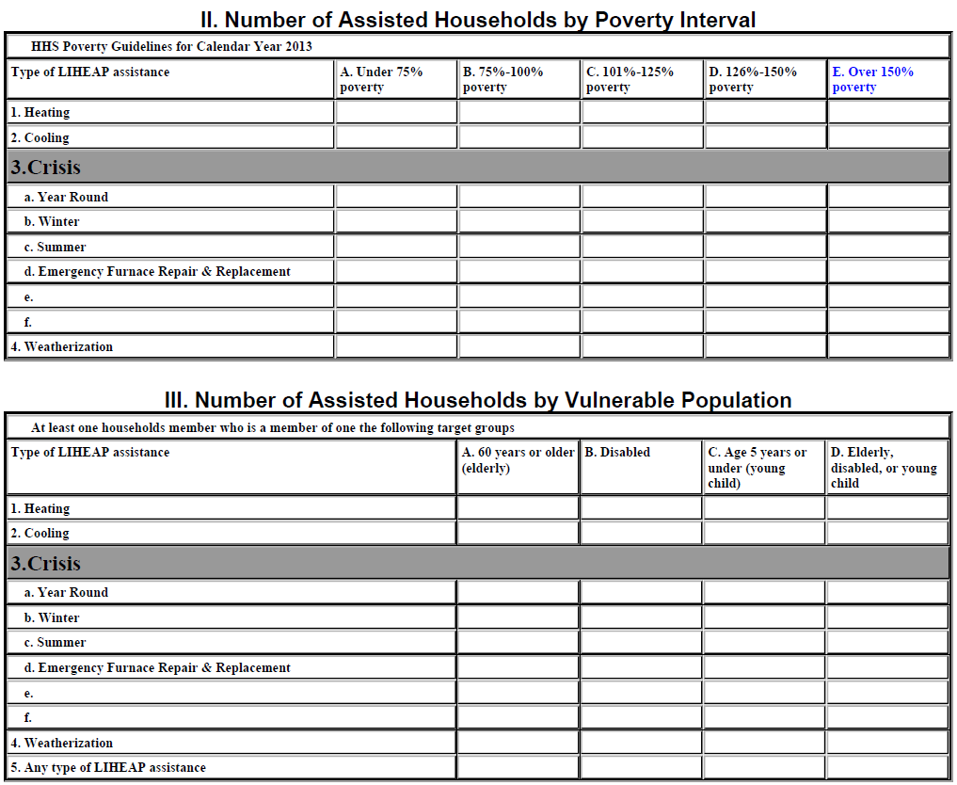
FY 2015 Household Report Form: Section II
Percent of Poverty Distributions REQUIRED for:
Heating
Cooling
Year Round Crisis
Winter Crisis
Summer Crisis
Other Type of Crisis
Equipment Furnace Repair & Replacement
Weatherization
Percent of Poverty Distributions NOT required for:
Any Type of LIHEAP Benefit
Any Type of Bill Payment Assistance
Nominal Benefits
Presenter(s):
Melissa Torgerson
30

Slide 31
FY 2015 Household Report Form: Section III
Vulnerable Population counts are REQUIRED for:
Heating
Cooling
Year Round Crisis
Winter Crisis
Summer Crisis
Other Type of Crisis
Equipment Furnace Repair & Replacement
Weatherization
Any Type of LIHEAP Benefit
Vulnerable Population counts are NOT required for:
Any Type of Bill Payment Assistance
Nominal Benefits
Presenter(s):
Melissa Torgerson
31

Slide 32
Topic #2 – FY 2014 Nominal Benefit Reporting
For FY 2014, nominal payment assisted households were defined as SNAP households assisted with a “nominal” LIHEAP benefit.
Grantees were instructed to exclude these households from all sections of the FY 2014 Household Report (Sections I-VI), and report on these households separately in the “Notes” field.
Example: For FY 2014, a SNAP household provided with a “Heat & Eat” benefit of $21 would be included among the nominal benefit assisted households reported in the “Notes” section of the FY 2014 Household Report.
Presenter(s):
Melissa Torgerson
32
Notes:
Note: In FY 2014, a “nominal” LIHEAP benefit was defined as a nominal LIHEAP grant provided to a household as part of a partnership with the SNAP program (“Heat or Eat” or “Cool or Eat” households).

Slide 33
Topic #2 – New Nominal Benefit Reporting
For FY 2015, nominal payment assisted households are defined as households assisted with any LIHEAP grant of $50 or less
Grantees are required to report on the total number of these households in the “Nominal Payments” field in Section I of the FY 2015 Household Report (Item 7).
Includes households provided with a nominal LIHEAP grant as part of a partnership with the SNAP program (“Heat & Eat” or “Cool & Eat” households).
Includes households receiving other LIHEAP cash benefits of $50 or less.
This is a total, NOT unduplicated, count of assisted households
Grantees should also include a note in the “Notes” section of their FY 2015 LIHEAP Household Report form that details:
The amount of the nominal benefit provided per household.
A brief description of the nominal benefit programs operated by the state, if the state operates more than 1 of these types of programs.
Presenter(s):
Melissa Torgerson
33
Notes:
Note: For FY 2015, a “nominal” LIHEAP benefit is defined as a nominal LIHEAP grant of $50 or less provided to a household.

Slide 34
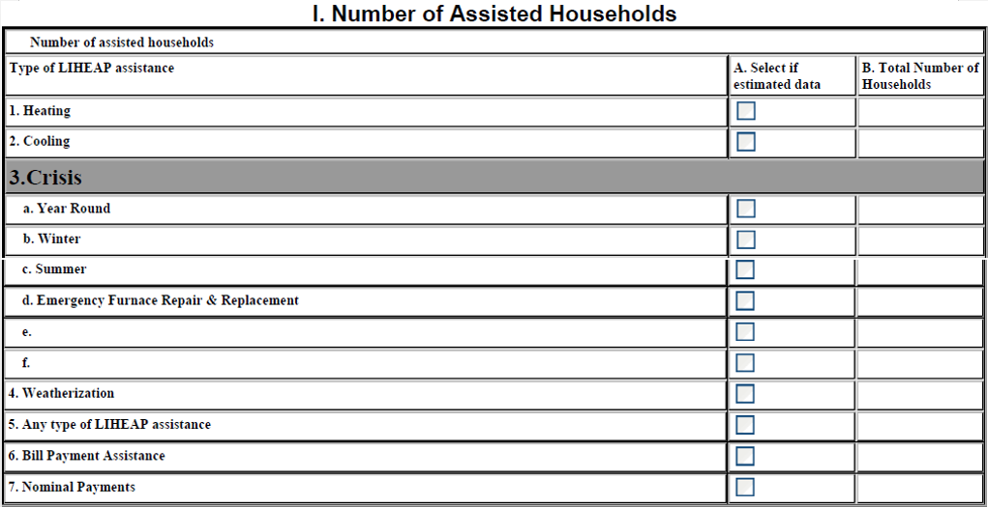
FY 2015 Household Report: Heating Assistance
Example: For FY 2015, a SNAP household provided with a “Heat & Eat” benefit of $21 would be reported in the “Nominal Payments” count in Section I of the Report (Item 7). The grantee would also report on the amount of the nominal “Heat & Eat” benefit provided per SNAP household in the “Notes” section of the FY 2015 Household Report.
1
NYS issued a $21 nominal “Heat & Eat” benefit to 1 household in FY 2015
Presenter(s):
Melissa Torgerson
34

Slide 35
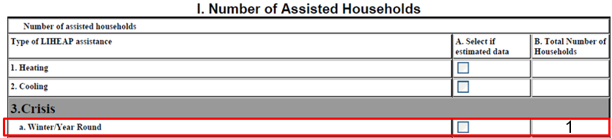
Topic #2 – FY 2014: Definition of LIHEAP Assistance Benefits
For FY 2014, any non-nominal payment household assisted with a heating, cooling, or crisis LIHEAP grant greater than $0 was reported under the corresponding line item for that assistance type in Sections I-III of the FY 2014 Household report.
Example: For FY 2014, if a grantee operated a year round crisis program and provided a household with a year round crisis assistance benefit of $50, the assisted household would be included in the state’s reported total winter/year round crisis assistance household count for Section I of the FY 2014 Household Report.
Presenter(s):
Melissa Torgerson
35

Slide 36
Topic #2 – FY 2015: Change in the Definition of LIHEAP Assistance Benefits
For FY 2015, in order for a household to be reported as a heating, cooling, or crisis assistance household in the FY 2015 Household Report Form, it must receive a LIHEAP grant greater than $50.
Note: This change is not applicable to LIHEAP weatherization or energy-related repair/replacement assistance reporting because they are not direct cash payments.
Presenter(s):
Melissa Torgerson
36

Slide 37
FY 2015 Household Report: Year-Round Crisis Assistance
0
mple: For FY 2015, if a grantee operated a Summer crisis program and provided a
Example: For FY 2015, if a grantee operated a year round crisis program and provided a household with a year round crisis assistance benefit of $50, the assisted household should be excluded from the state’s reported total year round crisis assistance household count for Section I of the FY 2015 Household Report. The household would be reported in the “Nominal Payments” count in Section I of the Report (Item 7). The grantee would also report on the amount of the nominal benefit provided per household in the “Notes” section of the FY 2015 Household Report.
1
Delaware issued a $50 nominal year round crisis benefit to 1 household in FY 2015
Presenter(s):
Melissa Torgerson
37

Slide 38
Topic #2 – Potential Programming Changes
Important Considerations
New changes will require programming modifications in Household Report queries/specifications for some Grantees for FY 2015
Separate households that receive a nominal LIHEAP grant of $50 or less from the population of assisted households
Run OLD programs on the remaining households in Heating, Cooling, Year Round Crisis, Winter Crisis, Summer Crisis, Other Crisis, Equipment Repair and Replacement, Weatherization, and Any Type of LIHEAP Benefit
REMEMBER to separate year round and winter crisis - separation should be based on the operation of grantees’ LIHEAP crisis program and consistent with the FY 2015 State Plan
Prepare NEW program to develop an unduplicated count of households receiving “Bill Payment Assistance,” defined as any LIHEAP benefit used to pay a share of a household’s energy bills and utility deposits
Includes: Heating, Cooling, Year Round Crisis, Winter Crisis, Summer Crisis and Other Crisis
Does not Include: Households that only received LIHEAP weatherization or energy-related repair/replacement assistance; or households that received nominal LIHEAP grants.
This data element is OPTIONAL for FY 2015, but will be mandatory for FY 2016.
Report on the TOTAL (NOT unduplicated) number of Nominal
Benefits paid
Presenter(s):
Melissa Torgerson
38

Slide 39
Topic #2 – Summary
What’s New in the FY 2015 Household Report Form in OLDC?
Improvements in Crisis Benefit Reporting/Alignment with Grantee Survey Reporting
New Nominal Benefit Reporting
Change in the Definition of LIHEAP Assistance Benefits
Addition of LIHEAP Bill Payment Assistance Line Item
New reporting guidelines are specified in the FY 2015 Household Report Instructions
http://www.acf.hhs.gov/programs/ocs/resource/liheap-action-transmittal-2016-02-on-fy-2015-hhr
Presenter(s):
Melissa Torgerson
39

Slide 40
Topic #2 – Questions
Grantee questions regarding what’s new in the FY 2015 Household Report Form in OLDC?
Presenter(s):
Melissa Torgerson
40

Slide 41
GoToWebinar – Asking a Question
41

Slide 42
Topic #3
42

Slide 43
Topic #3
Topic #3: What are the New Data Checks in the FY 2015 Household Report Form in OLDC?
Basic validation checks
New validation checks
Fatal errors vs. warning messages
Presenter(s):
Melissa Torgerson
43

Slide 44
Topic #3 – Basic validation checks
In FY 2014, there were two new data validation checks added to the LIHEAP Household Report form:
Outlier checks
Year-to-year consistency checks
FY 14 ↔ FY 15
These checks compare FY 2014 Household Report data to FY 2015 Household Report data
Presenter(s):
Melissa Torgerson
44
Notes:
Note: Regarding how these checks apply to the new crisis fields since now winter and year-round crisis are separate?
Outlier checks – Currently not programmed in OLDC. OCS/APPRISE working to incorporate these (ongoing).
Year-to-year consistency checks – should be superseded by new Model Plan vs. 2015 HHR cross checks. If Grantee reports operating a winter or year round crisis program in FY 2015 Plan (Q. 4.12), but reports 0 households for that type of assistance in HHR – OLDC issues warning.

Slide 45
Topic #3 – Basic validation checks
Outlier checks
If the reported number of households for a particular type of assistance for FFY 2015 is more than 10X the reported number of households for that type of assistance for FFY 2014, OLDC issues a warning.
If the reported number of households for a particular type of assistance for FFY 2015 is less than 1/10th the number of households for that type of assistance for FFY 2014, OLDC issues a warning.
Presenter(s):
Melissa Torgerson
45

Slide 46
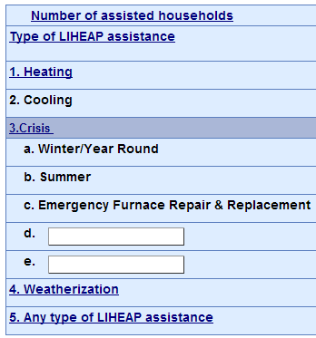
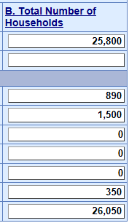
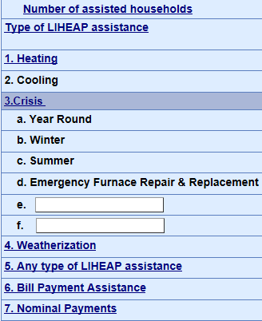
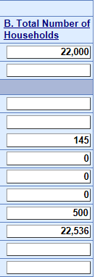
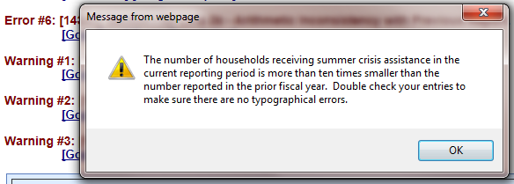
Topic #3 – Basic validation checks
Example – Outlier Check:
FY 2014
FY 2015
Presenter(s):
Melissa Torgerson
46

Slide 47
Topic #3 – Basic validation checks
Year-to-year consistency checks
If a grantee reports a non-zero number of households for a particular type of assistance for FFY 2015, but had reported zero households for that type of assistance in FFY 2014, OLDC issues a warning.
If a grantee reports a zero number of households for a particular type of assistance for FFY 2015, but had reported a non-zero number of households for that type of assistance in FFY 2014, OLDC issues a warning.
Presenter(s):
Melissa Torgerson
47

Slide 48
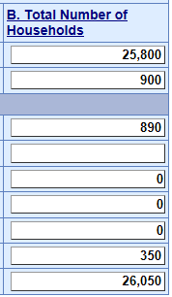
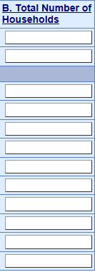
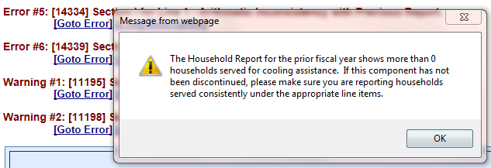
Topic #3 – Basic validation checks
Example – Year-to-Year consistency check:
FY 2014
FY 2015
22,000
800
100
500
23,000
Presenter(s):
Melissa Torgerson
48

Slide 49
Topic #3 – New validation checks
For FY 2015, there is one new data validation check for the FY 2015 Household Report form:
Form-to-form consistency check
FY 15 ↔ FY 15
This check compares FY 2015 Household Report data to FY 2015 Model Plan data
Presenter(s):
Melissa Torgerson
49

Slide 50
Topic #3 – New validation checks
Form-to-form consistency checks
If a grantee reports providing assistance for a particular type of assistance for FFY 2015 in its Model Plan, but reports zero households for that type of assistance in its FFY 2015 Household Report, OLDC issues a warning.
Presenter(s):
Melissa Torgerson
50

Slide 51
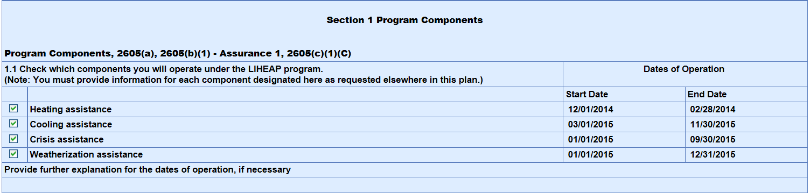
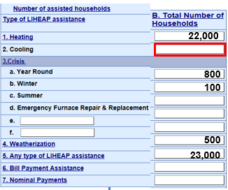
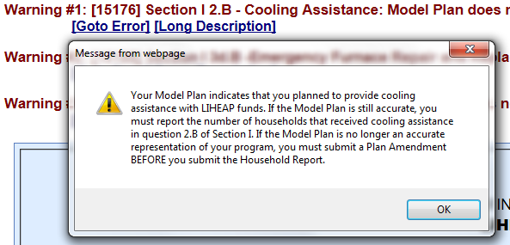
Topic #3 – New validation checks
Example – Form-to-form consistency check:
FY 2015 – Model Plan
FY 2015 - HHR
Presenter(s):
Melissa Torgerson
51

Slide 52
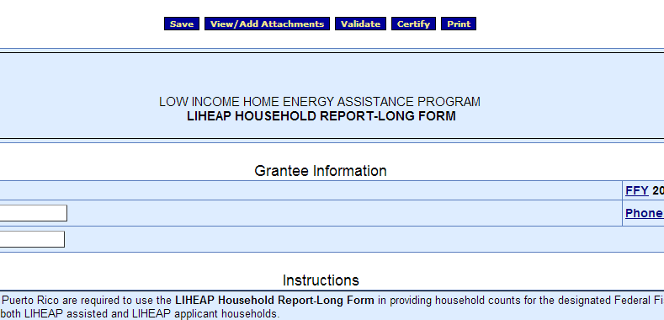
Topic #3 – Fatal errors vs. warning messages
Clicking the “Validate” button will run validation checks on the Household Report Form.
Presenter(s):
Melissa Torgerson
52
Notes:
Only the Data Entry person (Job Type) will have the Validate button

Slide 53
Topic #3 – Fatal errors vs. warning messages
Fatal error Messages versus Warning Messages
Fatal Error Messages indicate inconsistent data that must be corrected before states are able to submit their Household Report in OLDC
Warning Messages indicate data that may be correct but require confirmation and additional explanation in the “Notes” field of the form
Presenter(s):
Melissa Torgerson
53

Slide 54

Topic #3 – Fatal errors vs. warning messages
Reports with warnings or errors display a message with a short description of the issue just below the Action buttons
Click the “Go to Error” link to jump to the field on the screen in question
Click the “Long Description” link for more detailed information about the issue
Presenter(s):
Melissa Torgerson
54
Notes:
A report with errors stays in the “Edit – Saved” status. A report with Warnings moves to the Validated status.

Slide 55
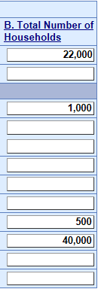
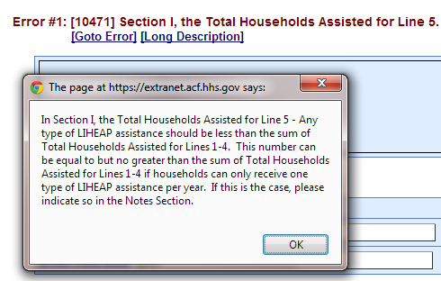
Topic #3 – Fatal Errors
Example: If the number of households that received “Any type of LIHEAP assistance” exceeds the sum of households that received each type of assistance, the following Error message will appear:
Presenter(s):
Melissa Torgerson
55

Slide 56
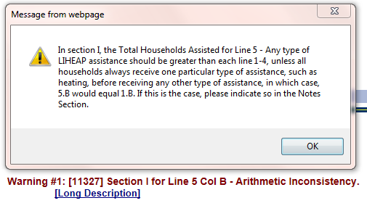
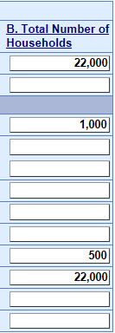
Topic #3 – Warnings
Example: If the number of heating assisted households is equal to the number of households that received any type of LIHEAP assistance, OLDC issues a warning:
Presenter(s):
Melissa Torgerson
56

Slide 57
Topic #3 – Warnings
If the stated warning message is correct, but the State’s LIHEAP program data in the Report is accurate, please include an explanation in the “Notes” field of the reporting form.
This will prevent follow-up contact from APPRISE
Note: Year-to-year alterations in reporting may lead to confusion:
Ex. Other Crisis assistance reporting
Presenter(s):
Melissa Torgerson
57

Slide 58
Topic #3 – Summary
What are the New Data Checks in the FY 2015 Household Report Form in OLDC?
Basic validation checks
Outlier checks
Year-to-year consistency checks
New validation checks
Form-to-form consistency checks
Fatal errors vs. warning messages
Fatal Errors - Please revise and re-validate the form in order to correct the error.
Warnings - If necessary, please include explanations in the “Notes” field of the reporting form.
Presenter(s):
Melissa Torgerson
58

Slide 59
Topic #3 – Questions
Grantee questions regarding data validation checks in the FY 2015 Household Report Form in OLDC?
Presenter(s):
Melissa Torgerson
59

Slide 60
GoToWebinar – Asking a Question
60

Slide 61
Topic #4
61

Slide 62
Topic #4
Common Issues
Program Operations vs. State Plan
Unduplicated Count Issues
Weatherization data
Nominal Benefit reporting
Presenter(s):
Melissa Torgerson
62

Slide 63
Topic #4 – Update State Plan
State Plan = Household Report
Example: In the State Plan, it is reported that the grantee plans to operate a Year Round Crisis program. Once LIHEAP funds are received, the grantee decides to change to a Winter Crisis program and a Summer Crisis program with different eligibility criteria because of funding limits. The State Plan needs to be updated to reflect that change. Household Report should report on Winter Crisis and Summer Crisis.
Presenter(s):
Melissa Torgerson
63

Slide 64
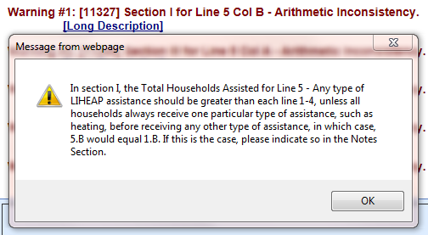
Topic #4 – Unduplicated Count Issues
Example: If households always receive heating assistance before receiving any other type of LIHEAP assistance, please include a note in the “Notes” section of the form.
Presenter(s):
Melissa Torgerson
64

Slide 65
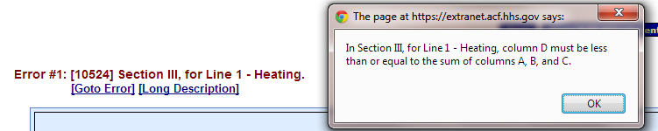

Topic #4 – Unduplicated Count Issues
Example: The number of households with at least one vulnerable member must be less than or equal to the sum of households with at least one elderly, at least one disabled, and at least one young child member.
Presenter(s):
Melissa Torgerson
65

Slide 66

Topic #4 – Weatherization data
A common unduplicated count issue that many grantees face relates to the incorporation of LIHEAP-funded Weatherization data with LIHEAP fuel assistance data
WAP is often administered by a separate State agency, making coordination and data sharing difficult
Presenter(s):
Melissa Torgerson
66

Slide 67
Topic #4 – Weatherization data
Weatherization data incorporation solutions:
If grantees need assistance regarding deduplication of weatherization and LIHEAP data, APPRISE will work with the State’s LIHEAP team to provide Training and Technical Assistance
If facilitation between State WAP and LIHEAP offices is needed, APPRISE will work to schedule a meeting with the State LIHEAP team, State WAP team, and OCS staff
Presenter(s):
Melissa Torgerson
67

Slide 68
Topic #4 – Nominal Benefit Reporting
In FY 2014, grantees reported on nominal benefits in the “Notes” field
In FY 2015, grantees will now report the total number of households assisted with any LIHEAP grant of $50 or less in the “Nominal Payments” field in Section I of the FY 2015 Household Report (Item 7) and include a note in the “Notes” section detailing the amount of the benefit and a description of the nominal benefit program if more than one is offered
APPRISE will provide Training and Technical Assistance if grantees need assistance with the new nominal benefit reporting requirement
68
Presenter(s):
Melissa Torgerson

Slide 69
Topic #4 – Summary
Common Issues
State Plan: Make sure that the state plan is updated for any changes.
Unduplicated Count Issues: OLDC includes checks for common unduplicated count issues. If needed, contact APPRISE for Training and Technical Assistance.
Weatherization Data: APPRISE can assist grantees with the deduplication of client records or facilitation between WAP and LIHEAP offices
Nominal Benefit Reporting: FY 2015 Household Report instructions include a new protocol for reporting nominal benefit households.
Presenter(s):
Melissa Torgerson
69

Slide 70
Topic #4 – Questions
Grantee questions regarding common reporting issues with the Household Report Form?
Presenter(s):
Melissa Torgerson
70

Slide 71
GoToWebinar – Asking a Question
71

Slide 72
Resources: Support
OCS liaisons
http://www.acf.hhs.gov/programs/ocs/resource/division-of-energy-assistance-federal-staff
OLDC Support Center
app_support@acf.hhs.gov or 866-577-0771
APPRISE Team
Trayvon Braxton, Trayvon-Braxton@appriseinc.org 609-252-9053
Gina Talt, Gina-Talt@appriseinc.org 609-252-9052
Melissa Torgerson, melissa@verveassociates.net
Presenter(s):
Melissa Torgerson
72

Slide 73
Grantee Questions?
Presenter(s):
Melissa Torgerson
73

Slide 74
GoToWebinar – Asking a Question
74

Slide 75
Future Webinars
LIHEAP Performance Data Form
Thursday, December 17th, 2015
3:00 to 4:30 PM ET
Tuesday, January 5th, 2016
3:00 to 4:30 PM ET
Presenter(s):
Melissa Torgerson
75

