Slide 1
LIHEAP Performance Measures
2015 National Training Conference

Slide 2
Introduction: Training Overview
After the first part of this training, attendees will:
Know what data are required for each measure
Understand the procedures that must be implemented to collect the required data
Have a better idea of how to go from the performance measures data to the performance measures report

Slide 3
Introduction: Training Overview
After the second part of this training, attendees will:
Have a detailed checklist to gauge their progress in preparing to report on LIHEAP Performance Measures
Know the schedule for Performance Measures data collection and reporting
Understand how to get information and technical assistance on Performance Measures

Slide 4
Introduction: Training Overview
After the third part of this training, attendees will:
Understand how the LIHEAP Performance Measures fit into the LIHEAP Performance Management Framework
Know how to get data on Inputs, Outputs, and Outcomes from the PMW Data Warehouse
Have access to the LIHEAP Performance Management Self-Assessment Tool

Slide 5
Introduction: Training Overview
8:00 to 9:30 - Part 1: LIHEAP Performance Measures
  Restoration and Prevention Data Collection and Reporting
  Energy Burden Measure Data Collection and Reporting
9:45 to 10:45 - Part 2: Schedule and Resources
  Schedule for Collecting and Reporting Performance Measures
  Performance Measures Checklist
  Performance Measures Resources
11:00 to 12:00 – Part 3: LIHEAP Performance Management System
  LIHEAP Logic Model – Performance Management Framework
  LIHEAP State Plan – Program Design and Implementation

Slide 6
Introduction: Training Overview
11:00 to 12:00 – Part 3 – continued
  PDF Section I. Grantee Survey – Inputs and Outputs
  Household Report – Outputs and Outcomes
  Data Warehouse Reports – Inputs, Outputs, Outcomes {Jenni and Jane}
  PDF Section II. LIHEAP Performance Measures – Outcomes and Impacts
  LIHEAP Performance Management Self-Assessment Tool {Heather}

Slide 7
Introduction: Navigating the Session
Training Materials in Packet
FFY 2014 Performance Measures Reporting Form and Instructions
FFY 2014 Performance Measures FAQs
Performance Measures Data Collection Guide
Vendor Data Exchange Templates (Gas, Electric, Fuel Oil, and Propane)
Subgrantee Data Exchange Templates
LIHEAP Logic Model
Performance Management Website
Resources for Grantees
Data Warehouse
Self-Assessment Tool
Session Logistics - Questions / Breaks

Slide 8
Part One – LIHEAP Performance Measures
8:00 to 9:30 - Part 1: LIHEAP Performance Measure
  Section 1 – Restoration and Prevention Data Collection
  Section 2 – Restoration and Prevention Reporting
  Section 3 – Energy Burden Data Collection
  Section 4 – Energy Burden Reporting

Slide 9
Restoration and Prevention Measures
Sections 1 and 2 focus on Performance Measures related to Restoration of Home Energy Service and Prevention of Loss of Home Energy. More specifically, this section hones in on the following questions:
What data do you need?
What are the steps for collecting these data?
What are the steps for reporting these data?

Slide 10
Section 1: Restoration and Prevention Measures
What Data Do You Need?
Data needed for Restoration and Prevention Measures:
At the time of the application, was the Household without Home Energy Service?
At the time of the application, was the Household at “Imminent Risk” of Losing Home Energy Service?
If either without service or at “imminent risk”, to which energy source (e.g. electric, gas, fuel oil, propane) was the LIHEAP benefit applied?

Slide 11
Section 1: Restoration and Prevention Measures
What Data Do You Need?
Status of Home Energy Service at Time of Application
    Household is without Energy Service. This includes whether a household is Disconnected, Out of Fuel, or has Inoperable Equipment.
    “Inoperable” includes red-tagged equipment, or equipment that if powered on, will result in injury or death.
    Note: Households that heat or cool their home in “some other way” still count if they can’t use their main system.

Slide 12
Section 1: Restoration and Prevention Measures
What Data Do You Need?
Status of Home Energy Service at Time of Application
Household is at “Imminent Risk” of Losing Home Energy Service. This includes whether a household has a utility Past Due or Shut-Off Notice, is Nearly Out of Fuel, or has equipment that is still operable, but places them at imminent risk of losing their home energy service.
“Imminent risk” should be defined by the grantee based on local conditions, and should correspond with existing state definitions used to determine home energy emergencies (as outlined in the grantee’s State Plan and/or policy manuals).

Slide 13
Section 1: Restoration and Prevention Measures
What Data Do You Need?
Energy Source
  Fuel type (Electric, Gas, Fuel Oil, Propane or Other) where the household LIHEAP benefit is applied.
  In some cases, this may not be the household’s primary fuel source.
  Example #1: If the household is at “imminent risk” of running out of propane for heating, the energy source is propane.
  Example #2: If the household has had their electric disconnected and cannot run their propane furnace, the energy source is electric.
  Example #3: If the household’s propane furnace is repaired or replaced, the energy source is propane.

Slide 14
Section 1: Restoration and Prevention Measures
Steps for Collecting the Data
Steps you need to take for collecting Restoration and Prevention data…

Slide 15
Section 1: Restoration and Prevention Measures
Steps for Collecting the Data
Determine your state’s criteria for “Imminent Risk.” In other words—when should a LIHEAP benefit be considered preventive? This criteria should correspond with your policy manuals, state plans.
Some states simply ask applicants to self-declare whether or not they are “nearly out of fuel.” Others are more specific. For example:
Maine: Less than 3-day supply of fuel (e.g. reading of 1/8 tank or less on a standard 275 gallon heating oil tank; reading of 25% or less on a propane tank). “3-day or less” supply standard applies to other delivered fuel types.
Michigan: A residential fuel tank must not contain more than 25% of its heating fuel capacity.

Slide 16
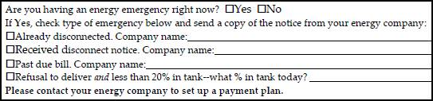
Section 1: Restoration and Prevention Measures
Steps for Collecting the Data
Add Home Energy Status to Client Application.
Examples include Disconnected, Out of Fuel, Inoperable Equipment, Past Due, Shut-off Notice, Nearly Out of Fuel, Unsafe Equipment, etc.
Example: Minnesota Client Application

Slide 17
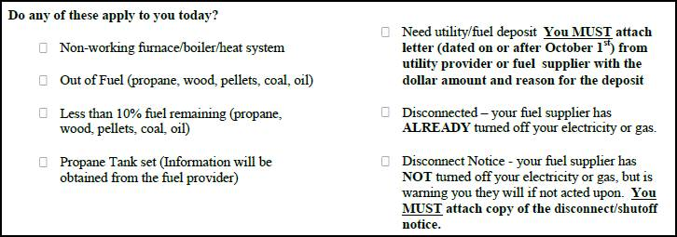
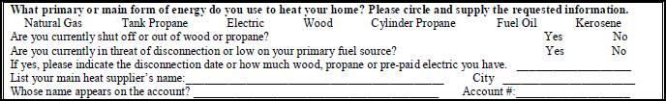
Section 1: Restoration and Prevention Measures
Steps for Collecting the Data
Example: Wyoming Client Application
Example: Missouri Client Application

Slide 18
Section 1: Restoration and Prevention Measures
Steps for Collecting the Data
Establish Equipment Repair and Replacement Criteria related to “Restoration and Prevention” with LIHEAP Weatherization Contractors.
In many cases, repair or replacement of heating/cooling equipment is administered by weatherization contractors. Therefore, grantees may need to coordinate with their Weatherization partners to establish when LIHEAP funds are used to “restore home energy” versus “prevent home energy loss.”
Coordinate Reporting of “Restoration and Prevention” with LIHEAP Weatherization Contractors.
This could be as straightforward as asking weatherization contractors to specify on invoices, work orders, or audit reports whether equipment repair/replacement is necessary to restore home energy or prevent home energy loss.

Slide 19
Section 1: Restoration and Prevention Measures
Steps for Collecting the Data
Record the Energy Source
If the household receives energy assistance, make sure you record the energy source for which the benefit was paid.
If the main heating equipment was repaired or replaced, make sure you record the primary energy source used by the equipment.
If the household’s cooling equipment was repaired or replaced, make sure to record that the energy source was electricity.

Slide 20
Section 1: Restoration and Prevention Measures Data Collection
Questions

Slide 21
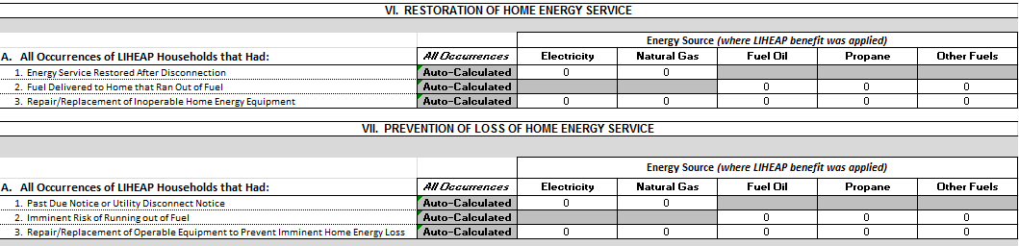
Section 2: Restoration and Prevention Measures
Completing Report Parts VI and VII
Restoration and Prevention data is reported in Parts VI and VII of the Performance Measures Report Form.

Slide 22
Section 2: Restoration and Prevention Measures
Completing Report Parts VI and VII
Part II: Report is for ALL Occurrences of LIHEAP Households
  Electric / Gas – Count the number of times that LIHEAP restored service after a disconnection.
  Fuel Oil / Propane / Other – Count the number of times that LIHEAP resulted in delivered fuel after the client ran out.
  All Sources– Count the number of inoperable heating systems repaired/replaced using LIHEAP.
  Electricity – Be sure to include the number of inoperable air conditioners repaired/replaced using LIHEAP.
  All Occurrences – Value is automatically calculated. It is the sum of the counts in each row.

Slide 23
Section 2: Restoration and Prevention Measures
Completing Report Parts VI and VII
Part III: Report is for ALL Occurrences of LIHEAP Households
  Electric / Gas – Count the number of times that LIHEAP prevented disconnection.
  Fuel Oil / Propane / Other – Count the number of times that LIHEAP delivered fuel to a client who was “at risk of” running out.
  All Sources– Count the number of operable heating systems repaired/replaced with LIHEAP in order to prevent loss of home energy service.
  Electricity – Be sure to include the number of operable air conditioners repaired/replaced using LIHEAP in order to prevent loss of home energy service.
  All Occurrences – Value is automatically calculated. It is the sum of the counts in each row.

Slide 24
Section 2: Restoration and Prevention Measures Data Reporting
Questions

Slide 25
Energy Burden Measures
Sections 3 and 4 focus on LIHEAP Performance Measures related to Home Energy Burden. More specifically, this section hones in on the following questions:
What data do you need?
What are the steps in collecting the data?
What are the steps for reporting these data?

Slide 26
Section 3: Energy Burden Measure Data Collection
What Data Do You Need?
Data Required for Energy Burden Measures:
Average Annual Household Income (Application)
Average Annual LIHEAP Benefit (Management System)
Main Fuel Type (Application)
Average Annual Household Main Fuel Bill (Vendors)
Average Annual Household Electricity Bill (Vendors)

Slide 27
Section 3: Energy Burden Measure Data Collection
What Data Do You Need?
Average Annual Household Income. Annual household income should be calculated in the same way it is calculated for the annual LIHEAP Household Report Form, using gross income. Zero income households should be included.
Average Annual LIHEAP Bill-Payment Assistance Benefit. This includes the total LIHEAP bill payment assistance granted to the household during the reporting period, including heating, cooling, and crisis assistance (cash/bill-payment only). In some cases, the annual LIHEAP bill payment assistance benefit will include more than one type of assistance—for example regular + crisis.

Slide 28
Section 3: Energy Burden Measure Data Collection
What Data Do You Need?
Main Fuel Type. Annual income and LIHEAP benefit data will be requested in OLDC by main fuel type. At the time of application, grantees will need to ask households to identify their main fuel type (Natural Gas, Electricity, Fuel Oil, Propane, or Other Fuels).
Cooling States and Main Fuel Type: Grantees who offer cooling programs should still ask households for their main fuel type.
It is important to look at the whole home energy bill for ALL clients, including cooling bills for households that are assisted with natural gas, propane, or fuel oil heating bills AND heating bills for clients that are assisted with cooling costs.

Slide 29
Section 3: Energy Burden Measure Data Collection
What Data Do You Need?
Average Annual Energy Bills for Main Fuel and Electricity. Grantees will need to collect annual household energy cost data for both main fuel and electricity. To reduce the burden associated with vendor data collection, grantees are only required to collect data from the largest vendors.
Requirements: Identify top five natural gas vendors, top five electric vendors, top ten fuel oil vendors (if applicable), top ten propane vendors, and top ten other fuel vendors (if applicable).
Recommendations: For grantees who are just starting to collect data, APPRISE has developed recommendations for prioritizing fuels that are customized for each grantee. Contact APPRISE for more information.
Option: Grantees may opt to collect data from additional vendors.

Slide 30
Section 3: Energy Burden Measure Data Collection
Steps for Collecting the Data
Steps you need to take for collecting Energy Burden data…

Slide 31
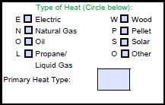
Section 3: Energy Burden Measure Data Collection
Steps for Collecting the Data
Add Main Fuel Type to the Client Application. At minimum, this should include Natural Gas, Electricity, Fuel Oil, Propane, and “Other.”
Examples:
State of Oregon Client Application (left)
State of Missouri Client Application (below)

Slide 32
Section 3: Energy Burden Measure Data Collection
Steps for Collecting the Data
Add Waiver (Release of Information) to the Client Application. This will assure that data exchanges can occur once vendor agreements are in place. Due to increased privacy restrictions, it is important to involve both vendors and attorneys in the development of this language.
Example #1: Minnesota
“I give my consent for my heating and electric companies to give data about my account and energy use to the Minnesota Department of Commerce (DOC) and DOC’s contractors for the Energy Assistance Program (EAP), the Weatherization Assistance Program (WAP) and the Conservation Improvement Program (CIP).”
Example #2: Colorado
“I am the customer of record, the customer’s authorized agent, or an authorized third party for the utility service account identified in this application, and I authorize my utility service provider to disclose my customer data as specified in section 9 of this application.”

Slide 33
Section 3: Energy Burden Measure Data Collection
Steps for Collecting the Data
Issues in Waiver Language – Make sure that the waiver language allows you to report the data to others and protects the utility from disclosure liability.
Example #1: Wisconsin
“I understand that the information collected on this form …. may be used for purposes of referral, research, evaluation, and analysis.”
Example #2: Colorado
“Please note that: … Your utility service provider will have no control over the data disclosed pursuant to this consent, and will not be responsible for monitoring or taking steps to ensure that the LEAP office maintains the confidentiality of the data or uses the data as authorized by you.”
Example #3: New Jersey
“…and further agree to hold harmless and/or releases such companies from and against any claims, losses, demands, damages, or liability of any kind caused by or allegedly caused by such disclosure.”

Slide 34
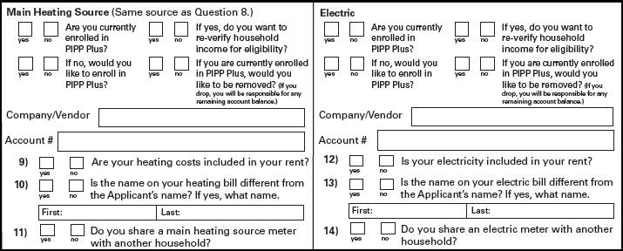
Section 3: Energy Burden Measure Data Collection Steps for Collecting the Data
Add Vendor Account Numbers to Client Application for both Main Fuel and Electricity. Identifying account information will allow grantees to pull up lists to submit to vendors when making data requests.
Example: State of Ohio

Slide 35
Section 3: Energy Burden Measure Data Collection
Steps for Collecting the Data
Identification of Top Five/Top Ten Vendors. Identify top five natural gas vendors, top five electric vendors, top ten fuel oil vendors (if applicable), top ten propane vendors, and top ten other fuel vendors (if applicable). Grantees who need help with this should contact APPRISE or their OCS Liaison.
Vendor Agreements. Work with vendors to develop language that requires vendors to provide annual bill data for LIHEAP recipients. This includes outlining expectations in terms of process and timeline. It should include protections for vendors.
  In states where subgrantees are responsible for vendor agreements, one best practice is to create a “minimum standard” template in collaboration with major vendors at the state level that all subgrantees can adopt.

Slide 36
Section 3: Energy Burden Measure Data Collection
Steps for Collecting the Data
  Example #1: Wisconsin Vendor Agreement (Cost/Usage Data)
  The Supplier agrees to the following:
To provide at no cost to the Division, client, or agency, written information on an applicant household’s home energy costs, bill payment history, or arrearage history for the time period of September 1 to August 31. If the company does not retain cost and/or billing information for this time period then the last 12 monthly billing periods must be provided.
Example #2: Texas Vendor Agreement (Cost/Usage Data)
The Vendor named above is a Retail Energy Provider who represents and warrants that it is authorized to receive payment from Agency on behalf of a customer that the Agency has determined to be eligible under the CEAP guidelines and as such is a "Certified Customer." Vendor will, with reference to a Certified Customer:
Upon verbal or written request from Agency, provide at no cost to the Agency the Certified Customer's billing history for the previous twelve (12) months, or available history plus estimates if less than 12 months of billing history and usage is available. Vendor will transmit such billing history via electronic mail of facsimile no later than the end of the next business day following the request.

Slide 37
Section 3: Energy Burden Measure Data Collection
Steps for Collecting the Data
Developing Data Exchange Systems.
  Intake-Based Systems. Some grantees use energy bills as part of the benefit determination process. Some systems include:
    Automated Data Exchange: Automated information system; program database sends information to the vendor and the vendor’s information system sends information back to the program.
    On-Line Data Entry: Data request sent to vendor on a daily basis. Vendor enters client information on-line within a target time period.
    Subgrantee Access: Vendor gives subgrantee access to summary information about customers.
    Telephone Contact: Subgrantee calls vendor to obtain information.
  Year End Systems (Least-Burden). Some grantees collect information from vendors at the end of the program year.
    Excel File: Most vendors accepted an excel file with the required client information.
    Secure Transfer: Most vendors required a secure transfer protocol; FTP site or password protected or encrypted data.

Slide 38
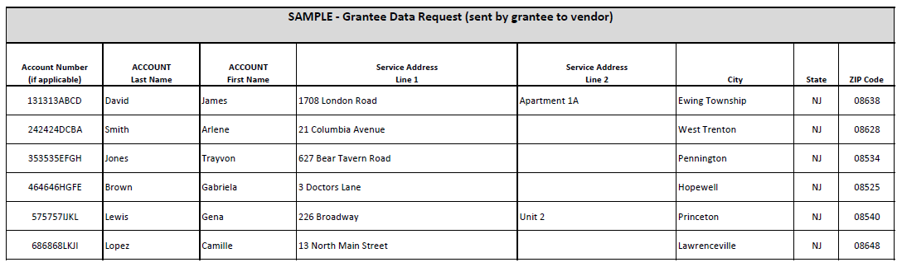
Section 3: Energy Burden Measure Data Collection
Steps for Collecting the Data
How can grantees request data?

Slide 39
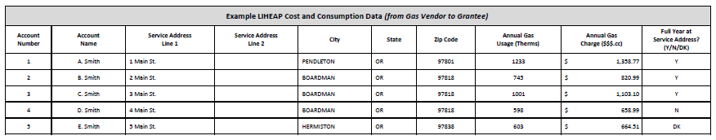
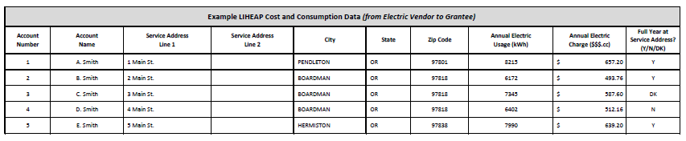
Section 3: Energy Burden Measure Data Collection
Steps for Collecting the Data
How can data be sent back to the grantee?
Natural Gas
Electric

Slide 40
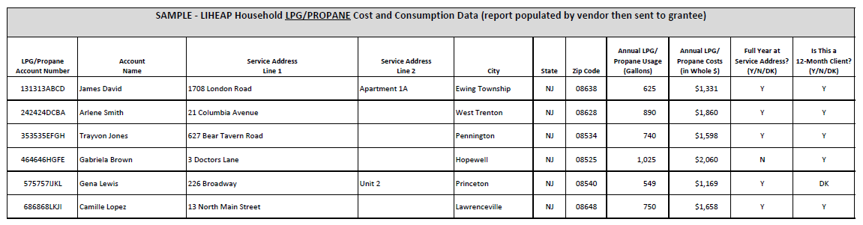
Section 3: Energy Burden Measure Data Collection
Steps for Collecting the Data
How can data be sent back to the grantee?
LPG/Propane

Slide 41
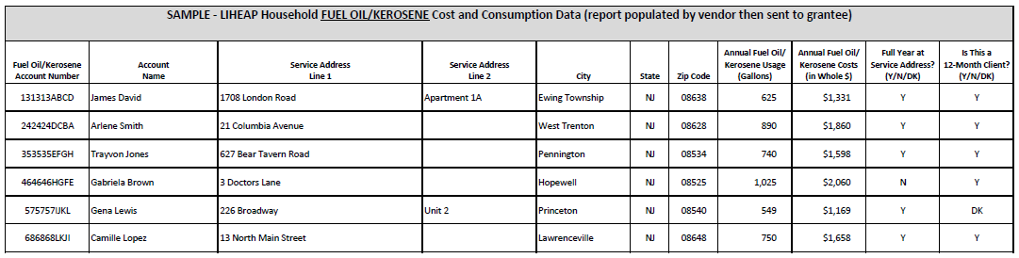
Section 3: Energy Burden Measure Data Collection
Steps for Collecting the Data
How can data be sent back to the grantee?
Fuel Oil/Kerosene

Slide 42
Section 3: Energy Burden Measure Data Collection
Questions

Slide 43
Section 4: Energy Burden Measure Data Reporting
Section 4 continues to focus on LIHEAP Performance Measures related to Home Energy Burden. More specifically, the purpose of this section is to show how you use the energy burden data you collected to prepare Part V of the LIHEAP Performance Measures Report.

Slide 44
Section 4: Energy Burden Measure Data Reporting
Completing Part V of the Report
Which Households should be counted in Part V?
Part V includes those households who received LIHEAP bill payment assistance during the reporting period. Bill payment assistance includes:
Heating and Cooling Assistance
Crisis Assistance (cash or bill-payment only)
Households should NOT be counted if they did not receive a bill payment (cash benefit) that directly impacted their home energy bill. This includes:
    Households receiving only LIHEAP weatherization assistance or energy-related home repair (e.g. heating or cooling equipment repair or replacement)
    Households that receive nominal benefits as part of a partnership with the Supplemental Nutrition Assistance Program (SNAP). This is often referred to as the "Heat or Eat" Program.

Slide 45
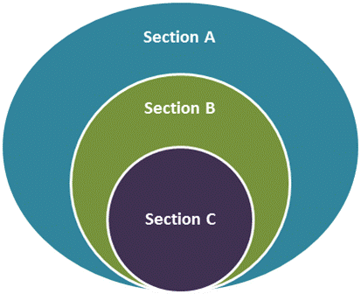
Section 4: Energy Burden Measure Data Reporting
Completing Part V of the Report
      Part V Sections. Part V is broken into sections A-E. Only 3 of these sections require data entry, the remaining sections are auto-calculated for the grantee.
      Which Clients are Included? Grantees start with a dataset for Part V, and use a piece of that dataset to report in each section (see below).
Section A— All Bill Payment Assisted Households
Section B— Bill Payment Assisted Households
with Available Energy Cost Data
Section C— Highest Burden
Bill Payment Assisted Households
with Available Energy Cost Data

Slide 46
Section 4: Energy Burden Measure Data Reporting
Completing Part V of the Report
Section A, Step 1: Unduplicated Number of LIHEAP Bill Payment-Assisted Households.
Note: this information will be pre-populated from the Household Report Form.
Section A, Step 2: Households should be broken out by main fuel type.

Slide 47
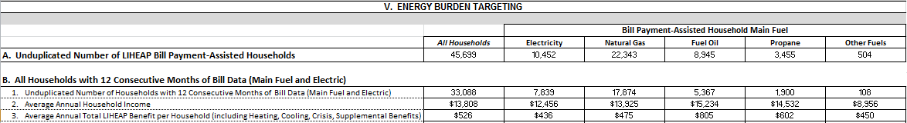
Section 4: Energy Burden Measure Data Reporting
Completing Part V of the Report
Part V, Section B of the Performance Measures Report Form includes only those households from Section A with 12 consecutive Months of Bill Data (Main Fuel and Electric).
  Unduplicated Number of Households with 12 consecutive Months of Bill Data
  Main Heating Fuel and Electric
  2. Average Annual Household Income
  Average Annual Total LIHEAP Benefit per Household
  Including Heating, Cooling, Crisis, Supplemental Benefits

Slide 48
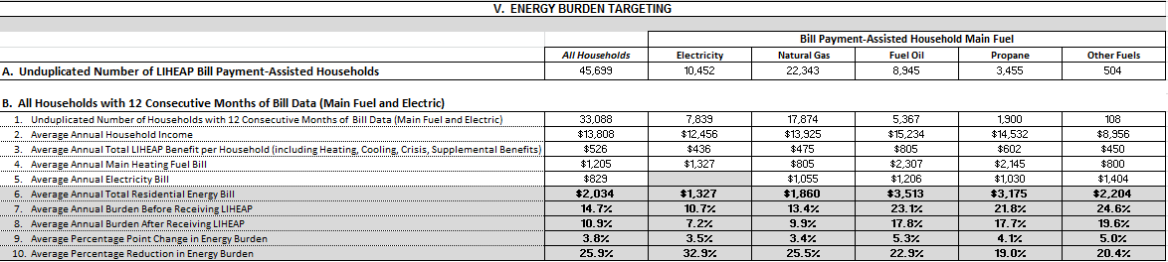
Section 4: Energy Burden Measure Data Reporting
Completing Part V of the Report
Part V, Section B of the Performance Measures Report Form also asks grantees to report households’ average annual main heating fuel bill (Line 4) and average annual electricity bill (Line 5).
Lines 6-10 are “auto-calculated” for the grantee based on data entered in Section B, and will be discussed in further detail during the next portion of the training.

Slide 49
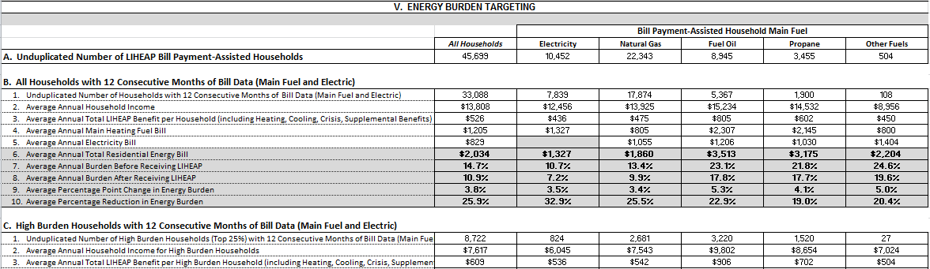
Section 4: Energy Burden Measure Data Reporting
Completing Part V of the Report
Part V, Section C of the Performance Measures Report Form includes only those 25% of households from Section B with the highest energy burden.
Grantees will need to use income and energy costs to calculate burden for households in Section B. Then take the 25% of households with highest energy burden and use their data in Section C.

Slide 50
Section 4: Energy Burden Measure Data Reporting
Completing Part V of the Report
Once the 25% of households with the highest energy burden have been identified for Section C—the same data elements are reported for these households that were reported in Section B. These include:
  1. Unduplicated Number of High Burden Households with 12 Months of Bill Data (Main Heating Fuel and Electric)
  2. Average Annual Household Income
  3. Average Annual Total LIHEAP Benefit per Household
  Including Heating, Cooling, Crisis, Supplemental Benefits
4. Average Annual Main Fuel Bill
5. Average Annual Electric Bill

Slide 51
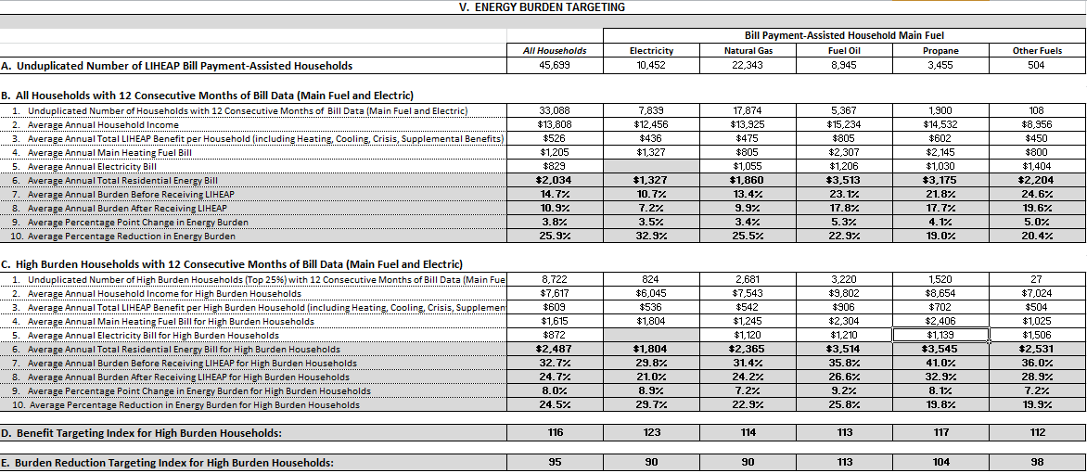
Section 4: Energy Burden Measure Data Reporting
Completing Part V of the Report
Part V, Sections D and E of the Performance Measures Report are auto-calculated for grantees‒and will be explained in more detail during the next portion of the training.

Slide 52
Section 4: Energy Burden Measure Data Reporting
Completing Part V of the Report
Questions

Slide 53
Break
Return at 9:45

Slide 54
Part Two – Checklist, Schedule, and Resources
9:45 to 10:45 – Part 2: LIHEAP Performance Management System
  Section 5: Schedule for Collecting and Reporting Performance Measures
  Section 6: Performance Measures Checklist
  Section 7: Performance Measures Resources

Slide 55
Section 5: LIHEAP Performance Measures Checklist
Engage Stakeholders
Grantee Agency Supervisors and Staff
IT Department
Subgrantee (Agency) Management and Staff
Vendors (Utilities and Delivered Fuels)
Weatherization Agency and Subgrantees
Other Stakeholders

Slide 56
Section 5: LIHEAP Performance Measures Checklist
Develop Policies
Prevention and Restoration Measures
  Mandatory Measures / Optional Measures / Grantee Measures
  Definition of “Imminent Risk”
  Weatherization Agency Reporting Cost / Compliance
Energy Burden Measures
  Mandatory Measures / Optional Measures / Grantee Measures
  Client Confidentiality Issues
  Fuel Prioritization / Vendor Prioritization
  Vendor Compliance Issues

Slide 57
Section 5: LIHEAP Performance Measures Checklist
Policy, Coordination of Program Delivery - Prevention and Restoration Measures
Determine your state’s criteria for “imminent risk.” Grantees should determine when a LIHEAP benefit is considered preventive. At-risk criteria should correspond with existing policy manuals, state plans.
Establish Equipment Repair and Replacement Criteria related to “Restoration and Prevention” with LIHEAP Weatherization Contractors. Grantees may need to coordinate with their Weatherization partners to establish when LIHEAP funds are used to “restore home energy” versus “prevent home energy loss.”
Coordinate Reporting of “Restoration and Prevention” with LIHEAP Weatherization Contractors. This could be as straightforward as asking weatherization contractors to specify on invoices, work orders, or audit reports whether equipment repair/replacement is necessary to restore home energy or prevent home energy loss.

Slide 58
Section 5: LIHEAP Performance Measures Checklist
Policy, Coordination of Program Delivery – Energy Burden Measures
Prioritize which fuels/vendors to work with first. Grantees are required to collect data for all types of fuels. However, while some grantees have been for many years, others are just starting to engage energy vendors in the data collection process. APPRISE recommends that grantees prioritize their data collection efforts.
Develop vendor compliance policy. Some vendors may not be able or willing to provide information due to cost and other issues. Other vendors may request that the state pay for data collection costs.

Slide 59
Section 5: LIHEAP Performance Measures Checklist
Prioritization of Fuels
Priority #1: Start by collecting data for the fuel that represents the greatest share of home energy expenditures for low-income households in the state
Priority #2: Continue by collecting electricity data for all clients
Priority #3: Attempt to cover at least 90 percent of clients by adding a third fuel.
Note: Please contact APPRISE for information on Low-Income Household Energy Expenditure statistics for your state, developed from the LIHEAP Allocation Formula.

Slide 60
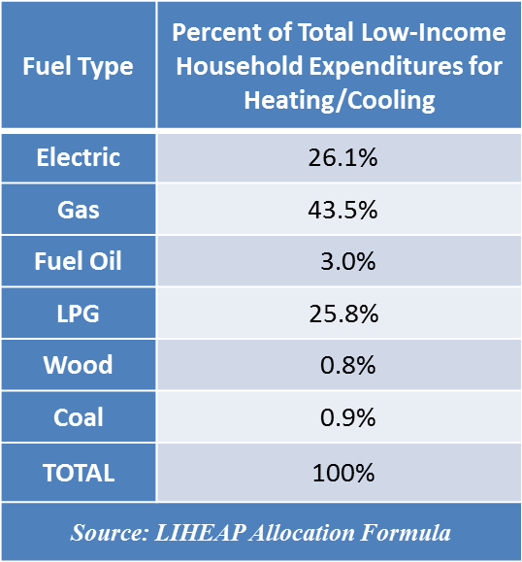
Section 5: LIHEAP Performance Measures Checklist
Prioritization of Fuels – Iowa
We recommend that Iowa prioritize data collection from the state’s gas vendors, the fuel that represents the greatest share of home energy expenditures for low-income households in the state
We recommend that Iowa then work to collect electricity data for all clients
Finally, we recommend that Iowa attempt to collect data from the state’s LPG vendors since they also represent a large share of LIHEAP clients.

Slide 61
Section 5: LIHEAP Performance Measures Checklist
Prioritization of Vendors
Electric Vendors: Attempt to collect data from at least five vendors. {Exception: A smaller number of vendors serve more than 90 percent of clients}.
Natural Gas Vendors: Attempt to collect data from at least five vendors. {Exception: A smaller number of vendors serve more than 90 of clients with natural gas heat.}
Delivered Fuel Vendors: For each delivered fuel, attempt to collect data from at least ten vendors. {Exception: A smaller number of vendors serve more than 50 percent of the clients that use that delivered fuel for main heat.}

Slide 62
Section 5: LIHEAP Performance Measures Checklist
IT Department
Client Information System
  Data for Prevention and Restoration Measures
  Data for Energy Burden Data Collection
Vendor Information System
  Data Export to Targeted Energy Vendors
  Data Import from Targeted Energy Vendors
Weatherization Agency Information System
  Energy Source for Equipment Measures
Reporting System
  Reporting by Energy Source (Restoration and Prevention) and Main Heating Fuel (Energy Burden)
  Identification of High Energy Burden Clients (Top 25%)

Slide 63
Section 5: LIHEAP Performance Measures Checklist
Subgrantees
Client Application
  Identify Information Requirements
  Assess Client’s Ability to Supply Required Information
Caseworkers
  Assess Need for Caseworker Intervention
  Furnish Appropriate Training
Information Systems (Subgrantee Managed Systems)
  Identify Required System Upgrades
  Develop Data Exchange Procedures (See APPRISE Subgrantee Data Exchange Template)

Slide 64
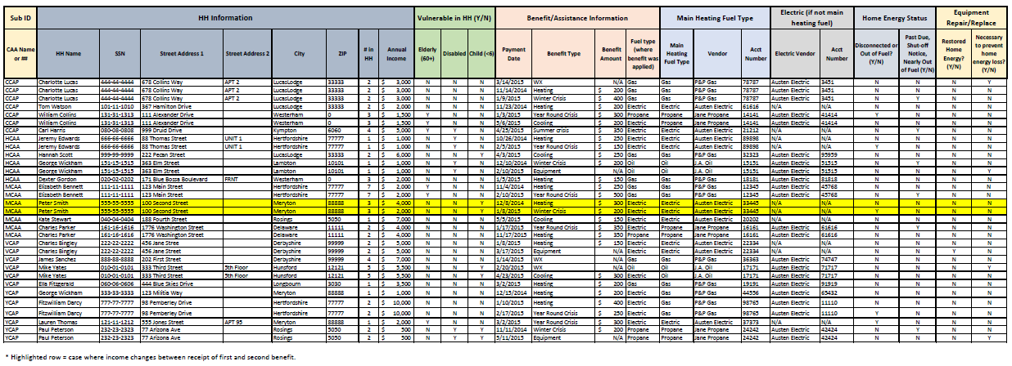
Section 5: LIHEAP Performance Measures Checklist
Subgrantee Data Exchange Template

Slide 65
Section 5: LIHEAP Performance Measures Checklist
Client Applications
Add Main Fuel Type to the Client Application. At minimum, this should include Natural Gas, Electricity, Fuel Oil, Propane, and “Other.”
Add or Modify Waiver (Release of Information) on Client Application. This will assure that data exchanges can occur once vendor agreements are in place. Due to increased privacy restrictions, it is important to involve both vendors and attorneys in the development of this language.
Add Vendor Account Numbers to Client Application for both Main Fuel and Electricity. Identifying account information will allow grantees to pull together lists to submit to vendors when making data requests.
Add Home Energy Status to Application. Includes Disconnected, Out of Fuel, Inoperable Equipment, Past-Due or Shut-off Notice, Nearly Out of Fuel, etc.

Slide 66
Section 5: LIHEAP Performance Measures Checklist
Vendors
Client Waivers
  Waiver Language / Waiver Verification Procedures
Client Identification
  Account Number / Name and Address
Data Exchange Schedule
  Time of Application / Monthly / Quarterly / End of Fiscal Year
Data Exchange Format
  See APPRISE Vendor Data Exchange Templates
Vendor Agreement
  Explicitly Addresses All Listed Issues

Slide 67
Section 5: LIHEAP Performance Measures Checklist
Vendor Partnerships
Identification of Top Vendors. Grantees will need to identify the largest five gas vendors, largest five electric vendors, largest ten propane vendors, the largest ten fuel oil vendors (if applicable), and largest ten other vendors (if applicable) within your state. Grantees who need help with this should contact APPRISE or their OCS Liaison.
Vendor Agreements. Work with one or more major vendors to develop language that requires vendors to provide annual bill data for LIHEAP recipients. This includes outlining expectations in terms of process and timeline. In states where subgrantees are responsible for vendor agreements, one best practice is to create a “minimum standard” template in collaboration with major vendors at the state level that all subgrantees can adopt.

Slide 68
Section 5: LIHEAP Performance Measures Checklist
Weatherization Agency and Subgrantees
Client Identification
  Develop LIHEAP ID for LIHEAP WX Clients
Prevention / Restoration Coding
  Coding of Equipment Repair/Replacement
  Furnish Appropriate Training to Staff
Information Systems
  Develop Data Exchange Procedures

Slide 69
Section 5: LIHEAP Performance Measures Checklist
Questions

Slide 70
Section 6: LIHEAP Performance Measures Timeline
FFY 2015: Prepare for Data Collection
FFY 2016: Collect Data and Develop Reporting Systems
FFY 2017: Report FFY 2016 Performance Measures Data (January 2017) and Use Performance Management Information

Slide 71
Section 6: LIHEAP Performance Measures Timeline
FFY 2015: Prepare for Data Collection
  Engage Stakeholders
  Develop Policy
    Prevention and Restoration Measures
    Energy Burden Measures
  Engage IT Systems Departments
    Update Specifications
    Implement Applicant Processing Systems Updates
  Subgrantee Agreements - Update for FFY 2016
  Application Forms – Update for FFY 2016
  Vendor Agreements – Update for FFY 2016
  Weatherization Agency – Specification for Information Exchange

Slide 72
Section 6: LIHEAP Performance Measures Timeline
FFY 2016: Collect Data and Develop Reporting Systems
  Furnish Updates to Stakeholders
  Implement Policies
  IT Systems
    Develop Energy Data System Specifications
    Implement Energy Data System
    Update Reporting System Specifications
    Implement Reporting System Updates
  Application Forms
    Process Assessment
    Data Quality Review
  Subgrantee Training
  Vendor Data Exchange Development
  Weatherization Agency Data Exchange Development

Slide 73
Section 6: LIHEAP Performance Measures Timeline
FFY 2017: Report and Use (!!) Data
  Furnish Reports to Stakeholders
  Assess Policies
  IT Systems
    Data Exchange with Subgrantees / Vendors / Weatherization Agency
    Prepare Reports
  Subgrantee Data Exchange
  Vendor Data Exchange
  Weatherization Agency Data Exchange
  Use Performance Management Information

Slide 74
Section 6: LIHEAP Performance Measures Timeline
Questions

Slide 75
Section 7: Performance Measures Resources
Resources for Grantees
Data Warehouse
Self-Assessment Tool

Slide 76
Section 7: Performance Measures Resources
Resources for Grantees
Webinars
  #1 FY 2014 Household Report: OLDC System
    https://liheappm.ncat.org/sites/default/files/private/training/webinars/OLDC_household_report_120414.pptx
  #2 FY 2014 Performance Data Form: OLDC System
    https://liheappm.ncat.org/sites/default/files/private/training/webinars/OLDC_perf_data_form_121014.pptx
  #3 Building Vendor Relationships
    https://liheappm.ncat.org/sites/default/files/private/training/Building_Vendor_Relationships_Webinar_121814.pptx
  #4 Delivered Fuel Vendors
    https://liheappm.ncat.org/sites/default/files/private/training/webinars/DeliveredFuelVendorsWebinar_061115.pptx

Slide 77
Section 7: Performance Measures Resources
Resources for Grantees
Performance Measures Tools
  Performance Measures Data Collection Guide
    https://liheappm.ncat.org/sites/default/files/private/training/PM_Data_Collection_Guide.docx
  Energy Vendor Data Exchange Templates
  Subgrantee Data Exchange Template

Slide 78
Section 7: Performance Measures Resources
Resources for Grantees
Performance Data Form and Instructions
  Performance Data Form
    https://www.acf.hhs.gov/sites/default/files/ocs/copy_of_liheap_performance_data_form_for_federal_fiscal_year_2014.xlsx
  Performance Data Form Instructions
    https://www.acf.hhs.gov/sites/default/files/ocs/liheap_performance_data_form_instructions_updated.pdf
  Performance Data Form FAQ
    https://liheappm.ncat.org/faq

Slide 79
Section 7: Performance Measures Resources
Data Warehouse
  Household Report Data – 2001 to 2014
    https://liheappm.ncat.org/data_warehouse/index.php?report=households
  Grantee Survey Data – 2001 to 2014
    https://liheappm.ncat.org/node/53
  Income Eligible Population Data – 2001 to 2014
    https://liheappm.ncat.org/data_warehouse/index.php?report=eligible

Slide 80
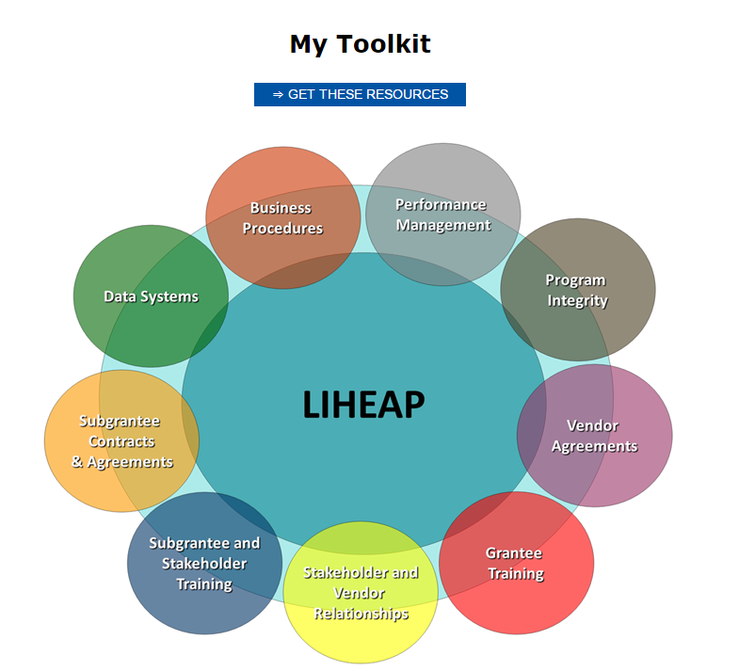
Section 7: Performance Measures Resources
Grantee Self-Assessment Tool

Slide 81
Section 7: Performance Measures Resources
Questions

Slide 82
Break
Return at 11:00

Slide 83
Introduction: Training Overview
11:00 to 12:00 – Part 3: LIHEAP Performance Management System
  LIHEAP Logic Model – Performance Management Framework
  LIHEAP State Plan – Program Design and Implementation
  PDF Section I. Grantee Survey – Inputs and Outputs
  Household Report – Outputs and Outcomes
  Data Warehouse Reports – Inputs, Outputs, Outcomes {Jenni and Jane}
  PDF Section II. LIHEAP Performance Measures – Outcomes and Impacts
  LIHEAP Performance Management Self-Assessment Tool {Heather}

Slide 84
Part 3: LIHEAP Performance Management System
LIHEAP Logic Model {PMIWG Logic Model Slide}
  Problem Statement/Intervention – What is the need and how is it addressed? (Program Plan)
  Inputs – What resources are devoted to addressing the problem? (Sources of Funds)
  Outputs – How are those resources used? (Uses of Funds and Clients Served)
  Outcomes – How does the program change the status of clients? (Vulnerable Households Targeted / Energy Burden Reduction / Service Restoration)
  Impacts – What is the lasting result of the program? (Lower Energy Burden and Continuous Service = More Affordable, Safer, and Healthier Homes)

Slide 85
Part 3: LIHEAP Performance Management System
LIHEAP Performance Management Information System
  Problem Statement/Intervention – LIHEAP State Plan
  Inputs – Performance Data Form Section I. Grantee Survey (Sources of Funds)
  Outputs – Performance Data Form Section I. Grantee Survey (Uses of Funds and Average Benefits) and Household Report (Clients Served)
  Outcomes – Household Report (Vulnerable Household Targeting) and Performance Data Form Section II. LIHEAP Performance Measures (Average Burden Reduction and Service Restoration)
  Impacts – Performance Data Form Section II. LIHEAP Performance Measures (Energy Burden Targeting and Service Loss Prevention)

Slide 86
Part 3: LIHEAP Performance Management System
LIHEAP Performance Management Reports
  LIHEAP State Plan – Program Design and Implementation
  Performance Data Form Section I. Grantee Survey – Program Inputs and Outputs
    https://liheappm.ncat.org/node/53
  LIHEAP Household Report – Program Outputs and Outcomes
    https://liheappm.ncat.org/data_warehouse/index.php?report=households
  Performance Data Form Section II. LIHEAP Performance Measures – Program Outcomes and Impacts {Note: Future Link}

Slide 87
Part 3: LIHEAP Performance Management System
Using LIHEAP Performance Management Reports
  Jane Blank – State of Wisconsin
  Jenni Sullivan – State of Montana

Slide 88
Part 3: LIHEAP Performance Management System
Questions

Slide 89
Restoration and Prevention Measures
What are We Reporting? Why Does It Matter?
Restoration vs. Prevention
Grantees are required to assist households experiencing energy crises within expedited time frames. However, grantees have found that “reactive” assistance (e.g., utility reconnection) is costly and exposes low-income households to significant health and safety risks.
Therefore, grantees have proposed to OCS that crisis program impacts should be measured in terms of both service restoration and the prevention of service termination, with an emphasis on moving clients from restoration to prevention. This information will help grantees more effectively manage LIHEAP crisis intervention—potentially reducing household health and safety risks, as well as optimizing limited funding resources.

Slide 90
Restoration and Prevention Measures
Using LIHEAP Performance Measures
Examples of How Performance Measures Can Be Used:
Reporting: Home energy loss resonates with multiple audiences. Therefore information regarding Restoration or Prevention proves meaningful for “telling our story” in legislative reports, fact sheets, or media releases.
Subgrantee Monitoring: One grantee noticed disproportionate numbers of disconnected applicants being processed by a local subgrantee. Research uncovered local policies that encouraged delaying intakes until applicants were disconnected.
Policy, Program Evaluation: While it is important to make sure people’s heating and cooling stay on—there are some programs that may be incentivizing clients to put themselves in crisis situations without knowing it. Prevention and Restoration data provide an opportunity to evaluate policy and program design. For example, if natural gas clients have lower bills and lower benefits, but have a higher rate of service restoration than other clients, grantees might look at ways to encourage clients to make payments during the winter when shutoff moratoria are in place.

Slide 91
Restoration and Prevention Measures
Using LIHEAP Performance Measures
Examples of How Performance Measures Can Be Used:
Program Pilot, Alternatives. Prevention and restoration data (by itself and in conjunction with energy burden data) provide a chance for grantees to test and evaluate how incentive, education, or other behavior modification programs could impact home energy status.
Utility Partnerships. Utilities are interested in improving client payment patterns and preventing disconnection. One grantee used account status data from client applications to identify those households with a history of waiting until they were disconnected to apply for LIHEAP services. They then partnered with a local utility to target these households and offer incentives for those who proactively sought assistance (including education) before they experienced a home energy crisis.
Notes:
Many ways to use this data—these are a few examples we’ve heard from grantees who already collect it.

Slide 92
Explaining Energy Burden Measure Data
What are we reporting? Why does it matter?
Change in Energy Burden
Indicator #1: Average pre-LIHEAP energy burden
Indicator #2: Average post-LIHEAP energy burden
Indicator #3: Average energy burden reduction as a result of LIHEAP
Indicator #4: Average energy bill offset as a result of LIHEAP
These indicators tell us how LIHEAP reduces the percentage of income households spend on their energy bills.
Why Does This Matter?
We know that low-income households have to make tough choices between paying their energy bills and other essential needs (food, prescriptions). Reducing the amount of income people spend on energy bills decreases the health and safety risks associated with these kinds of decisions.

Slide 93
Explaining Energy Burden Measure Data What are we reporting? Why does it matter?
Indicators #1 and #2 Example: Pre-Post LIHEAP Energy Burden
Percent of Income Spent on Energy Bills (before and after LIHEAP)
In 2005, LIHEAP reduced the percentage of income households paid on energy bills from 11.2% to 9.2%.
This was a reduction of 1.9 percentage points. LIHEAP paid 17% of client bills.
In 2009, LIHEAP reduced the percentage of income households paid on energy bills from 10.1% to 7.6%.
This was a reduction of 2.5 percentage points. LIHEAP paid 25% of client bills.
How much does LIHEAP reduce energy burden for low-income households?
In 2005, LIHEAP cut household energy bills and burden by 17%. In 2009, this number increased to 25%, in spite of the fact that households had higher energy bills than in 2005.

Slide 94
Explaining Energy Burden Measure Data What are we reporting? Why does it matter?
Indicator #3: Benefit Targeting Index
This measure tells us whether high energy burden households receive higher LIHEAP benefits than average households.
Why Does This Matter?
The LIHEAP Act requires grantees to provide the highest level of assistance to households with the highest energy burden (highest energy costs in relation to income and family size).

Slide 95
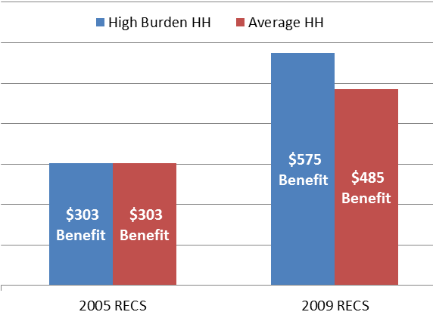
Explaining Energy Burden Measure Data What are we reporting? Why does it matter?
Indicator #3: Benefit Targeting Index Example
In 2005, high burden households received the same benefit as the average household.
[Index Score: 100]
In 2009, high burden households received a benefit 18.6% higher than the average household.
[Index Score: 118.6]
Does the LIHEAP program furnish higher benefits to high burden households?
Not in 2005. But, in 2009 the program did pay higher benefits to high burden households.

Slide 96
Explaining Energy Burden Measure Data What are we reporting? Why does it matter?
Indicator #4: Burden Reduction Targeting Index
This measure tells us whether high energy burden households have a larger share of their energy bill paid with LIHEAP than average households.
Why Does This Matter?
The LIHEAP Act requires grantees to provide the highest level of assistance to households with the highest energy burden. This measure goes beyond the size of the benefit to look at the share of the bill paid.

Slide 97
Explaining Energy Burden Measure Data What are we reporting? Why does it matter?
Index scores will be “automatically” calculated based on the data grantees enter into OLDC. It is helpful, however, to understand what index scores tell us. In the case of the Burden Reduction Targeting Index:
= 100: High burden households had the same amount of their home energy bill paid by LIHEAP than average households.
< 100: High burden households had a lower percentage of their home energy bill paid by LIHEAP than average households.
> 100: High burden households had a higher amount of their home energy bill paid by LIHEAP than average households.

Slide 98
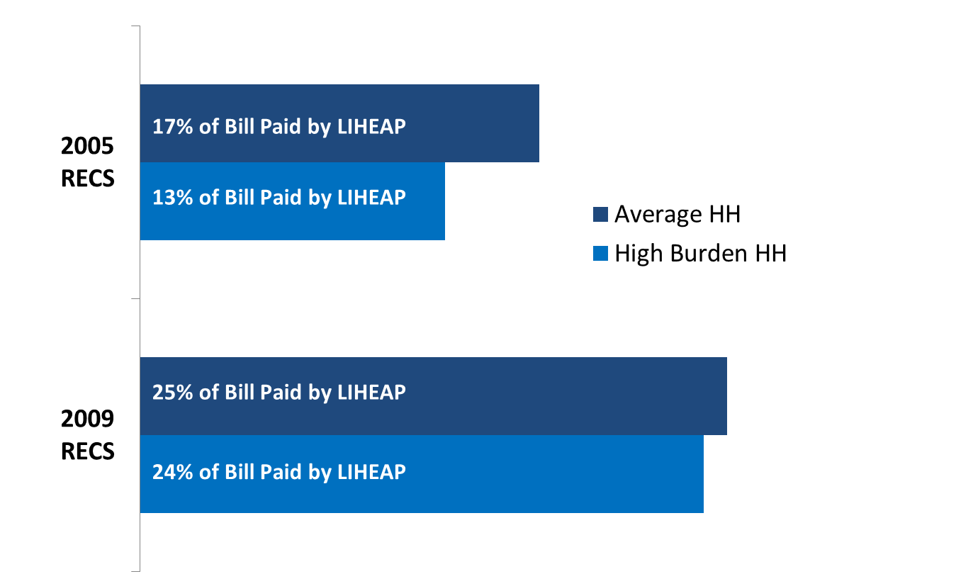
Explaining Energy Burden Measure Data
What are we reporting? Why does it matter?
Indicator #4: Burden Reduction Targeting Index Example
In 2005, high burden households had 13% of their annual home energy bill paid, compared to the average of 17%.
[Index Score: 76]
In 2009, high burden households had 24% of their annual home energy bill paid, compared to the average of 25%.
[Index Score: 96]
Does LIHEAP pay a larger share of the home energy bill for high burden households?
No. In both 2005 and 2009, high burden households had a lower percentage of their home energy bill paid by the program than the average household. But, the program improved on this measure between 2005 and 2009.

Slide 99
Explaining Energy Burden Measure Data
Using LIHEAP Performance Measures
How Can Grantees Use Energy Burden Data?
The Benefit Matrix. Many grantees evaluate their benefit matrix each year to decide whether to change benefit levels for households (based on income, fuel type, and other factors). Energy burden measures will show grantees whether or not their matrix is effectively targeting assistance to high burden households.
Moving Beyond Bill Payment Assistance. Energy burden measures will illuminate areas where energy program coordination might be useful. For example, if fuel oil clients continually have high bills and are receiving high LIHEAP benefits—it may prove valuable to target weatherization funding or other energy efficiency efforts toward these households.

Slide 100
Part 3: LIHEAP Performance Management System
Questions

Slide 101
Part 3: LIHEAP Performance Management System
PMIWG LIHEAP Self-Assessment Tool
  Are you ready to proactively manage your LIHEAP Program? Let’s find out!!
  Heather Jones – State of Missouri

Slide 102
Part 3: LIHEAP Performance Management System
Questions

Slide 103
Break
Go to Lunch!!

