Slide 1
LIHEAP Performance Management in the District of Columbia
Kenley Farmer
Associate Director, Department of Energy & Environment
Kevin McGrath
Project Director, APPRISE
2019 NEUAC Annual Conference

Slide 2
Presentation Agenda
Overview of the DC Energy Assistance Programs
Performance Data Research History in DC
2018 Energy Burden Study Findings
Using Study Findings to Make Program Changes

Slide 3
Overview of DC Energy Assistance Programs

Slide 4
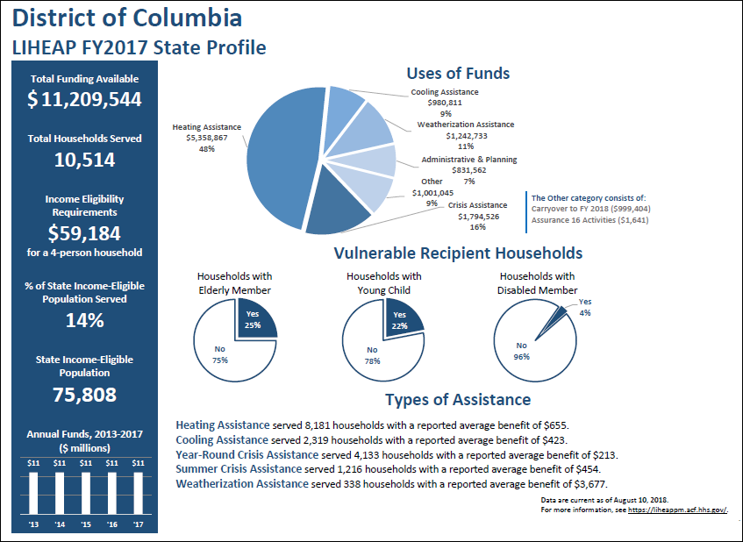
DC LIHEAP Program Profile
Federal Funding

Slide 5
DC LIHEAP Program Profile
Federal and Local Funding
 | Federal Funding | Federal and Local Funding
Funding for bill payment assistance | $8.13M | $14.96M
Total households served | 10,514 | 20,695
Percent of income-eligible households served | 14% | 27%

Slide 6
Funding for Energy Bill Payment Assistance Programs in DC

Slide 7
Performance Data Research History in DC

Slide 8
2014 Energy Burden Study Results
 | Electric Main Heat | Gas Main Heat
Income | $12,109 | $13,393
Estimated Total Energy Bill* | $1,692 | $2,409
Gross Energy Burden | 14% | 18%
LIHEAP Benefit | $683 | $512
Net Energy Burden | 8% | 14%
*Electric bill data were unavailable for LIHEAP clients; estimates from the American Community Survey used as proxy

Slide 9
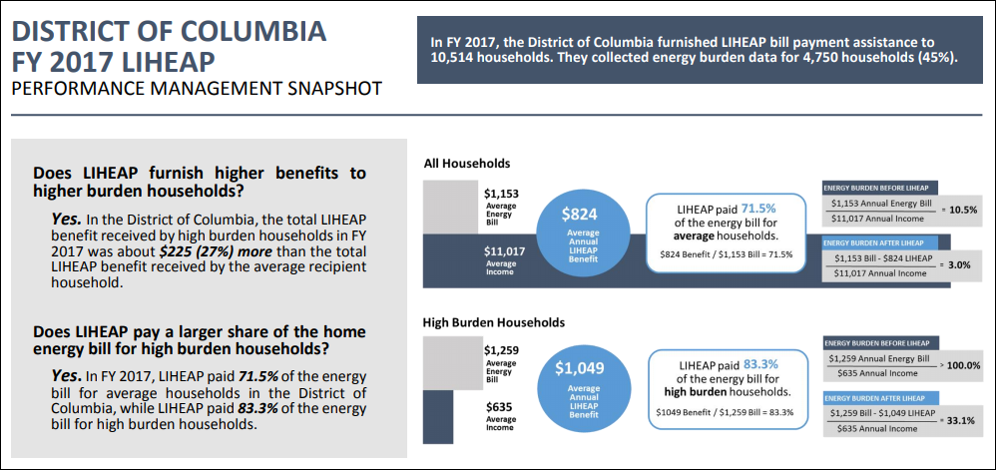
FY 2017 LIHEAP Performance Measures
Executive Summary

Slide 10
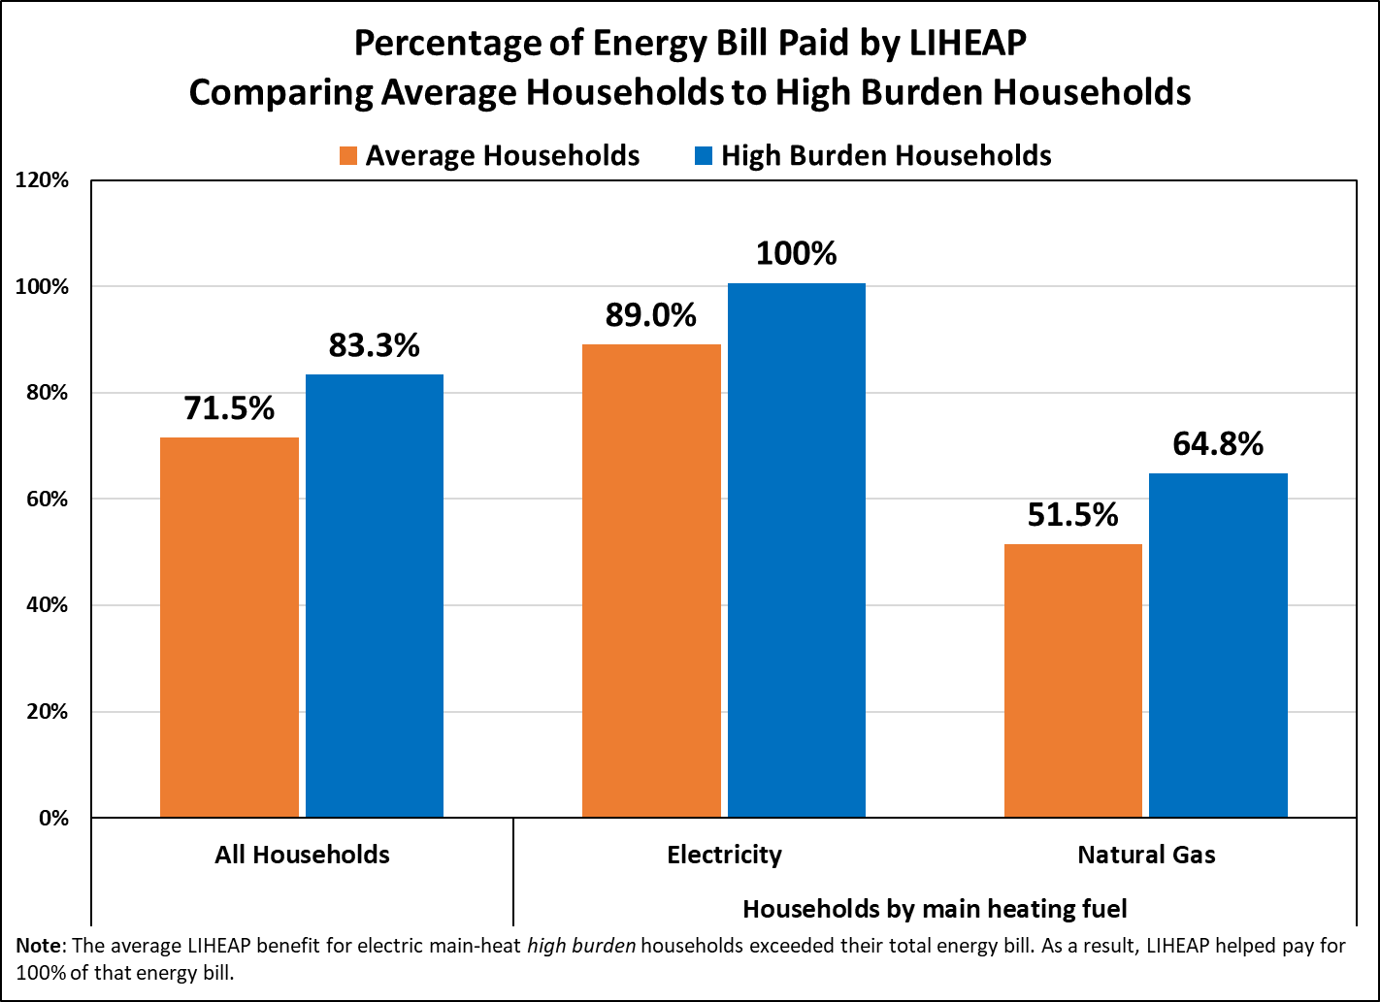
FY 2017 LIHEAP Performance Measures
Details by Heating Fuel Type

Slide 11
Purposes of 2018 Energy Burden Study
Increased local program funding between 2014 and 2018 to ensure year-round operation
Assess whether resources were being used in the best possible way to serve the most clients with the greatest impact

Slide 12
2018 Energy Burden Study Findings

Slide 13
Factors Used in Prior Benefit Matrix
Income
Less income → higher benefit
Household Size
More household members → higher benefit
Housing Unit Type
Single family home → higher benefit
Heating Fuel Type
Electric main heat → higher benefit

Slide 14
Data Sources & Reliability
LIHEAP Database → income, household size, main heating fuel type, demographics
PEPCO data file → electricity consumption and expenditures, factors to estimate ratepayer discount amount
  5.2k electric main heat clients → 80% with “complete” data
Washington Gas data file → gas consumption and expenditures, actual ratepayer discount amount
  7.7k gas main heat clients → 28% with “complete” data

Slide 15
Group Average Burden
Prior Benefit Matrix
 | Electric Main Heat Clients | Gas Main Heat Clients
Income | $13,874 | $15,148
Total Energy Bill* | $902 | $1,352
Gross Energy Burden | 7% | 9%
LIHEAP Benefit | $724 | $627
Net Energy Burden | 1% | 5%
*Total Energy Bill is net of ratepayer discount program benefits

Slide 16
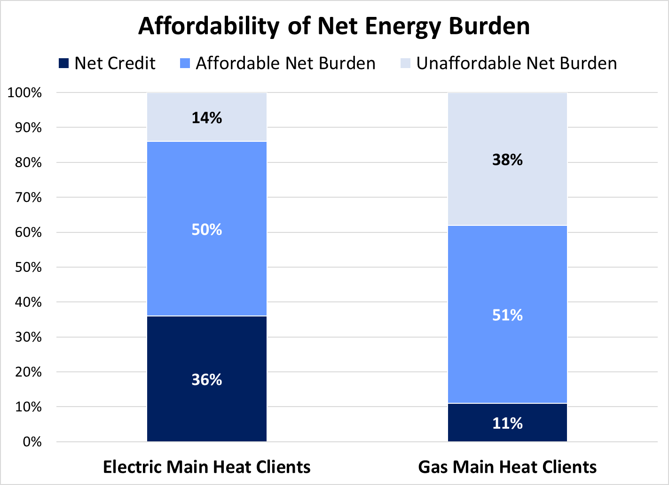
Distribution of Net Burden
Prior Benefit Matrix

Slide 17
Revised Benefit Matrix
“3% Matrix” → targets group average net home energy burden of 3% for both electric and gas main heat clients
Factors similar to prior benefit matrix except:
  Gas clients receive higher benefit
  Income, household size, and housing type adjustments based on updated data
Provides more equitable outcome across fuel types and approximately cost neutral, but…
Won’t solve distributional issues for individual clients

Slide 18
Group Average Burden
Revised Benefit Matrix
 | Electric Main Heat Clients |  | Gas Main Heat Clients
 | Prior Matrix | Revised Matrix | Prior Matrix | Revised Matrix
Income | $13,874 |  | $15,148
Total Energy Bill* | $902 |  | $1,352
Gross Energy Burden | 7% |  | 9%
LIHEAP Benefit | $724 | $483 | $627 | $888
Net Energy Burden | 1% | 3% | 5% | 3%
*Total Energy Bill is net of ratepayer discount program benefits

Slide 19
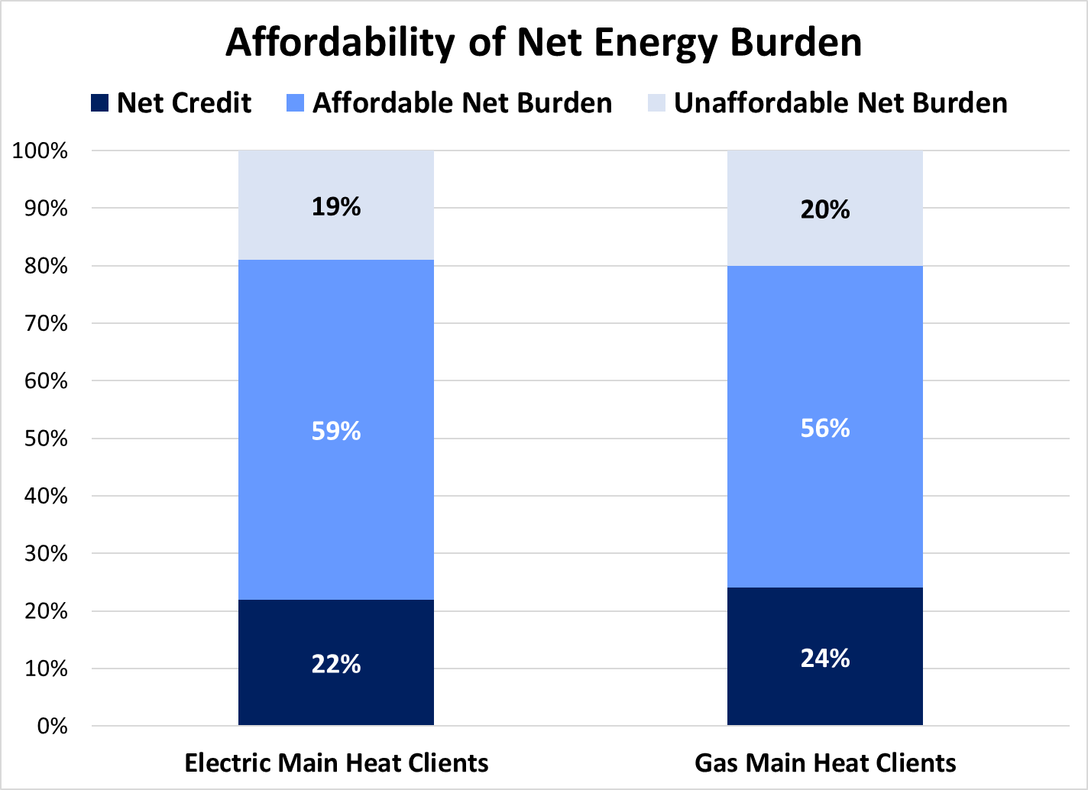
Estimated Net Affordability
Revised Benefit Matrix

Slide 20
Using Study Findings to Make Program Changes

Slide 21
Using Study Findings to Make Program Changes
Internal and external education
Advocate for additional funding
Implement a new benefit matrix and gain external and internal stakeholder input
Implement a long-term action plan for “real time” energy burden data

Slide 22
Questions & Answers
Kenley Farmer, Associate Director, DOEE
  Email: kenley.farmer@dc.gov
  Phone: (202) 478-2423
Kevin McGrath, Project Director, APPRISE
  Email: kevin-mcgrath@appriseinc.org
  Phone: (609) 252-2081

