Slide 1
How LIHEAP Performance Management is Increasing LIHEAP Program Success
NEUAC 2019
Melissa Torgerson, VERVE Associates, LLC
David Carroll, APPRISE Incorporated
Tracy Desmarais. APPRISE Incorporated
Kenley Farmer, District of Columbia
Kevin McGrath. APPRISE Incorporated

Slide 2
LIHEAP Performance Management – Increasing LIHEAP Program Success
Session Overview
LIHEAP Performance Management – Energy Burden Targeting
Information Available in 2009
Performance Management Issues
Actions and Initiatives
Information Available in 2019
Performance Management Tools
The New Hampshire Experience – Tracy Desmarais
Data collection and reporting
Findings and Next Steps
The District of Columbia Experience – Kenley Farmer and Kevin McGrath
Going Beyond Performance Management Statistics
Findings, Actions, and Next Steps
Presenter:
David Carroll

Slide 3
LIHEAP Performance Management – Energy Burden Targeting
Rationale for Targeting LIHEAP Benefits
LIHEAP Performance Measures were developed in response to:
Section 2605(b) of the Low Income Home Energy Assistance Act of 1981 (42 U.S.C. §8624(b)) as amended by Sec. 311(b) of the Human Services Amendments of 1994 (Public Law 103-252) requiring HHS to develop, in consultation with LIHEAP grantees, model performance goals that measure the success of each State’s LIHEAP activities.
Section 2610(b)(2) of the Low Income Home Energy Assistance Act of 1981 (42 U.S.C. §8629(b)(2)) requiring that HHS annually report to Congress on the impact LIHEAP is making on recipient and income eligible households.
Section 2605(b)(5) of the Low Income Home Energy Assistance Act of 1981 (42 U.S. C. §8624(b)(5)) requiring LIHEAP grantees to provide, in a timely manner, that the highest level of energy assistance will be furnished to those households that have the lowest incomes and the highest energy costs or needs in relation to income, taking into account family size.
Presenter:
David Carroll

Slide 4
LIHEAP Performance Management – Energy Burden Targeting
Rationale for Targeting LIHEAP Benefits
Scenario #1 – Differences in Energy Bills
Household #1 - Propane
Income = $8,000 (2 Person – 50% of Poverty)
Energy Bill = $2,000
Energy Burden = 25%
Household #2 – Natural Gas
Income = $8,000 (2 Person – 50% of Poverty)
Energy Bill = $1,600
Energy Burden = 20%
Presenter:
David Carroll

Slide 5
LIHEAP Performance Management – Energy Burden Targeting
Rationale for Targeting LIHEAP Benefits
Scenario #2 – Differences in Income
Household #2 – Natural Gas
Income = $8,000 (2 Person – 50% of Poverty)
Energy Bill = $1,600
Energy Burden = 20%
Household #3 – Natural Gas
Income = $20,000 (2 Person – 125% of Poverty)
Energy Bill = $2,000
Energy Burden = 10%
Presenter:
David Carroll

Slide 6
LIHEAP Performance Management – Energy Burden Targeting
Rationale for Targeting LIHEAP Benefits
Household #1 - Propane
Income = $8,000
Pre LIHEAP = $2,000 / Benefit = $800 / Post LIHEAP = $1,200
Gross Burden = 25% / Net Burden = 15%
Household #2 – Natural Gas
Income = $8,000
Pre LIHEAP = $1,600 / Benefit = $400 / Post LIHEAP = $1,200
Gross Burden = 20% / Net Burden = 15%
Household #3 – Natural Gas
Income = $20,000
Pre LIHEAP = $2,000 / Benefit = $200 / Post LIHEAP = $1,800
Gross Burden = 10% / Net Burden = 9%
Presenter:
David Carroll

Slide 7
LIHEAP Performance Management – Energy Burden Targeting
LIHEAP Benefit Targeting – Benefit Matrix
Percent of Poverty | Electric | Natural Gas | Fuel Oil | Propane | Other
0-50% | $250 | $500 | $750 | $750 | $750
50-100% | $200 | $400 | $600 | $600 | $600
100%+ | $125 | $250 | $375 | $375 | $375
Presenter:
David Carroll

Slide 8
LIHEAP Performance Management – Energy Burden Targeting
LIHEAP Benefit Targeting – Data Sources in 2009
#1 - State Energy Data System (SEDS) / RECS Survey
  SEDS - Energy Prices and Expenditures by State
  RECS – Energy Consumption by Other Factors
#2 - American Community Survey (ACS)
  ACS – Self-Reported Energy Bills
#3 - Energy Vendor Information
  Energy Vendors – Energy Bills for Customers
Presenter:
David Carroll

Slide 9
LIHEAP Performance Management – Energy Burden Targeting
LIHEAP Benefit Targeting – Data Sources in 2009
Benefit Targeting Data Issues (2009)
  Data Sources Complex
  Interpretation of Findings
  Updates Needed
  No Feedback on Results
Benefit Targeting Effectiveness
  Focus on Averages
  Cannot Adapt to Individual Households
Presenter:
David Carroll

Slide 10
LIHEAP Performance Management – Energy Burden Targeting
LIHEAP Benefit Targeting – Individual Circumstances
Household #1 – Elderly Couple / Retired Carpenter
Income = $16,000
Energy Bill = $1,600
Energy Burden = 10%
Household #2 – Young Couple / Fixer Upper
Income = $16,000
Energy Bill = $2,000
Energy Burden = 12.5%
Household #2 – Single Mother / Rental Unit
Income = $16,000
Energy Bill = $2,400
Energy Burden = 15%
Presenter:
David Carroll

Slide 11
LIHEAP Performance Management – Energy Burden Targeting
LIHEAP Benefit Targeting – Performance Management Pioneers
Five to Ten States with Advanced Information Systems
Data Exchanges with Energy Vendors
  Annual Data Exchange for Repeat Clients
  Realtime Data Exchange for New Clients
  Backup Matrix for Clients without Data
Information System Benefits
  Improved Benefit Targeting / Clients with Data
  Improved Backup Matrix / Clients without Data
  Feedback on Outcomes
Presenter:
David Carroll

Slide 12
LIHEAP Performance Management
A Brief History
2008-10: Performance Management Work Group (PMWG) develops Performance Measurement Recommendations.
2010-12: Performance Management Implementation Work Group (PMIWG) transforms PMWG recommendations into concrete Performance Measures.
2012-14: OCS and APPRISE work with grantees to develop the Performance Measurement Website.
2014-16: OMB approves PMIWG recommendations, making new Performance Measures required reporting beginning in FY 2016. PMIWG members work with OCS and APPRISE Team to develop guidance and support for grantees as they update systems to collect and report new data.
2016-19: PMIWG members work with OCS and APPRISE Team to develop guidance and support for grantees as they analyze and use their data.
Presenter:
David Carroll

Slide 13
LIHEAP Performance Management
Current Status
  Reporting = 48 of 51 State Grantees
  Median Share of Households = 45%
  Updates to Benefit Matrix / Updates to Benefit Determination Procedures
Presenter:
David Carroll

Slide 14
LIHEAP Performance Management
2009 “Suite” of Performance Management Data
  For many years, LIHEAP Grantees have had a suite of data and information available to inform program evaluation and planning.
  Required LIHEAP Reports
LIHEAP Model Plan
LIHEAP Household Report
LIHEAP Performance Data Form - Section I. Grantee Survey
  Other Data Sources
LIHEAP Home Energy Notebook
American Community Survey (Census)
Residential Energy Consumption Survey (RECS)
State Energy Data System (SEDS)
New Performance Measure data provides LIHEAP grantees with important additions to their collection of Performance Management tools.
Presenter:
David Carroll

Slide 15
LIHEAP Performance Management – Energy Burden Targeting
Energy Burden Measures
Energy Burden Measures
What is the average energy burden of LIHEAP households, and how does LIHEAP lower that burden?
[Benefit Targeting Index] Does LIHEAP furnish higher benefits to higher burden households?
[Burden Reduction Targeting Index] Does LIHEAP pays a larger share of the home energy bill for high burden households?
Why is this important?
Section 2605(b)(5) of the Low Income Home Energy Assistance Act of 1981 (42 U.S. C. §8624(b)(5)) states that grantees “provide, in a timely manner, that the highest level of energy assistance will be furnished to those households that have the lowest incomes and the highest energy costs or needs in relation to income, taking into account family size.”

Slide 16
LIHEAP Performance Management – Energy Burden Targeting
Performance Management Tools
LIHEAP Performance Management SNAPSHOT
Executive Summary – Overview of Program Performance
SNAPSHOT – Detailed Tables by Main Heating Fuel
Performance Management Assessment Tool (forthcoming)

Slide 17
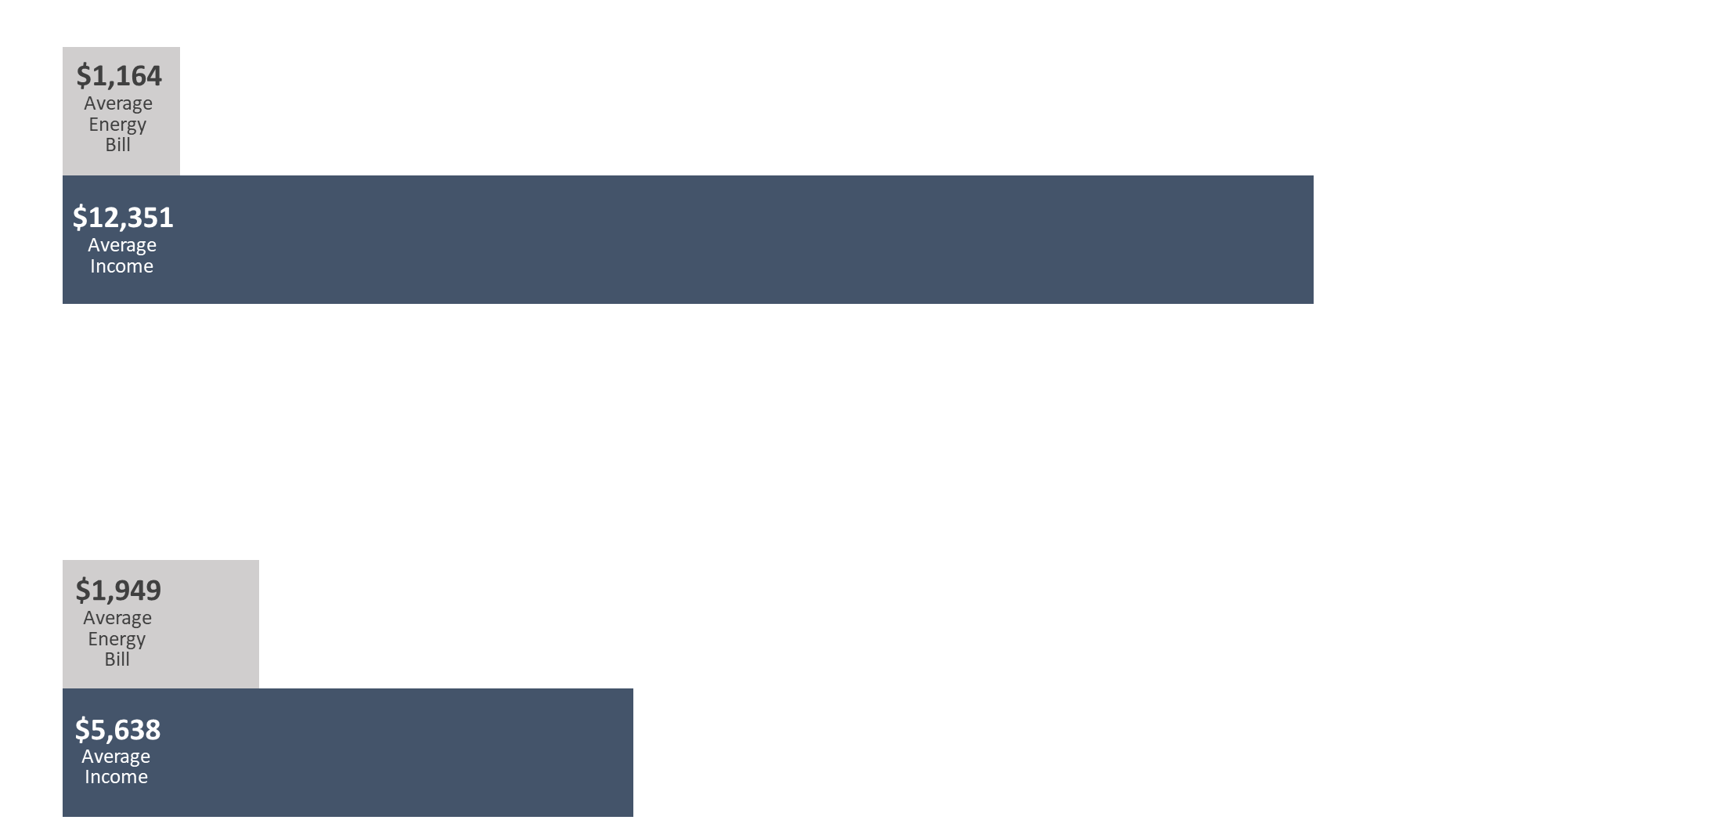
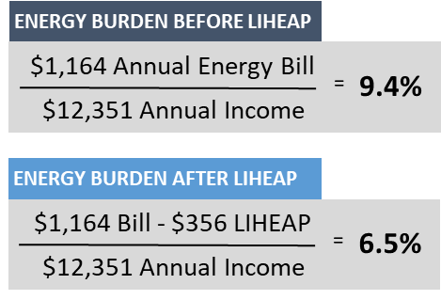

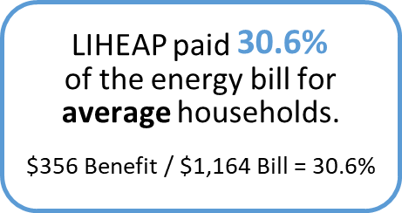
LIHEAP Performance Management – Energy Burden Targeting
Energy Burden Measures – SNAPSHOT Executive Summary
What is the average energy burden of LIHEAP households, and how does LIHEAP lower that burden?
Energy Burden is the percentage of income a household pays toward energy bills:
Energy Burden Data
Average annual income by household fuel type
Average annual main heating fuel costs by household fuel type
Average annual electric costs by household fuel type
Average annual LIHEAP benefit by household fuel type
Energy Bill
=
Energy
Burden
Income

Slide 18
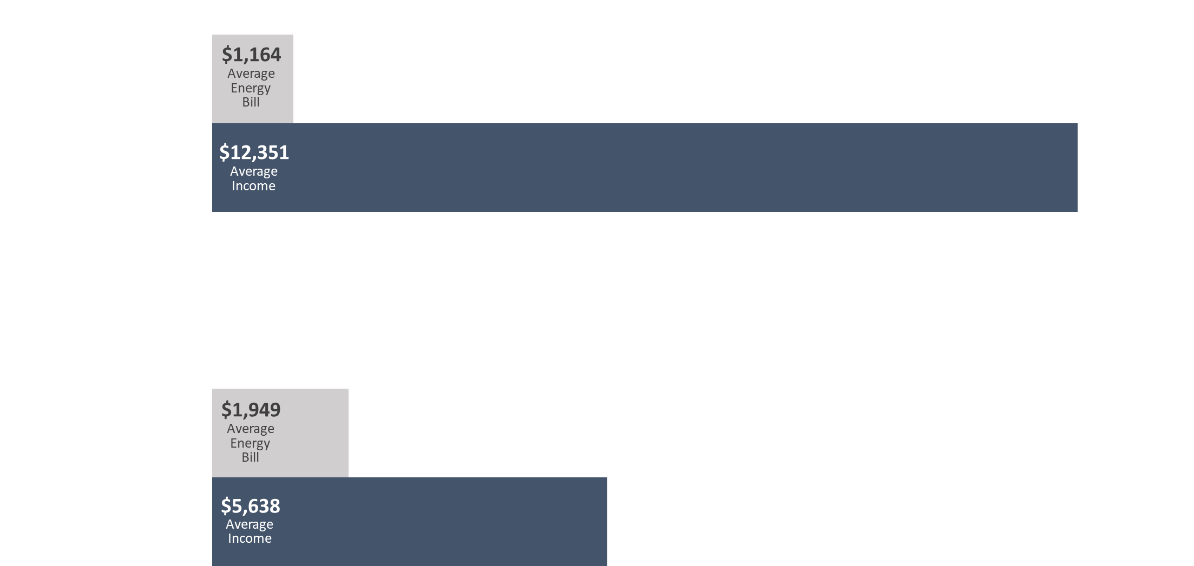
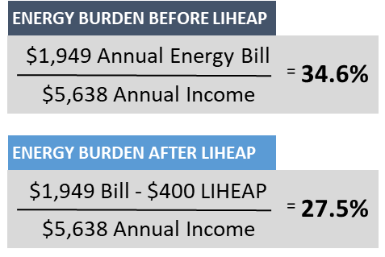

LIHEAP Performance Management – Energy Burden Targeting
Energy Burden Measures – SNAPSHOT Executive Summary
Does LIHEAP furnish higher benefits to higher burden households?
All Households
High Burden Households

Slide 19
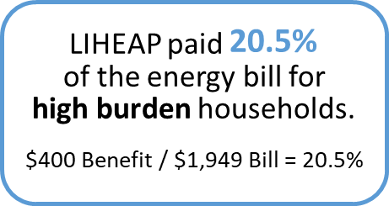
LIHEAP Performance Management – Energy Burden Targeting
Energy Burden Measures – SNAPSHOT Executive Summary
Does LIHEAP pays a larger share of the home energy bill for high burden households?
All Households
High Burden Households

Slide 20
LIHEAP Performance Management – Energy Burden Targeting
Summary of “New” Performance Measure Data
Household characteristics to inform program planning
Average annual income by household fuel type
Average annual energy costs by household fuel type
Average annual LIHEAP benefit by household fuel type
Indicators to evaluate impact of LIHEAP on households
Average pre-LIHEAP Energy Burden by fuel type
Average post-LIHEAP Energy Burden by fuel type
Average energy burden reduction as a result of LIHEAP by fuel type
Instances of Home Energy Loss Prevention v. Restoration of Home Energy Service
Targeting Indices to evaluate effectiveness of program (compliance with statute)
Benefit Targeting Index
Burden Reduction Targeting Index
Presenter:
David Carroll

Slide 21
Understanding LIHEAP Performance Measurement Policy
Contact Information
Melissa Torgerson
  Melissa@verveassociates.net
  503-706-2647
Kevin McGrath
  Kevin-McGrath@appriseinc.org
  609-252-2081
Dan Bausch
  Daniel-Bausch@appriseinc.org
  609-252-9050
Presenter:
Melissa Torgerson

