Slide 1

LIHEAP 102 – Matching Program Designs to Client’s Needs
June 28th, 2022
Moderator: Melissa Torgerson, Verve Associates
Lisa Goben, Oregon Housing & Community Services
Theresa Kullen, Colorado Department of Human Services
Jane Blank, Wisconsin Division of Energy, Housing, and Community Resources
Brian Sarensen, Washington State Department of Commerce
Keelie Gustin, Miami Valley Community Action Partnership

Slide 2
LIHEAP 102 Objective
The purpose of this session is to help you see how LIHEAP grantees and their stakeholders can tailor their programs to ensure that they are delivering the best possible benefits as efficiently as possible.
Presenter:
Melissa Torgerson

Slide 3
LIHEAP 102 Topics
Outreach and Marketing – How can you communicate with clients who need assistance?
Program Intake – How can you maintain program integrity but minimize client burden?
Program Coordination – How can you ensure clients receive comprehensive services?
Presenter:
Melissa Torgerson

Slide 4
LIHEAP Resources
4
What does my state do?
LIHEAP Clearinghouse – State Snapshot
LIHEAP Performance Management Website
Grantee Profile
Data Warehouse
Presenter:
Melissa Torgerson

Slide 5
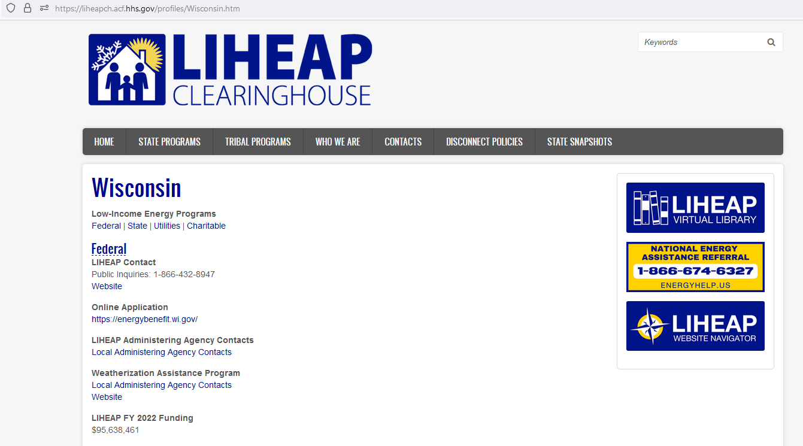
LIHEAP Clearinghouse State Snapshot
Presenter:
Melissa Torgerson

Slide 6
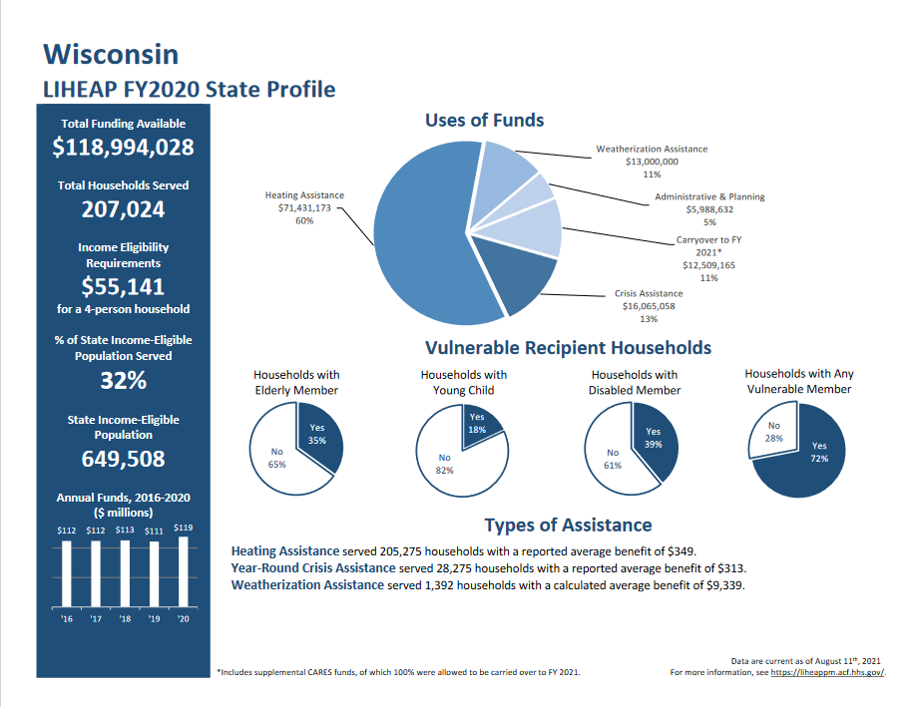
LIHEAP Grantee Profile: Wisconsin
Presenter:
Melissa Torgerson

Slide 7
Allocation of LIHEAP Funds: Wisconsin
Year | State | Heating | Crisis | Weatherization | Carryover | Administration
2015 | Wisconsin | 53% | 20% | 12% | 9% | 6%
2016 | Wisconsin | 60% | 17% | 10% | 8% | 5%
2017 | Wisconsin | 64% | 15% | 9% | 6% | 6%
2018 | Wisconsin | 64% | 14% | 10% | 6% | 6%
2019 | Wisconsin | 63% | 16% | 10% | 4% | 6%
2020 | Wisconsin | 60% | 14% | 11% | 11% | 5%
Presenter:
Melissa Torgerson

Slide 8
Allocation of LIHEAP Funds: Wisconsin
Year | State | Heating | Crisis | Weatherization | Carryover | Administration
2015 | Wisconsin | $55,474,517 | $21,169,312 | $12,120,244 | $9,908,820 | $6,076,159
2016 | Wisconsin | $67,304,117 | $19,089,948 | $11,333,776 | $8,603,201 | $5,991,566
2017 | Wisconsin | $71,535,306 | $16,780,899 | $9,904,271 | $7,243,799 | $6,320,636
2018 | Wisconsin | $72,592,958 | $15,735,375 | $11,307,154 | $6,412,375 | $6,503,595
2019 | Wisconsin | $70,293,400 | $18,141,382 | $11,102,170 | $4,757,342 | $6,856,845
2020 | Wisconsin | $71,431,173 | $16,065,058 | $13,000,000 | $12,509,165 | $5,988,632
Presenter:
Melissa Torgerson

Slide 9
LIHEAP Resources
9
What do other states do?
LIHEAP Clearinghouse – State Programs
LIHEAP Performance Management Website
Grantee Search Portal
Data Warehouse
Presenter:
Melissa Torgerson

Slide 10
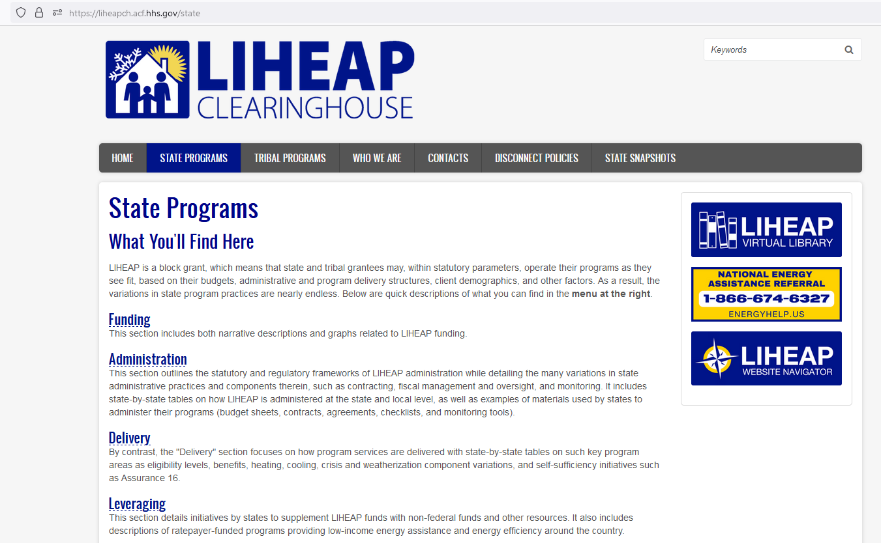
LIHEAP State Programs
https://liheapch.acf.hhs.gov/state
Presenter:
Melissa Torgerson

Slide 11
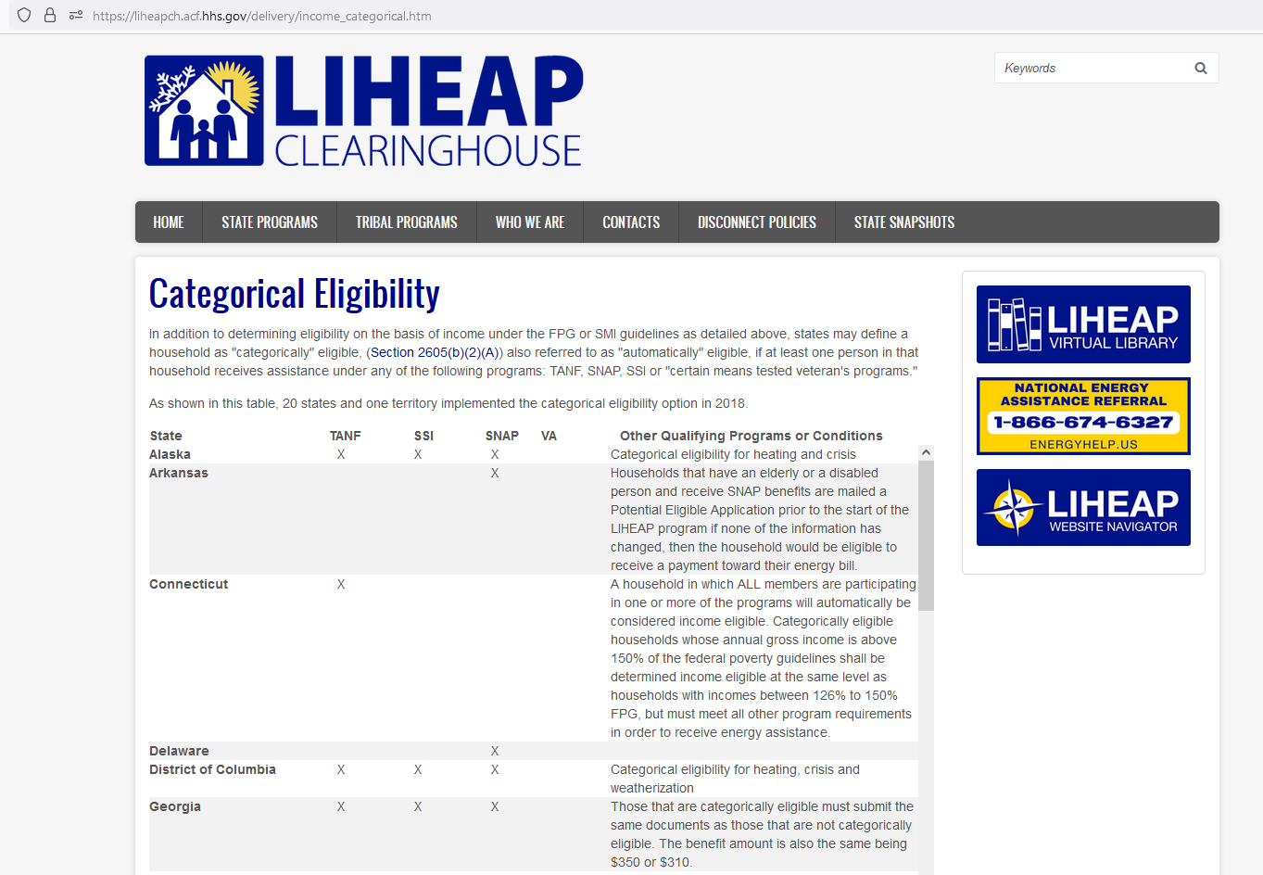
LIHEAP Categorical Eligibility
https://liheapch.acf.hhs.gov/delivery/income_categorical.htm
Presenter:
Melissa Torgerson

Slide 12
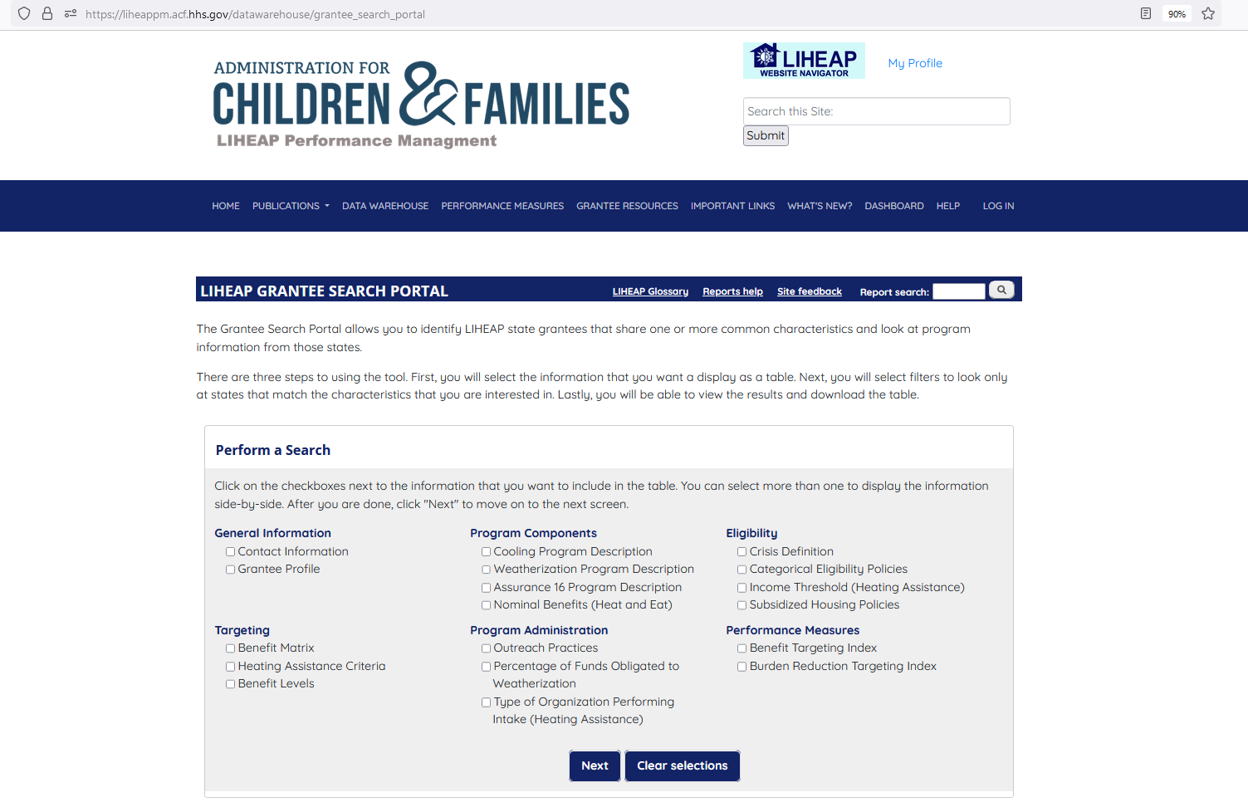
LIHEAP Grantee Search Portal
https://liheappm.acf.hhs.gov/datawarehouse/grantee_search_portal
Presenter:
Melissa Torgerson

Slide 13
Allocation of LIHEAP Funds: Wisconsin & Minnesota
Year | State | Heating | Crisis | Weatherization | Carryover | Administration | Other
2020 | Wisconsin | 60% | 14% | 11% | 11% | 5% | N/A
2020 | Minnesota | 46% | 24% | 8% | 8% | 11% | 3%
Presenter:
Melissa Torgerson

Slide 14
Allocation of LIHEAP Funds: Wisconsin & Minnesota
Year | State | Heating | Crisis | Weatherization | Carryover | Administration | Other
2020 | Wisconsin | $71,431,173 | $16,065,058 | $13,000,000 | $12,509,165 | $5,988,632 | N/A
2020 | Minnesota | $60,421,985 | $31,110,208 | $10,608,621 | $10,819,991 | $14,233,562 | $3,362,322
Presenter:
Melissa Torgerson

Slide 15
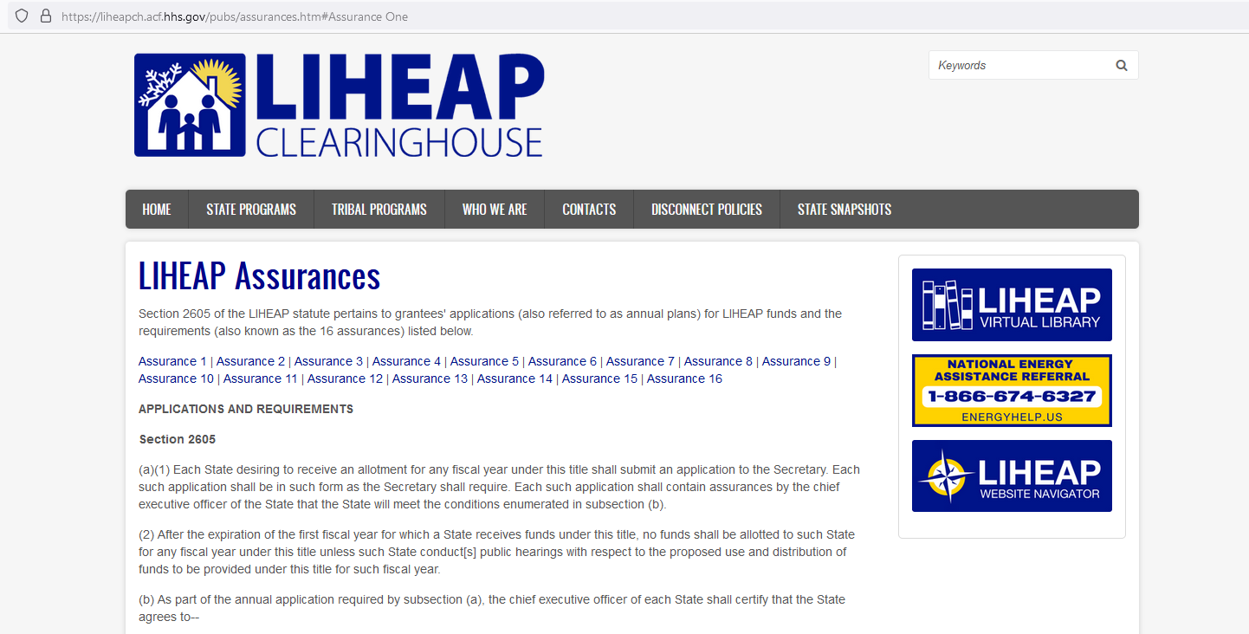
LIHEAP Assurances
15
The requirements for grantees’ applications are stipulated in Section 2605 of the LIHEAP Statute.
https://liheapch.acf.hhs.gov/pubs/assurances.htm#Assurance%2016
Presenter:
Melissa Torgerson

Slide 16
Outreach and Marketing
According to Assurance 3, outreach activities must be designed to ensure that eligible households, particularly households with elderly or disabled individuals, are made aware of assistance available.
How are your outreach activities fulfilling this objective?
Presenter:
Melissa Torgerson
Notes:
“the Assurance explicitly required states to make sure that people know about the programs. And that they current federal initiatives encourage grantees to reach out to underserved populations. Each panel is will then about things they are doing to fulfill that objective. “

Slide 17
Oregon Outreach and Marketing
17
We review performance using program data and Census data.
We meet with agencies to develop strategies to improve outreach to targeted populations.
The sub-subgrantees in Multnomah County serve different population groups.
The county has an organization that furnishes language services.
The county serves a larger share of Asian households.
Presenter:
Lisa Goben
Notes:
“Multnomah County has a sub-subgrantees that each serve a slightly different population. They also have an organization that furnishes language services. Our statistics showed that Multnomah County does a pretty good job of serving Asian households. Oregon is now considering how they might leverage that success with other agencies across the state who are not as successful at serving Asian households. [Maybe?]”
Intake agency responsibility
Reviewed performance using program data and Census data
Meeting with agencies to develop strategies to improve outreach to targeted populations

Slide 18
Wisconsin Outreach and Marketing
18
We have targeted postcard mailings.
We have geocoded advertising.
We’ve contracted a research and marketing firm that provides marketing recommendations.
We have extensive PSA coverage and specific Hispanic radio events.
We market in buses and bus stops.
Presenter:
Jane Blank
Notes:
Targeted postcard mailings
Geocode advertising
Contracted research and marketing firm conducting analysis and providing marketing recommendations
Extensive PSA coverage and specific Hispanic radio events
Bus and bus stop marketing

Slide 19
Colorado Outreach and Marketing
19
Strategic marketing in communities with lower-enrollment
We placed marketing boards in the communities within our mountainous regions. We were even placing boards in butcher shops.
We placed outreach boards in the communities of larger metro areas.
Targeted Advertisement
We purchased commercial time on Roku TV.
We recognized that low-income residents buy Roku sticks and watch Roku TV but don’t pay to opt-out of commercials.
Presenter:
Theresa Kullen
Notes:
Our enrollment in our mountainous communities is low and there are many low income folks working at the ski resorts in hidden communities within those towns. We strategically placed marketing boards in areas of those communities, such as a carnicerias, to bring awareness to the program.
We also did the outreach boards in our larger metro areas of low income populations and strategically placed them in those communities. Very successful!
We purchased commercial time for "Roku" TV - many low income folks either buy the Roku stick or have it on their television and you can watch Roku for free - you have to pay to opt out of the commercials so many low income households do not pay to opt out. Again a very successful outreach mechanism.

Slide 20
Ohio - Miami Valley Community Action Partnership Outreach and Marketing
20
We adjust outreach plans to provide the same program information in various formats.
Social media is indispensable to programming in two counties, whereas more rural counties that have more senior populations, rely more on print media.
We apprise customers of the application submission process using Facebook Live events, email billboards, signage (in drop-off areas), news broadcasts, and print media. We’ve recently reintegrated face-to-face appointments.
Presenter:
Keelie Gustin
Notes:
Social media has become indispensable to our outreach programming, but only in two of the counties we serve. We have to be nimble in our adjustments with our more rural counties, as they have a larger senior population that reads print media, rather than electronic media. There is no "one size fits all" marketing and outreach plan for an agency that serves rural, urban, and suburban clients. We are constantly pivoting to provide the same program information in various formats.
Our agency just began reintegrating face-to-face appointments for the first time since our shut down in March 2020. This is due to several reasons, most of them being a lack of staff, training hurdles for new staff, and the physical layout of our building that does not provide for adequate social distancing. This hurdle has been HUGE for our customers. To communicate how to submit applications and speak with someone at our office, we've tried everything from Facebook Live events, Constant Contact email communications to partners and clients, billboards, signage for our drop-off areas, news broadcasts and print media. It's a full-time job to keep our clients apprised of how we are processing their applications, and we're still figuring out the best way to do it as we continue to offer increased virtual processing options, alongside face-to-face appointments, when required by our programs.

Slide 21
Washington Outreach and Marketing
21
We’ve developed a Geospatial Dashboard, using LIHEAP program data and census data, to examine program results and to investigate which counties might need to increase their outreach to specific populations.
We identified a county that was underserving a specific demographic. We were able to provide that county with guidance and translation services to meet the underserved population.
We market in multiple languages.
We partner with other state agencies to provide LIHEAP & LIHWAP outreach.
Presenter:
Brian Sarensen
Notes:
Is there a way we can mention the GIS work you all are doing? Is that helping with Outreach and Marketing?
GIS Geo Spatial Analysis – Use our current data compared to census data to see if agencies are missing any populations
Marketing in multiple languages
Partnerships with other State agencies to provide LIHEAP & LIHWAP outreach

Slide 22
Program Intake
According to the LIHEAP application requirements, grantees are asked to ensure that households served are eligible for program benefits.
How are your intake activities fulfilling this objective?
Presenter:
Melissa Torgerson
Notes:
“…the strict LIHEAP application requirements are in direct response to the GAO report that told HHS that grantees needed to do a better job in making sure that households served by the program were eligible for program benefits... each of you have worked hard to maintain program integrity while also making sure that you are doing everything you can to ensure that clients are able to navigate these challenging documentation requirements. Each panelist will then talk about things they are doing to fulfill that objective. “

Slide 23
Colorado Program Intake
23
We have sent additional funds to local intake agencies and instructed them to reach out to HHS if there were incomplete applications that required additional assistance.
We have begun an outreach incentive program that offers additional funds to counties that reach out to households that were denied assistance for failing to provide additional verification.
Since COVID began, we’ve added the option for households to apply via telephone through our centralized call center.
This provided a new application method for individuals without a computer.
Presenter:
Theresa Kullen
Notes:
“Theresa reported that when she got the CARES funds, she sent additional funding to local intake agencies and directed them to reach out to HHs with incomplete applications to help them complete all of the required paperwork.”
We started offering an outreach incentive program for all of our counties to apply for additional outreach funds to reach out to any households in their counties denied for failing to provide the necessary verification to work their application to approval or denial status. This required a change to our state rules so that applications could be reopened vs. the household having to reapply.
Colorado does not require a face to face interview to apply for our program. Prior to COVID a person could apply in person at a county office, online at our single point of entry application, CO PEAK, or by downloading and completing an application to email into the administering agency. The year of COVID we had added the ability to apply via telephone through our centralized call center which really helped open up application options for folks without a computer while many counties offices were closed. That saved us! Enrollment has gone up steadily over the past 3 years.

Slide 24
Wisconsin Program Intake
24
We have reviewed program documentation to reduce the information required of clients.
Our subgrantees can access other program records to assist clients with documentation requirements.
We have automated and online applications.
Agencies may “complete” applications for customers who have outstanding information after 30 days of an incomplete application.
We have expanded third-party system access.
Presenter:
Jane Blank
Notes:
”Jane reported that they reviewed their program documentation requirements and found ways to reduce the amount of information that they were requiring of clients. In addition, Jane has told me that their subgrantees have the ability to access other program records and can make use of some of those to help with client documentation requirements.”
Automated and Online applications
“Reinstating applications”: still provide 30 days for customers to complete their application yet if provision of outstanding information occurs after 30 days, allow agencies to “complete” the application without additional burden to the customer
Expanded third-party system access

Slide 25
Ohio - Miami Valley Community Action Partnership Program Intake
25
We have used new technology to ensure that people had firm, in-person appointments to receive application assistance, and individuals no longer had to stand in line to wait.
We are gathering clients’ feedback to create a universal application within our agency.
Clients may apply through dropbox, an online application, and an online appointment. Clients may check on their application status through our LIHEAP Call Center.
We provide the State of Ohio client feedback from the comment period of our State Plan.
Presenter:
Keelie Gustin
Notes:
“In a past NEUAC, Keelie gave a presentation on they used technology to transform the client intake process to ensure that people had firm appointments and didn’t have to stand in line for hours to complete applications.”
The COVID-19 pandemic has made apparent the need for a universal application within our agency. We are gathering stakeholder information via surveys of clients and partners to figure out how to make this happen while respecting the parameters and requirements of each program app within our agency (CSBG, HWAP, LIHWAP, etc.). The process is long and challenging as we balance the interests, but the aforementioned marketing and outreach efforts are allowing us to survey those we serve to figure out what they NEED, rather than our internal stakeholders determining what the client should want or do. This is essential as we societally transform how we interact with one another throughout this pandemic.
Item 3 from Outreach and Marketing goes here - we are working to streamline the Intake process to encourage clients to maintain updated information with our agency to ensure access to all programs - CSBG, LIHEAP, HWAP, LIHWAP, in a more efficient manner. We want to maintain a better "conversation" with our clients to ensure they are keeping their information up to date to prevent debilitating utility defaults. Currently, we are trying to find the right balance between an "Intake Specialist" and "Case Manager." This gap has become one we've desperately needed to fill as we felt the weight of our clients worries during the COVID-19 pandemic. We are working to set clear expectations about what services we can provide, what referrals we can make, and to be honest about the timelines of each of those items. Creating opportunities for transparent conversations with our clients has become a top priority since the COVID-19 pandemic.
We currently use several options for clients to apply - dropbox (paper applications), online applications, online appointments (scheduled via phone or online scheduler, available 24/7) and outreach to our newly developed LIHEAP Call Center to check on application status or answer application-specific questions. Again, cultivating transparent conversations is our main goal. Accessibility is the second goal the COVID-19 pandemic highlighted. Though we have to ensure our efforts are specifically tailored to the community we are serving (rural, suburban, urban), technological platforms provide us with a way to not only communicate with our clients, but also track their satisfaction. Surveys are provided after each appointment, regardless of program, and available online at our website.
Stakeholder feedback continues to improve our application process. While we cannot change the rules our State has put in place, we can gather data to provide to the State of Ohio during the comment period on our State Plan, each year. Clients express frustration with certain areas of the rules - especially surrounding citizenship. While we may not be able to do something in that precise moment, we note the comment and provide that feedback each year to the State. What happens in our intake appointments, matters. We are responsible not only for providing the service to the client, but for harnessing their feedback and explaining to the State how the program could be adjusted to meet the needs of our vulnerable customers.

Slide 26
Oregon Program Intake
26
We’ve conducted a survey of program participants.
We’ve discovered that targeted population groups were more “anxious” about their treatment, but report higher intake satisfaction than other types of households
Presenter:
Lisa Goben
Notes:
Conducted survey with program participants
Findings
Before applying, targeted population groups were more “anxious” about being treated with respect
But targeted populations reported higher satisfaction rates with intake even than other types of households

Slide 27
Washington Program Intake
27
We offer online applications at the Community Action Agency level.
We have a remote application process. Clients may mail documents, use virtual appointments, and use computers in isolation rooms at community action agencies.
We certify income every two years for those on fixed incomes.
Presenter:
Brian Sarensen
Notes:
Online applications CAA level
Remote application process, mail, virtual appointments, and isolation rooms with computers at agency to minimize exposure
Two year certifications for those on fixed incomes

Slide 28
Program Coordination
According to the Assurances, states must coordinate with other program services.
Assurance 16 allows grantees to use up to 5% of funds to help individuals access other program services.
The LIHEAP statute allows grantees to allocate up to 15% (25% with a waiver) of funds to coordinate with WAP and other programs.
The leveraging incentive program allows grantees to fund program leveraging activities.
How are your coordination activities fulfilling this objective?
Presenter:
Melissa Torgerson
Notes:
“…will emphasize that the assurances ask states to coordinate with other program services. In addition, Assurance 16 allows grantees to use up to 5% of funds to help people access those kinds of services, the statute allows grantees to allocate up to 15% (25% with a waiver) to coordinate with WAP and other energy efficiency programs, and the leveraging incentive program allows grantees to fund program leveraging activities…emphasize that this is the area in which there is the greatest amount of diversity in grantee program offerings. “

Slide 29
Oregon Program Coordination
29
One of our local intake agencies coordinates with a local Tribal grantee to ensure that clients who receive LIHEAP benefits from the tribe are aware that they may receive an electric utility ratepayer benefit from the electric investor-owned utility (IOU) in the area.
Presenter:
Lisa Goben
Notes:
“…one of the local intake agencies coordinates with the local Tribal grantee to ensure that clients who get their LIHEAP benefit from the tribe also get an electric utility ratepayer benefit from the electric IOU.”
Agencies deliver LIHEAP and OEAP (ratepayer program)
One agency has a partnership with the local tribe some that tribal members receive OEAP services
This is misleading. The agency doesn’t have anything additional, they just happen to have a tribe in their area that’s somewhat receptive to sending their members to the local CAP agency to obtain assistance when they have run out or cannot accommodate the members need. Its not that this same option doesn’t exist in other areas with tribal lands, its simply a matter of which tribe is accepting of the partnership…no tribes receive OEAP assistance directly, it all goes through CAPS.

Slide 30
Wisconsin Program Coordination
30
Qualifying for a LIHEAP grant qualifies the client for a benefit from the electric IOU in the area, and in some cases, the municipal electric company.
Public Benefits (rate payer program) expands program coordination and leveraging.
Our Web Service is programmed in the centralized database that requires live interface with IOU systems for account information.
Our system generates weatherization and economic support program referrals for clients.
We have strong working relationships with local aging departments, Aging and Disability Resource Centers, Heat for Heroes, and other Veteran support programs.
Presenter:
Jane Blank
Notes:
”…qualifying for a LIHEAP grant also qualifies the client for a benefit from the client’s electric IOU and … in some cases … their municipal electric company.”
Public Benefits (rate payer program) expands the program/vendor coordination and leveraging
Web Service programmed in the centralized database/system that requires live interface with IOU systems for account information
System generated/Automated weatherization and Economic Support program referrals
Strong working relationships with local aging departments, Aging and Disability Resource Centers, Heat for Heroes and other Veteran support programs

Slide 31
Other States Program Coordination
31
In some states, intake agencies may also receive CSBG funding. When a household applies for LIHEAP, they furnish more comprehensive information on their needs and become qualified for all services that are available.
In some states (Iowa and Minnesota) LIHEAP performance data (energy expenditures and burden) is used to prioritize households who participate in other energy efficiency programs.
Presenter:
Notes:
“In some states, the intake agencies also have CSBG funding. When a household comes into apply for LIHEAP, they furnish more comprehensive information on their needs and are qualified for all of the services that are available.”
“In some states (IA and MN) the LIHEAP performance data (energy expenditures and burden) is used to prioritize households for participating in the energy efficiency programs.”

Slide 32
Colorado Program Coordination
32
We coordinate with Energy Outreach Colorado (EOC), a nonprofit organization that offers energy assistance to low-income households.
In cases where LIHEAP cannot assist a household, we refer those applicants to EOC, particularly when our application period is closed and when the applicant is facing disconnection with a fuel that our agency cannot assist with.
EOC ensures that applicants have already applied for LIHEAP, before they receive assistance from them.
LIHEAP and EOC contract with the same call center, so that applicants can be referred to the appropriate assistance program.
Presenter:
Theresa Kullen
Notes:
Energy Outreach Colorado (EOC)is a non-profit organization that offers energy assistance to low income households. During our application period both the LIHEAP program and EOC's bill payment assistance program refer households to each others agency to ensure when LIHEAP cannot help that the household is aware of their other avenue of possible assistance, we refer folks to EOC during the time when our application period is closed, and refer households to EOC when the household is facing disconnect with a supportive fuel that our agency cannot assist with. During the LIHEAP program application period if households apply through EOC they insure that their applicants have already applied to our program to ensure their limited funding can be used for folks that do not qualify for LIHEAP. LIHEAP and EOC contract with the same centralized call center and share expenses to ensure applicants can be referred to the correct program for assistance.

Slide 33
Ohio - Miami Valley Community Action Partnership Program Coordination
33
We coordinate heavily with services, both internally and externally. We are working to implement naming conventions in email subject lines, so that we can search client communications easily.
We send out internal and external newsletters to communicate with staff and partners, which allows us to coordinate client services more efficiently.
Presenter:
Keelie Gustin
Notes:
• Email, email, email. We coordinate heavily with services, internally and externally, to ensure client needs are met. It sounds crazy, but coordination of services in "COVID times" has truly come down to how organized we can be in our communication. For us, it was ensuring we had a naming convention in the subject line of each of our emails. So many priorities and clients were flying around, we needed to be able to search our secure server for communications as to client situations easily. We're working to implement this network-wide (internal and external stakeholders) and have already seen the benefits of "organizing the chaos."
• Newsletters - Internal and External. Though we don't often have the time, we've decided it's essential to carve it out to utilize internal and external newsletters to communicate with our staff and partners as to the ever-changing programs and program requirements within our agency. It's a tough job to make time for, with so many priorities floating around, but we have to carve out the time to communicate, on a mass scale, the changes happening to create the aforementioned program transparency and accessibility. These efforts allow us to coordinate client services more efficiently throughout our network.

Slide 34
Washington Program Coordination
34
We have one application for Energy Assistance (LIHEAP), Water Assistance (LIHWAP), and Weatherization Assistance (WAP).
We coordinate with the Office of Drinking Water to promote LIHWAP.
We coordinate with the Department of Aging and the Department of Disabilities to promote cooling assistance.
Presenter:
Theresa Kullen
Notes:
One application for LIHEAP, Water Assistance, and Weatherization
Coordination with Department of Health Office of Drinking Water to promote LIHWAP
Coordination with Department of Aging and Department of Disabilities to promote cooling options

Slide 35
Questions/Comments
Presenter:
Melissa Torgerson

Slide 36
Conclusion
Presenter:
Melissa Torgerson

Slide 37
Continuing the Learning
Office of Community Services
LIHEAP: www.acf.hhs.gov/ocs/low-income-home-energy-assistance-program-liheap
LIHWAP: www.acf.hhs.gov/ocs/programs/lihwap
LIHEAP Performance Management Website and the Data Warehouse
Performance Management Website: liheappm.acf.hhs.gov/
Data Warehouse: liheappm.acf.hhs.gov/data_warehouse/index.php?report=homepage
Virtual Library: liheappm.acf.hhs.gov/assessment/#nbb

