Slide 1


Slide 2


LIHEAP 101 for Tribes
June 14th, 2023
Moderator: David Carroll, APPRISE
Melissa Torgerson, VERVE Associates
Lori Walking Eagle, Rosebud Sioux Tribe
Pamela Murphy, Bristol Bay Native Association
Antoinette Horn, Cook Inlet Tribal Council

Slide 3
Introduction, Session Objectives
3
During this session, participants will:
Hear about some of the LIHEAP program design and implementation issues that are unique to tribal programs.
Learn how the three tribes on the panel have addressed some of these issues in their own programs.
Get a list of T&TA resources that can help a tribal program manager or stakeholder to learn more about requirements, options, and alternatives.
Presenter:
David Carroll

Slide 4
Topics, Presenters
4
Tribal Issues—Questions we have been asked by Tribal Program Managers
Melissa Torgerson, VERVE
Our LIHEAP Plan—The approach used by each panelist’s tribal program
Lori Walking Eagle, Rosebud Sioux Tribe, South Dakota
Pamela Murphy, Bristol Bay Native Association
Antoinette Horn, Cook Inlet Tribal Council
Attendee Comments—Different approaches that work for you!
Presenter:
David Carroll

Slide 5
5
Tribal LIHEAP Program Issues
Melissa Torgerson
VERVE Associates
Presenter:
Melissa Torgerson

Slide 6
Overview
6
In this section, we’ll discuss common questions that we have been asked by tribal program managers during our T&TA sessions. These include:
How are tribal funding allocations determined? Can they be modified? If so, what does that process look like?
What does the LIHEAP statute say about who I should be serving? What are the best ways to decide who we serve and who the state serves?
I have filed my LIHEAP plan. What flexibility do I have to adapt to changing circumstances during the year? Do I need approval from OCS?
Presenter:
Melissa Torgerson

Slide 7
Tribal Funding Allocations
7
What the statute says …
(d)(1) If, with respect to any State, the Secretary--
(A) receives a request from the governing organization of an Indian tribe within the State that assistance under this title be made directly to such organization; and
(B) determines that the members of such tribe would be better served by means of grants made directly to provide benefits under this title; the Secretary shall reserve from amounts which would otherwise be payable to such State from amounts allotted to it under this title for the fiscal year involved the amount determined under paragraph (2).
(2) The amount determined under this paragraph for a fiscal year is the amount which bears the same ratio to the amount which would (but for this subsection) be allotted to such State under this title for such fiscal year (other than by reason of section 2607(b)(2)) as the number of Indian households described in subparagraphs (A) and (B) of section 2605(b)(2) and residing within the State on the reservation of the tribes or on trust lands adjacent to such reservation bears to the number of all households described in subparagraphs (A) and (B) of section 2605(b)(2) in such State, or such greater amount as the Indian tribe and the State may agree upon. In cases where a tribe has no reservation, the Secretary, in consultation with the tribe and the State, shall define the number of Indian households for the determination under this paragraph.
Section 2604(d)(1) of the LIHEAP Act, 42 U.S.C. § 8624(a)(1)
Presenter:
Melissa Torgerson

Slide 8
Tribal Funding Allocations
8
What that means …
Tribes can propose to receive LIHEAP funds to serve their tribal members.
The default amount of funding that they receive is determined in the following way.
  State LIHEAP Allocation = X ($10,000,000)
  Number of Low-Income Households in the State = Y (100,000)
  Number of Tribal Low-Income Households on the Tribal Reservation = Z (5,000)
  % = Z / Y = 5,000/100,000 = 5%
  Tribal Funding = % * X = 5% * $10,000,000 = $500,000
If the tribe does not have a reservation some other procedure will be used.
Presenter:
Melissa Torgerson

Slide 9
Tribal Service Territories
9
The default service area for a tribe is their tribal reservation and adjacent trust lands.
The default population served by a tribe are tribal members.
Presenter:
Melissa Torgerson

Slide 10
State – Tribe Agreements
10
A state-tribal agreement is NOT required for a tribe to receive funding. Without an agreement, OCS will calculate the statistics to determine the LIHEAP funding using Special Tabulations from the Census Bureau.
However, a state-tribal agreement may be advantageous to a tribe in terms of the amount of funding received, the service areas covered, and the other resources the state program can make accessible to the tribe.
Presenter:
Melissa Torgerson

Slide 11
11
Questions/Comments

Slide 12
12
Funding, Service Area, Clients, Coordination
Pamela Murphy, Bristol Bay Native Association
Antoinette Horn, Cook Inlet Tribal Council
Lori Walking Eagle, Rosebud Sioux Tribe
Presenter:
Melissa Torgerson

Slide 13
Overview
13
In this section, we’ll ask each panelist to discuss:
Their funding allocation.
Their service territory and clients.
Their procedures for coordinating with the state program to avoid duplication of services.
Presenter:
Melissa Torgerson

Slide 14
Bristol Bay Native Association
14
Status - Are you a tribe, a tribal organization, or something else?
State-Tribe Agreement - Do you have a copy of your state-tribe agreement?
  Does is specify a funding %, a funding amount, or something else?
  What does it define as your service area?
  What population does it specify that you will serve?
  Does it have any information on coordination with the state?
Rationale
  Do you know the source of the agreement?
  Have you negotiated any changes?
  What would you change if you could?
Presenter:
Pamela Murphy

Slide 15
Cook Inlet Tribal Council
15
Status - Are you a tribe, a tribal organization, or something else?
State-Tribe Agreement - Do you have a copy of your state-tribe agreement?
  Does is specify a funding %, a funding amount, or something else?
  What does it define as your service area?
  What population does it specify that you will serve?
  Does it have any information on coordination with the state?
Rationale
  Do you know the source of the agreement?
  Have you negotiated any changes?
  What would you change if you could?
Presenter:
Antoinette Horn

Slide 16
Rosebud Sioux Tribe
16
Status - Are you a tribe, a tribal organization, or something else?
State-Tribe Agreement - Do you have a copy of your state-tribe agreement?
  Does is specify a funding %, a funding amount, or something else?
  What does it define as your service area?
  What population does it specify that you will serve?
  Does it have any information on coordination with the state?
Rationale
  Do you know the source of the agreement?
  Have you negotiated any changes?
  What would you change if you could?
Presenter:
Lori Walking Eagle

Slide 17
17
Questions/Comments

Slide 18
18
Adapting to Change – CARES and ARP Funding
Pamela Murphy, Bristol Bay Native Association
Antoinette Horn, Cook Inlet Tribal Council
Lori Walking Eagle, Rosebud Sioux Tribe
Presenter:
Melissa Torgerson

Slide 19
Overview
19
In this section, we’ll ask each panelist to discuss:
Roughly how much additional funding they received from CARES & ARP.
Whether they had to reduce spending on WX or Crisis during that period.
How they used the additional funding during that period.
Any questions or concerns they had about what was allowed.
Whether they were able to obligate all their funds or had to return some.
Presenter:
Melissa Torgerson

Slide 20
Bristol Bay Native Association
20
Funding Amount – 2019 = $1,085,585 / 2021 = $2,514,551
Spending by Program Service
  Did you reduce spending for any program component?
  Did you increase spending for any program component?
  Did you introduce any new service?
  Do you have any concerns about what was allowed?
Bottom Line
  Were you able to obligate all your funding?
  Did you have to return any funds to HHS?
Presenter:
Pamela Murphy

Slide 21
Cook Inlet Tribal Council
21
Funding Amount – 2019 = $312,859 / 2021 = $724,679
Spending by Program Service
  Did you reduce spending for any program component?
  Did you increase spending for any program component?
  Did you introduce any new service?
  Do you have any concerns about what was allowed?
Bottom Line
  Were you able to obligate all your funding?
  Did you have to return any funds to HHS?
Presenter:
Antoinette Horn

Slide 22
Rosebud Sioux Tribe
22
Funding Amount – 2019 = $1,025,492 / 2021 = $2,375,356
Spending by Program Service
  Did you reduce spending for any program component?
  Did you increase spending for any program component?
  Did you introduce any new service?
  Do you have any concerns about what was allowed?
Bottom Line
  Were you able to obligate all your funding?
  Did you have to return any funds to HHS?
Presenter:
Lori Walking Eagle

Slide 23
23
Questions/Comments

Slide 24
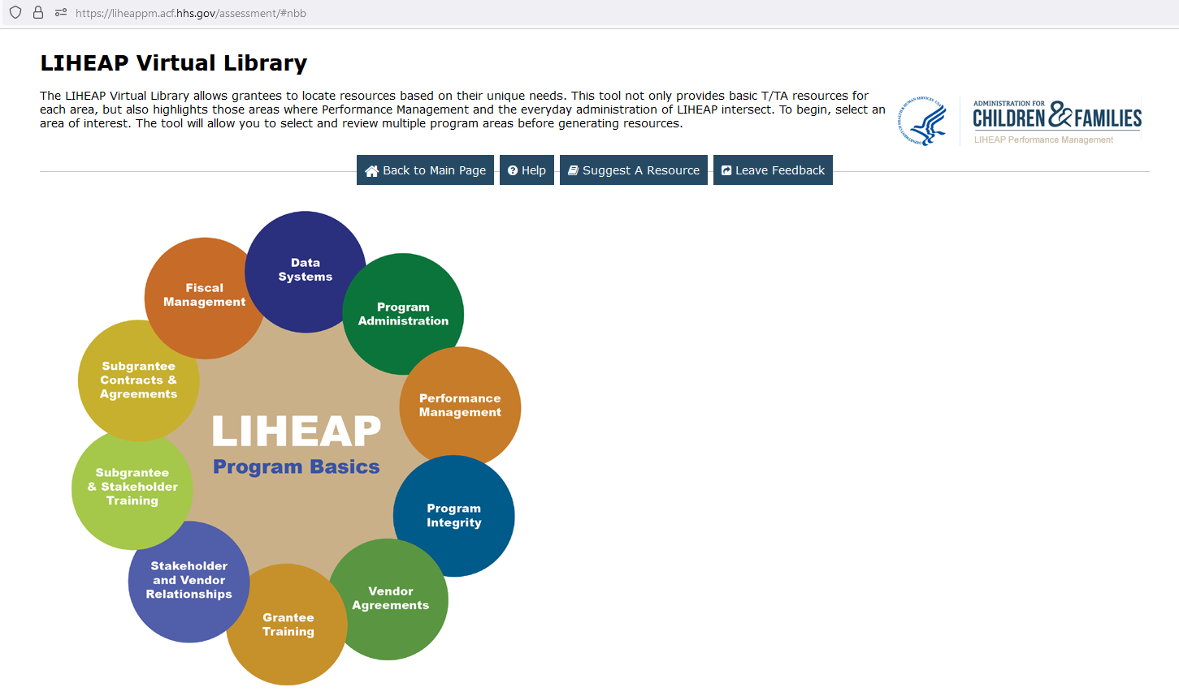
Conclusion
24
The LIHEAP Virtual Library contains resources that provide more comprehensive overview of federal statute, as well as more examples of how grantees incorporate federal statute, state law, and other factors into their programs.
Screenshot here.
Presenter:
Melissa Torgerson

Slide 25
Continuing the learning
You might want to look at the LIHEAP 101 and LIHEAP 102 presentations made earlier in this conference.
Contact Information
David Carroll, david-carroll@appriseinc.org
Melissa Torgerson, melissa@verveassociates.net
Pamela Murphy, pmurphy@bbna.com
Antoinette Horn, a.horn@citci.org
Lori Walking Eagle, lori.walkingeagle@rst-nsn.gov
Presenter:
David Carroll

