Slide 1
Understanding LIHEAP Performance Measurement Policy
NEUAC 2018
Holly Ravesloot
HHS, Office of Community Services
Melissa Torgerson
VERVE Associates, LLC
Heather Jones
Missouri Department of Social Services
Connie Sanchez
Spire Energy

Slide 2
Understanding LIHEAP Performance Measurement Policy
Session Overview
LIHEAP Performance Measures Background
The importance of LIHEAP Performance Measurement
LIHEAP Performance Measure development and implementation
Data access and transparency
LIHEAP Performance Measures: Nuts and Bolts
Overview of measures (including a walkthrough of state example)
Data resources for grantees, subgrantees, vendors, and LIHEAP partners
The Missouri State Experience
Data collection and reporting
Sharing data with partners—lessons learned
The Missouri Utility Experience
Data collection
Using data for collaboration, program improvement
Presenter:
David Carroll

Slide 3
Understanding LIHEAP Performance Measurement Policy
LIHEAP Performance Measures: Background
LIHEAP Performance Measures:
Background
Holly Ravesloot
HHS, Office of Community Services
Presenter:
Holly Ravesloot

Slide 4
Understanding LIHEAP Performance Measurement Policy
Importance of Performance Measures to LIHEAP Program
LIHEAP Performance Measures were developed in response to:
Section 2605(b) of the Low Income Home Energy Assistance Act of 1981 (42 U.S.C. §8624(b)) as amended by Sec. 311(b) of the Human Services Amendments of 1994 (Public Law 103-252) requiring HHS to develop, in consultation with LIHEAP grantees, model performance goals that measure the success of each State’s LIHEAP activities.
Section 2610(b)(2) of the Low Income Home Energy Assistance Act of 1981 (42 U.S.C. §8629(b)(2)) requiring that HHS annually report to Congress on the impact LIHEAP is making on recipient and income eligible households.
Section 2605(b)(5) of the Low Income Home Energy Assistance Act of 1981 (42 U.S. C. §8624(b)(5)) requiring LIHEAP grantees to provide, in a timely manner, that the highest level of energy assistance will be furnished to those households that have the lowest incomes and the highest energy costs or needs in relation to income, taking into account family size.
Presenter:
Holly Ravesloot

Slide 5
Understanding LIHEAP Performance Measurement Policy
OCS and LIHEAP Grantee Partnership
2008-10: Performance Management Work Group (PMWG) develops Performance Measurement Recommendations.
2010-12: Performance Management Implementation Work Group (PMIWG) transforms PMWG recommendations into concrete Performance Measures.
2012-14: OCS and APPRISE work with grantees to develop the Performance Measurement Website.
2014-16: OMB approves PMIWG recommendations, making new Performance Measures required reporting beginning in FY 2016. PMIWG members work with OCS and APPRISE Team to develop guidance and support for grantees as they update systems to collect and report new data.
2016-18: PMIWG members work with OCS and APPRISE Team to develop guidance and support for grantees as they analyze and use their data.
Presenter:
Holly Ravesloot

Slide 6
Understanding LIHEAP Performance Measurement Policy
OCS and LIHEAP Grantee Partnership
Charles Anderson | Connecticut
Laura Betzinger | Indiana
Jane Blank | Wisconsin
Debra Brown | California
Andrew Bryk | New York
Cecil Daniels | Washington
Lisa Goben | Oregon
Heather Jones | Missouri
Susan Marshall | Alaska
Lorraine Portis | Mississippi
Paula Reynolds | Maryland
Michael Schmitz | Minnesota
Sheri Shepard | Montana
Jenni Sullivan | Montana
  Performance
  Management
  Implementation
  Work Group
  Current Members

Slide 7
Understanding LIHEAP Performance Measurement Policy
Access to and Transparency of LIHEAP Performance Data
Summer 2013 | Performance Management Website Published for Grantees
Fall 2014 | OMB Approval of LIHEAP Performance Measures
Summer 2015 | PMIWG Launches LIHEAP Virtual Library and Data Warehouse Advanced Search Initiatives
Winter 2016 | Publication of LIHEAP Virtual Library and Data Warehouse Advanced Search Capabilities
Spring 2016 | Regional Training on Performance Management Techniques
Summer 2016 | NEUAC Presentation on FY 2015 Performance Measures Reports
Winter 2017 | Performance Management Website Goes Public
Spring 2017-18 | T&TA Related to Using LIHEAP Performance Management Data Reported by Grantees
FY 2018 | Addition of Performance Measure Data to Performance Management Website
Presenter:
Holly Ravesloot

Slide 8
Understanding LIHEAP Performance Measurement Policy
LIHEAP Performance Data: Nuts and Bolts
LIHEAP Performance Data:
Nuts and Bolts
Melissa Torgerson
VERVE Associates LLC
Presenter:
Melissa Torgerson

Slide 9
Understanding LIHEAP Performance Measurement Policy
Available “Suite” of Performance Management Data
  For many years, LIHEAP Grantees have had a suite of data and information available to inform program evaluation and planning.
  Required LIHEAP Reports
LIHEAP Model Plan
LIHEAP Household Report
LIHEAP Performance Data Form - Section I. Grantee Survey
  Other Data Sources
LIHEAP Home Energy Notebook
American Community Survey (Census)
Residential Energy Consumption Survey (RECS)
New Performance Measure data provides LIHEAP grantees with important additions to their collection of Performance Management tools.
Presenter:
Melissa Torgerson

Slide 10
Understanding LIHEAP Performance Measurement Policy
Energy Burden Measures
Energy Burden Measures
What is the average energy burden of LIHEAP households, and how does LIHEAP lower that burden?
[Benefit Targeting Index] Does LIHEAP furnish higher benefits to higher burden households?
[Burden Reduction Targeting Index] Does LIHEAP pays a larger share of the home energy bill for high burden households?
Why is this important?
Section 2605(b)(5) of the Low Income Home Energy Assistance Act of 1981 (42 U.S. C. §8624(b)(5)) states that grantees “provide, in a timely manner, that the highest level of energy assistance will be furnished to those households that have the lowest incomes and the highest energy costs or needs in relation to income, taking into account family size.”

Slide 11
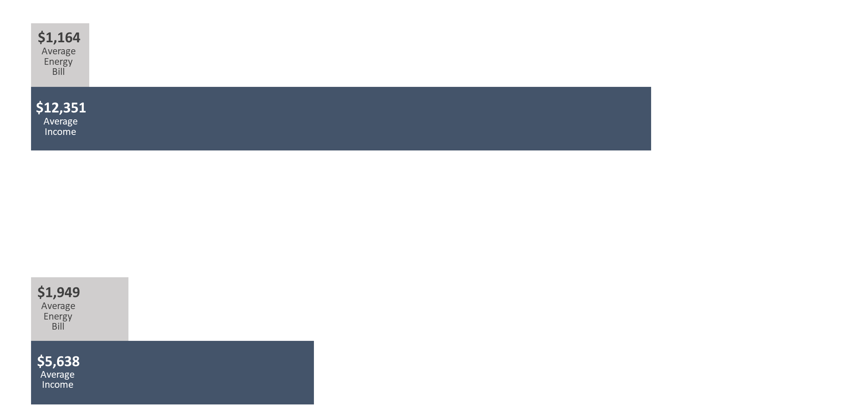
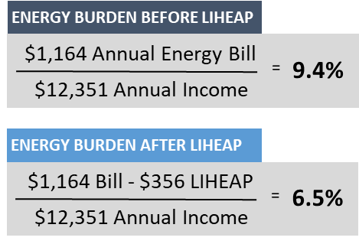

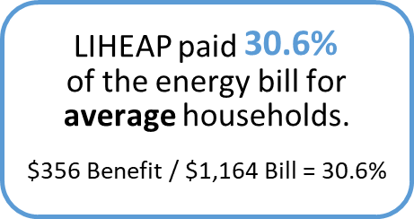
Understanding LIHEAP Performance Measurement Policy
Energy Burden Measures
What is the average energy burden of LIHEAP households, and how does LIHEAP lower that burden?
Energy Burden is the percentage of income a household pays toward energy bills:
Energy Burden Data
Average annual income by household fuel type
Average annual main heating fuel costs by household fuel type
Average annual electric costs by household fuel type
Average annual LIHEAP benefit by household fuel type
Energy Bill
=
Energy
Burden
Income

Slide 12
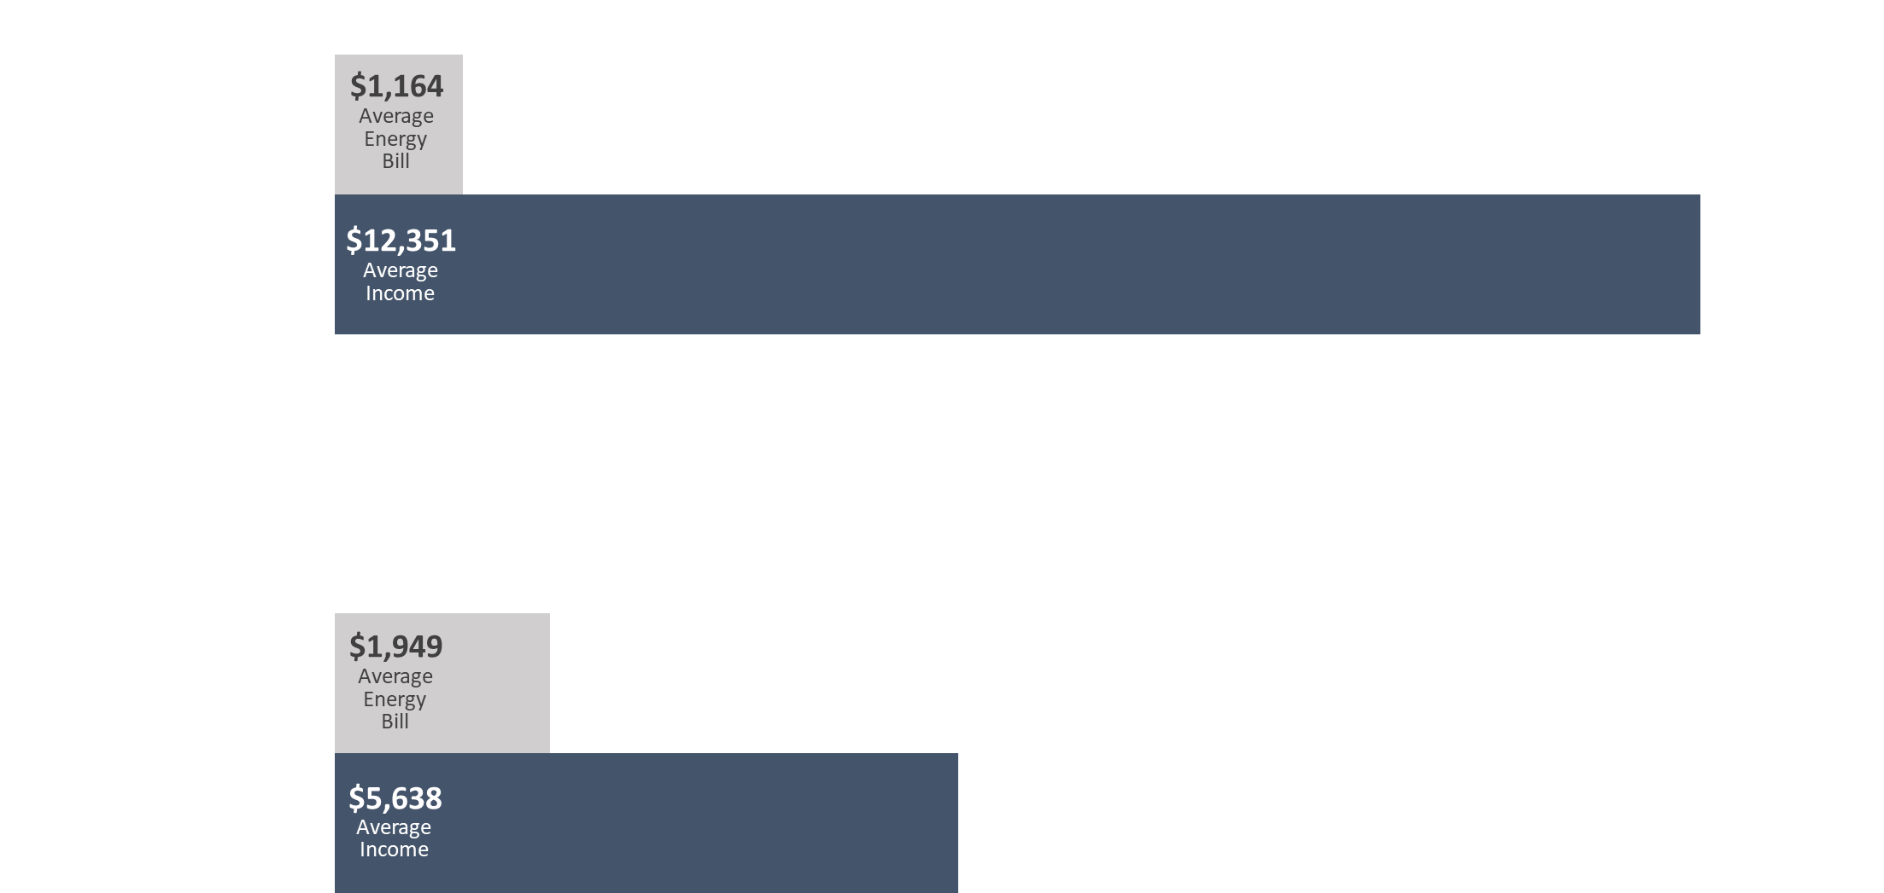
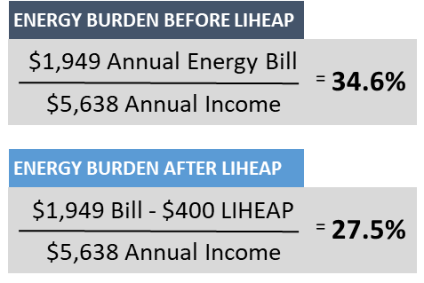
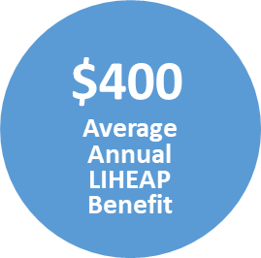
Understanding LIHEAP Performance Measurement Policy
Energy Burden Measures
Does LIHEAP furnish higher benefits to higher burden households?
All Households
High Burden Households

Slide 13
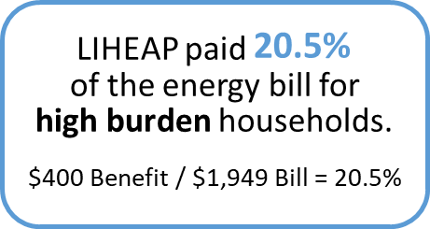
Understanding LIHEAP Performance Measurement Policy
Energy Burden Measures
Does LIHEAP pays a larger share of the home energy bill for high burden households?
All Households
High Burden Households

Slide 14
Understanding LIHEAP Performance Measurement Policy
Prevention and Restoration Measures
Restoration and Prevention Measures
How many times did a LIHEAP benefit prevent loss of home energy service for households at imminent risk?
How many times did a LIHEAP benefit restore home energy service for households who were disconnected, out of fuel, or who had inoperable equipment?
Why is this important?
By increasing the number of households where loss is prevented (relative to those households where home energy is restored), LIHEAP is mitigating crises—including health risks and costly reconnection fees—associated with home energy loss.

Slide 15
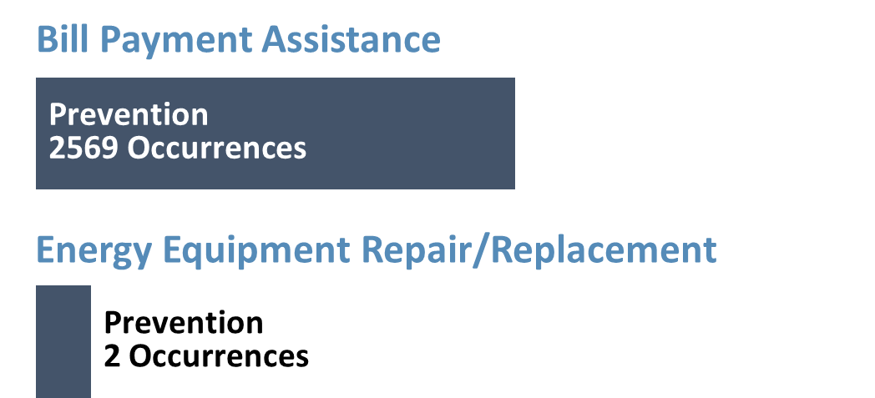
Understanding LIHEAP Performance Measurement Policy
Prevention and Restoration Measures
How many times did a LIHEAP benefit prevent loss of home energy service for households at imminent risk?
  “Imminent Risk” = pending disconnection, nearly out of fuel, or equipment deemed at risk of failure
(56%)
Restoration
3302 Occurrences
(95%)

Slide 16
Understanding LIHEAP Performance Measurement Policy
Prevention and Restoration Measures
How many times did a LIHEAP benefit restore home energy service?
  Already disconnected, out of fuel, or inoperable equipment
Bill Payment Assistance
(44%)
(56%)
Prevention
2569 Occurrences
Restoration
3302 Occurrences
Energy Equipment Repair/Replacement
(5%)
(95%)
Prevention
2 Occurrences
Restoration
35 Occurrences
Prevention
2 Occurrences

Slide 17
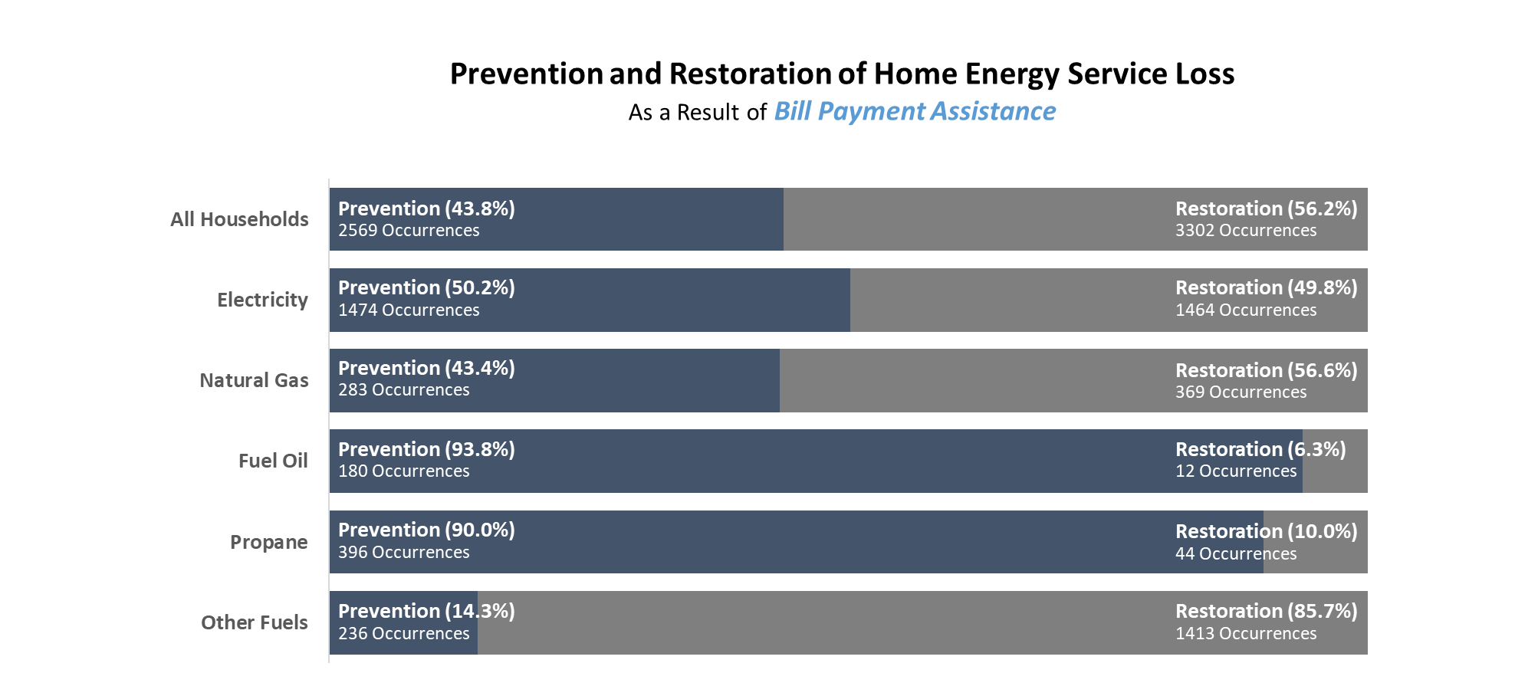
Understanding LIHEAP Performance Measurement Policy
Prevention and Restoration Measures
(44%)
Prevention
2569 Occurrences

Slide 18
Understanding LIHEAP Performance Measurement Policy
Summary of “New” Performance Measure Data
Household characteristics to inform program planning
Average annual income by household fuel type
Average annual energy costs by household fuel type
Average annual LIHEAP benefit by household fuel type
Indicators to evaluate impact of LIHEAP on households
Average pre-LIHEAP Energy Burden by fuel type
Average post-LIHEAP Energy Burden by fuel type
Average energy burden reduction as a result of LIHEAP by fuel type
Instances of Home Energy Loss Prevention v. Restoration of Home Energy Service
Targeting Indices to evaluate effectiveness of program (compliance with statute)
Benefit Targeting Index
Burden Reduction Targeting Index
Presenter:
Melissa Torgerson

Slide 19
Understanding LIHEAP Performance Measurement Policy
Performance Management Collaboration
NEUAC Session 6C
“How Performance Management can Improve LIHEAP.”
LIHEAP Performance Management Website
https://liheappm.acf.hhs.gov/
Kiosk at 2018 NEUAC conference!
  Guided search and ad hoc reporting tools
  LIHEAP Performance Management resources
Presenter:
Melissa Torgerson

Slide 20
Understanding LIHEAP Performance Measurement Policy
Contact Information
Melissa Torgerson
  Melissa@verveassociates.net
  503-706-2647
Kevin McGrath
  Kevin-McGrath@appriseinc.org
  609-252-2081
Dan Bausch
  Daniel-Bausch@appriseinc.org
  609-252-9050
Presenter:
Melissa Torgerson

Slide 21
Understanding LIHEAP Performance Measurement Policy
The Missouri Experience
LIHEAP Performance Measures:
The Missouri Experience
Heather Jones
LIHEAP Program Manager
Missouri Department of Social Services

Slide 22
Understanding LIHEAP Performance Measurement Policy
Missouri LIHEAP Program Performance Management Background
Missouri LIHEAP Data Collection
Missouri Low Income Home Energy Assistance Program (LIHEAP) has two components:
  Energy Assistance (EA)
  Energy Crisis Intervention Program (ECIP)
Missouri has a central data system used for Energy Assistance (EA) that determines eligibility for all LIHEAP applications.
A Management Information System (MIS) is used at the subgrantee level to process crisis payments (ECIP).
Presenter:
Heather Jones

Slide 23
Understanding LIHEAP Performance Measurement Policy
Missouri LIHEAP Program Performance Management Background
Missouri LIHEAP Data Reporting
In addition to meeting federal reporting requirements, EA and ECIP system reports are used to manage and improve program performance.
Since 2009, the state of Missouri has shared the following program (EA and ECIP) statistics during manager and utility meetings:
  Number of households served
  LIHEAP recipient income (percentage of poverty)
  Number of households with one or more vulnerable members
  Average LIHEAP benefit by fuel type
Presenter:
Heather Jones

Slide 24
Understanding LIHEAP Performance Measurement Policy
Missouri LIHEAP Program Performance Management Background
Energy Cost Data (for new Performance Measures)
The State of Missouri has been collecting usage and consumption data for over 20 years for the fuel type where the household benefit is applied (main heating fuel).
  Missouri’s LIHEAP application included the collection of electric vendor and account information (when electricity was not the main heating source)--however it was not a mandatory field in the LIHEAP system.
Missouri reported performance measures for FFY 2016. However, these measures did not include “secondary” electric data.
Presenter:
Heather Jones

Slide 25
Understanding LIHEAP Performance Measurement Policy
Performance Measure Data Sharing: Concerns
Concerns:
Data was not fully validated.
Data did not include “secondary” electric in the total residential energy cost (in cases where electric was not the main fuel source).
Presenter:
Heather Jones

Slide 26
Understanding LIHEAP Performance Measurement Policy
Performance Measure Data Sharing: Rationale
Reasons to Share Data Anyway:
Needed assistance from local subgrantees and vendors to gather “secondary” electric data.
Energy vendors and subgrantees worked hard to gather data for Performance Measures—so it is appropriate to share how their data is used in state reports.
Sharing data increases transparency, builds trust, and fosters collaboration.
Presenter:
Heather Jones

Slide 27
Understanding LIHEAP Performance Measurement Policy
Missouri Experience in Sharing Performance Measure Data
LIHEAP Manager Meeting with subgrantees (local agencies)
August 16, 2017
Energy Supplier/Vendor Webinar
August 30, 2017
LESSONS LEARNED
Kansas City Metro Meeting
September 9, 2017
LIHEAP Manager Meeting with Subgrantees
June 12, 2018
Presenter:
Heather Jones

Slide 28
Understanding LIHEAP Performance Measurement Policy
Missouri Conclusion
What We’ve Learned:
Share data with LIHEAP stakeholders and work together to gain understanding of data (and what it is telling you).
Assist partners in understanding why performance management data is important.
Start discussion (and thinking) about how to use performance data for LIHEAP process improvement.
Presenter:
Heather Jones

Slide 29

Understanding LIHEAP Performance Measurement Policy
The Missouri Experience
Heather Jones
Missouri LIHEAP Manager
Heather.Jones@dss.mo.gov
573-526-0677
Presenter:
Heather Jones

Slide 30
Understanding LIHEAP Performance Measurement Policy
Connie Sánchez
Community Services Department
June 26, 2018

Slide 31
Agenda
Introduction
State/Agency/Vendor Communication
Types of LIHEAP Performance Data Utilized in MO to Improve LIHEAP Agency Performance
Types of LIHEAP Performance Data Utilized by Spire to Improve LIHEAP Outreach & Education
Spire Outreach Review Results
Questions & Feedback

Slide 32
Introduction
MSW
Worked 15 years in the non-profit sector
  9 years in Community Development
  6 years as the LIHEAP Director for St. Louis City
    high-volume, urban area
Started at Spire in August 2017
  Natural gas company serving 1.7 million customers in MO, AL and MS

Slide 33
State/Agency/Vendor Communication
State
  Metro Meetings
  Webinars
  FSD Staff/Email
Spire
  Intern Program
  Staff Support
  Website Training
  Agency Meetings/Presentations
  Agency Appreciation Luncheon

Slide 34
Types of LIHEAP Performance Data Utilized in MO to Improve LIHEAP Performance
Registered vs. Pending Applications
  Utilized by State/Agency to Monitor Processing
  Tool to Safeguard Agency
Weekly Comparative Analysis
  Trend Data (are applications up/down from the previous year)
EA Assisted Households/ECIP Assisted Households
  Trend Data (are EA/ECIP benefits up/down from the previous year)
  Budget Monitoring
Average Monthly Income/Usage Data/Average EA Benefit Amount
  Trend Data
    Are current income guidelines still relevant?
    Are guidelines meeting the needs of the low-income?
    Are guidelines excluding any low-income populations?
  Analyzing Energy Burden
    Are LIHEAP benefits addressing the energy burden for low-income households?
    Do current EA benefit amounts need to be increased?

Slide 35
Types of LIHEAP Performance Data Utilized in MO to Improve LIHEAP Performance
Fuel Types Used/Total EA Payments
  Use data to start discussion with vendors to support LIHEAP.
    Staffing for LIHEAP Outreach/Education
    Utilize Vendor Communications Staff to Create Marketing Fliers/Templates
    In-Kind Donations
      Copies
      Supplies
      Postage
Percentage of Food Stamp Recipients
  Use data to simplify income qualifying applicants and contract with other state departments (70-75% in MO)
Number of Vulnerable Households Served (60+, Disabled, Young Children)
  Is outreach effectively reaching vulnerable households?

Slide 36

Types of LIHEAP Performance Data Utilized by Spire to Improve LIHEAP Outreach & Education
Spire tracks EA eligible recipients on a weekly basis throughout the winter (December – May) to monitor for disconnection notices.
  Information forwarded to CAA
    Winter ECIP
    Spire Energy Assistance
Spire tracks EA denials for accounts that were inactive and now active.
  Information forwarded to CAA
State Report – LIHEAP Applications by Zip Code
  Identify areas of need for LIHEAP outreach and education.

Slide 37

Spire Outreach Review Results
Applicants
  fixed-income (social security/SSI)
  health issues (reduced wages/unable to work; medical bills)
  unforeseen tragedy
  experienced a sudden/unexpected change in income status
Breaking Through Obstacles
  acquaint communities with LIHEAP and utilizing LIHEAP to leverage funds
  transportation to CAA
  unable to read/write
  access to an application
  stress
Debunking Misconceptions About LIHEAP
  LIHEAP only helps if you’re in threat of disconnection.
  LIHEAP only helps with electric bills.
  I make too much money.
  I would qualify, but my bills are current so I don’t need help.

Slide 38
Questions & Feedback
Connie Sanchez connie.sanchez@spireenergy.com

