Slide 1
How Performance Management Can Improve LIHEAP
NEUAC 2018
Melissa Torgerson
VERVE Associates, LLC
Heather Jones
LIHEAP Program Manager, Missouri Department of Social Services
Laura Betzinger
Community Programs Manager, Indiana Housing and Community Development Authority
Christine Taylor
Bureau Chief, Iowa Energy Assistance / LIHEAP

Slide 2
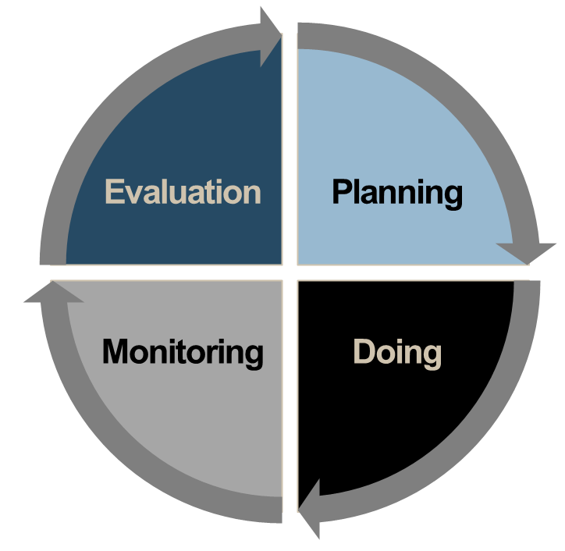
How Performance Management Can Improve LIHEAP
Performance Management Overview
PERFORMANCE MANAGEMENT is the process of evaluating data (together with other information) to make educated program decisions.
Performance Management is a cycle of continuous learning and improvement over time.
Presenter:
Melissa Torgerson

Slide 3
How Performance Management Can Improve LIHEAP
Performance Management Toolbox
  For many years, LIHEAP Grantees have had a suite of data and information available to inform program evaluation and planning.
  Required LIHEAP Reports
LIHEAP Model Plan
LIHEAP Household Report
LIHEAP Performance Data Form - Section I. Grantee Survey
  Other Data Sources
LIHEAP Home Energy Notebook
American Community Survey (Census)
Residential Energy Consumption Survey (RECS)
Presenter:
Melissa Torgerson

Slide 4
How Performance Management Can Improve LIHEAP
Performance Management Toolbox
New Performance Measure data provides LIHEAP grantees with important additions to their suite of Performance Management tools.
Household characteristics to inform program planning
Average annual income by household fuel type
Average annual energy costs by household fuel type
Indicators to evaluate impact of LIHEAP on households
Average pre-LIHEAP Energy Burden by fuel type
Average post-LIHEAP Energy Burden by fuel type
Average energy burden reduction as a result of LIHEAP by fuel type
Instances of Home Energy Loss Prevention v. Restoration of Home Energy Service
Targeting Indices to evaluate effectiveness of program (compliance with statute)
Benefit Targeting Index
Burden Reduction Targeting Index
Presenter:
Melissa Torgerson

Slide 5
How Performance Management Can Improve LIHEAP
Performance Management Toolbox
LIHEAP Performance Management Website:
https://liheappm.acf.hhs.gov/
Kiosk at 2018 NEUAC conference!
  Guided search and ad hoc reporting tools
  LIHEAP Performance Management resources
Presenter:
Melissa Torgerson

Slide 6
How Performance Management Can Improve LIHEAP
Performance Management Toolbox
For questions or more information:
Melissa Torgerson
  Melissa@verveassociates.net
  503-706-2647
Kevin McGrath
  Kevin-McGrath@appriseinc.org
  609-252-2081
Dan Bausch
  Daniel-Bausch@appriseinc.org
  609-252-9050
Presenter:
Melissa Torgerson

Slide 7
How Performance Management Can Improve LIHEAP
Understanding LIHEAP Performance Measures
Presenter:
Heather Jones

Slide 8
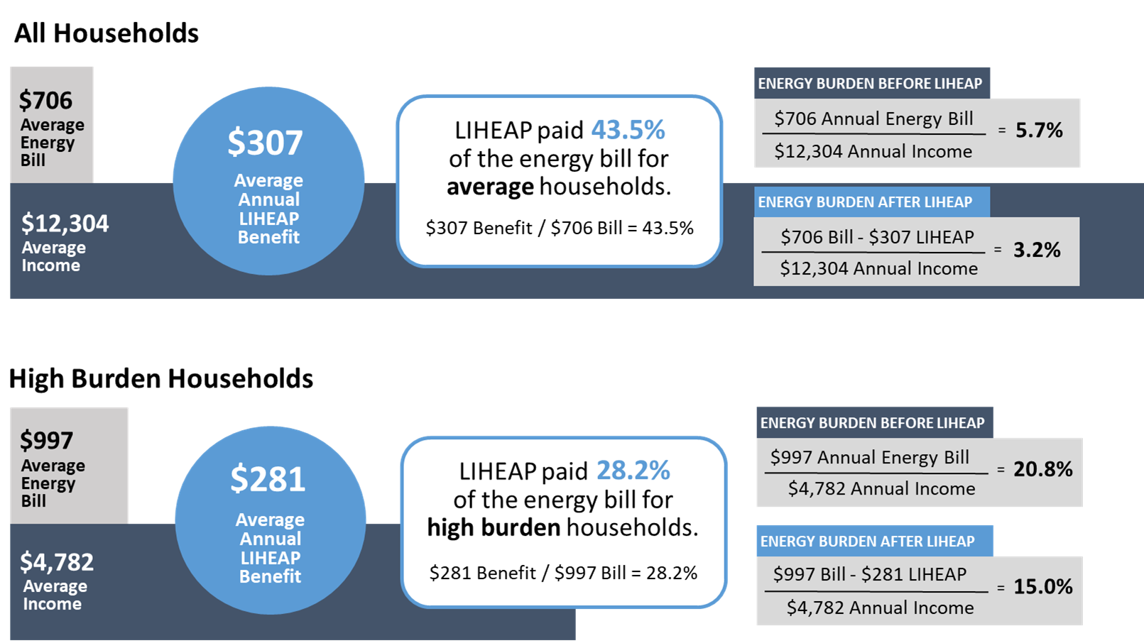
How Performance Management Can Improve LIHEAP
Understanding LIHEAP Performance Measures
Missouri State Snapshot
(Executive Summary—Energy Burden Measures)
Does LIHEAP furnish higher benefits to higher burden households?
No. In Missouri, the total LIHEAP benefit received by high burden households in FY 2017 was about $26 (8.4%) less than the total LIHEAP benefit received by the average recipient household.
Does LIHEAP pay a larger share of the home energy bill for high burden households?
No. In FY 2017, LIHEAP paid 45.3% of the energy bill for average households in Missouri, while LIHEAP paid 28.2% of the energy bill for high burden households.

Slide 9
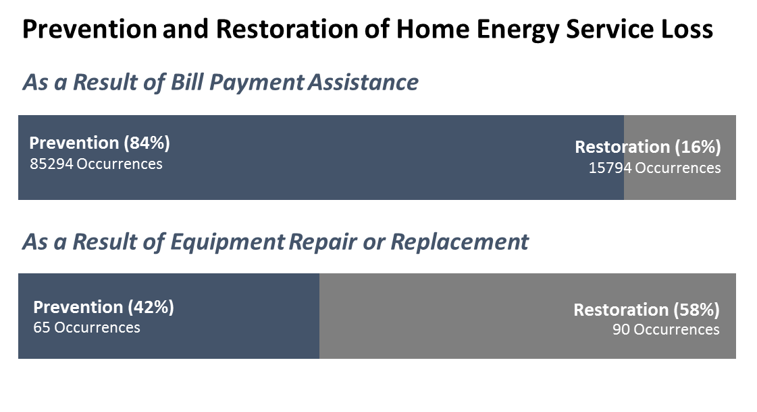
How Performance Management Can Improve LIHEAP
Understanding LIHEAP Performance Measures
MISSOURI State Snapshot
(Executive Summary—Prevention and Restoration Measures)
Prevention of Home Energy Loss
In FY 2017, LIHEAP benefits in Missouri prevented the loss of service 85,294 times, by stopping threatened utility service disconnections and by delivering fuels to homes that were at risk of running out.
The program also repaired or replaced heating or cooling equipment at imminent risk of failure for 65 households.
Restoration of Home Energy Service
In FY 2017, LIHEAP benefits restored home energy service 15,794 times for households who had been disconnected by their utility provider or who had run out of fuel oil, propane, or wood. The program also restored home energy service for 90 households by repairing or replacing inoperable heating or cooling equipment.

Slide 10
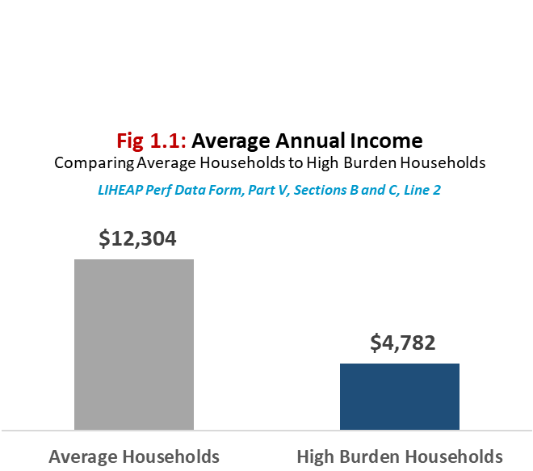
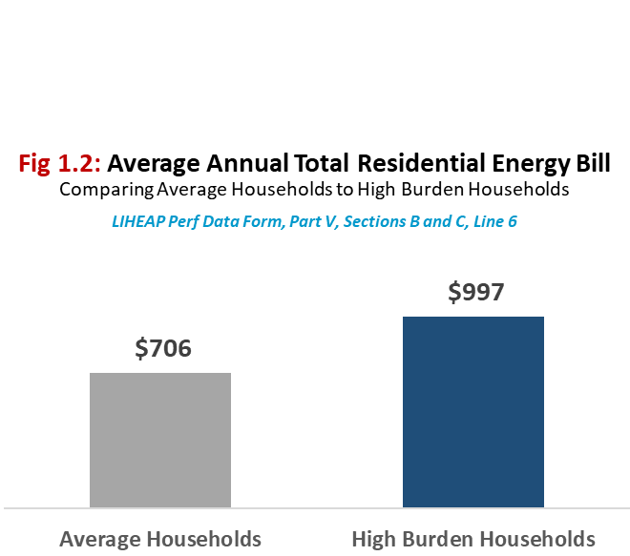
How Performance Management Can Improve LIHEAP
Understanding LIHEAP Performance Measures
MISSOURI State Snapshot
Annual Income
High burden households have an average annual income that is $7,522 or 61% less than average households.
Annual Energy Bill
High burden households have an average energy bill that is $291 or 41% greater than average households.
Presenter:
Heather Jones

Slide 11
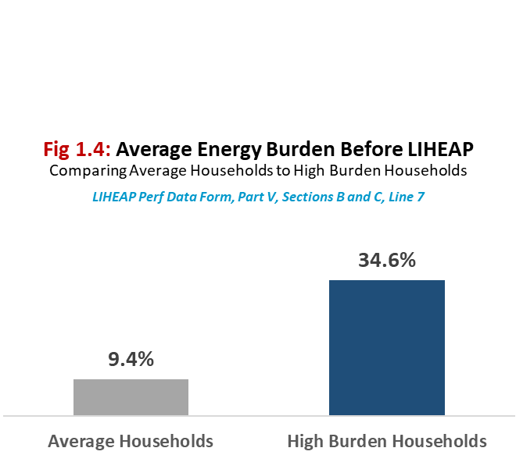
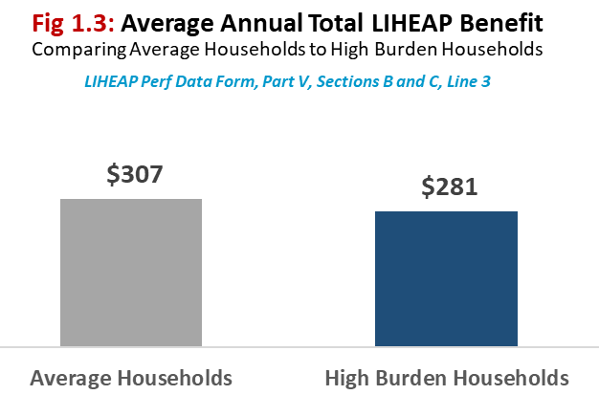
How Performance Management Can Improve LIHEAP
Understanding LIHEAP Performance Measures
MISSOURI State Snapshot
Energy Burden before LIHEAP
Before LIHEAP, high burden households are paying 3.6 times as much of their income toward energy costs than average households.
Annual LIHEAP Benefit
High burden households receive an average annual LIHEAP benefit that is $26 or 8.3% less than average households.

Slide 12
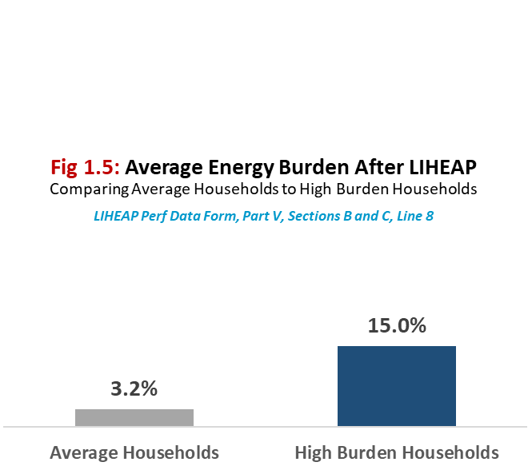
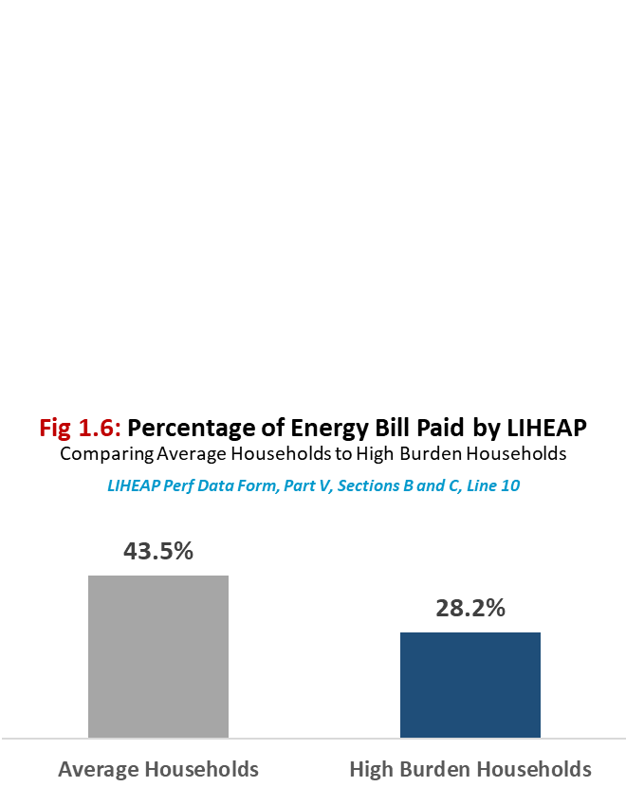
How Performance Measures Can Improve LIHEAP
Understanding LIHEAP Performance Measures
MISSOURI State Snapshot
Energy Burden after LIHEAP
After LIHEAP, high burden households are paying 4.6 times as much of their income toward energy costs than average households.
Percentage of Bill Paid
On average, high burden households have 35% less of their energy bill paid with LIHEAP than average households.

Slide 13
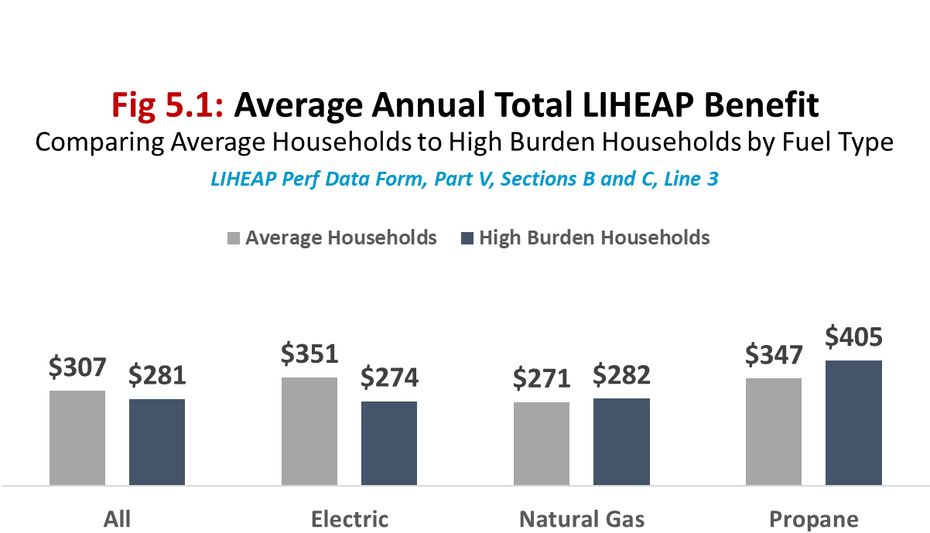
How Performance Management Can Improve LIHEAP
Understanding LIHEAP Performance Measures
MISSOURI State Snapshot
Does LIHEAP furnish higher benefits to higher burden households across all fuel types?
No. In FY 2017, high burden natural gas households received $11 (4%) greater benefits than average natural gas households. Similarly, high burden propane households received $58 (17%) greater benefits than average propane households. However, electric high burden households received $71 (22%) less than average electric households.

Slide 14
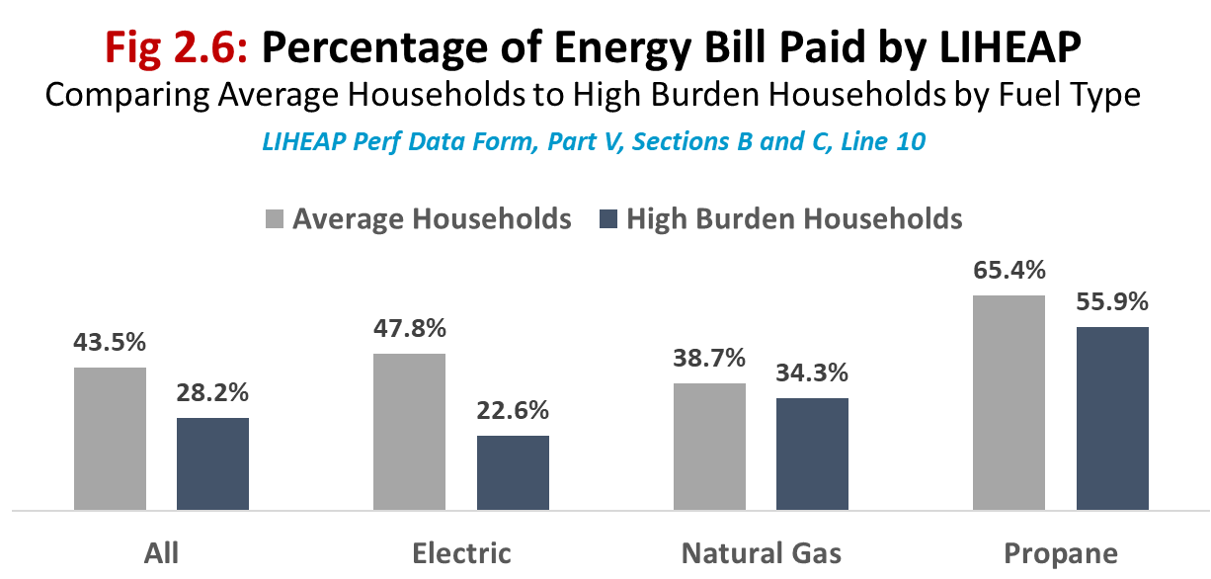
How Performance Management Can Improve LIHEAP
Understanding LIHEAP Performance Measures
MISSOURI State Snapshot
Does LIHEAP pay more of the energy bill for high burden households across all fuel types?
No. In FY 2017, high burden households in Missouri had less of their energy bill paid with LIHEAP than average households, regardless of fuel type. However, the extent of this difference varies by fuel type. For example, there is a 52% difference in the share of bill paid between electric high burden and average households. However, this difference is only 11% between natural gas high burden and average households.

Slide 15
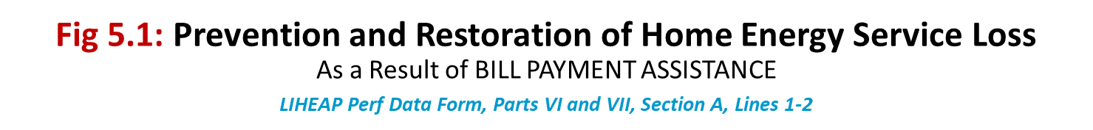
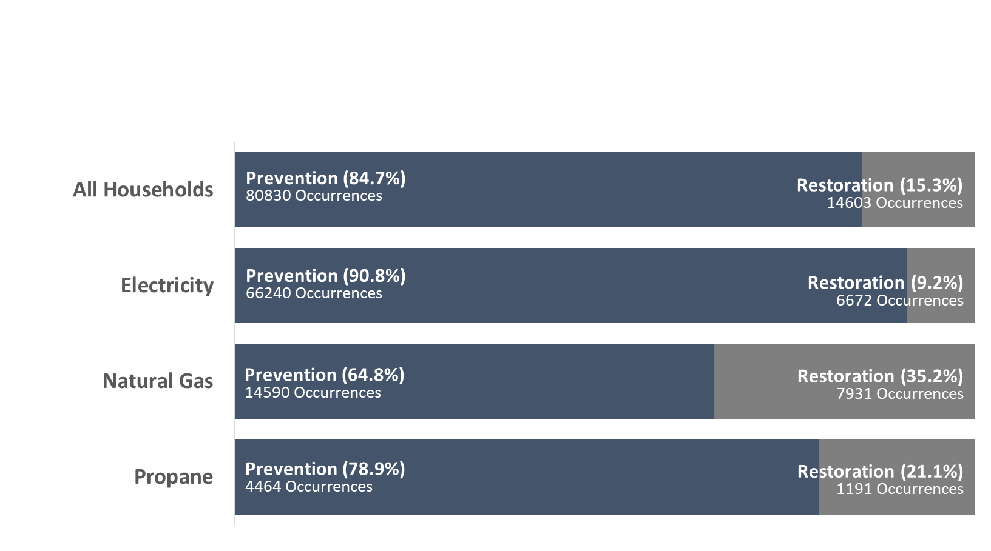

How Performance Management Can Improve LIHEAP
Understanding LIHEAP Performance Measures
MISSOURI State Snapshot
Are patterns of LIHEAP prevention and restoration of home energy service loss (as a result of bill payment assistance) consistent across all fuel types?
In FY 2017, Missouri LIHEAP bill payment assistance resulted in higher rates of prevention (relative to restoration) across all fuel types. However, the data shows a higher proportion of restoration (relative to prevention) for natural gas payments compared to electric and propane.

Slide 16
How Performance Management Can Improve LIHEAP
Understanding LIHEAP Performance Measures
Proposed Change Based on Performance Management
Missouri approved a benefit matrix change to target high burden households.
10% increase for income levels less than 75% FPL
5% increase for income levels greater than 75% FPL
In Missouri’s proposal we used data from the LIHEAP Performance Management Website:
Use of LIHEAP Program Funds
LIHEAP Heating Assisted Recipient Household – by Percent of HHS Poverty Guidelines
Performance Management Executive Summary and State Snapshots
We also used data from the U.S. Energy Information Administration Energy Residential Prices
Presenter:
Heather Jones

Slide 17
How Performance Management Can Improve LIHEAP
Performance Data Case Study
Presenter:
Laura Betzinger

Slide 18
How Performance Management Can Improve LIHEAP
Performance Data Case Study
Performance Data Case Study
PMIWG Data Case Study Team – Lead by Example
  Michael Schmitz of Minnesota LIHEAP examined changes in MN eligible and recipient households for discussions with subgrantees.
  Debra from California and I wanted to learn how to examine our data using Michael’s procedures.
  The analysis for Indiana revealed some important findings that we are still working to interpret and address.
Presenter:
Laura Betzinger

Slide 19
How Performance Management Can Improve LIHEAP
Performance Data Case Study
Performance Data Case Study
Common LIHEAP Issue – Some grantees are seeing declining enrollments in the programs
  At the LIHEAP National Training Conference, about three-fourths of grantees reported declining enrollments.
  Grantees did not have a good understanding of why that was occurring.
Presenter:
Laura Betzinger

Slide 20
How Performance Management Can Improve LIHEAP
Performance Data Case Study
Performance Data Case Study – Indiana’s Experience
To better understand the decline in enrollments, we looked at the following data for Indiana:
  The number of clients served with heating assistance between 2012 and 2016.
  The amount of heating assistance funding available between 2012 and 2016.
  The average heating assistance benefit between 2012 and 2016.
Presenter:
Laura Betzinger

Slide 21
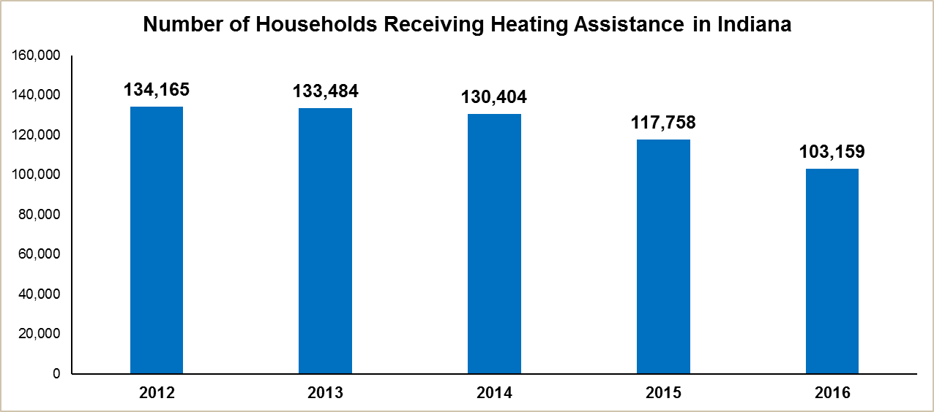
How Performance Management Can Improve LIHEAP
Performance Data Case Study
Indiana – Households Receiving Heating Assistance
Has the number of clients served decreased?
Yes. Between 2012 and 2016, we saw a 23 percent decrease in the number of households that received heating assistance.
Is this a result of decreases in the funding available or increase in benefit amount?
Presenter:
Laura Betzinger

Slide 22
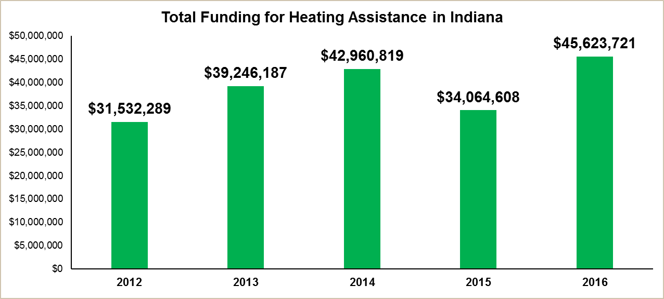
How Performance Management Can Improve LIHEAP
Performance Data Case Study
Indiana – Total Funding for Heating Assistance
Did the amount of heating assistance funding decrease as well?
No. Between 2012 and 2016, the total amount of heating assistance funding available actually increased by 45 percent.
Presenter:
Laura Betzinger

Slide 23
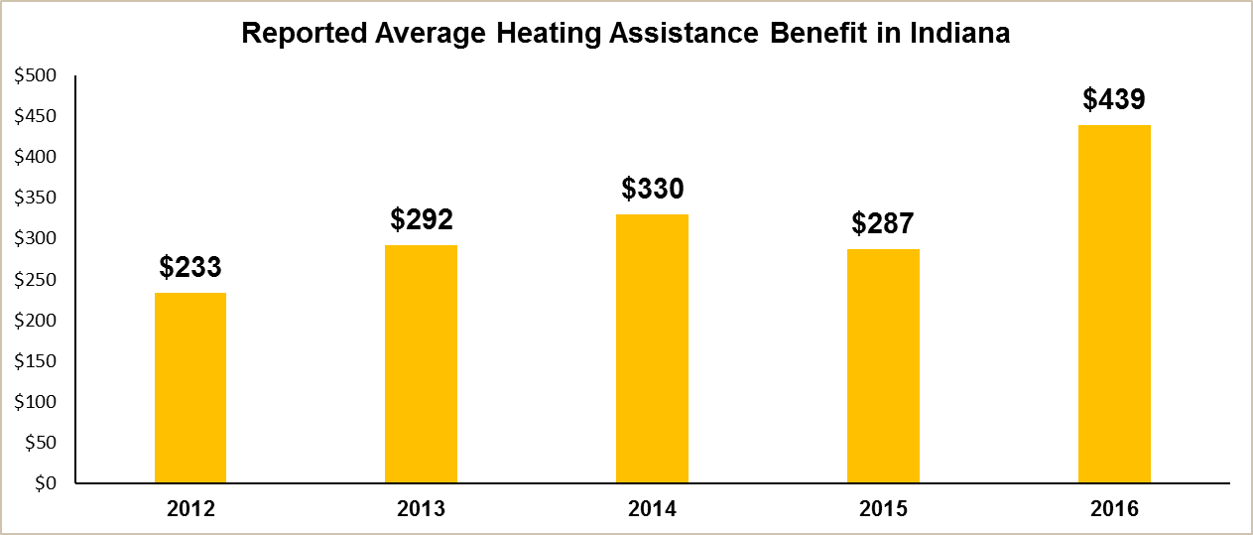
How Performance Management Can Improve LIHEAP
Performance Data Case Study
Indiana – Average Heating Assistance Benefit
Did the average heating assistance benefit change?
Yes. Between 2012 and 2016, the average heating assistance benefit increased by 88 percent.
Presenter:
Laura Betzinger

Slide 24
How Performance Management Can Improve LIHEAP
Performance Data Case Study
Performance Data Case Study – Indiana’s Experience
Even though our available funding increased during 2012 and 2016 the number of households that received heating assistance decreased during that same period. One good outcome is that we were able to increase the average benefit. But, we had to ask whether we were missing households who need assistance.
Why might this be happening?
  An improving economy may reduce the income-eligible population?
  Falling energy prices for some fuels may reduce demand?
What can we look at to better understand our overall LIHEAP program performance?
  The number of income-eligible households.
  The percent of income-eligible households served.
  How that varies by the different population segments.
Presenter:
Laura Betzinger

Slide 25
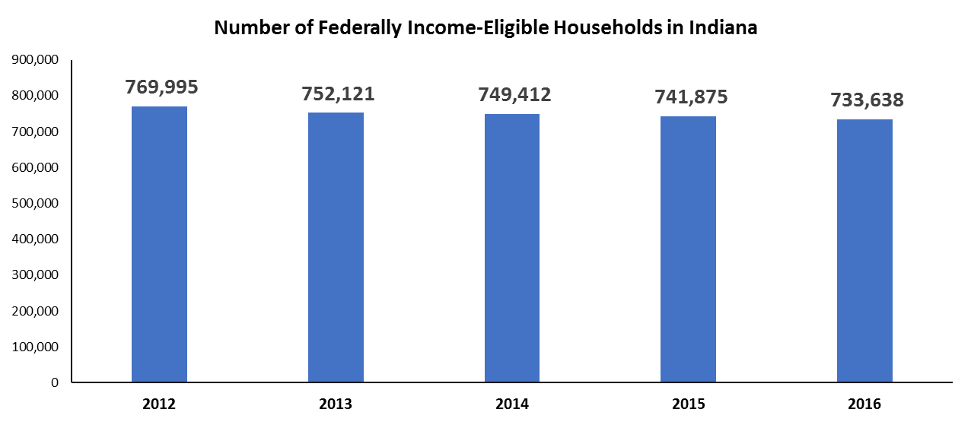
How Performance Management Can Improve LIHEAP
Performance Data Case Study
Indiana – Number of Income-Eligible Households
What happened to the total number of income-eligible households?
Between 2012 and 2016, we saw a 5 percent decrease in the total number of income-eligible households.
Presenter:
Laura Betzinger

Slide 26
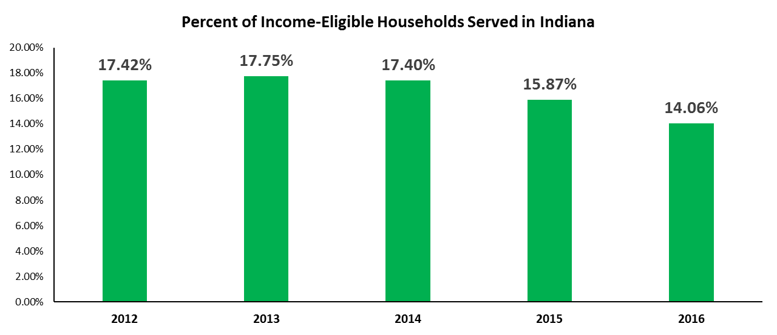
How Performance Management Can Improve LIHEAP
Performance Data Case Study
Indiana – Percent of Income-Eligible Households Served
Does the percent of income-eligible households served decrease?
Yes. Between 2012 and 2016, we saw a 19 percent decrease in the percent of income-eligible households served
Presenter:
Laura Betzinger

Slide 27
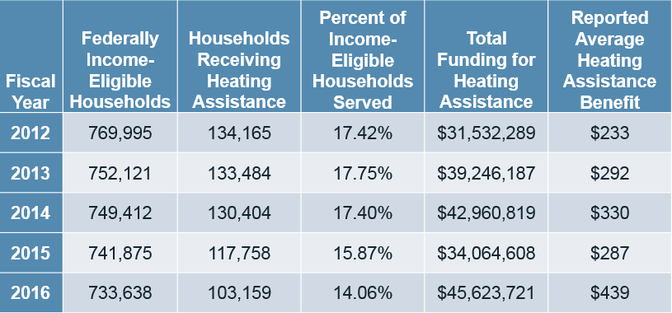
How Performance Management Can Improve LIHEAP
Performance Data Case Study
Summary of Overall Changes in Indiana’s LIHEAP Program
Presenter:
Laura Betzinger

Slide 28
How Performance Management Can Improve LIHEAP
Performance Data Case Study
Summary of Overall Changes in Indiana’s LIHEAP Program
What changes do we see in our overall LIHEAP program?
  The number of federally-income eligible households has decreased by 5 percent (769,995 to 733,638).
  The number of households receiving heating assistance decreased by 23 percent (134,165 to 103,159).
  The percent of income-eligible households served decreased by about 3.4 percentage points (17.42% to 14.06%).
  The total heating assistance funding available increased by 45 percent ($31,532,289 to $45,623,721).
  The average heating assistance benefit increased by 88 percent ($233 to $439).
Presenter:
Laura Betzinger

Slide 29
How Performance Management Can Improve LIHEAP
Performance Data Case Study
Changes in Indiana’s Low-Income Vulnerable Population
We see a general decline in the number of households receiving assistance in Indiana. To further explore this decline, we focused on the low-income vulnerable population.
What is happening to low-income vulnerable households in Indiana? Are these trends the same for those groups?
Specifically, we looked at:
  Households with an adult 60 years old or over.
  Households with a disabled member.
  Households with a child 5 years old or younger.
Presenter:
Laura Betzinger

Slide 30
How Performance Management Can Improve LIHEAP
Performance Data Case Study
Indiana – Number of Households Served by Vulnerability
We saw that the overall number of households served by LIHEAP heating assistance decreased by 23 percent.
What changes do we see in the number of low-income vulnerable households served?
  The number of elderly low-income households served decreased by 6 percent (38,100 to 35,640).
  The number of disabled low-income households served decreased by 13 percent (49,962 to 43,562).
  The number of young child low-income households served decreased by 39 percent (30,203 to 18,307)!!!
  The decrease in young child low-income households served is much larger compared to the decrease in elderly and disabled low-income households served.
Presenter:
Laura Betzinger

Slide 31
How Performance Management Can Improve LIHEAP
Performance Data Case Study
Changes in Indiana’s Low-Income Vulnerable Population
We saw declines in the share of eligible households served among all groups.
The percent of elderly households served fell from 14.8% to 13.7%
The percent of disabled households served fell from 17.2% to 14.8%
The percent of young child households served fell from 19.2% to 13.5%
The young child households went from having the highest share of eligible households served to having the lowest share of eligible households served.
Presenter:
Laura Betzinger

Slide 32
How Performance Management Can Improve LIHEAP
Performance Data Case Study
Changes in Indiana’s Low-Income Vulnerable Population
By looking at the number of low-income vulnerable households served and the number of income-eligible vulnerable households in Indiana, we learned two things:
Finding #1 – Across all vulnerable population groups, the decline in the number of households served is greater than the decline in the number of income-eligible households.
Finding #2 – We see the greatest level of comparative change for low-income households with young children.
Presenter:
Laura Betzinger

Slide 33
How Performance Management Can Improve LIHEAP
Performance Data Case Study
Next Steps for Indiana
Do we need to increase the marketing of our LIHEAP program?
  This would lead to an increase in households that are served.
  However, this could also result in a lower average benefit for each household served.
Do we need to increase marketing to certain groups?
  States are more likely to see changes in the young children population than in the disabled or elderly populations because young children can age out of their vulnerability status.
  Is the reduction in percent of low-income households with young children served due to limited program marketing?
Presenter:
Laura Betzinger

Slide 34
How Performance Management Can Improve LIHEAP
Prioritizing Clients Using Estimates of Client Bill Savings
Presenter:
Christine Taylor

Slide 35
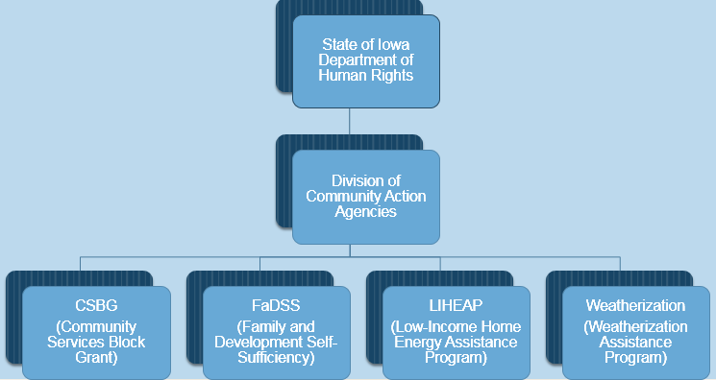
How Performance Management Can Improve LIHEAP
Prioritizing Clients Using Estimates of Client Bill Savings
Structure
Presenter:
Christine Taylor

Slide 36
How Performance Management Can Improve LIHEAP
Prioritizing Clients Using Estimates of Client Bill Savings
Background Information
Iowa Subgrantees
  17 – LIHEAP (Community Action Agencies)
  18 – Weatherization (17 Community Action Agencies + 1 Local Government)
Applications
  Applicants apply for LIHEAP and Weatherization in tandem
  80,000+ approved applicants every year
  The LIHEAP client list becomes Weatherization’s waiting list
    All LIHEAP clients are considered possibilities for Weatherization, regardless of their fuel usage – therefore, a priority list is necessary
Presenter:
Christine Taylor

Slide 37
How Performance Management Can Improve LIHEAP
Prioritizing Clients Using Estimates of Client Bill Savings
Determining Client Priority
Determining Client Priority
  Annual heating fuel savings, water heater fuel savings, and air conditioning savings are calculated
    Client fuel consumption data is a key parameter in this calculation
  The annual fuel savings for each fuel type is added together and multiplied by the average statewide fuel costs
    Savings estimates are obtained from annual evaluations of the Weatherization Assistance Program
  The estimated annual bill savings is then adjusted using a 5% multiplier for those households with occupants who are elderly, and/or disabled, and/or young children
    The 5% adjustments applies to each of the household characteristics, so a household containing elderly and disabled persons would have the estimated annual fuel savings adjusted by 10%
Presenter:
Christine Taylor

Slide 38
How Performance Management Can Improve LIHEAP
Prioritizing Clients Using Estimates of Client Bill Savings
Obtaining Client Fuel Consumption Data
Clients with Investor-Owned Utilities
  Client list is sent to Iowa’s energy program evaluation contractor
  Primary and secondary consumption data is obtained by the contractor
  Fuel usage for the entire state is sent to the state weatherization office and imported into the reporting system
  The state weatherization office sends fuel usage data to each weatherization subgrantee; they import the data into their reporting database (stand-alone Access database; not web-based)
  A client priority routine in the reporting database calculates priority numbers (points) for clients whose consumption data is available
Presenter:
Christine Taylor

Slide 39
How Performance Management Can Improve LIHEAP
Prioritizing Clients Using Estimates of Client Bill Savings
Obtaining Client Fuel Consumption Data
Clients with Municipal Utilities, Rural Electric Cooperatives (RECs), and Deliverable Fuel Vendors
  Primary and secondary consumption data is obtained by the subgrantee
    Preferable to have 12 months of both heating and electric consumption data
    If less than 12 months of a client’s consumption data is available, the client priority routine in the reporting database is able to convert the data to an annual amount as long as the data collected accounts for a minimum of 30 days between December 15 and March 15
  Fuel data is entered into the reporting database by the subgrantee
  A client priority routine in the reporting database calculates priority numbers (points)
Presenter:
Christine Taylor

Slide 40
How Performance Management Can Improve LIHEAP
Prioritizing Clients Using Estimates of Client Bill Savings
Obtaining Client Fuel Consumption Data
Consumption Data Unattainable or Not Available for Sufficient Number of Months
  A square foot calculation can be used to determine priority numbers for those clients
    Square footage of living space area is provided by the client or viewed on assessor’s website
    The subgrantee enters the square footage into the reporting database
  The fuel usage per square foot factors is based on historic program data
  The square foot calculation is also contained in the client priority routine in the reporting database
Presenter:
Christine Taylor

Slide 41
How Performance Management Can Improve LIHEAP
Prioritizing Clients Using Estimates of Client Bill Savings
Client Priority List
Subgrantees Use the Reporting Database to Produce Client Priority List
  Client names are listed in priority order using the client priority points as the basis for prioritization (highest priority listed first and must be served first)
  New list produced each year after the most recent LIHEAP heating season
List Includes:
  Names of clients eligible for weatherization
  Clients’ addresses
  Telephone numbers
  Client priority point
  Other pertinent information
Presenter:
Christine Taylor

Slide 42
How Performance Management Can Improve LIHEAP
Prioritizing Clients Using Estimates of Client Bill Savings
Client Priority List
List is Produced for Each County in the Subgrantee’s Service Territory
  Must keep in mind that percentage of homes weatherized is the same or close to the same percentage of LIHEAP clients that reside in those counties relative to the total number of LIHEAP clients in their entire service area
    If 15% of the total LIHEAP clients who reside in the subgrantee’s service territory reside in County A, the subgrantee should try to ensure 15% of the dwellings it weatherizes during the year are located in County A
Eligible Households Include:
  Owners
  Renters (with landlord approval)
  Shelters (domestic abuse shelters, homeless shelters)
    Note: Shelters are excluded from the priority system
Presenter:
Christine Taylor

Slide 43
How Performance Management Can Improve LIHEAP
Prioritizing Clients Using Estimates of Client Bill Savings
Prioritization Effectiveness
Iowa Weatherization Assistance Program Annual Evaluation
  An evaluation of Iowa’s program is conducted each year by a contractor (Dalhoff Associates)
    Iowa has attained around 25% savings for gas in recent years
  Results show that Iowa has higher savings than the national averages for cold climates
    National Weatherization Evaluation reported gas savings of 13%-18%
Presenter:
Christine Taylor

Slide 44
How Performance Management Can Improve LIHEAP
Prioritizing Clients Using Estimates of Client Bill Savings
Summary
Iowa Prioritizes clients based upon a rough expectation of energy bill savings
Subgrantees weatherize highest priority homes first
  Targeted populations receive an increase in priority
Prioritizing achieves greater savings for clients
Presenter:
Christine Taylor

Slide 45
How Performance Management Can Improve LIHEAP
Questions / Discussions

