Slide 1
Budget Tracking
Division of Energy Assistance (DEA)
Office of Community Services (OCS)
Administration for Children & Families (ACF)
U.S. Department of Health and Human Services (HHS)
Notes:
Welcome participants to the session.
Explain that this session will explore the concept and methods for expenses and other elements of your budget to maintain the best possible performance of your program budget throughout the fiscal year.

Slide 2
Agenda
Understanding the Importance of Tracking
Gathering Tracking Information
Tracking Information Against Your Budget
Using Tracked Information to Adapt
Questions and Answers
Notes:
Review the agenda.
State: For this session, we will first explain the importance of tracking expenditures against your LIHEAP budget. Next, we will discuss how to gather information, such as various reports, that can be used to track the information that affects your budget. Then, we will identify the elements you need to track in order to control how your budget performs. Finally, we will briefly talk about what to do after you have obtained tracking information that identifies a need for change, before addressing any final questions you may have.

Slide 3

Were You There?
Notes:
Ask: How many of you participated in or saw the Program Manager’s Budget Webinar on April 17?
Acknowledge the response according to the results:
[Most of the participants saw it] – Excellent! For those who didn’t see it, that’s okay.
[About half of the participants saw it] – Great! If you didn’t see it, that’s okay.
[Less than half of the participants saw it] – For those who didn’t see it, that’s okay.

Slide 4
Budgeting Cycle
INPUT
People
Data
Time
Resources
Assumptions
PROCESS
Planning
Proposal
Approval
Dissemination
Tracking
Reporting
Evaluation
MONITOR
OUTPUT
Implementation
Expenditure
Objectives
Notes:
Explain: In the Webinar, we talked about how a budget is established so that it can be used throughout the fiscal year to plan, track, and control the key areas within the budget to ensure program performance. We discussed, at a high level, the formal review process using data inputs from various sources to gather needed information on expenditures and obligations in these key areas that can be used to evaluate the program’s performance in order to adapt to changing circumstances. It is that gathering of information process, called tracking, that we will focus on for this session.
Turn this presentation over to Iris.

Slide 5
Understanding the Importance of Tracking
Understand the importance of tracking expenditures against your
LIHEAP budget.
Notes:
Explain: In this section, we will talk about the importance of tracking expenditures and what it means for the performance of your LIHEAP budget.

Slide 6

What’s the Point?
Tracking your actual expenditures against your budget throughout the year helps to ensure that your program is neither over- nor under-expending in any important line item in your original budget.
The continuous monitoring of your expenditures helps to ensure that your program’s priorities are being met.
Notes:
State: If you saw the Program Manager’s Budget Webinar, you learned that your budget is a crucial part of your manager’s plan and should reflect the policy priorities of your LIHEAP program. Your PMB should be adaptable to program needs throughout the year, such as the following:
Mid-course corrections
Re-allocation of funds based on subgrantee program performance
Adjustments to supplemental funding
Unanticipated program changes
Adapting to disasters
Accounting for subgrantee failures
Explain that tracking your actual expenditures against your budget throughout the year helps to ensure that your program is neither over- nor under-expending in any important line item in your original budget. The continuous monitoring of your expenditures helps to ensure that your program’s priorities are being met.
Stress that this means remaining within expenditure and obligation limits, not just within your budget.
State: Tracking this information helps to spot troubles before they become major issues.

Slide 7
It’s Required!
Tracking your obligations and expenditures is part of the fiscal and administrative requirements.
  45 CFR 96.30
  … obligate and expend block grant funds in accordance with the laws and procedures applicable to the obligation and expenditure of its own funds …
  … establish that such funds have not been used in violation of the restrictions and prohibitions of the statute authorizing the block grant …
Notes:
Explain that tracking your obligations and expenditures are part of the fiscal and administrative requirements.
State: Per the Uniform Administrative Guidelines, a grantee must obligate and expend block grant funds in accordance with the applicable laws and procedures. The grantee’s fiscal control and accounting procedures must be sufficient to provide the required reports and track funds in such a way to prove that those funds have not been misused, based on the restrictions and prohibitions of the statute authorizing the block grant.
Stress: Compliance with statutory requirements on the use of funds is based on actual expenditures, not on budgeted limits.

Slide 8

Common Types of Tracking
High-Level Cost Tracking
Progress Toward Objectives
Milestones and Deliverables
Notes:
Explain that a program manager should track the actual usage of LIHEAP funds throughout the year to ensure the program operates within the budgeted parameters. There are numerous ways to track your budget. Some of the most common methods include the following:
High-Level Cost Tracking – Helps spot variances or possible trouble spots in the program
Progress Toward Objectives – Monitors actual spending versus the projected spending in the budget
Milestones and Deliverables – Monitors the overall project progress by meeting milestone and/or deliverable criteria on schedule
State: Before we get into the details about tracking your budget, let’s look at some methods you can use to track needed information.

Slide 9
Gathering Information
Gather reporting data to track the information that affects your budget.
Notes:
Explain: In this section, we will discuss how to gather information, such as various reports, that can be used to track the information that affects your budget.

Slide 10

Reporting Time Frames
Quarterly Reports
Monthly Reports
Weekly Reports
Other Reports
Notes:
Explain that information is gathered from numerous reporting sources and summarized to compare costs with the Program Manager’s Budget categories.
State: Reports are used at various times of the fiscal year, depending on the types of information you need to collect for each area of your budget. This includes the following:
Quarterly – These reviews are typically scheduled four times a year and are used to review quarterly fiscal reports from every source (summarized in the higher-level Program Manager’s Budget categories).
Monthly – These reviews are used to examine monthly fiscal reports (may not be formally summarized).
Weekly – These reviews are used to track the usage of benefit funds on a weekly basis (or even a daily basis during the height of the regular benefit season), to ensure budget limits are being met, and determine when to stop the regular season program.
Other – There may be other time frames, such as during the height of the regular benefit season or when a crisis arises, that require accelerated or daily reporting.

Slide 11

It Takes Coordination!
Sources
  Agency Fiscal Departments
  Subgrantees
  Other Agencies
  Utility Vendors
  Other Contractors
Notes:
Explain: It takes a lot of data to produce the fiscal information needed to track the progress of a program.
Stress that to obtain good information, you need to have open lines of communication and dedicated coordination between your program and the many sources of data. Work with other entities to get relevant information in a timely manner. These entities could include:
Agency fiscal departments provide the program’s main source of expenditures.
Subgrantees are your source of information on local obligations and expenditures.
Other agencies, such as those providing weatherization assistance, are a source of information for additional obligations and expenditures outside of heating and cooling assistance.
Utility vendors have information about heating and cooling expenditures. While you will likely be able to obtain this information from other sources, information from utility vendors can be used as a good way to double-check the expenditure amounts are correct.
Other contractors typically provide information on obligations and expenditures related to the administration of your program.
State: Depending on how robust your program is, you could have other sources, too. With all of these sources communicating information, you can see how coordination plays a key role in managing a successful budget. In fact, because coordination is so important, I would like to ask a few guest speakers to come forward so we can get their input on what they do to get/track this information, how they communicate this information, and what they can do with this information once they have it.

Slide 12
Reporting
Types of Reports
  Quarterly Budget (Established Targets)
  Budget Variances
  Seasonal Program (Accelerated Tracking)
  Federal Funding Sources
Common Reports
  Grantee Level Fiscal Reports
  Subgrantee Level Fiscal Reports
  Subgrantee Periodic Reports
  Federal Reports
Notes:
Explain that some sources of information will come from various reports.
Briefly identify these various reports:
Types of Reports
Quarterly Budget (Established Targets)
Budget Variances
Seasonal Program (Accelerated Tracking)
Federal Funding Sources
Common Reports
Grantee Level Fiscal Reports
Subgrantee Level Fiscal Reports
Subgrantee Periodic Reports
Federal Reports

Slide 13

Designing A Useful Budget
Notes:
State: Before we get into the details about how to track information against your budget, let’s see two examples of a budget that is well-designed to fit the needs of the grantee.
Introduce John and Häly.

Slide 14
Minnesota LIHEAP
Communication
  Establish relationship with your fiscal department/staff/unit.
  Meet on a regularly basis.
  Attend each business unit’s regular meeting.
Notes:
Communication
Establish relationship with your fiscal department/staff/unit.
Meet on a regularly basis.
Attend each business unit’s regular meeting.

Slide 15
Minnesota LIHEAP
Document processes (both program and fiscal)
  Develop and write processes for both program and fiscal activities
    Include who, what, and when
    Have backups
  Reports
    Requirements and management
    Understand and document each other’s terminology
    Understand and document each other’s definition of “year”
Notes:
Document processes (both program and fiscal)
Develop and write processes for both program and fiscal activities
Include who, what, and when
Have backups
Reports
Requirements and management
Understand and document each other’s terminology
Understand and document each other’s definition of “year”

Slide 16
Minnesota LIHEAP
Planning
  Use the documentation to establish and maintain routines
  Be prepare for upcoming report (see EAP List of Reports)
  Adjust when needed or when things are working
  Repeat
Notes:
Planning
Use the documentation to establish and maintain routines
Be prepare for upcoming report (see EAP List of Reports)
Adjust when needed or when things are working
Repeat

Slide 17

Minnesota LIHEAP
John Harvanko
Director of Office of Energy Assistance Programs
Phone: (651) 539-1805
Email: John.harvanko@state.mn.us
Notes:
Review your contact information.

Slide 18
Delaware LIHEAP
Before the beginning of the Program Year:
  Create and estimate the overarching budget that includes all the aspects of statutory requirements.
  Make sure that it includes TWO identical sections: Current Budget and Carryover Budget.
  Include sections for the funds distributed to other state agencies and reallotment disbursement.
  Provide the copy of estimated budget to our fiscal and program staff fiscal and program staff
  INTERNAL CONTROLS
  Examples
Budget Tracking Tool
Contract Tracking Tool
Purpose
Effective Communication
Accurate Communication
Notes:
In Delaware, LIHEAP program uses two main internal controls for reliable reporting and operational efficiency. One is for tracking budgets outside the financial system and the other one is for tracking contractual expenditures against the budgets. The State of Delaware utilizes the financial application called the First State Financials Accounting System and in Microsoft Excel we create the budget that reflects the structure of our financial application, so that we can communicate with fiscal staff accurately and effectively. We use this budget spreadsheet to communicate the status of the budget and what changes have been or should be executed in the financial system. However, if you don’t have such a financial software, these spreadsheets can still make your tracking of budget and contracts less stressful and reporting easier.
Before the beginning of the Program Year we create and estimate the overarching budget that includes all the aspects of statutory requirements so that it would be easier for us to track the budget spending the rest of the year.
For that purpose we make sure that the budget includes two identical sections-current section and carryover section, plus the special sections for the reallotment funds and for the funds that we allocate to other state agencies. And after we have created the estimated budget we start using the budget spreadsheet for all the future adjustments to the budget.

Slide 19
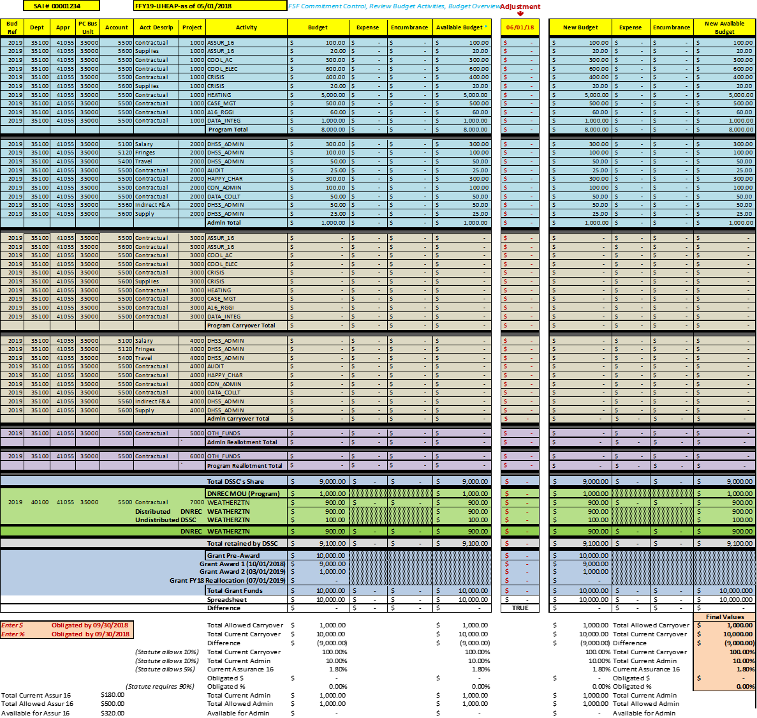
Budget Example
Notes:
Here you can see the entire example budget how it would look in Microsoft Excel. In this example, every section is colored differently for easier view and every sub-section is separated by grey median. Light blue is the current budget, brown is the carryover budget, purple is the reallotment budget, green is the funds distributed to another state agency and dark blue is the federal grant distributions to the state. And the bottom part of the budget tracks the statutory guidelines for managing LIHEAP grant.

Slide 20
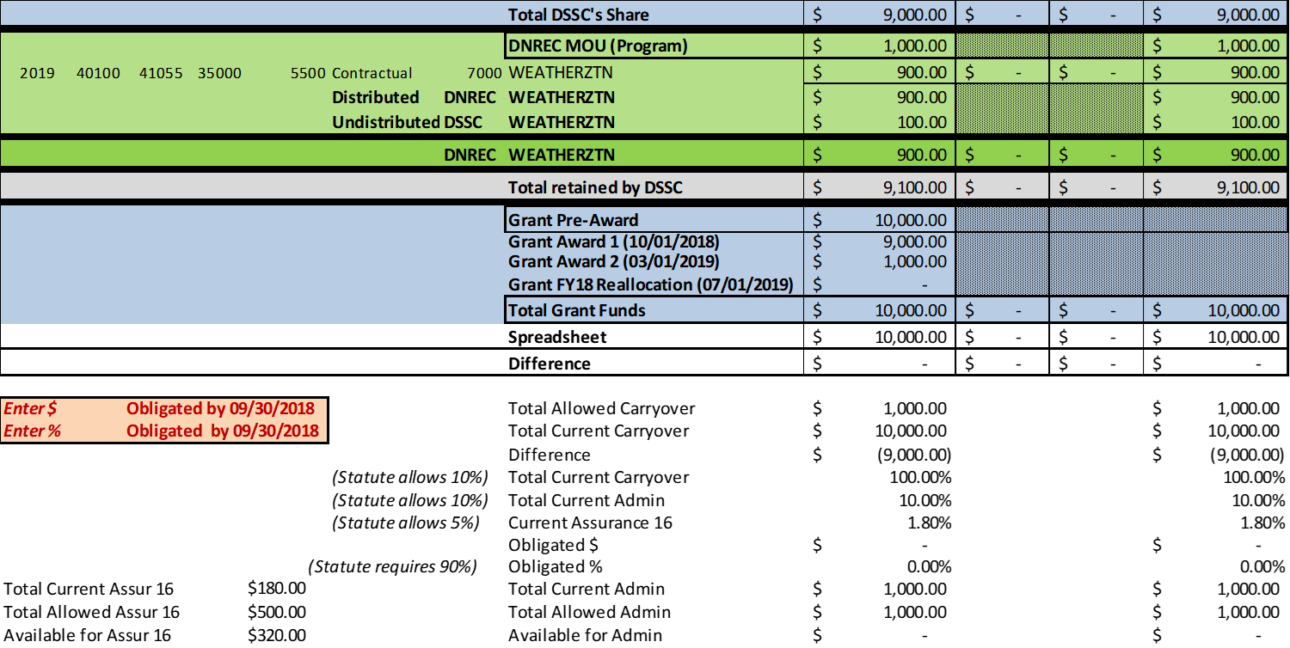
Statutory Limits
  10% Carryover
  10% Administrative
  90% Obligation
  5% Administrative
Notes:
Here you can see better all the criteria of the budget that the spreadsheet helps us to track. We make sure that all the statutory limits are easily trackable and you can always see how much you are over the allowed percent or how much more you are allowed to spend before you exceed the threshold. The little red box is for recording the static results of the obligated funds by the end of September of the first grant year. The latter is necessary because the spreadsheet is dynamic and changes with every adjustment and we want to make sure that we don’t forget to record the obligated amount in the end of the program year and that we have that amount easily available for carryover report.

Slide 21
Budget Details
  Each Budget Section includes TWO sub-sections:
Program
Administrative
Each Budget Line includes FOUR status elements:
Budget
Expense
Encumbrance
Available Budget
Notes:
Here you can see the section of the budget dedicated for current year expenses. The current year portion of the budget is used for obligating and reimbursing the expenses incurred during the first grant year.
In the end of the first grant year we move all the funds from the available budget of the current section to the carryover section of the budget so that we can use the remaining funds for obligation and reimbursement. As you saw in previous slide, the carryover section is the exact copy of the current year section and I will show in the subsequent slides how we move the funds from one section to another section. This technique allows us easily to track and report the carryover amounts.
When we create the budget, we make sure that the current and the carryover budgets have two sub-sections. One for tracking program funds and the other for tracking administrative funds. Each sub-section also has its own project number. For example, the current budget’s program sub-section has project number 1000 and the administrative sub-section has project number 2000.
We also make sure that each activity that we plan to conduct during the program year will have its own budget line. For example, if we plan to distribute electric benefit during the summer, we make sure that we have an activity called Cooling Electric. We also specify certain activities in our budget at more detailed level. For example, we divide our internal administrative costs into several different account descriptions – salaries, fringes, travel, supply, and so on. Or we divide Assurance 16 activities into contractual and supplies. Creating specific budget lines for each LIHEAP component, like heating, cooling, and crisis, have made our reporting for grantee survey much easier.
Each budget Line in our budget includes 4 budget elements that demonstrate status of that budget line. Budget element shows the allocated amount of grant funds to the budget line. Two obligation elements, Expenses for the funds that have been reimbursed or actually spent, Encumbrances for the funds that have been put on the purchase orders but have not yet been spent, including the funds under contractual obligations. The Available Budget is what we have remaining after deducting the expenses and encumbrances from the budget of that budget line.
Here you can see the example of how the budget would look if we have created a contract but the contractor has not yet spent any funds. Before the funds would move to encumbrance from the available budget, we will create a contract and give fiscal staff the exact coding reflecting this spreadsheet for creating a purchase order. While fiscal office creates the purchase order and executes other necessary tasks, we create a contractual tracking sheet with the same coding that we gave to fiscal for tracking the balance of the contract.

Slide 22
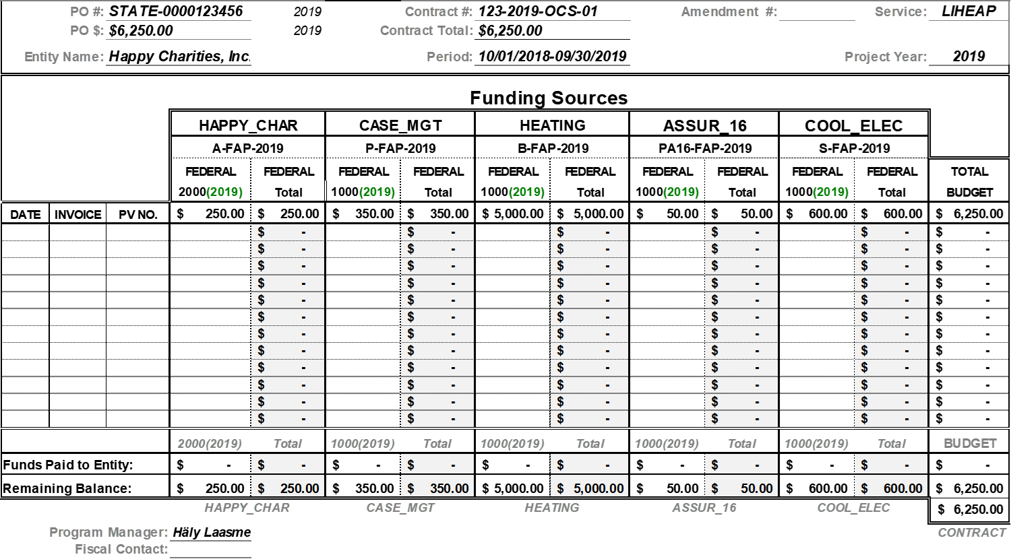
Contract Tracking
Notes:
Here is the example of the contract tracking sheet. Actually we create these tracking sheets for all of our budget lines so that the program office would know better what invoices or expenses were deducted from each budget line. This aids us in auditing the expenses and communicating not only with fiscal staff but also with all of our contractors because we can send the tracking sheet to the contractor and tell them to review it against their fiscal tracking mechanisms to make sure that our balances match. If they don’t match, we both can easily see what is causing discrepancy. This tracking sheet also helps us with figuring out where to return the refunds received from the energy vendors because it tells us exactly which invoice was paid with what funds.

Slide 23
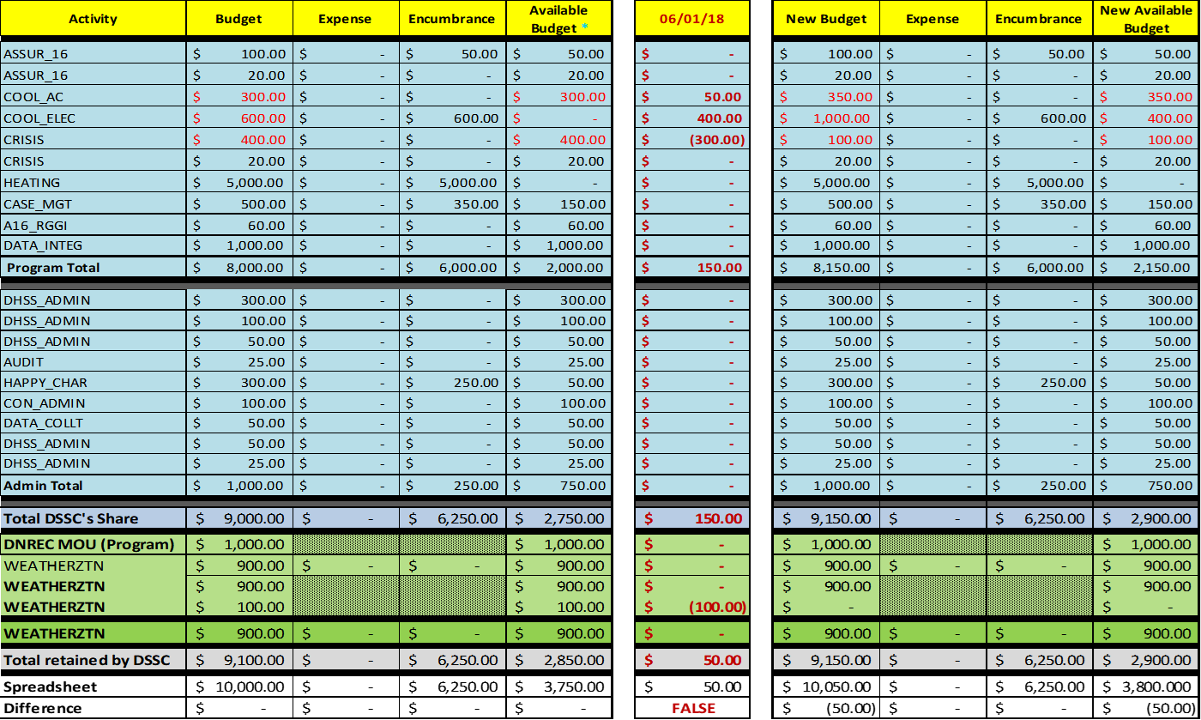
Adjusting Funds
  TRUE if budget is in balance, FALSE if not
Notes:
Here you can see an example of budget adjustment and how we communicate it to the fiscal office so that they can change the budget accurately in the financial system. On the left side you see budget before adjustment and on the right side you see the budget after adjustment. The column in the middle shows the date of the adjustment and the amounts. For example, crisis has 400 dollar budget on the left side, before adjustment, and after we deduct 300 dollars in the adjustment column, the new budget on the right side shows only 100 dollars for crisis budget.
This spreadsheet also helps us easily to move the money around without causing budget deficit. You can see in the bottom of the spreadsheet what is the result of your adjustment. If the difference says TRUE, our changes to the budget have not caused it to go out of equilibrium. If the difference says FALSE, you have caused the budget to go out of balance. To me personally this has been extremely useful when making complicated budget changes that include lot of different budget lines because it catches you right away if you make a mistake even by a penny and then you can go back and forth in the adjustment column to balance your budget.

Slide 24
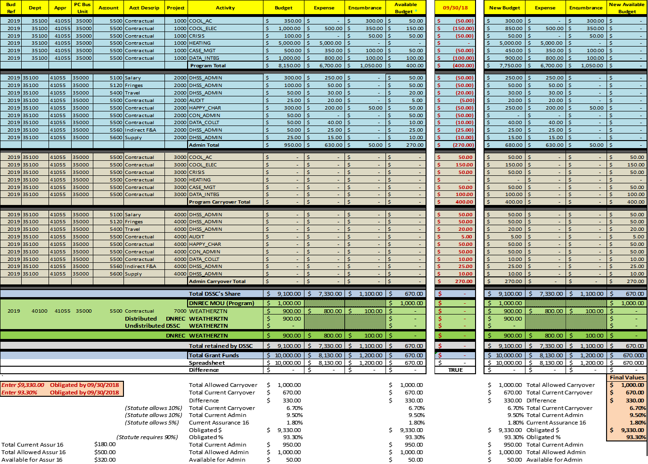
Carryover
Notes:
Finally here you can see how we credit and debit the estimated expense budget lines when creating the carryover budget. As you can see we deplete all the available budget in the current budget section to zero and increase the same budget lines accordingly in the carryover section. This is the main reason why we create two exact copies of the budget sections in the beginning of the program year. It makes creation of carryover budget very easy process. And after recording our carryover amount we start utilizing the carryover portion of the budget. Now, if we get a refund during the carryover period and it has to go back to the current year budget line, the blue section, we use the same method of moving it from the current year available budget to the carryover budget and we keep doing it as long as we are not going over 10% carryover, which we can easily track in the bottom of the spreadsheet.

Slide 25
Thank You
Häly Laasme
LIHEAP Program Manager
Phone: (302) 255-9744
Email: Haly.Laasme-Mcquilkin@state.de.us
  Please do not hesitate to contact me if you wish to use these spreadsheets or you have more questions.
LIHEAP is funded by the U.S. Department of Health and Human Services. The opinions, findings, conclusions, and recommendations expressed in this presentation are those of the author(s) and do not necessarily reflect the views of the U.S. Department of Health and Human Services or the State of Delaware.
Notes:
Review your contact information.

Slide 26
Tracking Information Against Your Budget
Identify the elements you need to track to control how your
budget performs.
Notes:
State: Now that we have heard about some methods for obtaining the information needed to track your budget, let’s get into the details about how to use this information to determine where a problem may occur so that corrective action can be applied quickly, before the problem gets out of hand.
Explain: In this section, you will learn about the elements that need to be tracked in order to control how your budget performs.

Slide 27

Know What to Track
Obligations
Expenditures
Limits
Notes:
Ask participants what types of items they think should be tracked in the budget.
Allow participants to provide some suggestions before continuing.
[click presentation to bring up bullet text]
State: Good answers. For this session, we are going to focus on the following items to track:
Obligations
Expenditures
Limits

Slide 28

Tracking Obligations
Obligations are funds that have been committed for payment of goods and services.
Try to keep spending within the obligated limits you set.
  REMEMBER: Block grant funds are to be obligated in accordance with the Grantee’s own laws and procedures.
Notes:
Explain that it is important to keep track of the funds that have been committed for payment of goods and services so that you do not spend more than you have allotted for those payments. These committed funds are called obligations.
Ask: Who can give me an example of what you consider obligated funds to be?
Call on a few participants to provide answers.
Provide the following information if it has not already been addressed by participants:
Purchase Orders
Signed Contracts/Agreements (e.g., subgrantee agreements, copier service agreement)
Household Benefits Approved (not yet paid)

Slide 29

Tracking Expenditures
Expenditures are funds that have been paid for goods and services.
Try to keep payments within the limits you have obligated.
  REMEMBER: Block grant funds are to be obligated in accordance with the Grantee’s own laws and procedures.
Notes:
State: Actual payments are referred to as expenditures. For your program, keep in mind that most of your expenditures will be for your pre-determined obligations.
Ask: Who can give me an example of an expenditure?
Call on a few participants to provide answers.
Provide the following information if it has not already been addressed by participants.
Benefit Payments for Goods or Services on Behalf of Households
Payments for Office Supplies
Payments to Employees for Salaries
Reimbursements to Local Agencies for Incurred Costs

Slide 30
Tracking Limits
Budgetary limits indicate budget balance.
Statutory limits indicate budget category caps.
BUDGET CATEGORIES | BUDGETARY LIMITS | STATUTORY LIMITS
ADMINISTRATION | ✓ | ✓
CARRYOVER | ✓ | ✓
ASSURANCE 16 | ✓ | ✓
LEVERAGING | ✓ | ✓
HEATING ASSISTANCE | ✓
COOLING ASSISTANCE | ✓
CRISIS ASSISTANCE | ✓ | ✓
WEATHERIZATION ASSISTANCE | ✓ | ✓
Notes:
Explain that you will need to analyze your tracked obligations and expenditures in each budget category to make sure you are effectively controlling your budget limits.
State: When obligations and expenditures are within the established budget limits, you will have a balanced budget.
Explain that your budget limits are caps you impose for each category, such as seasonal benefits (heating/cooling).
State: When obligations and expenditures are within the established Statue limits, you will not exceed the caps for any of these categories.
Ask: Who can tell me some of the caps defined in the Statute limits?
Provide corrective feedback if answers do not include the following caps:
Administration: 10%
Weatherization: 15%,
Assurance 16: 5%
Carryover: 10% (un-obligated)
Stress: When your budget is balanced and you are within the cap limits, you know that your program is performing effectively.

Slide 31
Methods for Tracking
Monitoring Variances
Testing Performance
Testing Assumptions
Notes:
Ask participants what types of methods they think should be used to track these items in the budget.
Allow participants to provide some suggestions before continuing.
[click presentation to bring up bullet text]
State: Good answers. For this session, we are going to focus on the following methods:
Monitoring Variances
Testing Performance
Testing Assumptions

Slide 32
Monitoring Variances
Budget variances are the differences between your budgeted funds for a category and the amount of total funds used.
BUDGET CATEGORY | ADMINISTRATION
Budgeted Period | 52 | weeks
Budgeted Amount | $ 6,500,000 | annual
 | $ 125,000 | weekly
Report Period (Week #) | 25
Expended To Date | $ 3,400,000
Obligated To Date | $ 450,000
 | Amounts | Variances
Usage TARGET To Date | $ 3,125,000
Actual Usage To Date (total) | $ 3,850,000 | $ (725,000) | -23.20%
Actual Usage To Date (per week) | $ 154,000
Projected Budget Period Expend | $ 7,072,000 | $ (572,000) | -8.80%
Projected Cap Usage (10%) | $ 7,203,100 | $ 131,100 | 1.82%
  Negative Variance
  Positive Variance
Notes:
State: Your budget provides the direction of your program, guiding your program towards its objectives. Budget controls are tracking techniques used to compare actual results against the budget. This comparison is used to identify differences (called variances) that need to be addressed through corrective actions or budget changes.
Explain that budget variances (in dollars or percentages) are the differences between your budgeted funds for a category and the amount of total funds used (which include both obligations and expenditures for that category).
Explain that there are two types of variances, positive and negative.
Positive Budget Variance (favorable) occurs when you have more funds available in your budget than you have obligated and expended. [click presentation to bring up highlight]
Negative Budget Variance (unfavorable) occurs when you have less funds available in your budget than you have obligated and expended. [click presentation to bring up highlight]

Slide 33
Monitoring Variances (continued)
BUDGET CATEGORY | ADMINISTRATION
Budgeted Period | 52 | weeks
Budgeted Amount | $ 6,500,000 | annual
 | $ 125,000 | weekly
Report Period (Week #) | 25
Expended To Date | $ 3,400,000
Obligated To Date | $ 450,000
 | Amounts | Variances
Usage TARGET To Date | $ 3,125,000
Actual Usage To Date (total) | $ 3,850,000 | $ (725,000) | -23.20%
Actual Usage To Date (per week) | $ 154,000
Projected Budget Period Expend | $ 7,072,000 | $ (572,000) | -8.80%
Projected Cap Usage (10%) | $ 7,203,100 | $ 131,100 | 1.82%
Notes:
State: To determine the variances in your budget, you will need to track each budget line item separately. You will also need to identify the following items in your budget: [click presentation to bring up each highlight with the associated bullet]
Budgeted Period: Number of weeks budgeted for use of funds for each budget category
Budgeted Amount: Amount in each budget category in the Program Manager’s Budget (such as, Administration, Assurance 16, Weatherization, Carryover, Benefits)
Report Period: Amount of time (weekly, monthly, quarterly, or year-to-date) during which the information is measured
Actual Usage: Funds already obligated and expended to-date for the budget category
Projections: Anticipated use of funds for a remaining period (helps predict whether funds are adequate as budgeted and whether overall budget or an individual budget category is over- or under-spending)

Slide 34
Analyze This …
  Usage-To-Date Variance
  Usage-To-Date Variance
BUDGET CATEGORY | ADMINISTRATION
Budgeted Period | 52 | weeks
Budgeted Amount | $ 6,500,000 | annual
 | $ 125,000 | weekly
Report Period (Week #) | 25
Expended To Date | $ 3,400,000
Obligated To Date | $ 450,000
 | Amounts | Variances
Usage TARGET To Date | $ 3,125,000
Actual Usage To Date (total) | $ 3,850,000 | $ (725,000) | -23.20%
Actual Usage To Date (per week) | $ 154,000
Projected Budget Period Expend | $ 7,072,000 | $ (572,000) | -8.80%
Projected Cap Usage (10%) | $ 7,203,100 | $ 131,100 | 1.82%
  Projected Expenditures Variance
  Projected Cap Usage Variance
Notes:
State: Let’s walk through an example of how to analyze tracked information. We will take a look at three types of variance: Usage-To-Date, Projected Expenditures, and Projected Cap Usage.
[click presentation to highlight the first type of variance]
State: First, let’s look at this example’s usage-to-date variance.
Explain that this variance is calculated by subtracting the actual usage ($3,850,000) [click presentation to bring in the highlight] from the target usage ($3,125,000) [click presentation to bring in the highlight].
Ask: Based on this information, should you be concerned about the projected performance of this budget? Why/why not?
Allow a few participants to respond.
Confirm that for this example, the variance equals a negative (unfavorable) variance of $725,000 (or 23.2%) [click presentation to bring in the highlight]. At almost half way through the budget period, this negative variance may be cause for concern because it indicates that funds are being spent at an accelerated rate.

Slide 35
Analyze This …
  Usage-To-Date Variance
BUDGET CATEGORY | ADMINISTRATION
Budgeted Period | 52 | weeks
Budgeted Amount | $ 6,500,000 | annual
 | $ 125,000 | weekly
Report Period (Week #) | 25
Expended To Date | $ 3,400,000
Obligated To Date | $ 450,000
 | Amounts | Variances
Usage TARGET To Date | $ 3,125,000
Actual Usage To Date (total) | $ 3,850,000 | $ (725,000) | -23.20%
Actual Usage To Date (per week) | $ 154,000
Projected Budget Period Expend | $ 7,072,000 | $ (572,000) | -8.80%
Projected Cap Usage (10%) | $ 7,203,100 | $ 131,100 | 1.82%
  Projected Expenditures Variance
  Projected Cap Usage Variance
Notes:
State: Recall that the actual usage includes both obligated and expended funds. To investigate this potential concern, you may want to look at only the expended funds to analyze the amount of funds you may need for the rest of the budget period. This is where the projected expenditure variance comes into play.
Explain that this variance is calculated in a few parts.
First, you need to find the average expended funds by report period. To do this, divide the funds expended-to-date ($3,400,000) [click presentation to bring in the highlight] by the number of report periods that have passed so far (25 weeks) [click presentation to bring in the highlight]. For this example, the average is $136,000 per week.
Then, you will use this average to calculate the projected expenditures for the entire budget period by multiplying that average by the number of periods in the budget period (52 weeks) [click presentation to bring in the highlight]. For this example, the projected budget period expenditures are $7,072,000 for 52 weeks [click presentation to bring in the highlight].
Finally, you will use this average to calculate the projected expenditure variance by subtracting the projected budget period expenditures for the year ($7,072,000) [click presentation to bring in the highlight] from the total budgeted amount for the year ($6,500,000) [click presentation to bring in the highlight]. For this example, the projected expenditure variance equals a negative (unfavorable) variance of $572,000 (or 8.8%) [click presentation to bring in the highlight].
Explain that this negative variance indicates that if funds continue to be expended at the rate they currently are, by the end of the budget period, you will have spent significantly more than what you had budgeted.

Slide 36
Analyze This …
  Usage-To-Date Variance
BUDGET CATEGORY | ADMINISTRATION
Budgeted Period | 52 | weeks
Budgeted Amount | $ 6,500,000 | annual
 | $ 125,000 | weekly
Report Period (Week #) | 25
Expended To Date | $ 3,400,000
Obligated To Date | $ 450,000
 | Amounts | Variances
Usage TARGET To Date | $ 3,125,000
Actual Usage To Date (total) | $ 3,850,000 | $ (725,000) | -23.20%
Actual Usage To Date (per week) | $ 154,000
Projected Budget Period Expend | $ 7,072,000 | $ (572,000) | -8.80%
Projected Cap Usage (10%) | $ 7,203,100 | $ 131,100 | 1.82%
  Projected Expenditures Variance
  Projected Cap Usage Variance
Notes:
State: Now, let’s look at the third type of variance, the projected cap variance. You should monitor this type of variance for each budget category that has a statutory limit on expenditures.
Explain that this variance is calculated by subtracting the projected budget period expenditures ($7,072,000) [click presentation to bring in the highlight] from the projected cap usage ($7,203,100) [click presentation to bring in the highlight]. For this example, the variance equals a positive (favorable) variance of $131,000 (or 1.82%) [click presentation to bring in the highlight]. This positive variance indicates that if funds continue to be spent at the current rate, you will end up within the statutory limit for this category by the end of the budget period.
NOTE: For this example, the projected cap usage amount is given. To calculate this yourself, you would multiple the total LIHEAP funds by the percentage cap.

Slide 37

Monitoring Variances (continued)
We identified the problem. Now, let’s find a solution!
Notes:
Explain that after variances are identified, you should analyze these variances by asking questions such as:
Is the amount of the variance significant? (For example, crisis funds are depleted a month prior to March 15.)
Are funds being used at a significantly higher amount than budgeted? (For example, a subgrantee is nearly out of Administrative money with three months left in the primary benefit season.)
Are funds being used at a significantly lower rate than budgeted? (For example, a subgrantee is using a lower amount of heating dollars than it normally spends.)
Are used funds within the limits of the budget, particularly the statutory limits? (For example, an error in accounting results in Administrative costs exceeding the 10% statutory cap.)
Explain that when projections show a negative (unfavorable) variance, you should take a look at what is left for the period to determine where you can make adjustments. You will learn more about adapting your budget during the Adapting to Change session later in this conference. For now, let’s move on to the types of performance that you will want to track.

Slide 38

Testing Performance
Testing the performance of a category, such as seasonal benefits, from year to year can be helpful to see if you are trending along the same path.
This can help you estimate whether you think your budget will be enough for the season.
Notes:
Explain that testing the performance of a category, such as seasonal benefits, from year to year can be helpful to see if you are trending along the same path. This can help you estimate whether you think your budget will be enough for the season. For example, you can look at factors such as:
Spending at least the same amount of heating benefit money as last year
Serving at least the same number of households with heating benefits as last year
Maintaining the same level of average heating benefit as last year
State: We are going to hand out an example that you can look at on your own time. It goes into a lot more detail about how you might track performance from one year to the next.
Distribute the Performance Testing handout.

Slide 39

Testing Assumptions
By testing assumptions in your budget, you can evaluate your program’s performance.
  Assurance 16 services will reduce the energy assistance needs.
  Weatherization will save program benefit money for a targeted group.
  Change in the benefit matrix will increase the number of households served overall.
Notes:
Explain that another part of your budget that you should track is your assumptions (often referred to as “testing assumptions”). By testing assumptions in your budget, you can evaluate your program’s performance.
Ask: What are some program assumptions that might be used when allotting funds to A16?
[click presentation to bring up bullet text]
Based on participant responses, confirm the following program assumptions:
Spending funds on Assurance 16 services will reduce the energy assistance needs.
Spending additional percentage of funds on weatherization will save program benefit money for a targeted group (such as households with high energy burdens).
Reducing the average benefit through a change in the benefit calculation matrix will increase the number of households served overall.
Additionally:
Planning to carry over a certain percentage of funds will improve the start of the next year’s program.
Adding Administrative expenditures for another position at the grantee level will improve program monitoring, without affecting program efficiency elsewhere.
State: As a budget assumption, we are also assuming that the allotment of funds to Assurance 16 activities from other budget line items is cost-effective.
State: As you progress through the fiscal year, your initial budget assumptions may no longer be true. When this happens, you may need to adjust your budget. We are going to hand out an example that you can look at on your own time. It goes into a lot more detail about how assumptions are tracked and their impact on a budget.
Distribute the Assumptions Testing handout.

Slide 40
Using Tracked Information to Adapt
Take action based on the information you obtained from all forms
of tracking.
Notes:
Explain: In this section, we will briefly explain the next steps you will take after you have obtained information that identifies a need for change.

Slide 41

Taking Action
Correcting Actions
Adapting Your Budget
  Projections for Households Served
  Adjustments to Funding
  Adjustments to Benefit Amounts
Notes:
Explain that with the information you obtained from all of this tracking, you will be able to determine when you need to take action to correct and adjust elements within your program. Changes in your program may be needed at any time, or even several times, throughout the fiscal year. Changes could include the need for corrective actions for subgrantees, contractors, or clients when monitoring findings are not favorable. Most often, changes needed are due to elements outside of your control. When these types of changes happen, you will want to review projections for households served and make adjustments to your budget to provide the best outcome for those households within the limitations of where your budget it at.
State: You will learn techniques for how use the tracked information in the Adapting to Change session later in this conference.

Slide 42
Conclusion
This section summarizes key points from the session.
Notes:
Explain: Let’s review some of the key points for implementing and tracking expenses.

Slide 43
Summary
Use various tracking methods to ensure you are capturing a
well-rounded picture of what is going on with your budget throughout the year.
Identify and track every expense, comparing it to your budget continuously within the fiscal year.
Analyze the tracked information often to identify problems early, while they can still be corrected.
Notes:
Stress the following key points:
Use various tracking methods to ensure you are capturing a well-rounded picture of what is going on with your budget throughout the year.
Identify and track every expense, comparing it to your budget continuously within the fiscal year.
Analyze the tracked information often to identify problems early, while they can still be corrected.

Slide 44

Questions?
Notes:
Ask: Are there any other questions or comments?
Allow several minutes for any last questions or comments.
Thank the participants for attending the session.

